Slide 1





Team-YATRA
Members :
Saharsha ojha
Sanjeev Kumar Khatri
Sachin karki
This Photo by Unknown author is licensed under CC BY-NC-ND.

Slide 2

What is YATRA?
• ‘Yatra’ is a ridesharing application which allows users to request rides from virtual location at any time. This application allows travel by connecting users to drivers in the area. Users simply enter their pickup location as well as drop location or destination and wait for the rider to arrive. So basically, ridesharing is simply ridesharing vehicles can share the ride with riders heading to the same destination. This system helps to keep the information of Customer online, can check customer information any time by using this system. Two separate app will be made for both driver(Driver app) and user(Customer app ).where in driver app one can accept the customer request or reject it and in customer app one can request a ride for him from the variety of option of rides available for him/her .

Slide 3
Our Motivation
Ridesharing app has make a certain compact in the world as one can travel from one place to another through easier method and by choosing the rides s/he likes.
The main motive behind choosing this project is to build a ride sharing app which will have more advanced features than that of the ride sharing app present in the context of our country.
it will have feature like Realtime GPS tracing , waiting time required to reach a ride for a customer , rider can notified a customer whenever s/he reach the starting point of the ride as well as chat system for the rider and customer

Slide 4






Our Methods

Slide 5
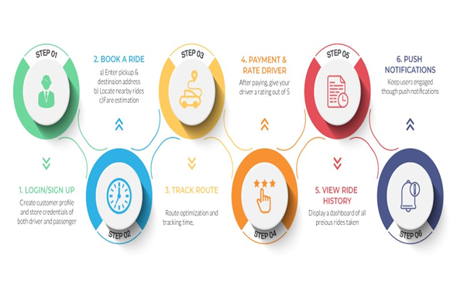
Driver App features:

Slide 6
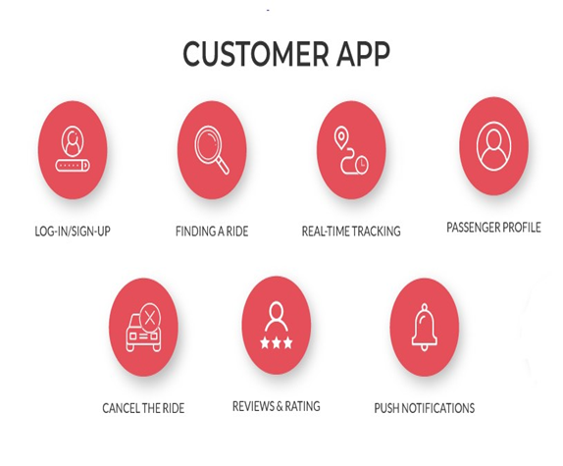
Customer App features:

Slide 7


Thank You
This Photo by Unknown author is licensed under CC BY-SA-NC.

