Slide 1

SMART INDIA HACKATHON 2026
Problem Statement ID –26132
Problem Statement Title- Strengthening market
linkages and price discovery for farmers
Theme- Agriculture, FoodTech & Rural Development
PS Category- Software
Team ID-
Team Name- AgriSetu

Slide 2
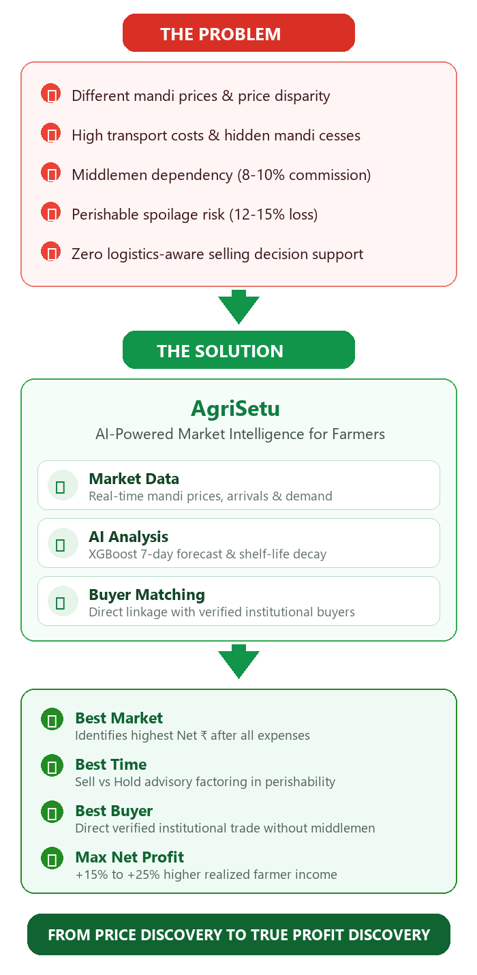
ArgiSetu-
Intelligent Market Linkage & Price Discovery for Farmers
AgriSetu
PROBLEM
Farmers often see only the headline mandi price, while their actual earnings are reduced by transportation costs, mandi fees, storage expenses and crop spoilage. They also lack reliable price forecasts and direct access to suitable buyers, increasing their dependence on intermediaries.
OUR IDEA
SmartAgri is a single platform that helps farmers make better selling decisions by answering three questions:
• WHERE to sell
• WHEN to sell
• WHOM to sell to
PROPOSED SOLUTION
• Net Realization Engine – identifies the market where the farmer can earn the highest profit after expenses.
• Sell vs Hold Engine – recommends whether to sell immediately, wait, or sell partially based on price forecasts, spoilage and storage costs.
• Direct Buyer Matching – connects farmers with suitable buyers based on price, quantity, distance and reliability.
• Telugu AI Assistant – provides personalized market guidance through Telugu voice and text.
INNOVATION & UNIQUENESS
• Net Profit: Price → Actual Profit
• Smart Timing: Forecast → Sell / Hold
• Direct Link: Farmer → Buyer
• Trust Score: Price + Reliability
• Telugu AI: Voice + Text Advisory
• One Decision: Data → Best Selling Option
USP:
PRICE → PROFIT → DECISION

Slide 3
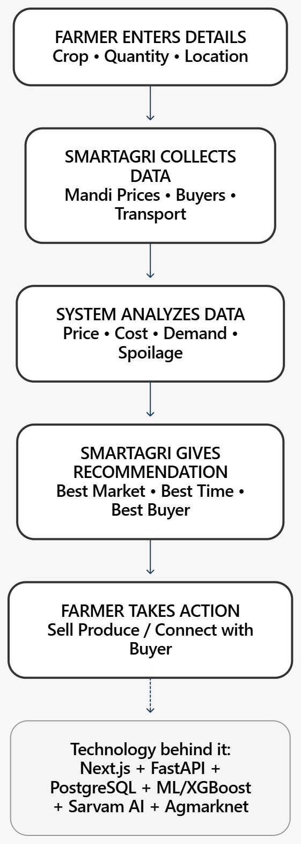
TECHNICAL APPROACH
AgriSetu
FRONTEND
Next.js • React • Tailwind CSS
→ Farmer-facing web interface
BACKEND
FastAPI • Python • REST APIs
→ Handles application logic, calculations & requests
DATABASE
PostgreSQL • Supabase • SQLAlchemy
→ Stores farmer, buyer, crop, market & transaction data
AI & MACHINE LEARNING
Scikit-learn • XGBoost • Pandas • NumPy
→ Price forecasting, data analysis & intelligent recommendations
TELUGU AI
Sarvam AI
→ Telugu voice & text-based farmer advisory
DATA SOURCES
Agmarknet • Market Data • Buyer Data • Location/Transport Data
→ Provides the information required for market analysis
CORE ENGINES
Net Realization • Sell vs Hold • Buyer Matching
→ Converts market data into actionable selling decisions
Github link:

Slide 4
FEASIBILITY AND VIABILITY
AgriSetu
STRATEGIES TO OVERCOME
Data Failure → Use historical price fallback + clearly show last update time.
Prediction Risk → Show confidence level & risk category; avoid guaranteed predictions.
Poor Connectivity → Lightweight interface + offline caching + sync when internet returns.
Buyer Risk → Reliability score + verified buyer profiles + cancellation tracking.
Quality Disputes → Standardized produce photos + agreed quality criteria + dispute mechanism.
Transport Cost Changes → Allow farmers to update local transport rates.
FEASIBILITY — WHY IT CAN WORK
Existing Technology: Next.js, FastAPI, PostgreSQL and ML are proven technologies.
Available Data: Mandi price data can be sourced from Agmarknet.
Modular System: Price prediction, buyer matching and advisory can work as independent modules.
Regional Access: Telugu voice/text through Sarvam AI makes the platform easier for farmers to use.
Scalable: Can expand from pilot markets to more crops, districts and FPOs.
KEY CHALLENGES & RISKS
Stale / unavailable mandi data
Incorrect price predictions due to sudden market or weather changes
Poor rural internet connectivity
Buyer cancellations or payment issues
Quality disputes between farmers and buyers
Variation in transportation costs
VIABILITY
Low-cost Software → Existing Data Sources → Modular AI → Regional Language → Scalable Deployment
Result: A practical, scalable platform that can continue functioning even when individual data, connectivity or prediction components fail.

Slide 5
IMPACT AND BENEFITS
AgriSetu
Impact table
MARKET DATA | AGRISETU INTELLIGENCE | FARMER ACTION | IMPACT
Mandi Prices | Net Realization | WHERE to Sell | Better Value
Transport Costs | Price Forecast | WHEN to Sell | Lower Costs
Buyer Offers | Buyer Matching | WHOM to Sell | Less Wastage
Spoilage Data | Telugu AI | Better Decisions | Stronger Bargaining
Benefits table
Target Audience / Area | Key Benefits
Farmers | Better net realization • Direct buyer access • Informed selling decisions
Economic | Transparent price discovery • Lower transaction costs • Stronger bargaining power
Social | Telugu voice/text access • Reduced information gap • More inclusive market access
Environmental | Reduced produce wastage • More efficient transportation

Slide 6
RESEARCH AND REFERENCES
AgriSetu
Research basis
References
Research Area | Evidence Used | How it Supports SmartAgri
Farmer Profile | Telangana Socio-Economic Outlook | Focus on small & marginal farmers
Market Prices | Agmarknet | Mandi prices, arrivals & price comparison
Post-Harvest Loss | ICAR-CIPHET | Supports spoilage-aware Sell/Hold decisions
Market Linkages | NSSO Report 587 | Supports direct farmer–buyer connectivity
Digital Access | TRAI Reports | Supports mobile-first + offline approach
Regional AI | Sarvam AI | Enables Telugu voice/text assistance
Government of Telangana — Socio-Economic Outlook 2024
DMI / Agmarknet — Agricultural market prices & arrivals
MoSPI / NSSO — Report No. 587, Situation Assessment of Agricultural Households
ICAR-CIPHET — Post-harvest management & losses
TRAI — Rural digital connectivity reports
Sarvam AI — Telugu Speech & Language APIs
⚙ PROTOTYPE STATUS: ✅ Backend (FastAPI + SQLite): Auth, Market Intelligence, Net Realization Engine, Sell/Hold Engine, Buyer Matching, Price Prediction (ML), Telugu AI Assistant (Sarvam AI), Listings & Offers, Transaction Flow — ALL WORKING. ✅ Frontend (Next.js): Farmer Dashboard, Buyer Dashboard, Admin Panel, Market Comparison, AI Chatbot (Voice + Text) — ALL WORKING. ✅ Tests: Auth, Buyer Matching, Sell/Hold, Market Intelligence — PASSING. 🔄 In Progress: PostgreSQL migration (currently SQLite for demo), Agmarknet live API integration, PWA offline mode.
Note: This is a working prototype with simulated Telangana market data. Core engines (Net Realization, Sell/Hold, Buyer Matching, Telugu AI) are fully functional end-to-end. GitHub: github.com/darkbyteRo/smartagri
⚙ PROTOTYPE STATUS: ✅ Backend (FastAPI + SQLite): Auth, Market Intelligence, Net Realization Engine, Sell/Hold Engine, Buyer Matching, Price Prediction (ML), Telugu AI Assistant (Sarvam AI), Listings & Offers, Transaction Flow — ALL WORKING. ✅ Frontend (Next.js): Farmer Dashboard, Buyer Dashboard, Admin Panel, Market Comparison, AI Chatbot (Voice + Text) — ALL WORKING. ✅ Tests: Auth, Buyer Matching, Sell/Hold, Market Intelligence — PASSING. 🔄 In Progress: PostgreSQL migration (currently SQLite for demo), Agmarknet live API integration, PWA offline mode.
Note: This is a working prototype with simulated Telangana market data. Core engines (Net Realization, Sell/Hold, Buyer Matching, Telugu AI) are fully functional end-to-end. GitHub: github.com/darkbyteRo/smartagri

