Slide 1
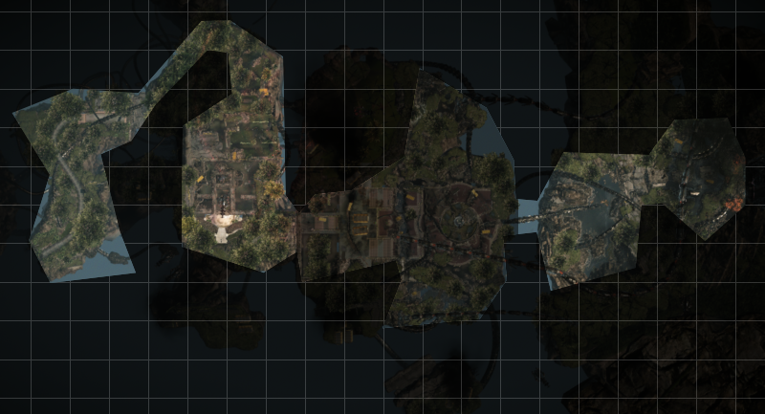
Action Bubble 2
By Sven Fahrenwald
Action Bubble 1
Action Bubble 3
Bandshell
Stalker Boss

