Slide 1
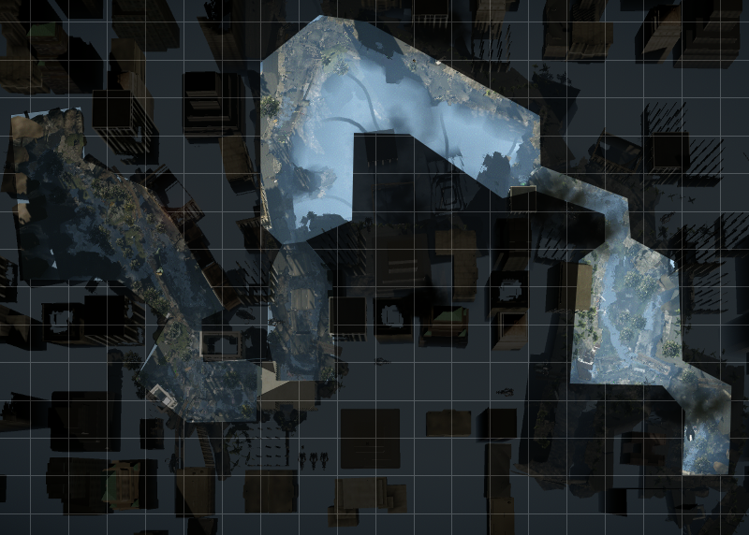
Action Bubble 2
Driving Section
Action Bubble 1
By Eddy Heinig
Action Bubble 3
Dropship Combat

