Slide 1
Data Warehousing
PROBLEM DEFINITION AND DESIGN THINKING

Slide 2
Abstract
Data warehouses and on-line analytical processing (OLAP) tools have become essential elements of decision support systems. Traditionally, data warehouses are refreshed periodically (for example, nightly) by extracting, transforming, cleaning and consolidating data from several operational data sources. The data in the warehouse is then used to periodically generate reports, or to rebuild multidimensional (data cube) views of the data for on-line querying and analysis. Increasingly, however, we are seeing business intelligence applications in telecommunications, electronic commerce, and other industries, that are characterized by very high data volumes and data flow rates, and that require continuous analysis and mining of the data. For such applications, rather different data warehousing and on-line analysis architectures are required. In this paper, we first motivate the need for a new architecture by summarizing the requirements of these applications.

Slide 3
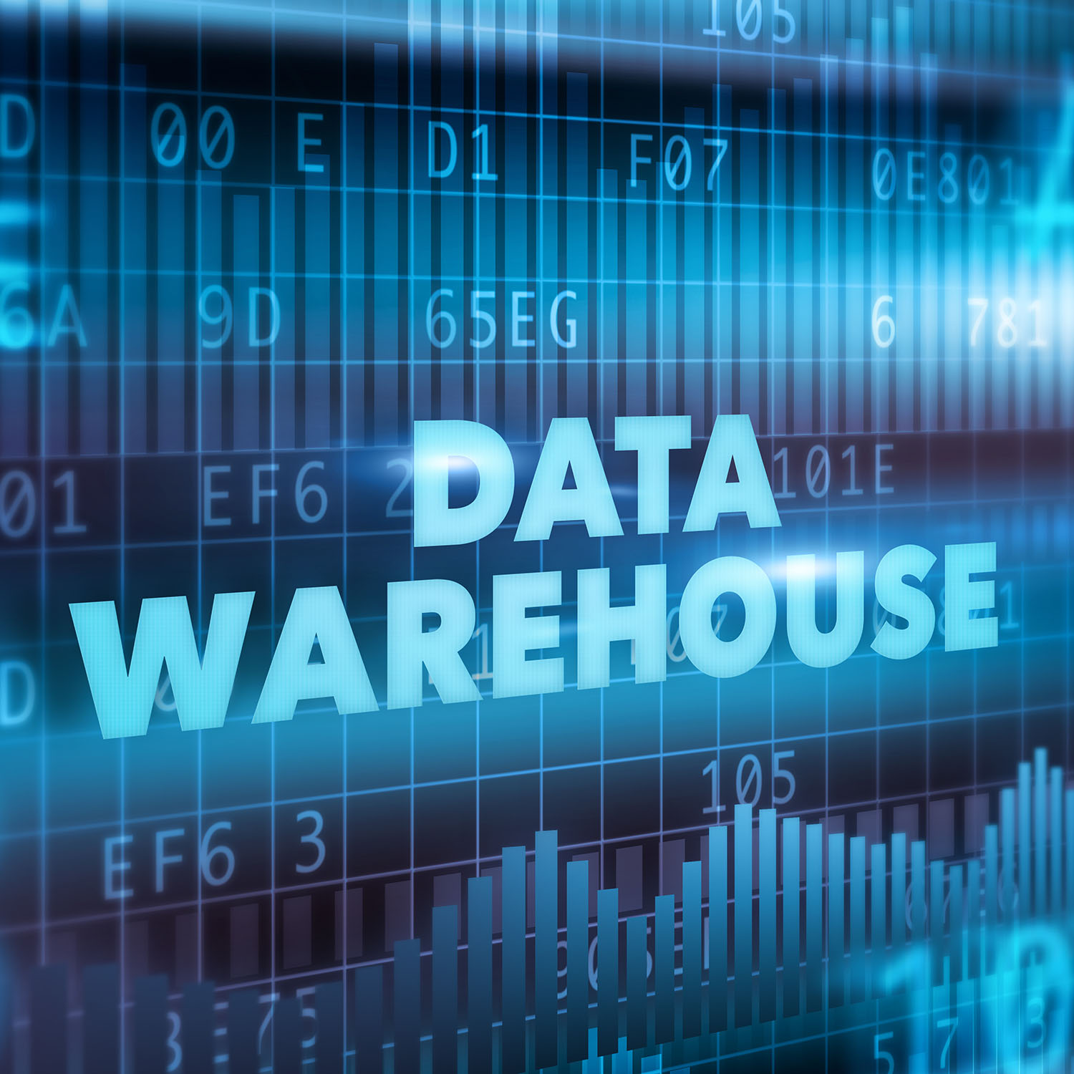
Problem Definition
The project involves designing and setting up a robust warehouse using IBM cloud Db2 Warehouse. The objective is to bring together data from various sources, perform advanced data integration and transformation, and provide data architects with the tools to explore, analyze, and deliver actionable data for informed decision making. This project encompasses defining the data warehouse structure, integrating data source, performing ETL processes, and enabling data analysis.

Slide 4
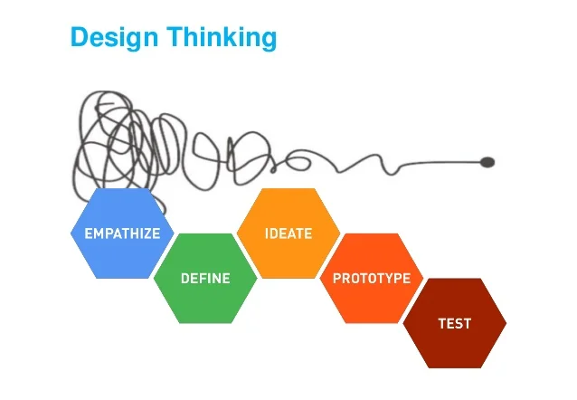
Design Thinking
To address this problem, we follow a systematic approach involving the following key steps:
Data warehouse structure
Data integration
ETL processes
Data Exploration
Actionable Insights

Slide 5
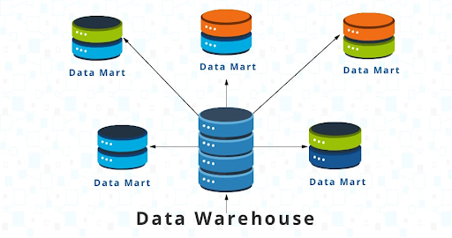
Data Warehouse Structure
Bottom tier: The bottom tier consists of a data warehouse server, usually a relational database system, which collects, cleanses, and transforms data from multiple data sources through a process known as Extract, Transform, and Load (ETL) or a process known as Extract, Load, and Transform (ELT).
Middle tier: The middle tier consists of an OLAP (i.e. online analytical processing) server which enables fast query speeds. Three types of OLAP models can be used in this tier, which are known as ROLAP, MOLAP and HOLAP. The type of OLAP model used is dependent on the type of database system that exists.
Top tier: The top tier is represented by some kind of front-end user interface or reporting tool, which enables end users to conduct ad-hoc data analysis on their business data.

Slide 6
Data Integration
Turn raw data into quality info, fast: Quickly transform large amounts of raw data from any format, complexity or size into consumable, quality information.
Simplify real-time data integration: Detect unknown data incidents earlier, resolve them faster and deliver reliable and readily consumable data.
Simplify data governance and maintain privacy: Understand and govern all enterprise data to manage risk and accelerate insights.
Break down data silos: Get a single view of data across different data types and sources without data movement and in a secure, governed fashion.
Deliver reliable data: Detect unknown data incidents earlier, resolve them faster and deliver trustworthy data.

Slide 7
ETL Process
Data extraction involves extracting data from homogeneous or heterogeneous sources
Data transformation processes data by cleaning and transforming them into a proper storage format/structure for the purposes of querying and analysis
Data loading describes the insertion of data into the target data store, data mart, data lake or data warehouse.

Slide 8
Data Exploration
.Explore relationships in your data When you create an exploration, you can start from a data source. A starting points page is displayed with suggestions for how to get started.
Visualizations You can change the visualization type or change the columns that are used in the visualization.
Principles of advanced data analytics IBM Cognos Analytics with Watson is a business intelligence tool for managing and analyzing data. It includes self-service features for users to prepare, explore, and share data. Cognos Analytics includes predictive, descriptive, and exploratory techniques, also known as numeric intelligence. Cognos Analytics uses many statistical tests to analyze your data.

Slide 9
Actionable Insights
Set the right goals
Automate where you can.
Target reporting data to your audience.
Use segmentation where it makes sense.
Break down silos.

Slide 10
Conclusion
Databases play a critical role in almost all areas where computers are used. Today, there are many challenges in the data mining system. A great example of data warehousing that everyone can relate to is what Facebook does. Data mining is widely used in fraud detection contexts, as an aid in marketing campaigns, and even supermarkets use it.
Data warehouse provides us generalized and consolidated data in a multidimensional view. Several types of analytical software are available: statistical, machine learning, and neural networks.

