Slide 1
Data Warehousing with IBM Cloud Db2 Warehouse Innovation
“Revolutionizing Data Warehousing in the Cloud”

Slide 2
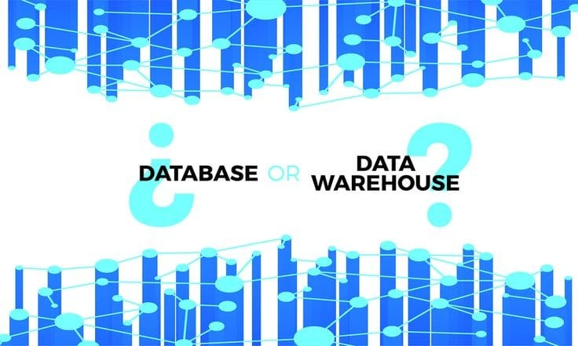
Agenda
Introduction to IBM Cloud Db2 Warehouse
Key Features and Benefits
Innovations in Data Warehousing
Use Cases
Deployment Options
Future Trends
Conclusion

Slide 3

Introduction to IBM Cloud Db2 Warehouse
IBM Cloud Db2 Warehouse is a powerful and versatile data warehousing solution offered by IBM, designed to meet the ever-growing demands of modern data-driven businesses.
Scalability: It can seamlessly scale to accommodate data growth, ensuring that your data warehouse remains efficient and cost-effective.
High Performance: Db2 Warehouse is optimized for performance, allowing users to run complex queries and analytics on large datasets quickly.
Security: It provides robust security measures to protect your data, including encryption, authentication, and authorization controls.

Slide 4
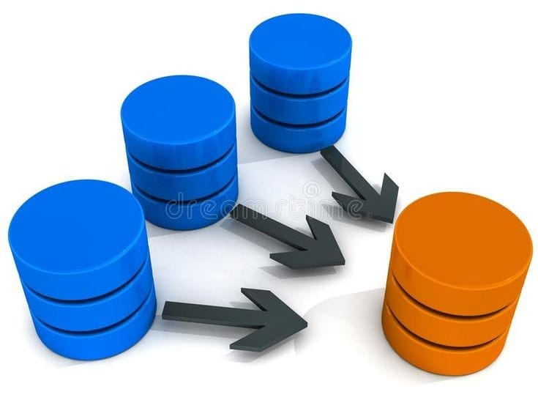
Key Features and Benefits
Scalability: It can seamlessly scale to accommodate data growth, ensuring that your data warehouse remains efficient and cost-effective.
High Performance: Db2 Warehouse is optimized for performance, allowing users to run complex queries and analytics on large datasets quickly.
Security: It provides robust security measures to protect your data, including encryption, authentication, and authorization controls.
Integration: It integrates with various data sources and analytics tools, facilitating easy data integration and analysis.
Flexibility: Db2 Warehouse supports both structured and unstructured data, making it suitable for a wide range of use cases.

Slide 5

Innovations in Data Warehousing
Cloud-Based Solutions: The migration to cloud-based data warehousing offers unparalleled scalability, cost-effectiveness, and flexibility compared to traditional on-premises systems.
Data Lake Integration: Data warehouses now seamlessly integrate with data lakes, accommodating structured and unstructured data for comprehensive analytics.
In-Memory Processing: In-memory data warehousing accelerates query performance by storing data in RAM, enabling real-time analytics and faster data retrieval.
Columnar Storage: Storing data in columns rather than rows optimizes query performance, compression, and analytical processing.

Slide 6

Use Cases
Retail Industry:
Inventory Management: A large retail chain uses Db2 Warehouse to analyze sales data and manage inventory more efficiently. Predictive analytics helps them optimize stock levels and reduce overstocking and stockouts.
Financial Services:
Fraud Detection: Financial institutions deploy Db2 Warehouse to analyze transaction data in real-time, identifying unusual patterns and potential fraud. This proactive approach safeguards against financial losses.
Healthcare Sector:
Patient Care Improvement: Hospitals leverage Db2 Warehouse to store and analyze patient data. Machine learning models identify treatment trends, enabling better patient care decisions and reducing readmission rates.

Slide 7

Deployment Options
IBM Cloud (Public Cloud):
Deploying Db2 Warehouse on IBM Cloud provides a fully managed, cloud-native solution. It offers scalability, reliability, and a pay-as-you-go pricing model. You can easily provision and manage resources, allowing for rapid scalability as your data needs grow.
AWS (Amazon Web Services):
Db2 Warehouse can be deployed on AWS, allowing you to leverage the power and global reach of the AWS cloud infrastructure. This option provides flexibility for organizations already invested in the AWS ecosystem.
Azure (Microsoft Azure):
Organizations using Microsoft Azure can choose to deploy Db2 Warehouse on Azure infrastructure. This integration simplifies data management for Azure users and offers seamless scalability.
Hybrid Cloud:
Db2 Warehouse supports hybrid cloud deployments, where you can run the database across both on-premises infrastructure and a cloud environment. This option suits organizations with specific data residency or compliance requirements.

Slide 8

Future Trends
Serverless Data Warehousing:
Trend: The move towards serverless data warehousing eliminates infrastructure management, allowing organizations to focus solely on data and analytics.
Alignment: Db2 Warehouse offers serverless capabilities, reducing operational overhead and simplifying resource provisioning and management.
Data Lake Integration:
Trend: Data warehouses are increasingly integrating with data lakes to enable the storage and analysis of structured and unstructured data together.
Alignment: Db2 Warehouse seamlessly integrates with data lakes, providing a unified platform for diverse data types, making it easier to harness the full potential of data.
Real-Time Data Processing:
Trend: The demand for real-time data processing and analytics is growing, enabling organizations to make immediate decisions based on live data streams.
Alignment: Db2 Warehouse supports real-time data streaming and processing, allowing businesses to act on data as it arrives.

Slide 9

Conclusion
As data continues to grow in complexity and volume, the innovative capabilities of Db2 Warehouse, including serverless computing, data lake integration, real-time processing, AI and machine learning integration, and multi-cloud support, position it as a reliable and future-proof solution. By aligning with these emerging trends, IBM Cloud Db2 Warehouse offers organizations the means to unlock the full potential of their data, make informed decisions, and stay competitive in an ever-evolving digital world

