Slide 1
Hyper Text Transfer Protocol
How clients/servers talk to each other

Slide 2
Objectives
To know how web clients and servers communicate
To know where resources (web content) come from
Knowing how web transactions work “under the hood”
To know the format of the messages used for HTTP communication

Slide 3

Clients & Servers
Notes:
Web servers speak the HTTP protocol, so they are often called HTTP servers. These HTTP servers store the Internet's data and provide the data when it is requested by HTTP clients. The clients send HTTP requests to servers, and servers return the requested data in HTTP responses, as sketched in Figure 1-1. Together, HTTP clients and HTTP servers make up the basic components of the World Wide Web

Slide 4
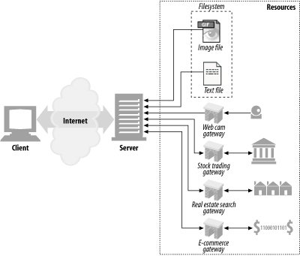
Resources
Notes:
Web servers host web resources. A web resource is the source of web content. The simplest kind of web resource is a static file on the web server's filesystem. These files can contain anything: they might be text files, HTML files, Microsoft Word files, Adobe Acrobat files, JPEG image files, AVI movie files, or any other format you can think of.
However, resources don't have to be static files. Resources can also be software programs that generate content on demand. These dynamic content resources can generate content based on your identity, on what information you've requested, or on the time of day. They can show you a live image from a camera, or let you trade stocks, search real estate databases, or buy gifts from online stores

Slide 5
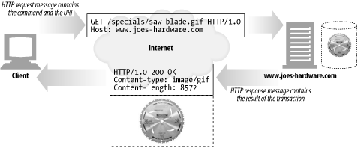
Transactions
Notes:
Let's look in more detail how clients use HTTP to transact with web servers and their resources. An HTTP transaction consists of a request command (sent from client to server), and a response result (sent from the server back to the client). This communication happens with formatted blocks of data called HTTP messages

Slide 6
Methods
Some common HTTP methods
HTTP method | Description
GET | Send named resource from the server to the client.
PUT | Store data from client into a named server resource.
DELETE | Delete the named resource from a server.
POST | Send client data into a server gateway application.
HEAD | Send just the HTTP headers from the response for the named resource.
Notes:
Every HTTP response message comes back with a status code. The status code is a three-digit numeric code that tells the client if the request succeeded, or if other actions are required
HTTP also sends an explanatory textual "reason phrase" with each numeric status code (see the response message in Figure 1-5). The textual phrase is included only for descriptive purposes; the numeric code is used for all processing.
The following status codes and reason phrases are treated identically by HTTP software:
200 OK
200 Document attached
200 Success200 All's cool, dude

Slide 7
Status Codes
Some common HTTP status codes
HTTP status code | Description
200 | OK. Document returned correctly.
302 | Redirect. Go someplace else to get the resource.
404 | Not Found. Can't find this resource.
Notes:
HTTP supports several different request commands, called HTTP methods. Every HTTP request message has a method. The method tells the server what action to perform (fetch a web page, run a gateway program, delete a file, etc.). Table 1-2 lists five common HTTP methods.

Slide 8
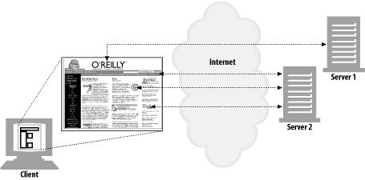
HTTP Multiple Requests
Notes:
An application often issues multiple HTTP transactions to accomplish a task. For example, a web browser issues a cascade of HTTP transactions to fetch and display a graphics-rich web page. The browser performs one transaction to fetch the HTML "skeleton" that describes the page layout, then issues additional HTTP transactions for each embedded image, graphics pane, Java applet, etc. These embedded resources might even reside on different servers, as shown in Figure 1-6. Thus, a "web page" often is a collection of resources, not a single resource.

Slide 9
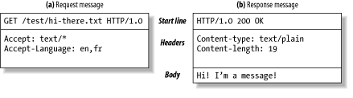
Messages
Notes:
HTTP messages are simple, line-oriented sequences of characters. Because they are plain text, not binary, they are easy for humans to read and write.[1] Figure 1-7 shows the HTTP messages for a simple transaction
HTTP messages sent from web clients to web servers are called request messages. Messages from servers to clients are called response messages. There are no other kinds of HTTP messages. The formats of HTTP request and response messages are very similar.
HTTP messages consist of three parts:
Start line
The first line of the message is the start line, indicating what to do for a request or what happened for a response.
Header fields
Zero or more header fields follow the start line. Each header field consists of a name and a value, separated by a colon (:) for easy parsing. The headers end with a blank line. Adding a header field is as easy as adding another line.
Body
After the blank line is an optional message body containing any kind of data. Request bodies carry data to the web server; response bodies carry data back to the client. Unlike the start lines and headers, which are textual and structured, the body can contain arbitrary binary data (e.g., images, videos, audio tracks, software applications). Of course, the body can also contain text.

Slide 10
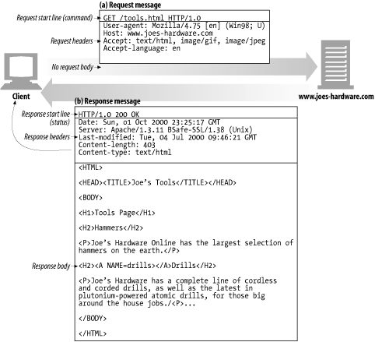
Example GET transaction
Notes:
Example GET transaction for http://www.joes-hardware.com/tools.html
the browser sends an HTTP request message. The request has a GET method in the start line, and the local resource is /tools.html. The request indicates it is speaking Version 1.0 of the HTTP protocol. The request message has no body, because no request data is needed to GET a simple document from a server.
The server sends back an HTTP response message. The response contains the HTTP version number (HTTP/1.0), a success status code (200), a descriptive reason phrase (OK), and a block of response header fields, all followed by the response body containing the requested document. The response body length is noted in the Content-Length header, and the document's MIME type is noted in the Content-Type header.

Slide 11
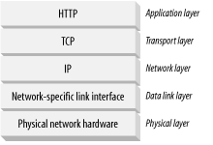
Connections
Notes:
Now that we've sketched what HTTP's messages look like, let's talk for a moment about how messages move from place to place, across Transmission Control Protocol (TCP) connections.
HTTP is an application layer protocol. HTTP doesn't worry about the nitty-gritty details of network communication; instead, it leaves the details of networking to TCP/IP, the popular reliable Internet transport protocol.
TCP provides:
· Error-free data transportation
· In-order delivery (data will always arrive in the order in which it was sent)
· Unsegmented data stream (can dribble out data in any size at any time)
The Internet itself is based on TCP/IP, a popular layered set of packet-switched network protocols spoken by computers and network devices around the world. TCP/IP hides the peculiarities and foibles of individual networks and hardware, letting computers and networks of any type talk together reliably.
Once a TCP connection is established, messages exchanged between the client and server computers will never be lost, damaged, or received out of order.
In networking terms, the HTTP protocol is layered over TCP. HTTP uses TCP to transport its message data. Likewise, TCP is layered over IP

Slide 12
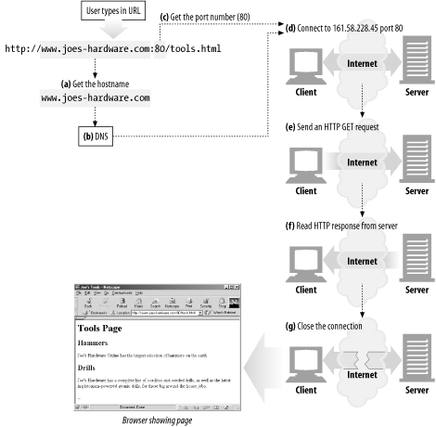
What steps happens during connection?
Notes:
Before an HTTP client can send a message to a server, it needs to establish a TCP/IP connection between the client and server using Internet protocol (IP) addresses and port numbers.
Setting up a TCP connection is sort of like calling someone at a corporate office. First, you dial the company's phone number. This gets you to the right organization. Then, you dial the specific extension of the person you're trying to reach.
In TCP, you need the IP address of the server computer and the TCP port number associated with the specific software program running on the server.
This is all well and good, but how do you get the IP address and port number of the HTTP server in the first place? Why, the URL, of course! We mentioned before that URLs are the addresses for resources, so naturally enough they can provide us with the IP address for the machine that has the resource. Let's take a look at a few URLs:
http://207.200.83.29:80/index.html
http://www.netscape.com:80/index.html
http://www.netscape.com/index.html
The first URL has the machine's IP address, "207.200.83.29", and port number, "80".
The second URL doesn't have a numeric IP address; it has a textual domain name, or hostname ("www.netscape.com"). The hostname is just a human-friendly alias for an IP address. Hostnames can easily be converted into IP addresses through a facility called the Domain Name Service (DNS), so we're all set here, too. We will talk much more about DNS and URLs in Chapter 2.
The final URL has no port number. When the port number is missing from an HTTP URL, you can assume the default value of port 80.
With the IP address and port number, a client can easily communicate via TCP/IP.
Here are the steps:
(a)
The browser extracts the server's hostname from the URL.
(b)
The browser converts the server's hostname into the server's IP address.
(c)
The browser extracts the port number (if any) from the URL.
(d)
The browser establishes a TCP connection with the web server.
(e)
The browser sends an HTTP request message to the server.
(f)
The server sends an HTTP response back to the browser.
(g)
The connection is closed, and the browser displays the document.

