Slide 1
E-COMMERCE Price Optimization
by Diptyajit Das

Slide 2

HOW MUCH IS MORE?

Slide 3
Agenda
Introduction
Exploratory Data Analysis
Machine Learning
Recommendations

Slide 4
INTRODUCTION
Price optimization aims to find the ideal balance between pricing and customer demand to maximize revenue and sales volume.
This approach leverages data-driven strategies to set competitive prices that attract customers while ensuring profitability.
The goal is to enhance sales and customer satisfaction through smart, balanced pricing techniques, supported by EDA, time series analysis, and ML regression models.

Slide 5
EXPLORATORY DATA ANALYSIS

Slide 6
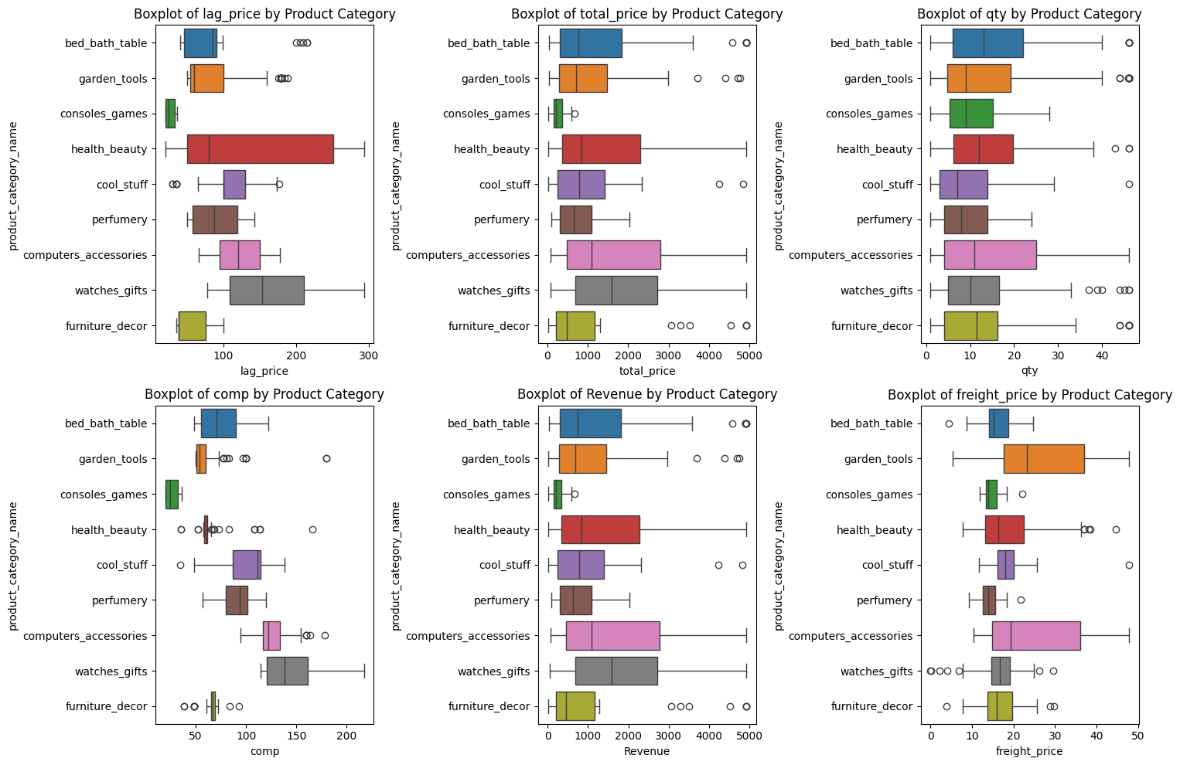
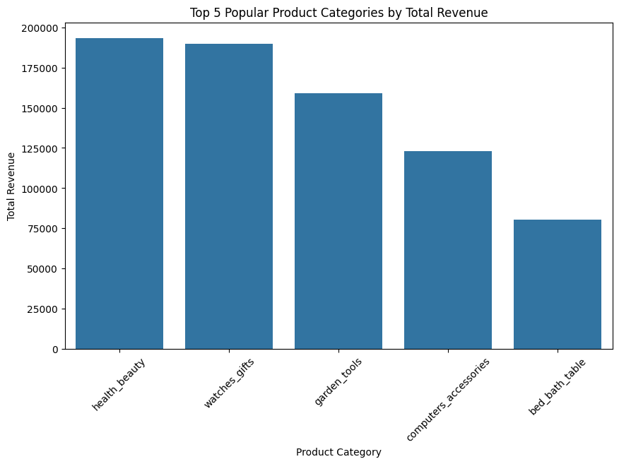
KEY FINDINGS
Correlations:
- Positive: freight_price & weight, total_price & quantity
Negative: weekday & weekend counts
Popular categories and products[Revenue wise]:
- health_beauty, watches_gifts, garden_tools,`computer_accessories`.
- Popular products: health5, health2, bed2, health7
Revenue peak in November 2017.
unit_price higher than competitor prices.

Slide 7
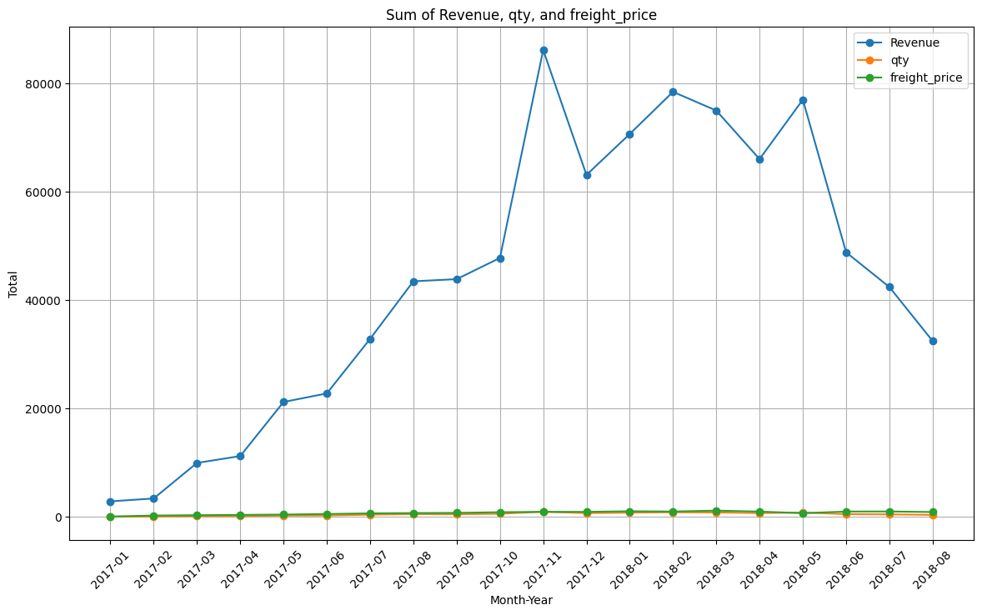
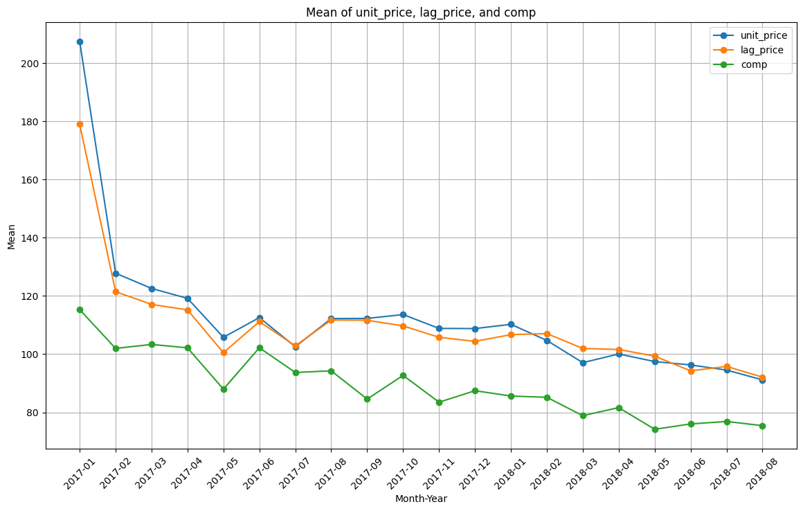
KEY FINDINGS
Stable Metrics:
- freight_price and qty consistent over time.
Mean Comparisons:
- No significant differences in weekday, weekend, and holiday counts.
Price Strategy:
- unit_price close to lag_price, potential for pricing adjustments.

Slide 8
MACHINE LEARNING

Slide 9
Model Insights & Performance
Models Used:
- xgboost Regression models for predicting total_price, qty, and unit_price.
- Prophet library utilized to predict metrics product, category level.
Performance Metrics:
- Quantity: R² = 0.89, RMSE = 3.85
- Total Price: R² = 0.998, RMSE = 63.98
- Unit Price: R² = 0.84, RMSE = 28.01

Slide 10
RECOMMENDATIONS
1. Implement targeted discount strategies : for popular products to attract more customers and increase revenue.
2. Focus marketing efforts : on high-revenue categories and products (e.g., `health_beauty` and products like `health5`).
3. Monitor competitive pricing and adjust `unit_price` to stay competitive while maintaining profitability.
4. Leverage the predictive models to forecast `total_price`, `qty`, and `unit_price` for various scenarios to plan pricing and inventory effectively.
5. Continue evaluating and refining models against baselines to ensure sustained accuracy and performance.

Slide 11
Thank you
©dip2_11_24
NOTEBOOK
CARD.py

