Slide 1

Address Classification with Trie
Instructor: PhD. Tran Tuan Anh
November 25, 2023

Slide 2
Teammate
Name | Performence
Nguyen Truong An - 2370388 | 20%
Chu Hai Nam - 2370189 | 20%
Khuat Hoang Tri - 2370127 | 20%
 | 20%
 | 20%

Slide 3
Table of contents
01
02
03
04
Problem
Solution
Address classification problem
Using trie for search and classify province, district and ward
Result
References
The result of algorithm
Code resource

Slide 4
01
Problem
Address classification problem

Slide 5
Classify address from OCR
OCR
X. Thuận Thành, H. Cần Giuộc, T. Long An
Thuận Thanh, HCần Giuộc, Tlong An
Thuận Thành, H Cần Giuộc T. Long An
X Thuận Thành H. Cần Giuộc, Long An
X ThuanThanh H. Can Giuoc, Long An
Xã: Thuận Thành
Huyện: Cần Giuộc
Tỉnh: Long An

Slide 6
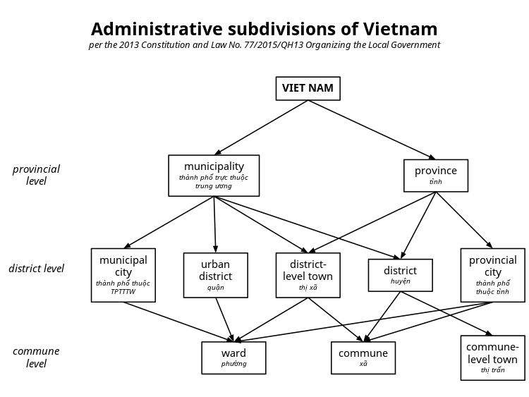
Administrative subdivisions of Vietnam

Slide 7
02
Solution
Using trie for search and classify province, district and ward

Slide 8
Process sequence
Build Tries
Preprocess
Search
Maping
Build the tries, dictionaries with address data from file. Tries include word without space, accent and uppercase
Postfix search with sequence, with one error, redundant. Return ID valid in dictionary
list_xxx.txt
tries
exception_list
dictionary
Remove accent, space, exception; Lowercase; parse string to array
Return true data from dictionary

Slide 9
Process sequence
Build Tries
Preprocess
Search
Maping
Build the tries, dictionaries with address data from file. Tries include word without space, accent and uppercase
Postfix search with sequence, with one error, redundant. Return ID valid in dictionary
list_xxx.txt
tries
exception_list
dictionary
Remove accent, space, exception; Lowercase; parse string to array
Return true data from dictionary

Slide 10
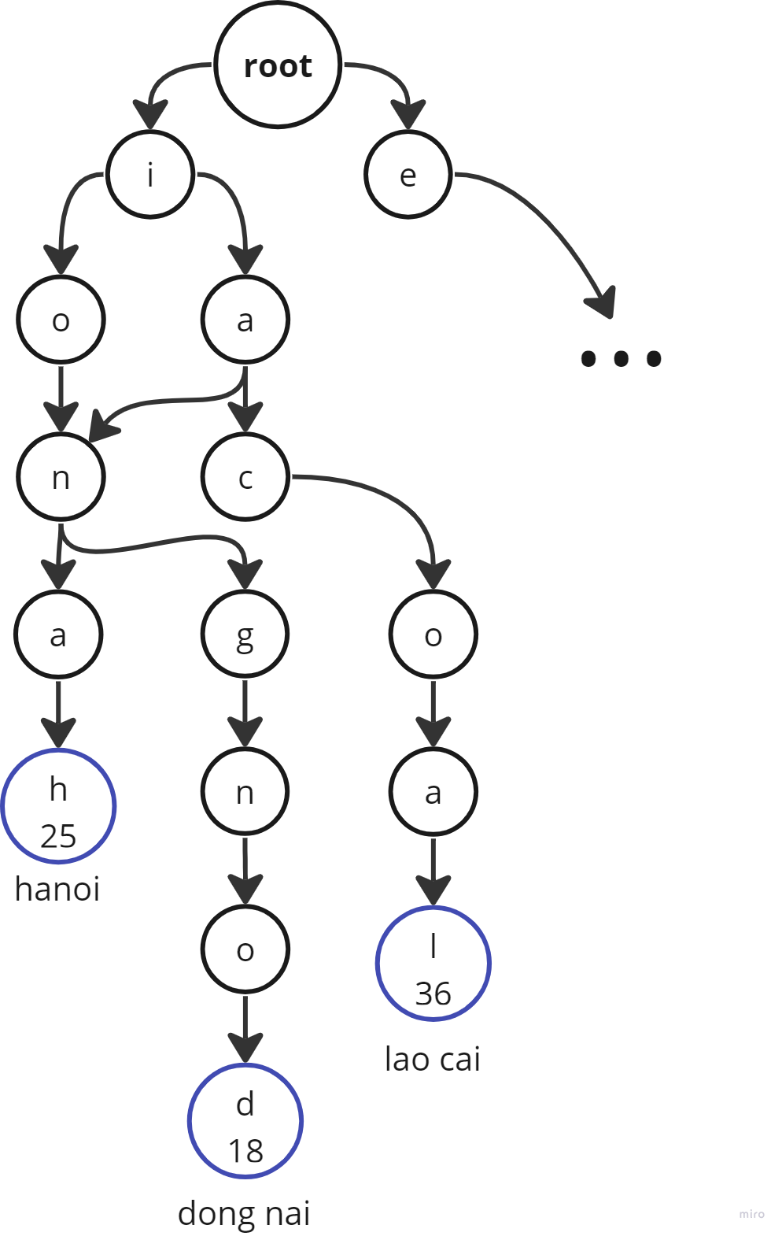
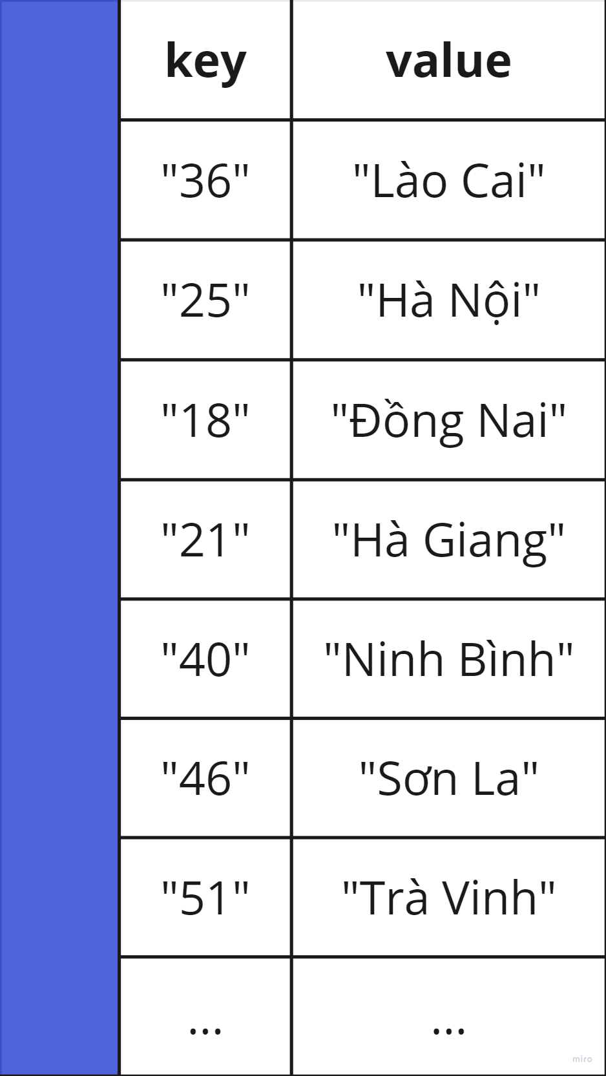
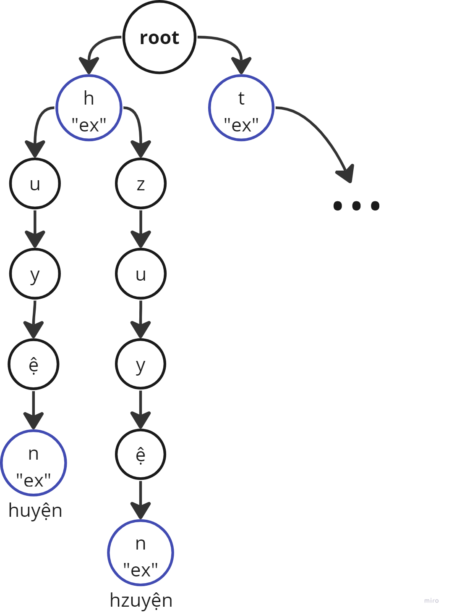
Tries, dictionary, exception

Slide 11
Process sequence
Build Tries
Preprocess
Search
Maping
Build the tries, dictionaries with address data from file. Tries include word without space, accent and uppercase
Postfix search with sequence, with one error, redundant. Return ID valid in dictionary
list_xxx.txt
tries
exception_list
dictionary
Remove accent, space, exception; Lowercase; parse string to array
Return true data from dictionary

Slide 12
Preprocess step
Split a squence string to array by dash, space, comma
Remove all empty or blank elements from spliting
Reduce the dot, or dash still exist in elements
Split to array
Remove empty
Reduce dot
Remove accent
Remove exception
Lowercase
Use unidecode library for remove all accents from elements
Using twin search and remove exception apart from elements, an research to remove element match with exception
Lowercase elements for easy to search

Slide 13
Preprocess step
55/21/1 Khu phố 2, Thới An Quận 12, TP. Hồ Chí Minh
['55/21/1', 'khu', 'phố', '2', '', 'thới', 'an', 'quận', '12', '', 'tp.', 'hồ', 'chí', 'minh']
['55/21/1', 'khu', 'phố', '2', 'thới', 'an', 'quận', '12', 'tp.', 'hồ', 'chí', 'minh']
['55/21/1', 'khu', 'phố', '2', 'thới', 'an', '12', 'hồ', 'chí', 'minh']
['55/21/1', 'khu', 'pho', '2', 'thoi', 'an', '12', 'ho', 'chi', 'minh']

Slide 14
Process sequence
Build Tries
Preprocess
Search
Maping
Build the tries, dictionaries with address data from file. Tries include word without space, accent and uppercase
Postfix search with sequence, with one error, redundant. Return ID valid in dictionary
list_xxx.txt
tries
exception_list
dictionary
Remove accent, space, exception; Lowercase; parse string to array
Return true data from dictionary

Slide 15
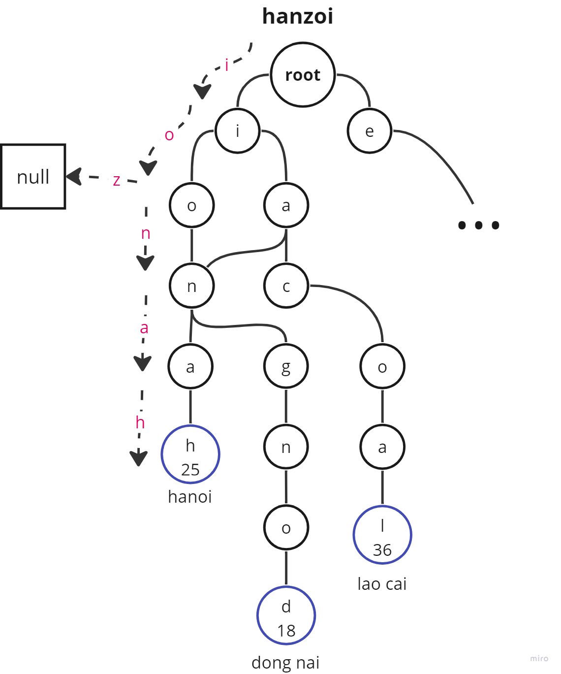
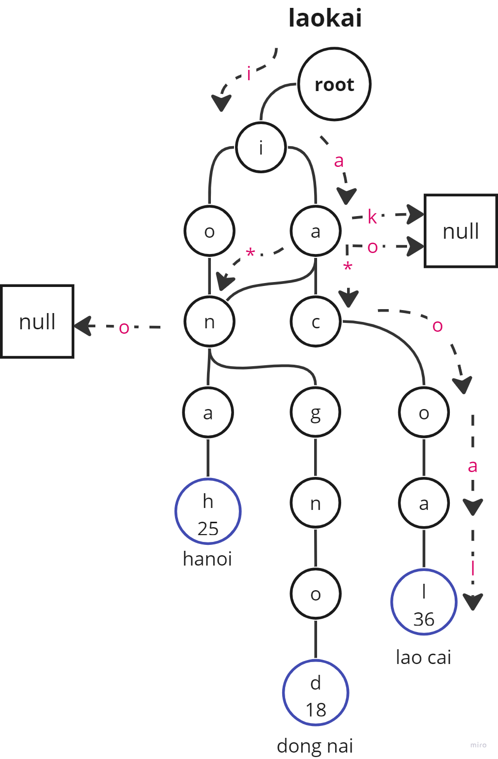
Search with one error, redundant char

Slide 16
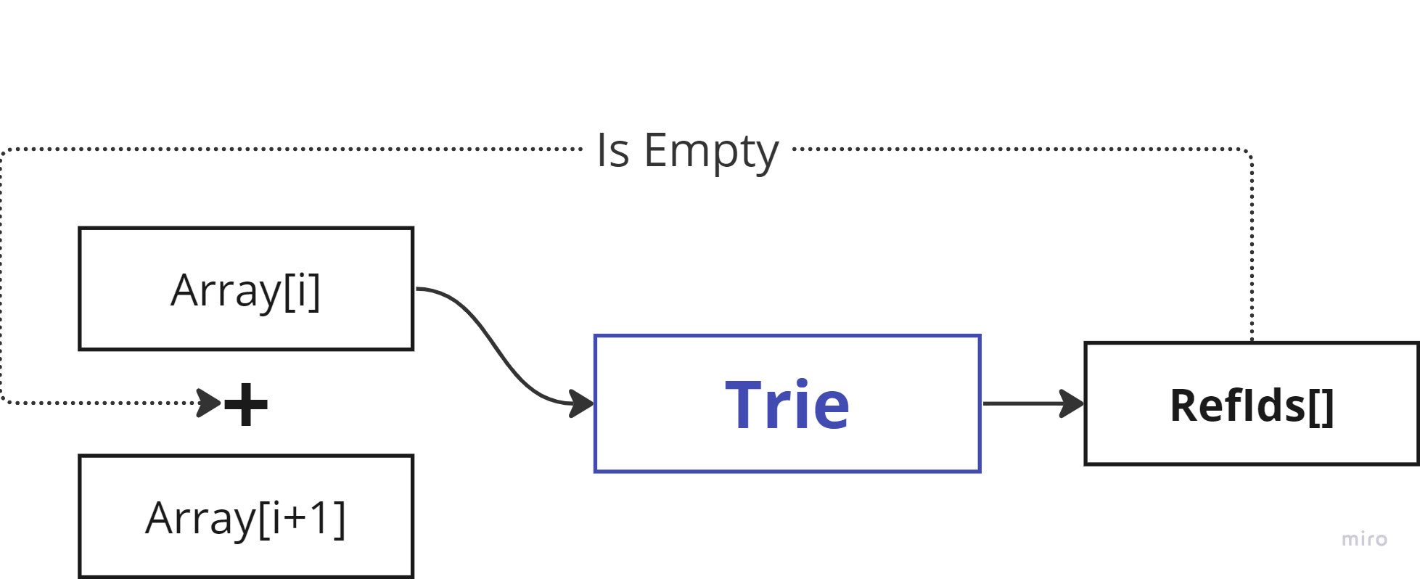
Sequence search

Slide 17
Process sequence
Build Tries
Preprocess
Search
Maping
Build the tries, dictionaries with address data from file. Tries include word without space, accent and uppercase
Postfix search with sequence, with one error, redundant. Return ID valid in dictionary
list_xxx.txt
tries
exception_list
dictionary
Remove accent, space, exception; Lowercase; parse string to array
Return true data from dictionary.

Slide 18
Mapping with dictionary
ID: “21”
Province: “Hà Giang”

Slide 19
03
Result
The result of algorithm

Slide 20
Ratio of true value
79%
Match ratio
correct = 1071 / 1350 (7.93 / 10)
max_time_sec = 0.0018
avg_time_sec = 0.0001

Slide 21

Analysis a missing case
+ Not yet process for missing one character
+ The exception data is limit
+ Have mistake when detect a number or short data

Slide 22
04
References
Code resource

Slide 23
References
 | https://www.geeksforgeeks.org/trie-insert-and-search/
 | https://stackoverflow.com/

Slide 24

Thanks!
Do you have any questions?
chnam.sdh231@hcmut.edu.vn

