Slide 1
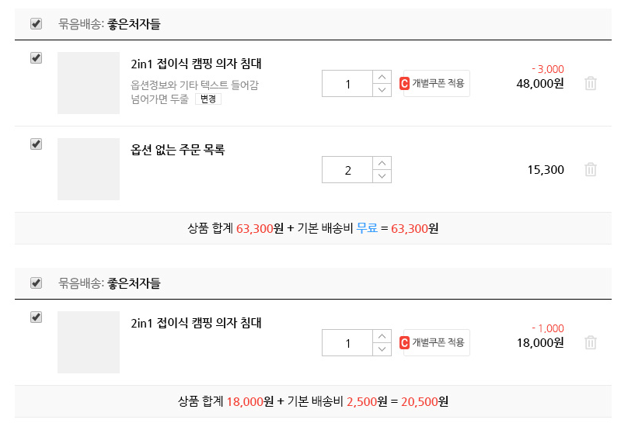
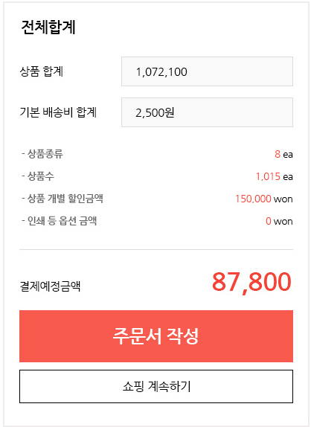
장바구니
B
A
all D
C
all E
all B
(all D + all E) – all B =
D = all C - B
E
F

Slide 2
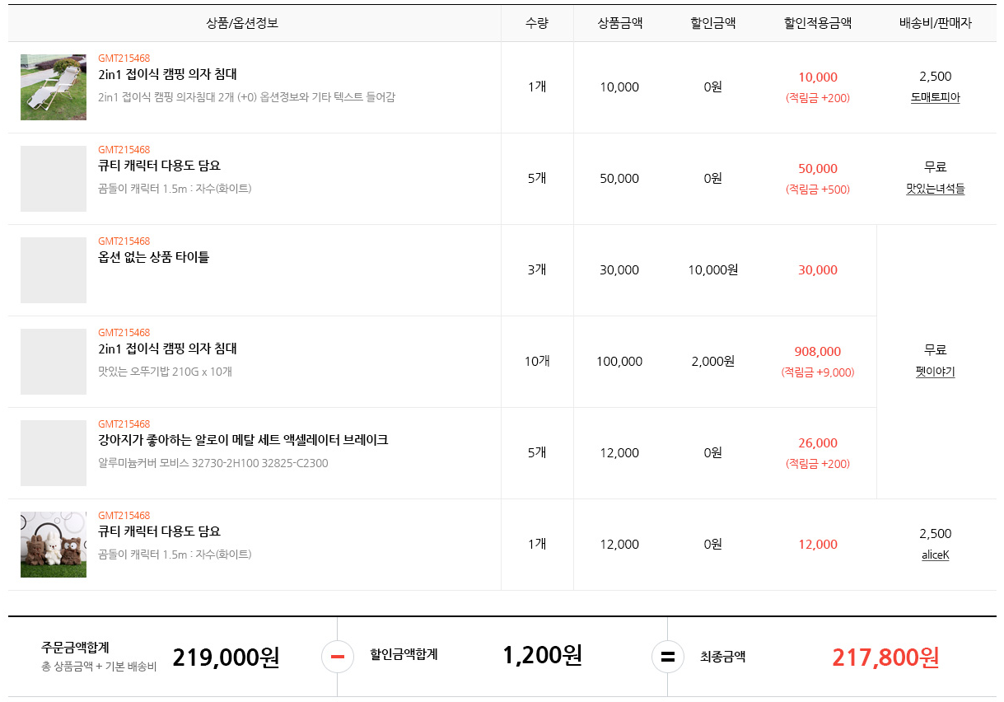
A
B
C
E
1 x 10000
5 x 10000
3 x 10000
all A + all E
all B
(all A + all E) - all B

