Slide 1


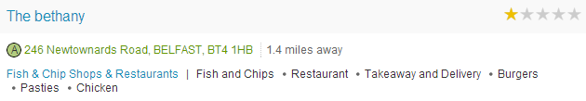
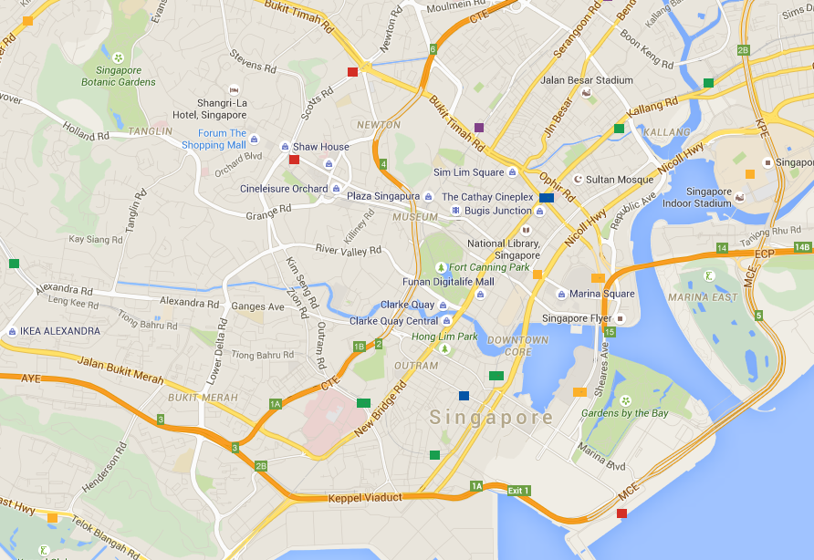

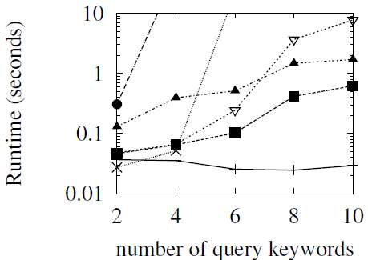
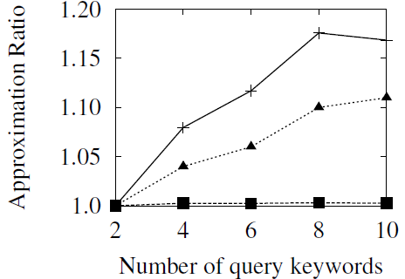
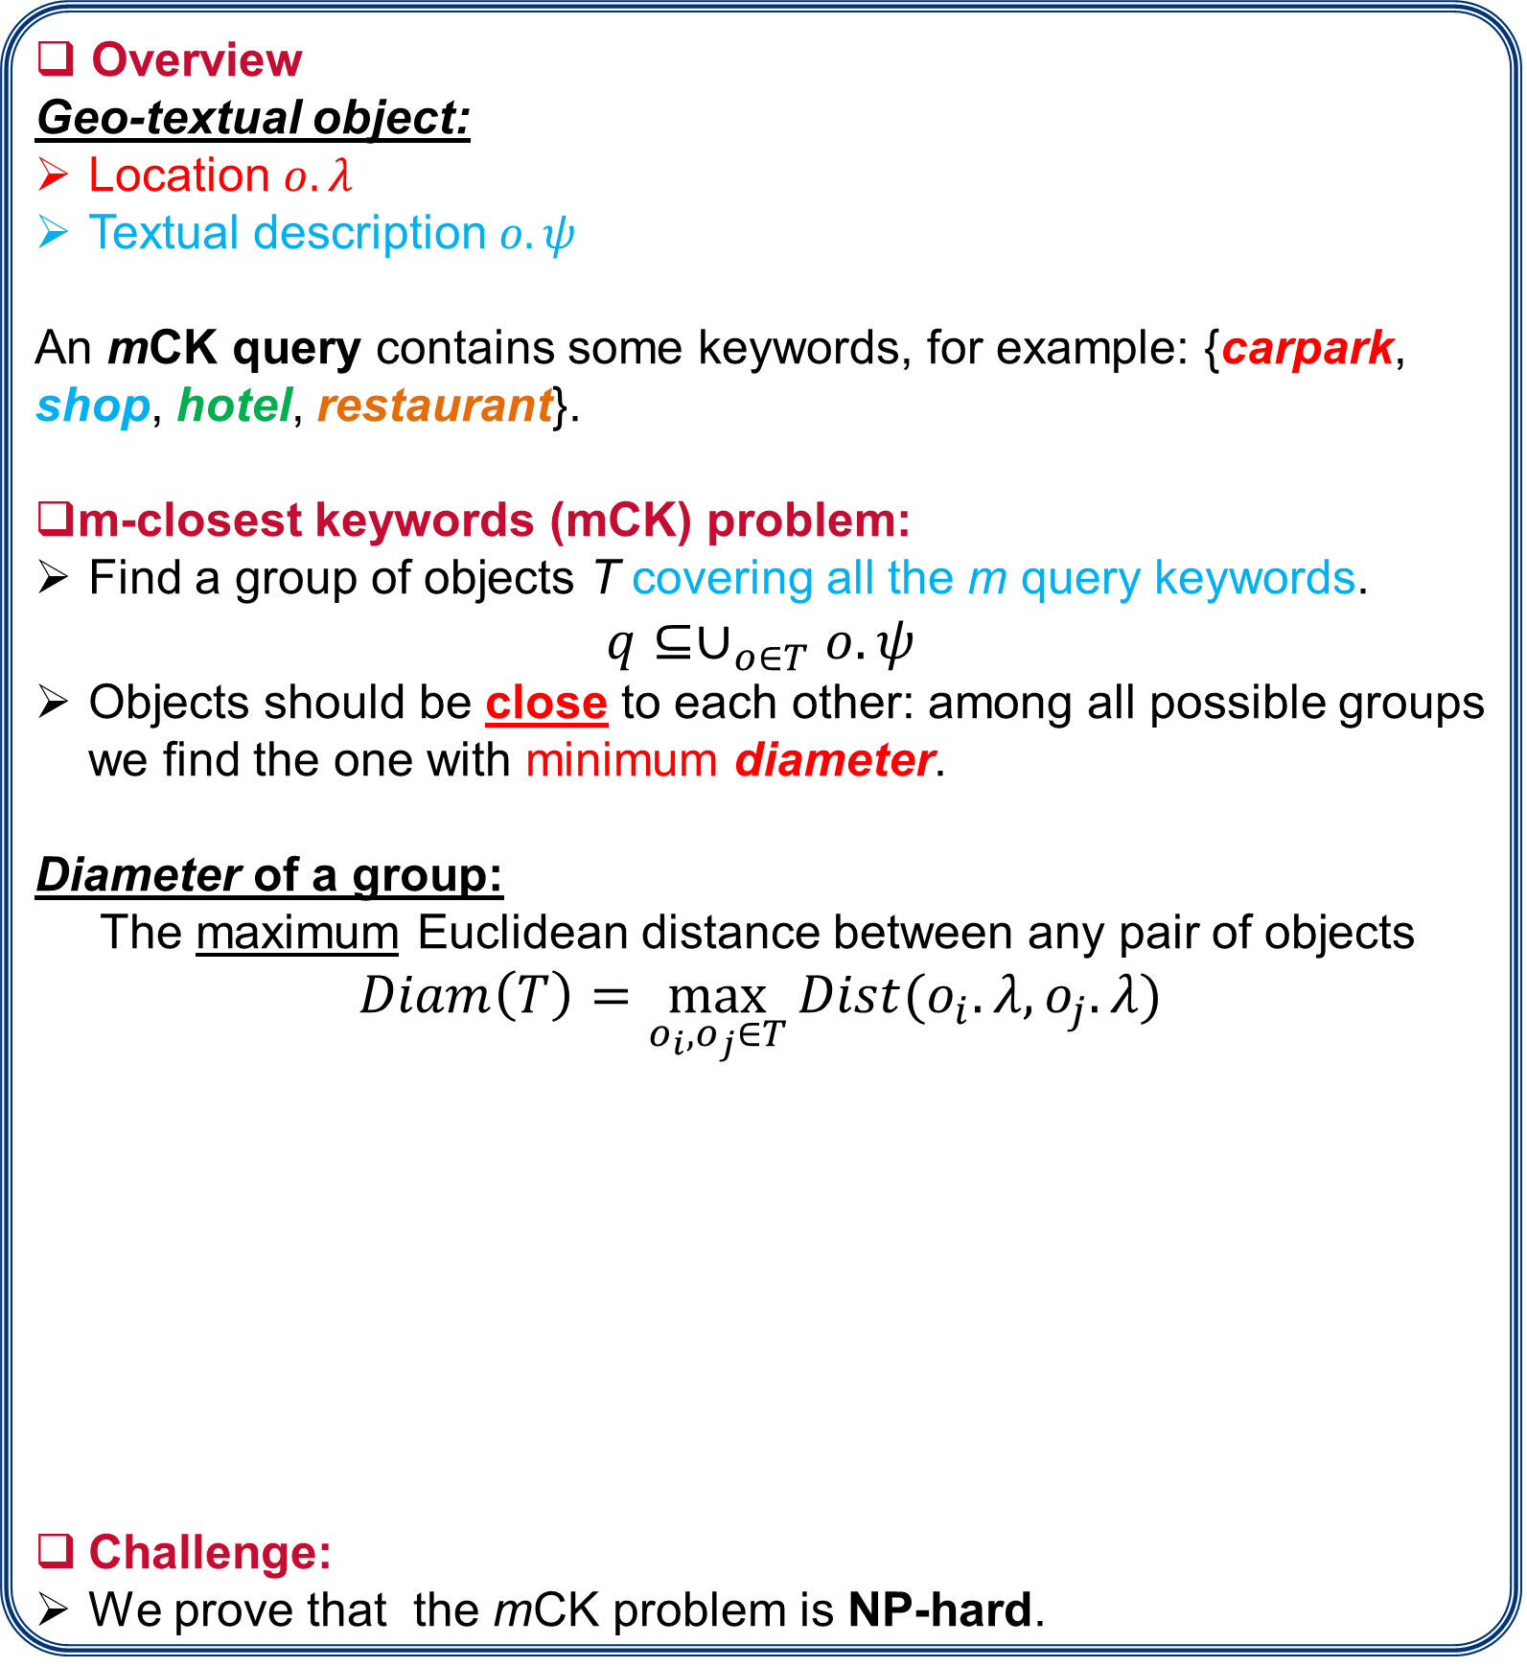

Efficient Algorithms for Answering the m-Closest Keywords Query
Tao Guo, Xin Cao , Gao Cong
Problem Statement:
Approaches:
Overview
Geo-textual object:
Location $o.λ$
Textual description $o.ψ$
An mCK query contains some keywords, for example: {carpark, shop, hotel, restaurant}.
m-closest keywords (mCK) problem:
Find a group of objects T covering all the m query keywords.
$$q⊆∪_{o∈T}o.ψ$$
Objects should be close to each other: among all possible groups we find the one with minimum diameter.
Diameter of a group:
The maximum Euclidean distance between any pair of objects
$$Diam\left(T\right)=\max_{o_{i},o_{j}∈T}{Dist(o_{i}.λ,o_{j}.λ)}$$
Challenge:
We prove that the mCK problem is NP-hard.
Greedy Keyword Group
Given a query, find the most infrequent keyword $t_{inf}$.
Find objects containing $t_{inf}$, and combine the nearest object with uncovered keywords until we find a group.
The results can be bounded by a factor of 2.
Smallest Keywords Enclosing Circle
Observation: If the objects are close to each other, we can find a circle enclosing all of them.
Smallest Keywords Enclosing Circle(SKEC):
the smallest circle enclosing all query keywords
Example: query {carpark, shop, hotel, restaurant}
Although SKEC could miss the optimal group, the results can be bounded by a factor of $2/{\sqrt{3}}$ (≈1.15).
Exact algorithm for mCK problem
Enlarge the SKEC by ${\sqrt{3}}/2$, optimal solution must be covered.
Sweep the circle, and do exhaustive search in each valid circle
Diameter of this group
SKEC
The group in SKEC is an approximate solution for mCK problem
Applications:
SKEC
Optimal group enclosing circle
Explore an area fulfilling user’s personalized needs
Single object may not fulfill a user’s needs.
Explore an area fulfilling user’s personalized needs.
Users can issue an mCK query consisting of some keywords (e.g. A user may intend to go to the following locations {sushi, cinema, spa}).
Detect geographic locations of web resources
Web resources (e.g. documents or photos) sometimes are posted missing geographic location, and with some tags describing the content.
We can issue an mCK query using these tags as keywords.
The center of the returned group can be used to geo-tag this resource approximately.
Experimental Results:
Baselines:
Adapted Spatial Group Keyword (ASGK)
Adapted Spatial Group Keyword approximation (ASGKa)
Virtual bR*-tree (VirbR)
Our Methods:
Greedy Keyword Group (GKG)
Smallest Keywords Enclosing Circle approximation(SKECa+)
Exact algorithm for m-CK problem (EXACT)

