Slide 1



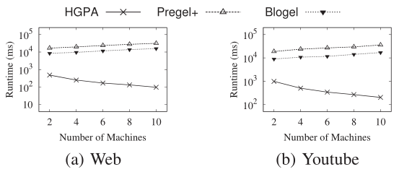
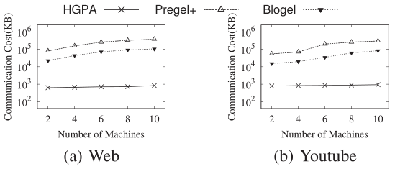


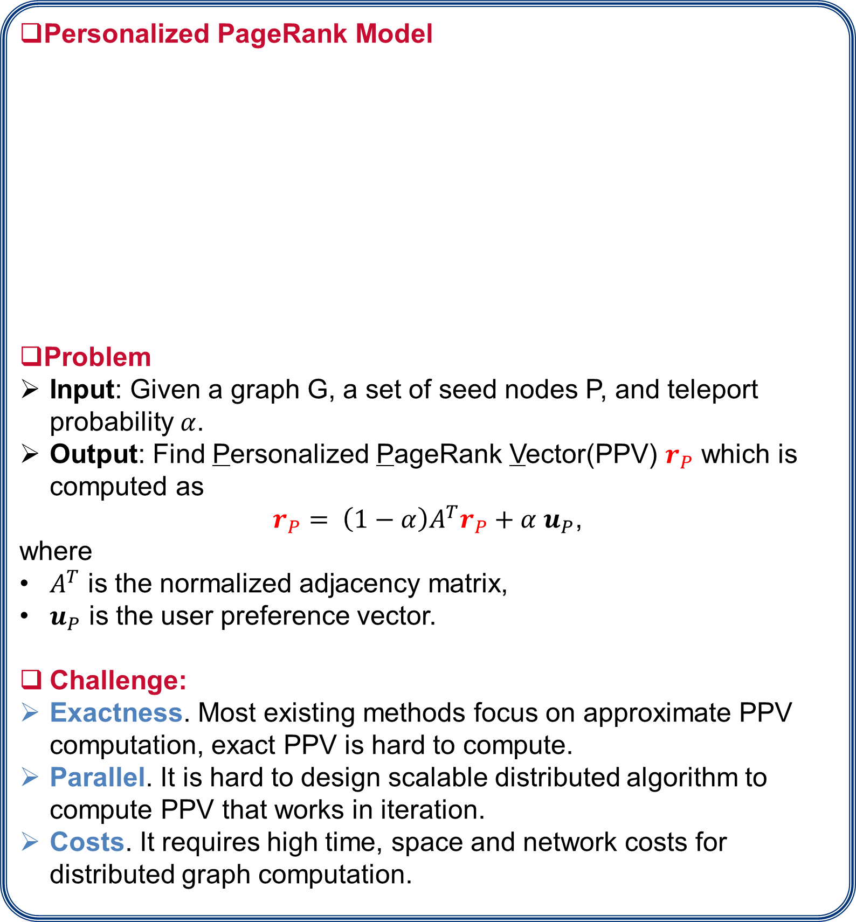
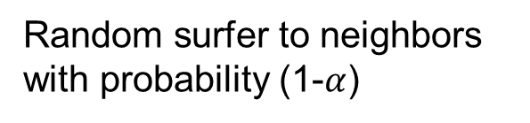




Distributed Algorithms on Exact Personalized PageRank
Tao Guo, Xin Cao , Gao Cong, Jiaheng Lu, Xuemin Lin
Problem Statement:
Approaches:
Personalized PageRank Model
Problem
Input: Given a graph G, a set of seed nodes P, and teleport probability $α$.
Output: Find Personalized PageRank Vector(PPV) $r_{P}$ which is computed as
$r_{P}= \left(1−α\right)A^{T}r_{P}+α u_{P}$,
where
$A^{T}$ is the normalized adjacency matrix,
$u_{P}$ is the user preference vector.
Challenge:
Exactness. Most existing methods focus on approximate PPV computation, exact PPV is hard to compute.
Parallel. It is hard to design scalable distributed algorithm to compute PPV that works in iteration.
Costs. It requires high time, space and network costs for distributed graph computation.
Graph Partition Based Algorithm
Hierarchical Graph Partition Based Algorithm
Seed node
Seed node
0.27
1
0.21
0.16
If we choose the hub nodes that can separate the graph, the size of partial vector can be bounded inside a subgraph.
converge
2
4
0.26
3
Random surfer to neighbors
with probability (1-$α$)
Jump to seed nodes
with probability $α$
5
0.1
The stable probability can be used to measure the similarity w.r.t. the seed nodes
Can not be bounded ×
Can be bounded √
We partition the graph to disjoint components and distribute each subgraph on each machine to compute PPV.
The partial vector computation in a subgraph is to compute a “local” PPV. We can further partition the subgraph recursively.
Background:
From PPV to random tours
PPV scores can be computed by random tours
Example:
there are 3 random tours from u₁ to u_{3:}
The PPV score can be computed by adding up the weight of all possible random tours.
$$r_{u_{1}}{(u}_{3})=P\left(t_{1}\right)+P\left(t_{2}\right)+P(t_{3})$$
Random Tour Decomposition
If we select some nodes to be hub nodes
The random tours can be decomposed by these hub nodes.
Result in two types of tours
Partial vector: tours passing through no hub nodes
$$pt_{u_{1}}=P\left(t1\right)+P\left(t_{2}\right)=P\left(u_{1}→u_{4}\right)+P(u_{1}→u_{4}→u_{5})$$
Skeleton vector: tours stop at a hub node
$${sk}_{u_{1}}=P\left(t3\right)+P\left(t_{4}\right)+P\left(t_{5}\right)+P\left(t_{6}\right)=P\left(u_{1}→u_{2}\right)+P\left(u_{1}→u_{2}→u_{3}\right)+P\left(u_{1}→u_{2}→u_{5}→u_{3}\right)+P\left(u_{1}→u_{4}→u_{5}→u_{3}\right)$$
Example:
Consider a tour $u_{1}→u_{2}→u_{3}→u_{6}$
$t_{1}: u_{1}→u_{2}→u_{3}$
$t_{2}: u_{1}→u_{4}→u_{5}→u_{3}$
$t_{3}: u_{1}→u_{4}→u_{5}→u_{2}→u_{3}$
Experimental Results:
The weight of a tour t
$$P(t)=α{\left(1−α\right)}^{L\left(t\right)}\prod_{i=1}^{L\left(t\right)}{\frac{1}{|Out(w_{i})|}}$$
Baselines:
Approximate : FastPPV [Fanwei Zhu, PVLDB 2013]
Exact : Power Iteration
Graph Processing Systems: Pregel+ [Da Yan, VLDB 2014], Blogel [Da Yan, VLDB 2014]
All possible tours can be constructed by partial vectors and skeleton vectors.
In skeleton vector of u₁
In partial vector of u₃

