Slide 1



Efficient Algorithms for Answering the m-Closest Keywords Query
Tao Guo
Nanyang Technological University
Xin Cao
Queen’s University Belfast
Gao Cong
Nanyang Technological University

Slide 2
Outline
Problem Statement
Applications
Algorithms
Experimental Results
Conclusions

Slide 3
Outline
Problem Statement
Applications
Algorithms
Experimental Results
Conclusions

Slide 4
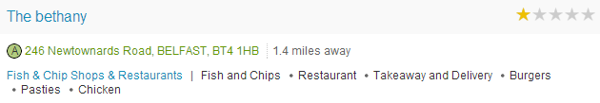
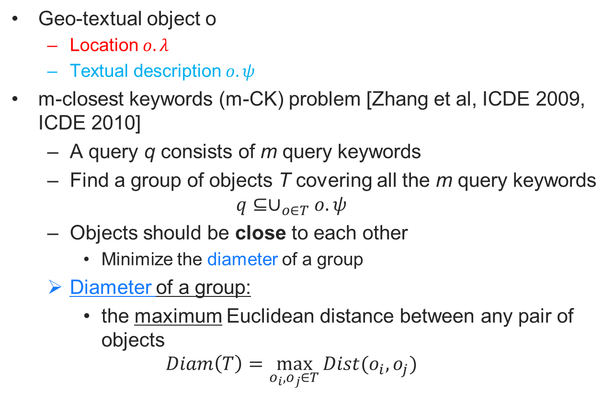
Problem Statement
Geo-textual object o
Location $o.λ$
Textual description $o.ψ$
m-closest keywords (m-CK) problem [Zhang et al, ICDE 2009, ICDE 2010]
A query q consists of m query keywords
Find a group of objects T covering all the m query keywords
$$q⊆∪_{o∈T}o.ψ$$
Objects should be close to each other
Minimize the diameter of a group
Diameter of a group:
the maximum Euclidean distance between any pair of objects
$$Diam\left(T\right)=\max_{o_{i},o_{j}∈T}{Dist(o_{i},o_{j})}$$

Slide 5
Outline
Problem Statement
Applications
Algorithms
Experimental Results
Conclusions

Slide 6
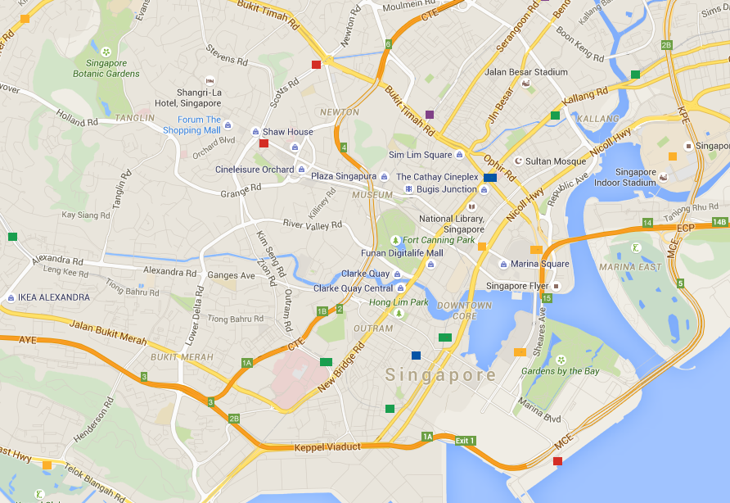
Applications
Explore an area fulfilling user’s personalized needs
Issue an m-CK query {sushi, cinema, spa}

Slide 7

Applications
Detecting geographic locations of web resources
Web resource can be documents, photos, etc.
These resources are usually associated with some tags describing the content.
They may be posted without geographic location.
We can issue an m-CK query using these tags as keywords.
The center of the m-CK result can be used to geo-tag this resource approximately.

Slide 8
Outline
Problem Statement
Applications
Algorithms
Experimental Results
Conclusions

Slide 9
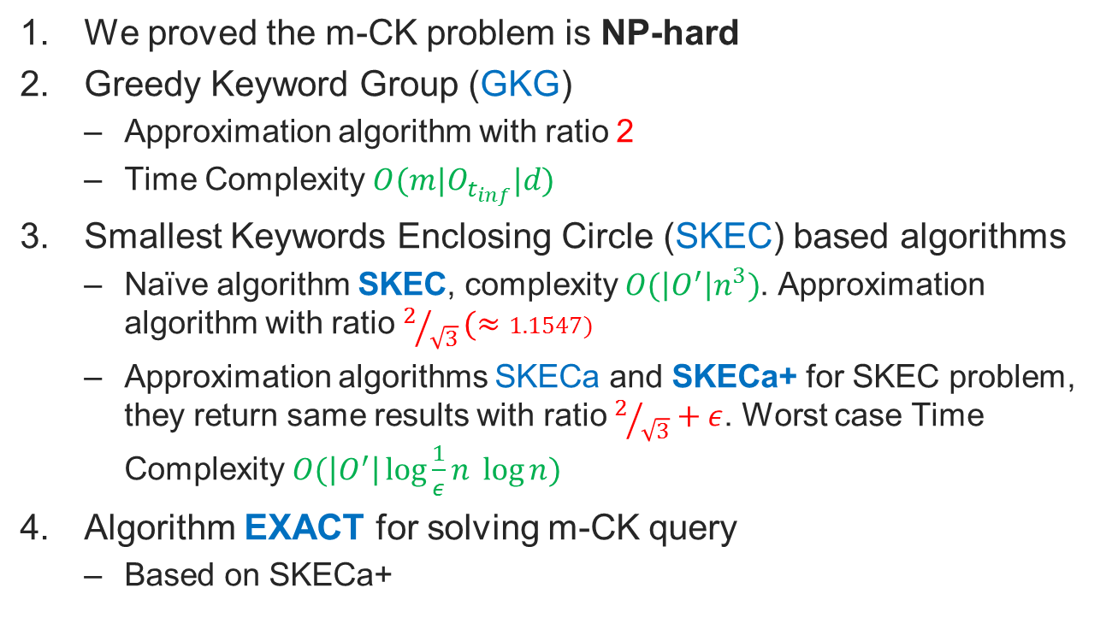
Contributions Overview
We proved the m-CK problem is NP-hard
Greedy Keyword Group (GKG)
Approximation algorithm with ratio 2
Time Complexity $O(m|O_{t_{inf}}|d)$
Smallest Keywords Enclosing Circle (SKEC) based algorithms
Naïve algorithm SKEC, complexity $O(\left|O^{′}\right|n^{3})$. Approximation algorithm with ratio$2/{\sqrt{3}}(≈1.1547)$
Approximation algorithms SKECa and SKECa+ for SKEC problem, they return same results with ratio $2/{\sqrt{3}}+ε$. Worst case Time Complexity $O(\left|O^{′}\right|\log{\frac{1}{ε}n} \log{n})$
Algorithm EXACT for solving m-CK query
Based on SKECa+
Notes:
$m$ is the number of keywords
$|O_{t_{inf}}|$ is the number of objects containing the most infrequent keyword
d is time cost finding the nearest object containing a given keyword
O’ is the number of objects relevant to the query

Slide 10
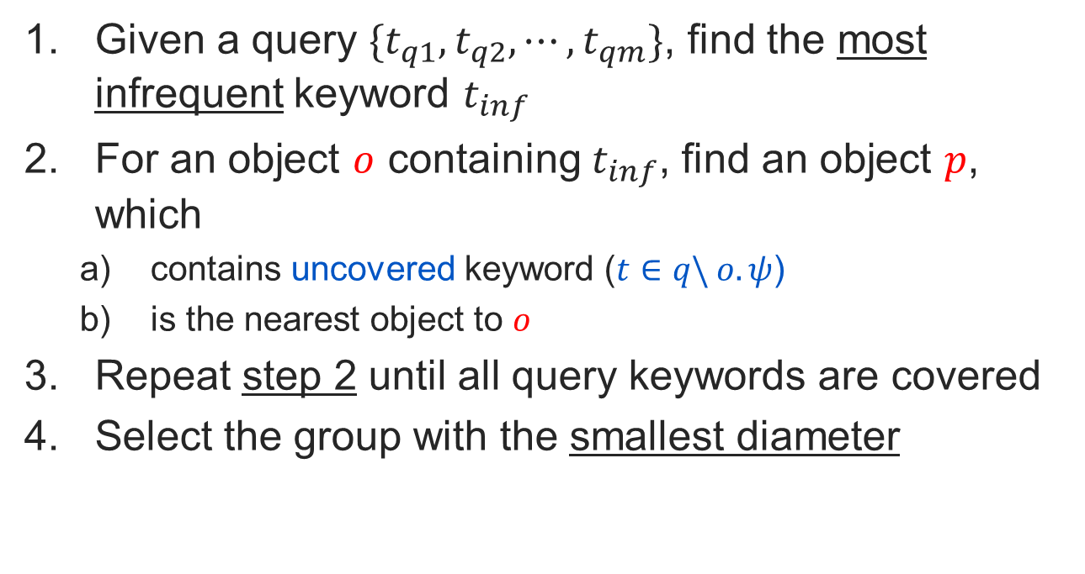
Greedy Keyword Group
Given a query $\{t_{q1},t_{q2}, ⋯,t_{qm}\}$, find the most infrequent keyword $t_{inf}$
For an object $o$ containing $t_{inf}$, find an object $p$, which
contains uncovered keyword ($t∈q\backslash o. ψ$)
is the nearest object to $o$
Repeat step 2 until all query keywords are covered
Select the group with the smallest diameter

Slide 11
Greedy Keyword Group
Example
For a query contains keywords {carpark, shop, hotel}
Suppose carpark is the most infrequent keyword

Slide 12

Smallest Keywords Enclosing Circle
Observation:
The optimal solution can be enclosed by a circle.
Minimum Objects Enclosing Circle (MOEC): the smallest circle enclosing given objects
If we can find this circle first, it will help find the optimal group.
Problem
It remains challenging to find such a circle
How about finding the smallest circle enclosing all query keywords?
Notes:
It is hard to find the optimal group.

Slide 13
Smallest Keywords Enclosing Circle
Smallest Keywords Enclosing Circle (SKEC)
Smallest circle enclosing all query keywords
Example:
Query {carpark, shop, hotel, restaurant}
SKEC
If the group of objects enclosed by SKEC is the optimal result?

Slide 14
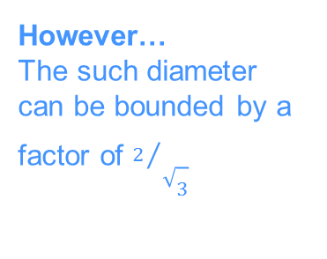
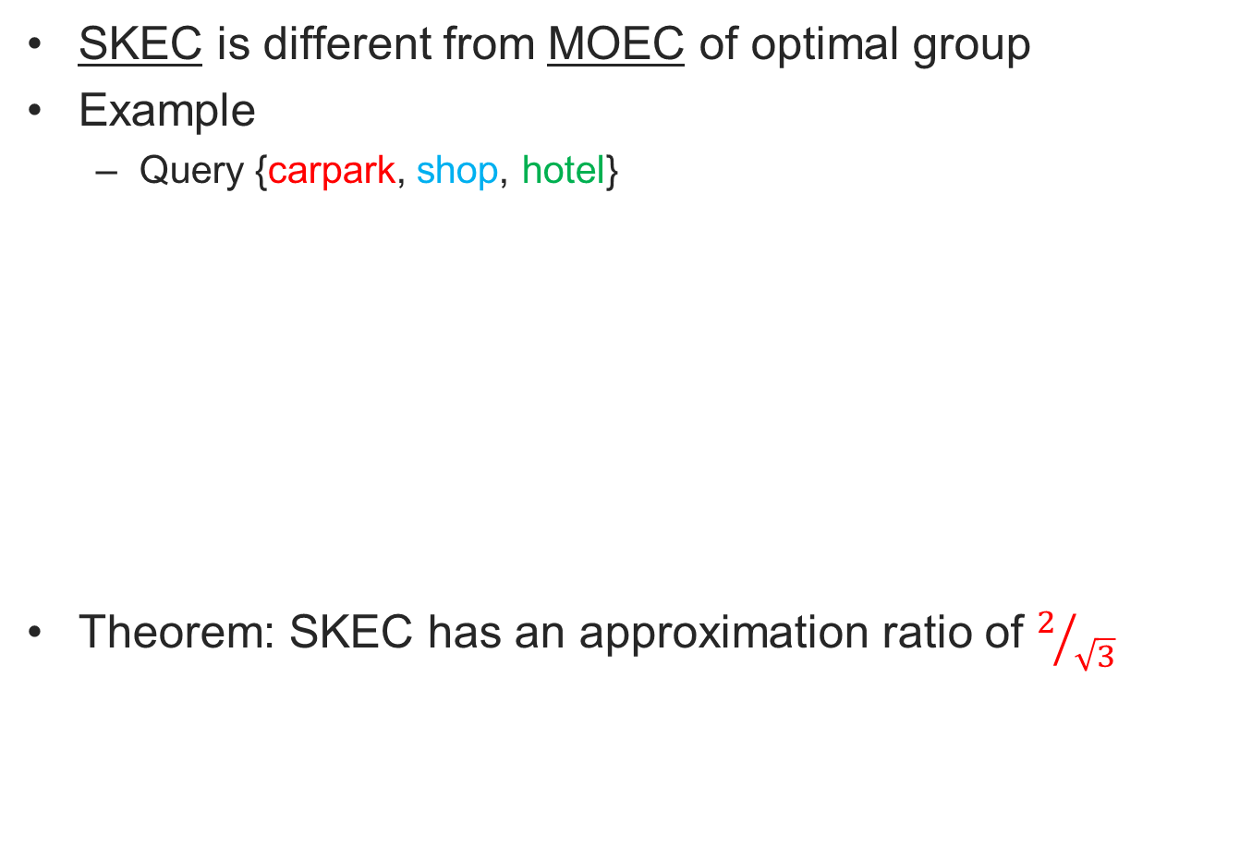
Why SKEC is not the optimal result?
SKEC is different from MOEC of optimal group
Example
Query {carpark, shop, hotel}
Theorem: SKEC has an approximation ratio of $2/{\sqrt{3}}$
SKEC
Optimal group enclosing circle (MOEC)
However…
The such diameter can be bounded by a factor of $2/{\sqrt{3}}$

Slide 15
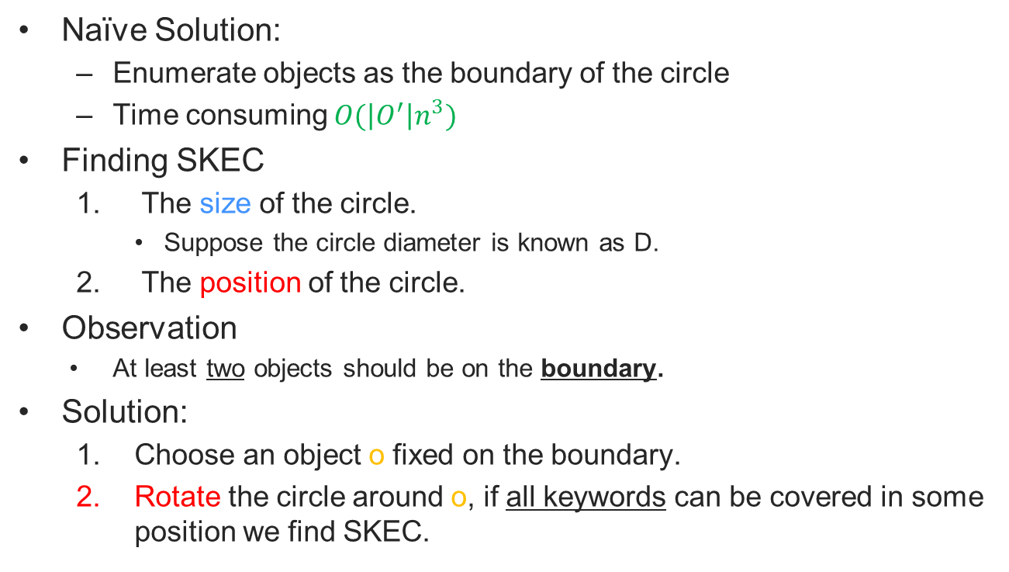
How to find SKEC
Naïve Solution:
Enumerate objects as the boundary of the circle
Time consuming $O(\left|O^{′}\right|n^{3})$
Finding SKEC
The size of the circle.
Suppose the circle diameter is known as D.
The position of the circle.
Observation
At least two objects should be on the boundary.
Solution:
Choose an object o fixed on the boundary.
Rotate the circle around o, if all keywords can be covered in some position we find SKEC.

Slide 16
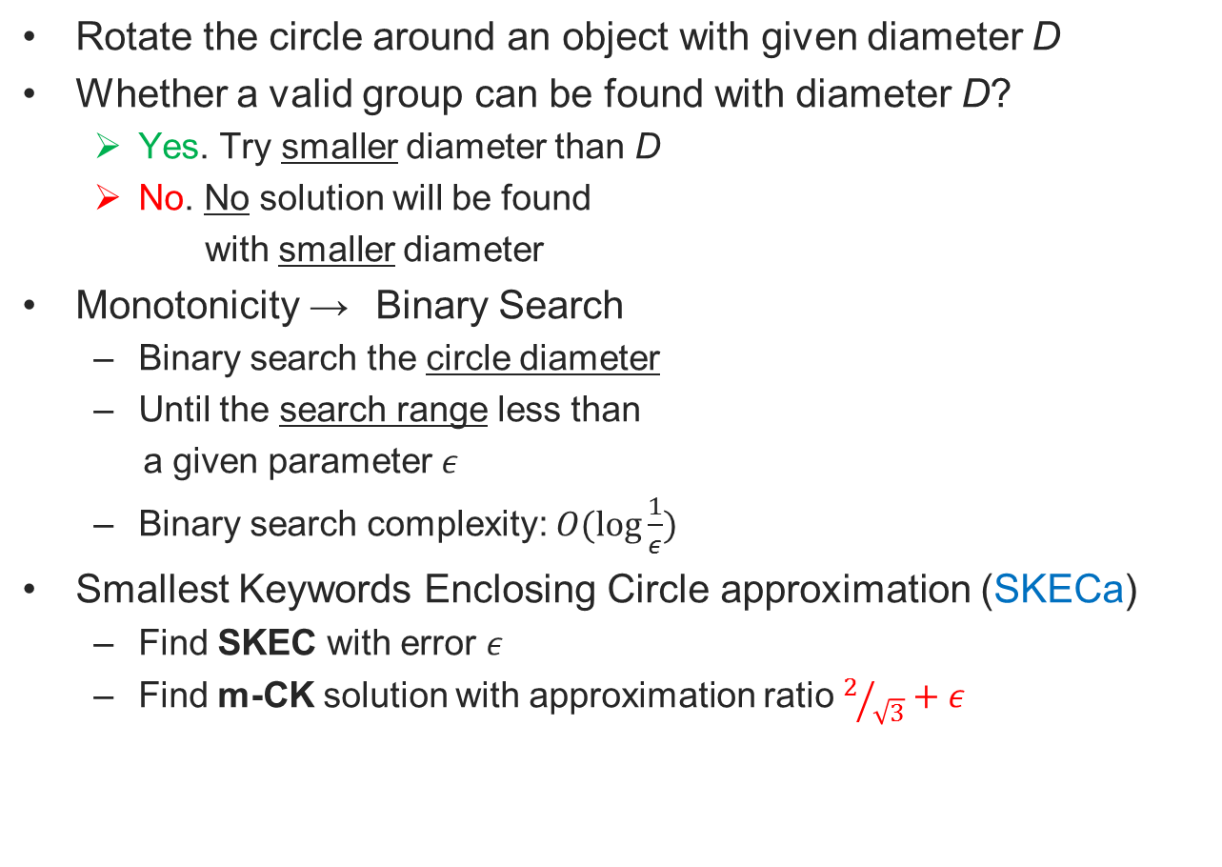
How to find SKEC
Rotate the circle around an object with given diameter D
Whether a valid group can be found with diameter D?
Yes. Try smaller diameter than D
No. No solution will be found
with smaller diameter
Monotonicity → Binary Search
Binary search the circle diameter
Until the search range less than
a given parameter $ε$
Binary search complexity:$O(\log{\frac{1}{ε}})$
Smallest Keywords Enclosing Circle approximation (SKECa)
Find SKEC with error $ε$
Find m-CK solution with approximation ratio $2/{\sqrt{3}}+ε$

Slide 17
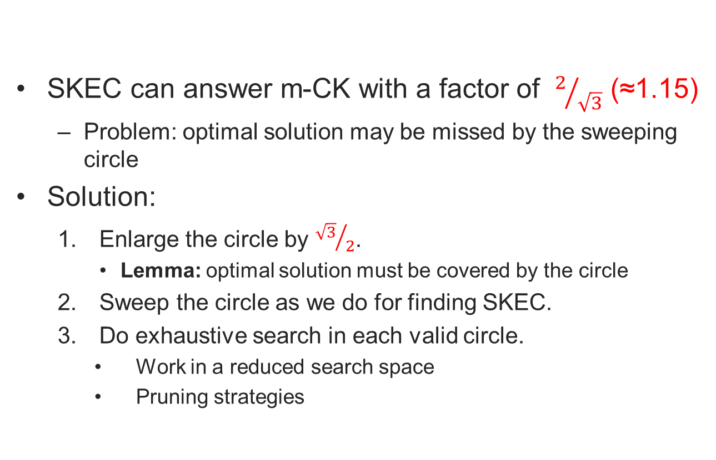
Exact algorithm for m-CK problem
SKEC can answer m-CK with a factor of $2/{\sqrt{3}}$ (≈1.15)
Problem: optimal solution may be missed by the sweeping circle
Solution:
Enlarge the circle by ${\sqrt{3}}/2$.
Lemma: optimal solution must be covered by the circle
Sweep the circle as we do for finding SKEC.
Do exhaustive search in each valid circle.
Work in a reduced search space
Pruning strategies

Slide 18
Outline
Problem Statement
Applications
Algorithms
Experimental Results
Conclusions

Slide 19
Approximation Algorithms
Baseline:
Adapted Spatial Group Keyword approximation (ASGKa) SIGMOD 2013
Query as part of result
Enumerate all objects containing the most infrequent keyword as query
Our Methods:
Greedy Keyword Group (GKG)
Smallest Keywords Enclosing Circle approximation (SKECa+)

Slide 20
Exact Algorithms
Baselines:
Virtual bR*-tree (VirbR), ICDE 2010
Exhaustive search
Adapted Spatial Group Keyword (ASGK), SIGMOD 2013
Query point as part of result
Enumerate all objects containing the most infrequent keyword as query
Our Method:
Exact algorithm for m-CK problem (EXACT)

Slide 21
Experimental Results
Datasets
POI crawled from Google Place API
Geo-tweets with in USA
Experiments
Vary number of query keywords
Vary optimal group diameter bound
Vary optimal group diameter bound
Vary query keywords frequency
Scalability
Dataset | Number of Objects | Unique words | Total words
New York(NY) | 485,059 | 116,546 | 1,143,013
Los Angeles(LA) | 724,952 | 161,489 | 1,833,486
Twitter(TW) | 1,000,100 | 487,552 | 5,170,495

Slide 22
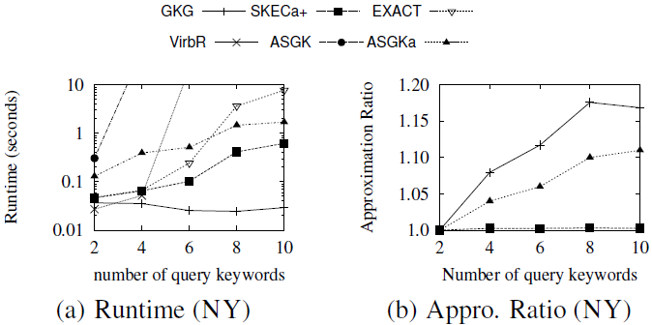
Experimental Results
Vary number of query keywords

Slide 23
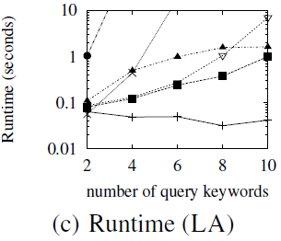
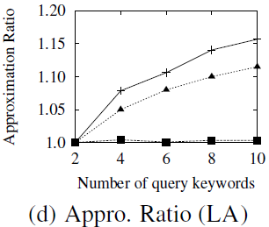
Experimental Results
Vary query keywords number

Slide 24
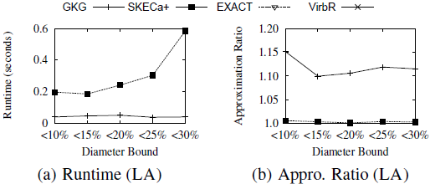
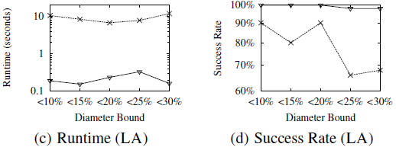
Experimental Results
Vary optimal group diameter bound
Success Rate: success results within 1 minute timeout threshold

Slide 25
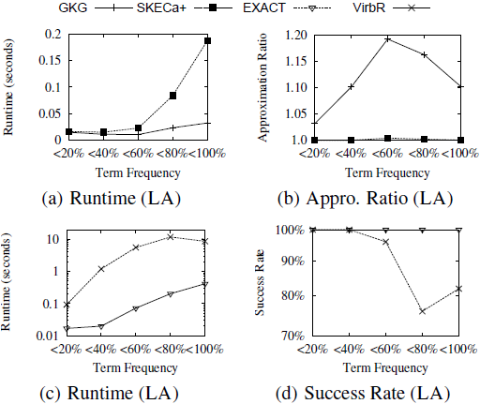
Experimental Results
Vary query keywords frequency

Slide 26
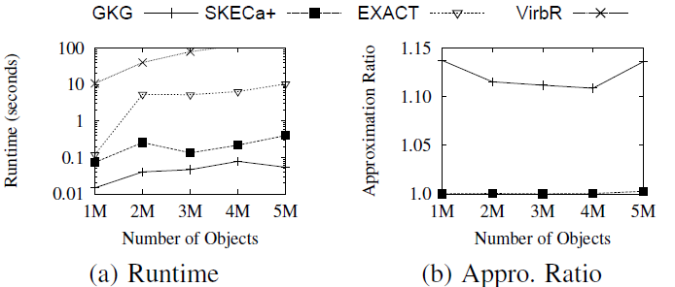
Experimental Results
Scalability
Geo-tagged tweets of different sizes

Slide 27
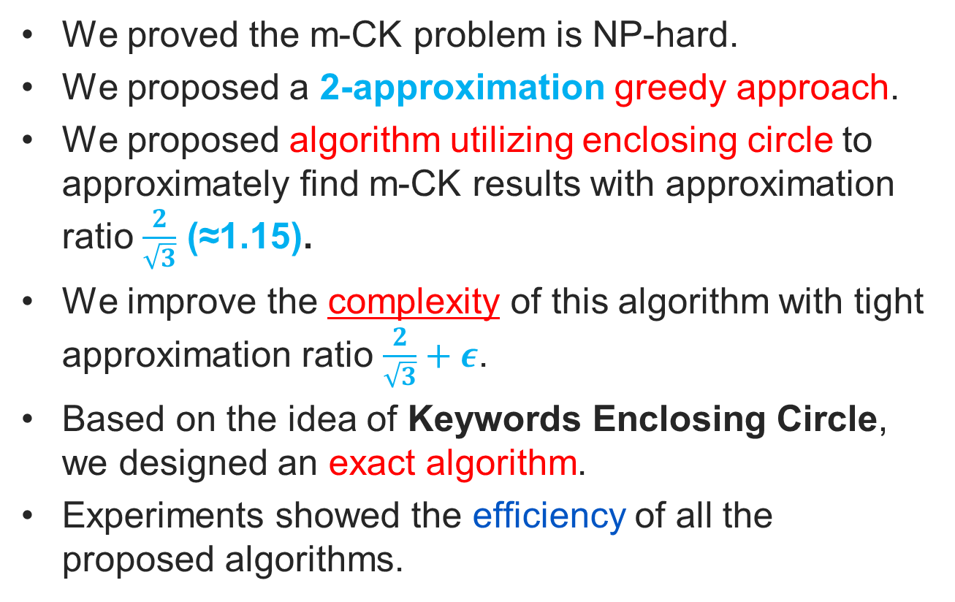
Conclusions
We proved the m-CK problem is NP-hard.
We proposed a 2-approximation greedy approach.
We proposed algorithm utilizing enclosing circle to approximately find m-CK results with approximation ratio $\frac{2}{\sqrt{3}}$ (≈1.15).
We improve the complexity of this algorithm with tight approximation ratio $\frac{2}{\sqrt{3}}+ε$.
Based on the idea of Keywords Enclosing Circle, we designed an exact algorithm.
Experiments showed the efficiency of all the proposed algorithms.

Slide 28
Thank you!
Q&A

