Slide 1




Distributed Algorithms on Exact Personalized PageRank
Tao Guo
Nanyang Technological University
Xin Cao
The University of New South
Wales
Gao Cong
Nanyang Technological University
Jiaheng Lu
University of Helsinki
Xuemin Lin
The University of New South
Wales

Slide 2
Outline
Introduction
Preliminary
Proposed Methods
Experimental Results
Conclusions

Slide 3
Introduction
How to compute the similarity between two nodes in a graph?
Example:
1
2
3
4
5

Slide 4
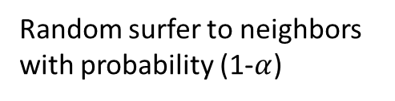
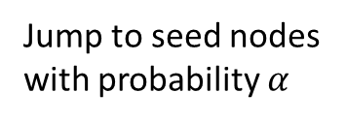
Introduction
Personalized PageRank performs a random surfer model on a graph.
Seed node
Seed node
Random surfer to neighbors
with probability (1-$α$)
Jump to seed nodes
with probability $α$

Slide 5

Introduction
Personalized PageRank Vector (PPV) is used to describe the similarity between each node and other nodes.
The value is the stationary probability that the random surfer stays at each node.
0.21
Node | PPV Score (w.r.t. node 2)
1 | 0.21
2 | 0.27
3 | 0.16
4 | 0.26
5 | 0.10
1
0.27
0.16
2
0.26
3
4
5
0.1
with $α$=0.15

Slide 6
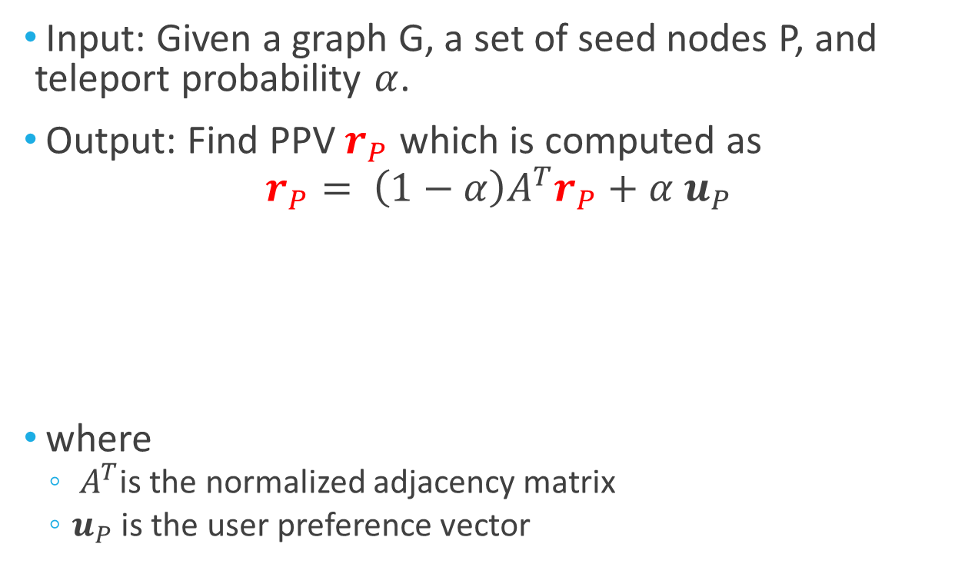
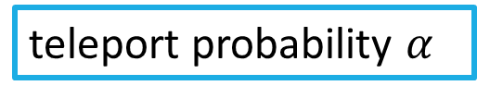
Problem Statement
Input: Given a graph G, a set of seed nodes P, and teleport probability $α$.
Output: Find PPV $r_{P}$ which is computed as
$$r_{P}= \left(1−α\right)A^{T}r_{P}+α u_{P}$$
where
$A^{T}$is the normalized adjacency matrix
$u_{P}$ is the user preference vector
Probability that the random surfer reaches each node
Probability that the random surfer jumps to seed nodes
teleport probability $α$

Slide 7
Different with PageRank
PageRank model
No query is given.
Personalized PageRank model
User can specify some nodes as query nodes.
PPV need to be computed online!

Slide 8
Challenges
Exactness. Most existing methods focus on approximate PPV computation, exact PPV is hard to compute.
Parallel. It is hard to design scalable distributed algorithm to compute PPV, since most graph algorithms work in iterations.
Cost. It requires high time, space and network cost for distributed graph computation.

Slide 9
Outline
Introduction
Preliminary
Proposed Methods
Experimental Results
Conclusions

Slide 10



From PPV to random tours
PPV scores can be computed by random tours [G. Jeh et al, WWW 2003]
Example:
there are 3 random tours from u₁ to u_{3:}
$t_{1}: u_{1}→u_{2}→u_{3}$
$t_{2}: u_{1}→u_{4}→u_{5}→u_{3}$
$t_{3}: u_{1}→u_{4}→u_{5}→u_{2}→u_{3}$

Slide 11


From PPV to random tours(2)
The PPV score can be computed by adding up the weight of all possible random tours.
PPV score from $u_{1}$ to $u_{3}$is
$$r_{u_{1}}{(u}_{3})=P\left(t_{1}\right)+P\left(t_{2}\right)+P(t_{3})$$
The weight of a tour t
$$P(t)=α{\left(1−α\right)}^{L\left(t\right)}\prod_{i=1}^{L\left(t\right)}{\frac{1}{|Out(w_{i})|}}$$
Problem
There maybe infinite number of random tours, so computing all possible tours is impractical.
8

Slide 12
Random Tour Decomposition
If we select some nodes to be hub nodes
The random tours can be decomposed by these hub nodes.
Result in two types of tours
Partial vector: tours passing through no hub nodes
Skeleton vector: tours stop at a hub node
By using partial vector and skeleton vectors, we can compute all exact PPV scores.

Slide 13

Example of Partial Vector
Partial vector: tours passing through no hub nodes
Partial vector of node u₁ (u₂ u₃ are hub nodes)
$$pt_{u_{1}}=P\left(t1\right)+P\left(t_{2}\right)=P\left(u_{1}→u_{4}\right)+$$
$$P(u_{1}→u_{4}→u_{5})$$

Slide 14

Example of Skeleton Vector
Skeleton vector: tours stop at a hub node
Skeleton vector of node u₁ (u₂ u₃ are hub nodes)
$${sk}_{u_{1}}=P\left(t3\right)+P\left(t_{4}\right)+P\left(t_{5}\right)+P\left(t_{6}\right)=P\left(u_{1}→u_{2}\right)+P\left(u_{1}→u_{2}→u_{3}\right)+P\left(u_{1}→u_{2}→u_{5}→u_{3}\right)+P\left(u_{1}→u_{4}→u_{5}→u_{3}\right)$$
11

Slide 15

PPV Construction
All possible tours can be constructed by partial vectors and skeleton vectors.
Example:
Consider a tour $u_{1}→u_{2}→u_{3}→u_{6}$
In skeleton vector of u₁
In partial vector of u₃
12

Slide 16
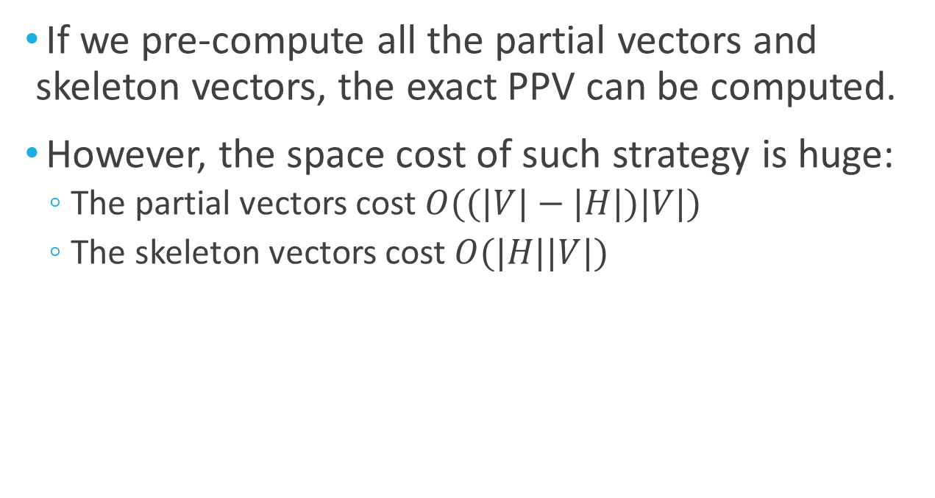
Brute-force doesn’t work
If we pre-compute all the partial vectors and skeleton vectors, the exact PPV can be computed.
However, the space cost of such strategy is huge:
The partial vectors cost $O((|V|−|H|)|V|)$
The skeleton vectors cost $O(|H||V|)$
The total space is equal to pre-compute the PPVs of all nodes!
13

Slide 17
Outline
Introduction
Preliminary
Proposed Methods
Experimental Results
Conclusions

Slide 18
Algorithm GPA
We propose graph partition based algorithm (GPA) based on the observations:
Observation 1: if we choose the hub nodes that can separate the graph, the size of partial vector can be bounded in a sub-graph.
15

Slide 19
Algorithm GPA(2)
Observation 1: if we choose the hub nodes that can separate the graph, the size of partial vector can be bounded in a sub-graph.
Example:
Can not be bounded ×
Can be bounded √
16

Slide 20
Algorithm GPA(3)
We propose graph partition based algorithm (GPA) based on the observations:
Observation 2: if we partition the graph to disjoint components, we can compute PPV in parallel by distributing each subgraph on each machine.
17

Slide 21
Algorithm GPA(4)
Offline Phrase:
The graph is partitioned into disjoint parts.
Each sub-graph is sent to one machine, and partial vectors/skeleton vectors are computed on each machine.
18

Slide 22
Algorithm GPA(5)
Online Phrase:
Each machine receives the query and computes a vector of size at most |V|.
The results on each machine is sent to a coordinator.
The coordinator sums up all the received vectors to obtain PPV.
19

Slide 23
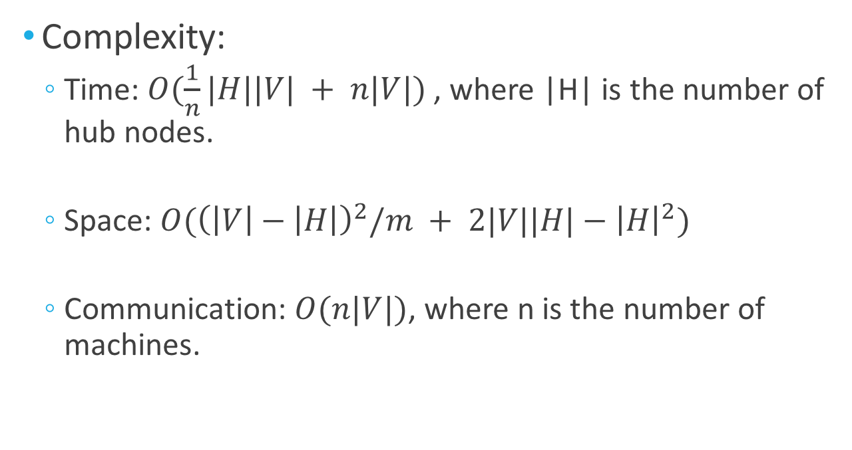
Algorithm GPA(6)
Complexity:
Time: $O(\frac{1}{n}|H||V| + n|V|)$ , where |H| is the number of hub nodes.
Space: $O({\left(\left|V\right|−\left|H\right|\right)}^{2}/m + 2|V||H|−{\left|H\right|}^{2})$
Communication: $O(n|V|)$, where n is the number of machines.
20

Slide 24
Algorithm HGPA
The space cost of GPA can be further improved based on the observation:
Observation 3: the partial vector computation in a subgraph is to compute a “local” PPV. We can further partition the subgraph by choosing next level hub nodes.
21

Slide 25
Algorithm HGPA(2)
Partitioning after partitioning
22

Slide 26
Algorithm HGPA(3)
We get a hierarchy of graphs
23

Slide 27
Algorithm HGPA(4)
How to distribute the computation?
the sizes of subgraphs in different levels of the hierarchy are different
We propose hierarchical graph partition based algorithm (HGPA) that evenly distributes the hub nodes to each machine.
24

Slide 28
HGPA Architecture
25

Slide 29
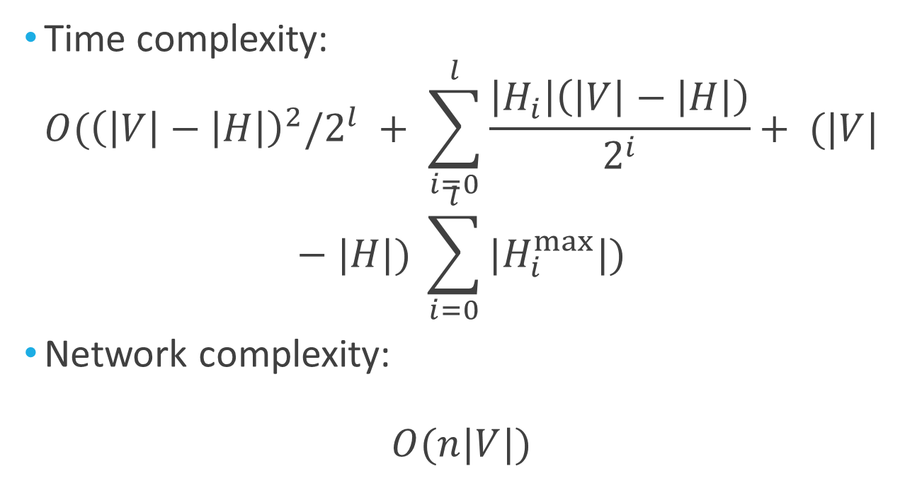
Algorithm HGPA(5)
Time complexity:
$$O({\left(\left|V\right|−\left|H\right|\right)}^{2}/2^{l} + \sum_{i=0}^{l}{\frac{\left|H_{i}\right|\left(\left|V\right|−\left|H\right|\right)}{2^{i}}}+ (|V|−|H|) \sum_{i=0}^{l}{{|H}_{i}^{max}|})$$
Network complexity:
$$O(n|V|)$$
28

Slide 30
Outline
Introduction
Preliminary
Proposed Methods
Experimental Results
Conclusions

Slide 31
Experiments
Datasets:
Baselines:
Approximate : FastPPV [Fanwei Zhu, PVLDB 2013]
Exact: Power Iteration
Graph Processing Systems: Pregel+ [Da Yan, VLDB 2014], Blogel [Da Yan, VLDB 2014]
Dataset | Node | Edge
Email | 265,214 | 420,045
Web | 875,713 | 5,105,039
Youtube | 1,134,890 | 2,987,624
PLD | 3,000,000 | 18,185,350
Meetup | 1,796,226 | 194,083,414

Slide 32
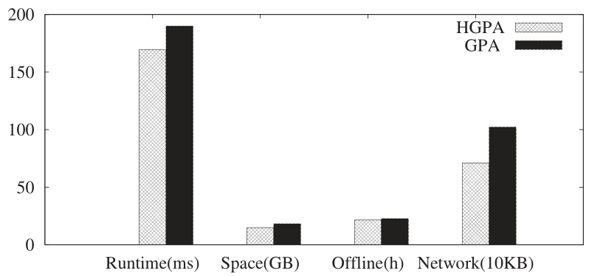
GPA vs HGPA
Algorithms Comparison on Web

Slide 33
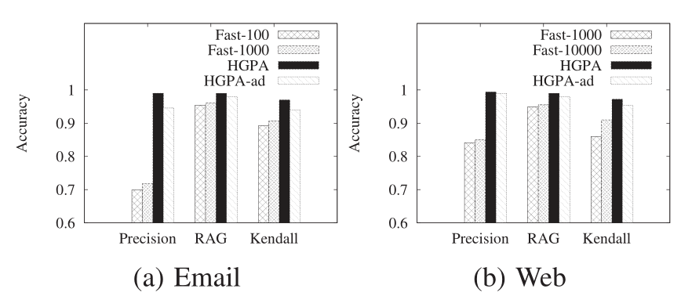
Exact vs Approximate
Metrics:
Precision, Kendall’s τ and RAG

Slide 34
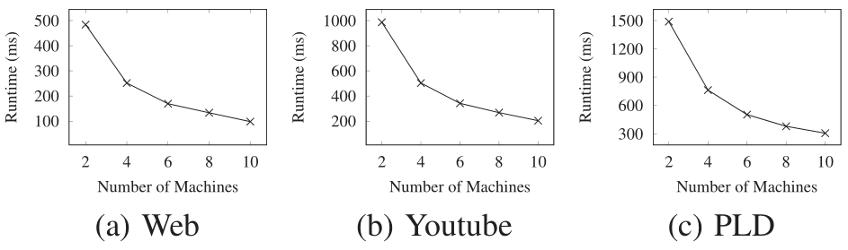
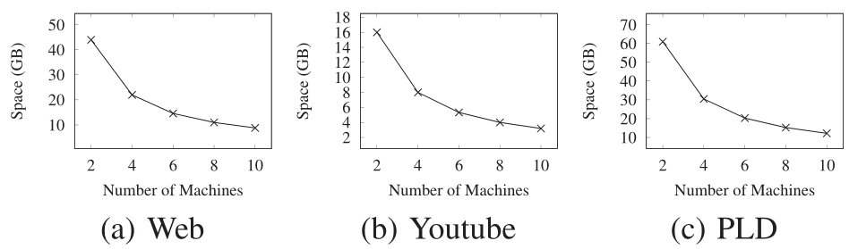
Effects of Number of Machines
33

Slide 35
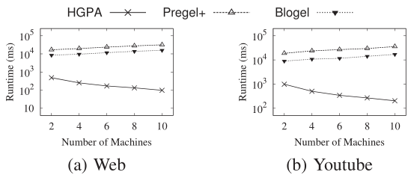
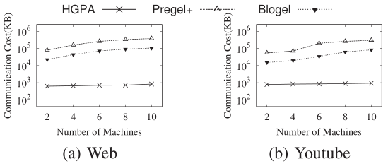
Comparison with General Distributed Graph Processing Systems
30

Slide 36
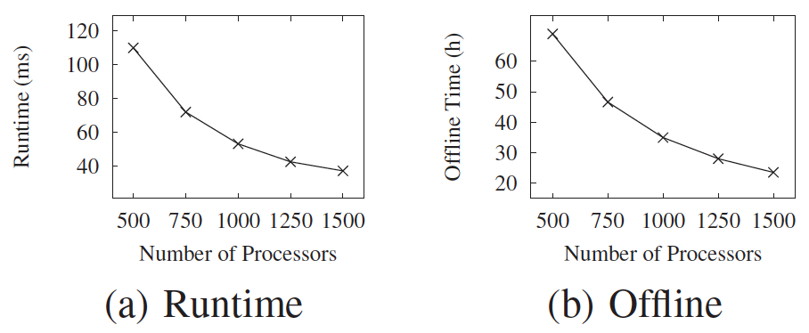
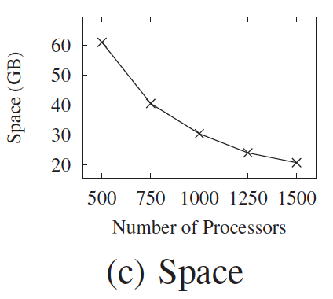
Working on Big Graph
Dataset: 101M nodes, 1.94B edges
Environment: AWS EC2 24 instances, each with 64 processors
31

Slide 37
Conclusions
We propose novel and efficient distributed algorithms to compute exact PPVs on a general coordinator-based share-nothing distributed computing platform.
We develop the algorithm GPA that works based on subgraph.
We further improve the performance by proposing HGPA based on a hierarchy of subgraphs.
The experimental study shows that HGPA has excellent performance in terms of efficiency, space cost, communication cost, and scalability.
32

Slide 38
Thank you!
Q&A

