Slide 1


New To Mining Guide
community
Requirements
GPU
Mining Software
Ergo Wallet
1
2
3
1
2
3
GPU Requirements
Nvidia
1000 series or newer
AMD
400 series or newer
4GB VRAM or higher
Mining Software
Nvidia
T-Rex miner recommended (github.com/trexminer/T-Rex/releases)
or NBminer, lolminer, nanominer
AMD
Team Red Miner recommended (github.com/todxx/teamredminer/releases)
or NBminer, SRBminer, lolminer, nanominer
Ergo Wallet
Browser Based
Nautilus Wallet (Chrome Store)
SafeW
Mobile
Aneta Wallet (Google Play Store)
Ergo Mobile App (Android & TestFlight iOS)
Exclude or add exceptions for your software miner folder with any anti-virus and/or firewall
v 0.3 anetaBTC.io

Slide 2
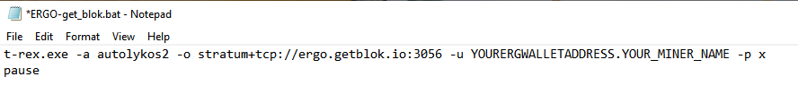
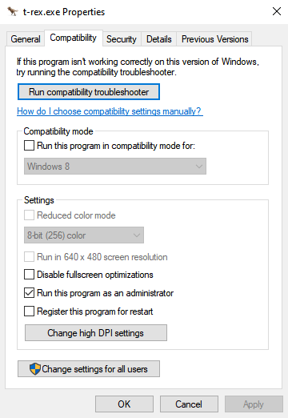
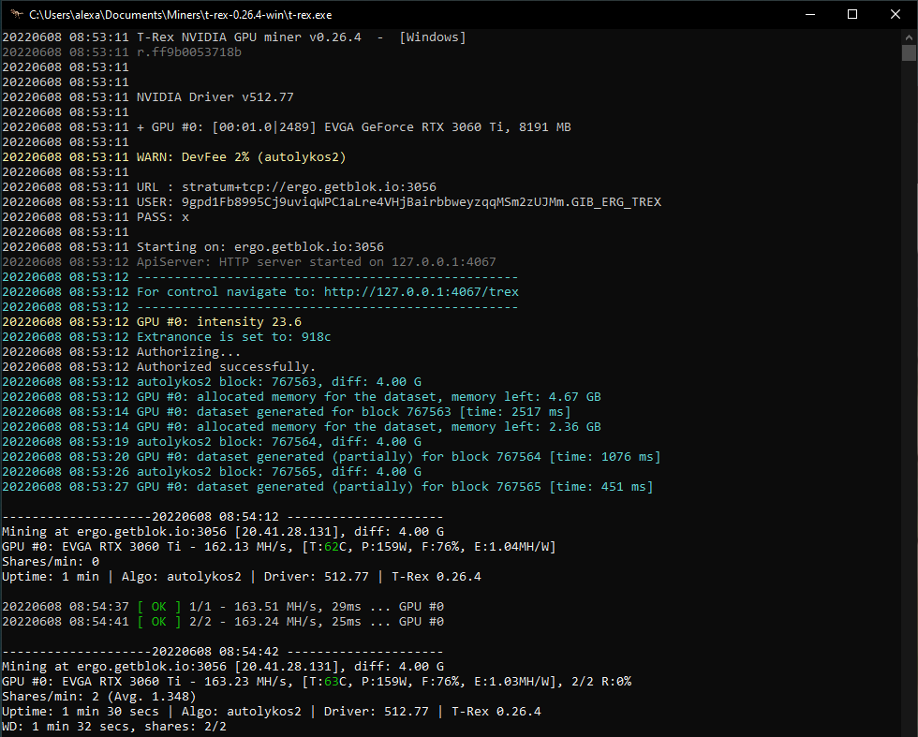
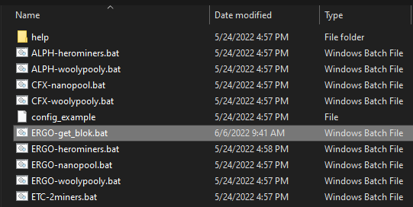
Mining Software Setup (for T-Rex Miner)
Rename ‘ERGO-2miners’ to ‘ERGO-get_blok’
Set ‘t-rex.exe’ to run as admin
Right click ‘t-rex.exe’ -> properties -> compatibility tab -> check ‘Run this program as an admin’
Set up miner config
Right click ‘ERGO-get_blok.bat’ -> edit (w/ notepad)
Add GetBlok.io Server + your ERG wallet address
Save + close
Double click ‘ERGO-get_blok.bat’ to run!
community
1
2
3
For more: getblok.io/how-to-connect/
3
4
2
Success!
4
1

Slide 3
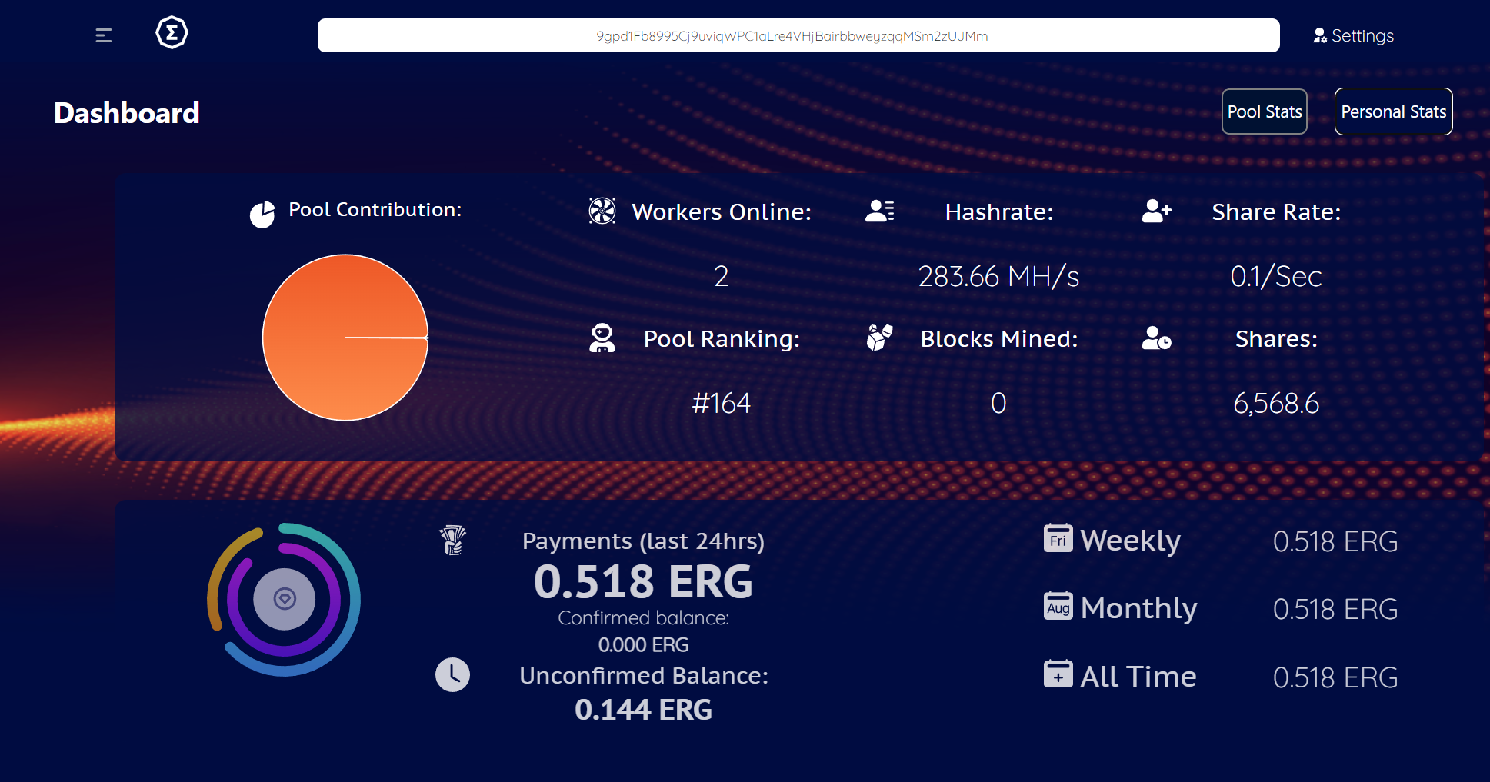
Mining Continued
community
To Monitor:
Go to ‘ergo.getblok.io’ -> input your mining wallet ergo address
YOUR MINER WALLET ADDRESS HERE
Allow up to 60 minutes mining for your wallet address to be recognized
Allow 12-24 hours mining for your average pool hashrate to align with your local miner software
anetaBTC mining will appear in ‘SmartPools’ tab on Saturday, June 11
getblok.io/smartpool-faq/

Slide 4

Resources
community
Full Step-by-Step Guide (not specific to GetBlok.io)
youtu.be/5SRlga9Q7rY
Excellent Community Documentation on Ergo Mining
ergonaut.space/en/Guides/Mining
Subreddit Dedicated to Ergo Mining
reddit.com/r/erg_miners/
Official Ergo Platform Mining Documentation
docs.ergoplatform.com/mining/
GetBlok.io Resources
ergo.getblok.io/
getblok.io/how-to-connect/
getblok.io/smartpool-faq/
Mining Earnings Calculator
whattomine.com/
For more technical discussion on GPU and hashrate optimization please see:
reddit.com/r/erg_miners anetaBTC discord #mining GetBlok.io discord

