Slide 1
Equipment identification through image recognition
Darkhan’s Master thesis
Biweekly report
Transfer learning in domain adaptation

Slide 2
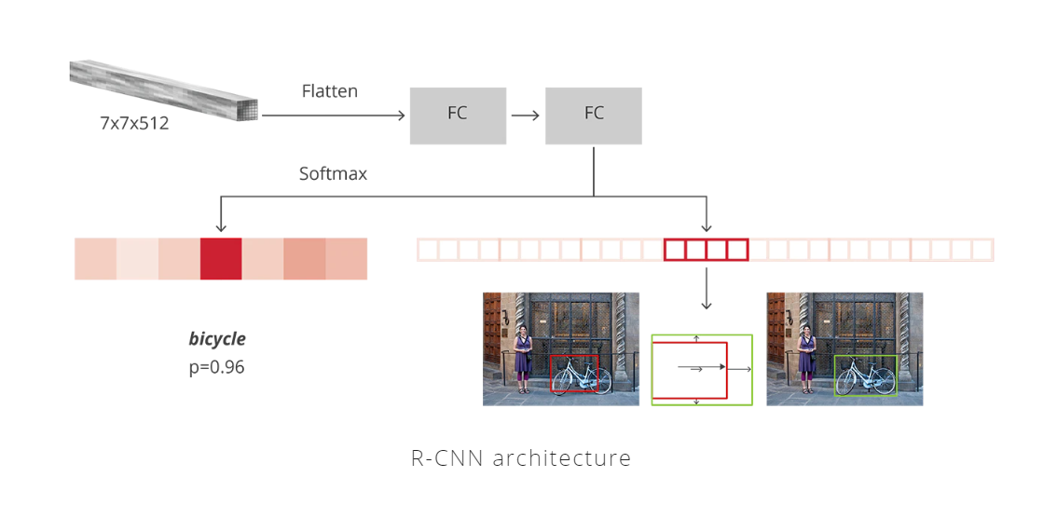
Transfer learning
Traditional fine-tuning steps
Filter the dataset to load only a subset of classes
Load labels for the first N number of classes and train the model (both source and target images)
Remove/modify the output layer of Faster RCNN model (two linear layers for classification and box regression)
Load labels for the next M number of classes, and adjust the model to return N+M outputs
Freeze the backbone network (Resnet) and everything in Faster-RCNN except the final layers
Source: Faster R-CNN: Down the rabbit hole of modern object detection

Slide 3
Fine tuning
Experiments
Model trained on classes #1-20
'MODEL.ROI_HEADS.NUM_CLASSES', '20'
'SOLVER.BASE_LR', '0.001’
'SOLVER.MAX_ITER', '35000’
AP,AP50,AP75
58.1596,75.2764,66.8970
Total training time: 8h, num_gpus=2
Full data (all images)
Model trained on classes #20-30
'MODEL.ROI_HEADS.NUM_CLASSES', '30’
'SOLVER.BASE_LR', '0.0005’
'SOLVER.MAX_ITER', '35000’
AP,AP50,AP75
19.9303,29.7858,22.3647
Training time: 9 hours, num_gpus=2
Model “.pth” file + only images for new classes (both source and target)

Slide 4
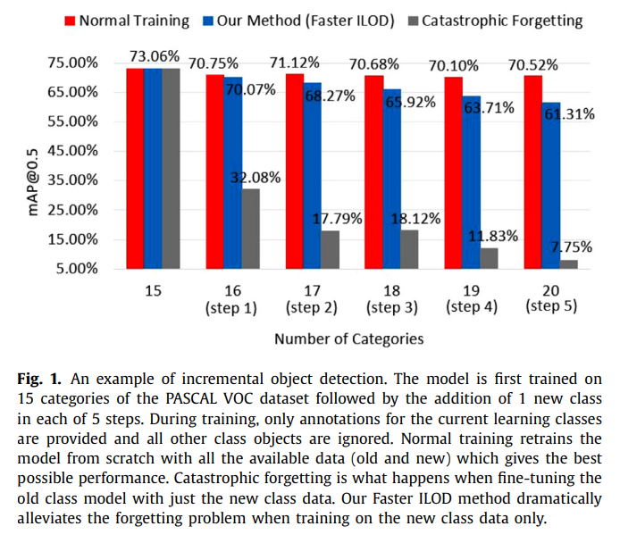
Fine tuning
Issues: Catastrophic forgetting phenomenon
Source: Faster ILOD: Incremental learning for object detectors based on faster RCNN

Slide 5
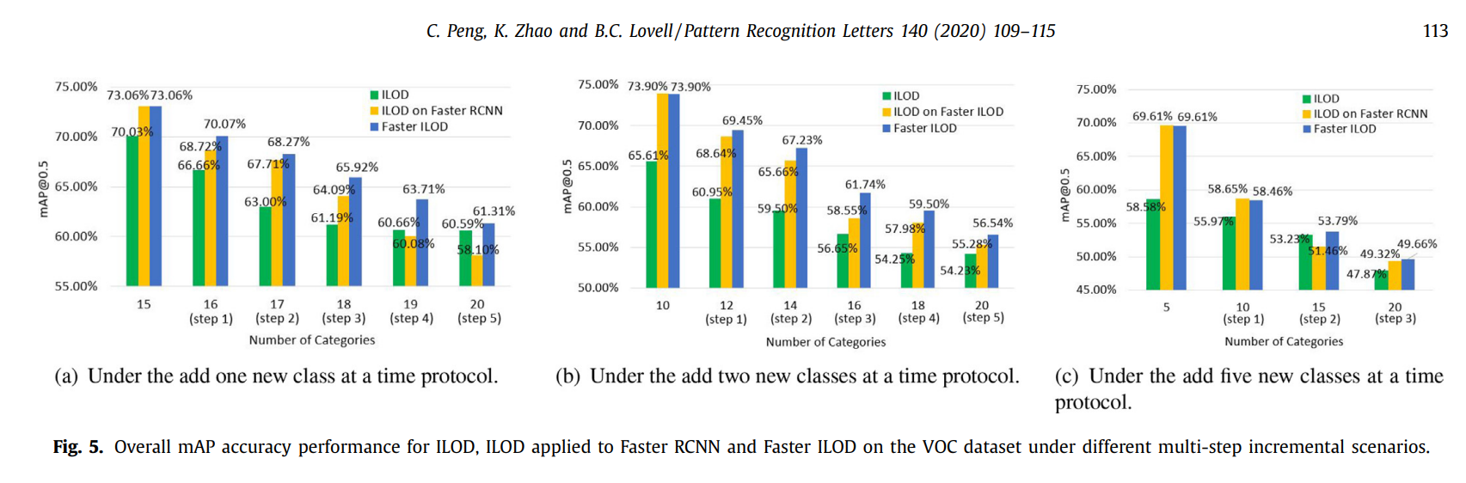
Fine tuning
Issues: Too many unfamiliar classes
Source: Faster ILOD: Incremental learning for object detectors based on faster RCNN

Slide 6
Proposed incremental fine tuning
Steps
Instead of replacing the original output of Faster-RCNN, keep the original classifier and create a new layer with dimensions (n_hidden, M) that will classify ONLY the new class.
Concatenate the prediction of this layer with the previous classifier
Freeze all but the new layer (CNN backbone + old classifier)
Train with a smaller number of class increments
Remove optimizer states as it resumes training with small LR from the original model

Slide 7
Incremental fine tuning
Experiments
Model trained on class #1
'MODEL.ROI_HEADS.NUM_CLASSES', ‘1'
'SOLVER.BASE_LR', '0.001’
'SOLVER.MAX_ITER', ‘40000’
AP,AP50,AP75
40.0319,63.5951,43.4694
Total training time: 10h, num_gpus=1
Full data (all images)
Model trained on class #2 'MODEL.ROI_HEADS.NUM_CLASSES', ‘1’ + extra class
'SOLVER.BASE_LR', '0.0005’
'SOLVER.MAX_ITER', ‘20000’ (converged at 11k)
AP,AP50,AP75 (for the class #2)
9.3121,17.8519,9.6233
Training time: 3 hours 30 mins, num_gpus=1
Model “.pth” file + only images for new classes (both source and target)

Slide 8
Incremental fine tuning
Potential reason for poor results
When we freeze the classifier in the final layer of Faster-RCNN, it also freezes the weights, responsible for the background classification
When the new class is added, the original weights predict that the new class is a background, so it might require longer training for the outputs of the new layer to surpass the background probabilities.

Slide 9
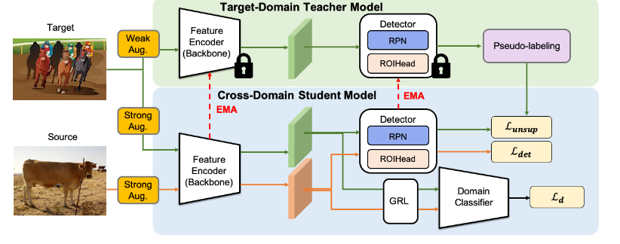
Cross domain object detection
Own model
Domain classifier
GRL
L_instance
Consistency loss
Sources: Cross-Domain Adaptive Teacher for Object Detection
Exploring Categorical Regularization for Domain Adaptive Object Detection

Slide 10
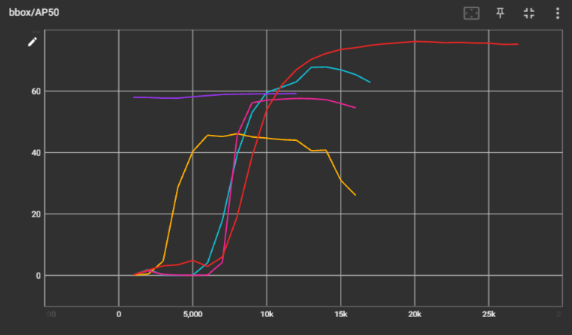
Cross domain object detection
Results
training with the original model(0-20)
training with my model (0-20)
training with my model (0-21)
training with my model for only 21
fine tuning on 0-21

Slide 11
Incremental fine tuning
To preserve knowledge of older classes
Original classifier
Weights are not frozen
LR is 1000 times lower
Predicts N original classes
Frozen weights
Detector head
Frozen weights
Extra classifier
Weights are not frozen
Normal LR
Predicts M new classes

Slide 12
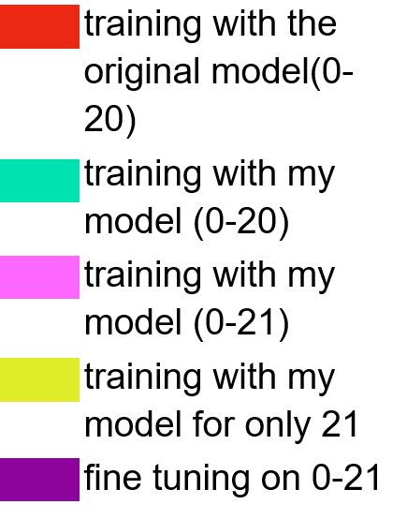
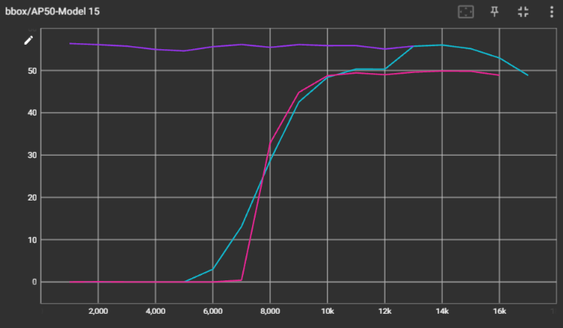
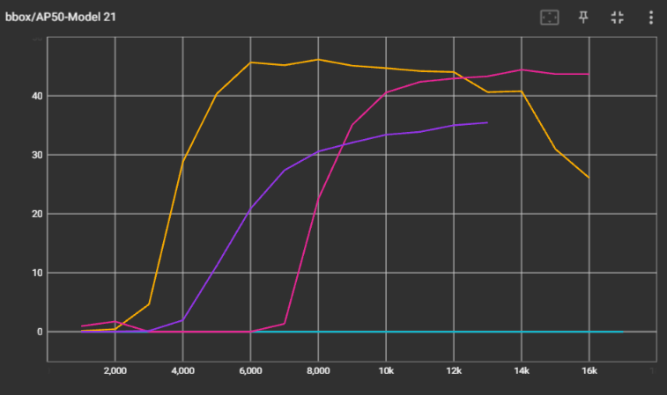
Incremental fine tuning
Results
Knowledge for the older classes is mostly preserved
Fine tuning seems more promising than training on one class alone

