Slide 1
FUNCTIONS
Zhursin Darkhan Email: daratechn@gmail.com

Slide 2
What are functions?
When first learning how to calculate the area of a rectangle, there’s a sequence of steps to calculate the correct answer:
1. Measure the width of the rectangle.
2. Measure the height of the rectangle.
3. Multiply the width and height of the rectangle.
With practice, you can calculate the area of the rectangle without being instructed with these three steps every time. We can calculate the area of one rectangle with the following code:
const width = 10;
const height = 6;
const area = width * height;
console.log(area); // Output: 60

Slide 3
Imagine being asked to calculate the area of three different rectangles:
// Area of the first rectangle
const width1 = 10;
const height1 = 6;
const area1 = width1 * height1;
// Area of the second rectangle
const width2 = 4;
const height2 = 9;
const area2 = width2 * height2;
// Area of the third rectangle
const width3 = 10;
const height3 = 10;
const area3 = width3 * height3;
In programming, we often use code to perform a specific task multiple times. Instead of rewriting the same code, we can group a block of code together and associate it with one task, then we can reuse that block of code whenever we need to perform the task again. We achieve this by creating a function. A function is a reusable block of code that groups together a sequence of statements to perform a specific task.
In this lesson, you will learn how to create and use functions, and how they can be used to create clearer and more concise code.

Slide 5
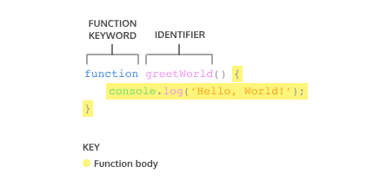
Function Declarations
In JavaScript, there are many ways to create a function. One way to create a function is by using a function declaration. Just like how a variable declaration binds a value to a variable name, a function declaration binds a function to a name, or an identifier. Take a look at the anatomy of a function declaration below:
A function declaration consists of:
The function keyword.
The name of the function, or its identifier, followed by parentheses.
A function body, or the block of statements required to
perform a specific task, enclosed in the function’s curly brackets, { }.

Slide 6

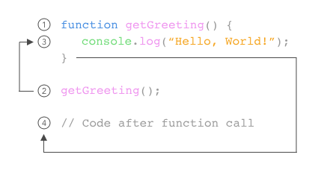
Calling a Function
As we saw in previous exercises, a function declaration binds a function to an identifier.
However, a function declaration does not ask the code inside the function body to run, it just declares the existence of the function. The code inside a function body runs, or executes, only when the function is called.
To call a function in your code, you type the function name followed by parentheses.
This function call executes the function body, or all of the statements between the curly braces in the function declaration.
We can call the same function as many times as needed.

Slide 7
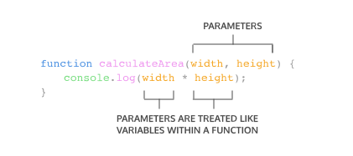
Parameters and Arguments
So far, the functions we’ve created execute a task without an input. However, some functions can take inputs and use the inputs to perform a task. When declaring a function, we can specify its parameters. Parameters allow functions to accept input(s) and perform a task using the input(s). We use parameters as placeholders for information that will be passed to the function when it is called. Let’s observe how to specify parameters in our function declaration:
In the diagram next, calculateArea(), computes the area of a rectangle, based on two inputs, width and height. The parameters are specified between the parenthesis as width and height, and inside the function body, they act just like regular variables. width and height act as placeholders for values that will be multiplied together.

Slide 8
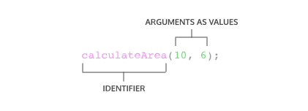
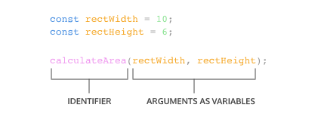
When calling a function that has parameters, we specify the values in the parentheses that follow the function name. The values that are passed to the function when it is called are called arguments. Arguments can be passed to the function as values or variables.
In the function call next, the number 10 is passed as the width and 6 is passed as height. Notice that the order in which arguments are passed and assigned follows the order that the parameters are declared.
The variables rectWidth and rectHeight are initialized with the values for the height and width of a rectangle before being used in the function call.
By using parameters, calculateArea() can be reused to compute the area of any rectangle!

Slide 9
Default Parameters
One of the features added in ES6 is the ability to use default parameters. Default parameters allow parameters to have a predetermined value in case there is no argument passed into the function or if the argument is undefined when called. Take a look at the code snippet below that uses a default parameter:
function greeting (name = 'stranger') {
console.log(`Hello, ${name}!`)
}
greeting('Nick') // Output: Hello, Nick!
greeting() // Output: Hello, stranger!
In the example above, we used the = operator to assign the parameter name a default value of 'stranger'. This is useful to have in case we ever want to include a non-personalized default greeting!
When the code calls greeting('Nick') the value of the argument is passed in and, 'Nick', will override the default parameter of 'stranger' to log 'Hello, Nick!' to the console.
When there isn’t an argument passed into greeting(), the default value of 'stranger' is used, and 'Hello, stranger!' is logged to the console.

Slide 10
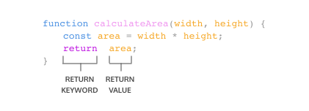
Return
When a function is called, the computer will run through the function’s code and evaluate the result of calling the function. By default that resulting value is undefined.
function rectangleArea(width, height) {
let area = width * height;
}
console.log(rectangleArea(5, 7)) // Prints undefined
In the code example, we defined our function to calculate the area of a width and height parameter. Then rectangleArea() is invoked with the arguments 5 and 7. But when we went to print the results we got undefined. Did we write our function wrong? No! In fact, the function worked fine, and the computer did calculate the area as 35, but we didn’t capture it. So how can we do that? With the keyword return!
To pass back information from the function call, we use a return statement. To create a return statement, we use the return keyword followed by the value that we wish to return. Like we saw above, if the value is omitted, undefined is returned instead.

Slide 11
When a return statement is used in a function body, the execution of the function is stopped and the code that follows it will not be executed. Look at the example below:
function rectangleArea(width, height) {
if (width < 0 || height < 0) {
return 'You need positive integers to calculate area!';
}
return width * height;
If an argument for width or height is less than 0, then rectangleArea() will return 'You need positive integers to calculate area!'. The second return statement width * height will not run.
The return keyword is powerful because it allows functions to produce an output. We can then save the output to a variable for later use.
}

Slide 12
Helper Functions
We can also use the return value of a function inside another function. These functions being called within another function are often referred to as helper functions. Since each function is carrying out a specific task, it makes our code easier to read and debug if necessary.
If we wanted to define a function that converts the temperature from Celsius to Fahrenheit, we could write two functions like:
We can use functions to section off small bits of logic or tasks, then use them when we need to. Writing helper functions can help take large and difficult tasks and break them into smaller and more manageable tasks.
function multiplyByNineFifths(number) {
return number * (9/5);
};
function getFahrenheit(celsius) {
return multiplyByNineFifths(celsius) + 32;
};
getFahrenheit(15); // Returns 59

Slide 13
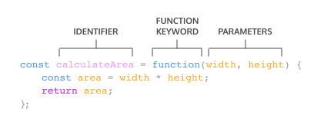
Function Expressions
Another way to define a function is to use a function expression. To define a function inside an expression, we can use the function keyword. In a function expression, the function name is usually omitted. A function with no name is called an anonymous function. A function expression is often stored in a variable in order to refer to it. Consider the following function expression:
Declare a variable to make the variable’s name be the name, or identifier, of your function. Since the release of ES6, it is common practice to use const as the keyword to declare the variable.
Assign as that variable’s value an anonymous function created by using the function keyword followed by a set of parentheses with possible parameters. Then a set of curly braces that contain the function body.
To invoke a function expression, write the name of the variable in which the function is stored followed by parentheses enclosing any arguments being passed into the function: variableName(argument1, argument2)
Unlike function declarations, function expressions are not hoisted so they cannot be called before they are defined.

Slide 14
Arrow Functions
ES6 introduced arrow function syntax, a shorter way to write functions by using the special “fat arrow” () => notation.
Arrow functions remove the need to type out the keyword function every time you need to create a function. Instead, you first include the parameters inside the ( ) and then add an arrow => that points to the function body surrounded in { } like this:
const rectangleArea = (width, height) => {
let area = width * height;
return area;
};
It’s important to be familiar with the multiple ways of writing functions because you will come across each of these when reading other JavaScript code.

Slide 15
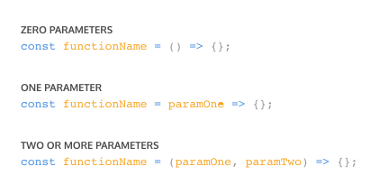
Concise Body Arrow Functions
JavaScript also provides several ways to refactor arrow function syntax. The most condensed form of the function is known as concise body. We’ll explore a few of these techniques below:
Functions that take only a single parameter do not need that parameter to be enclosed in parentheses. However, if a function takes zero or multiple parameters, parentheses are required.

Slide 16
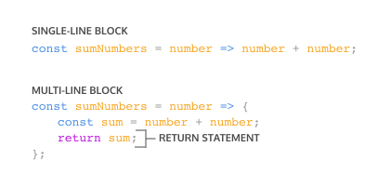
2. A function body composed of a single-line block does not need curly braces. Without the curly braces, whatever that line evaluates will be automatically returned. The contents of the block should immediately follow the arrow => and the return keyword can be removed. This is referred to as implicit return.

