Slide 1


2019 Jacksonville Jaguars
Analytical Review
Josh Harkness

Slide 2
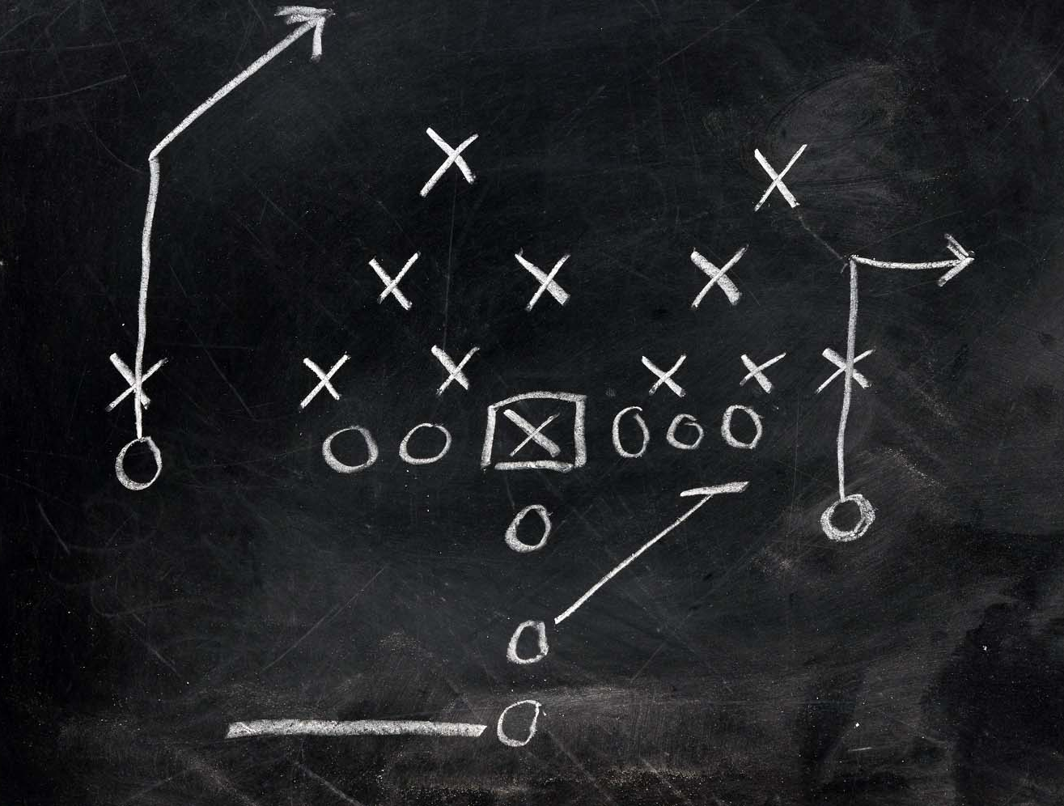
Purpose
Discover Strengths and Weaknesses
The defense struggles on third downs when passing to the right
Discover Predictable Trends
On first downs, the offense tends to run up the middle for minimal yardage
Use the strengths and weaknesses to provide draft insight
The running game does not appear to work well when running the Guard Gap on the left. Maybe the Jaguars should draft a Left Guard.
Notes:
What I hoped to achieve through this analysis was…
Trends: These are not necessary strengths or weakness, but trends could potentially make it easier for a team to gameplan against you.
Draft: Lastly, the strengths and weaknesses could provide insight into the draft. So if a team ends up being weak in a certain area, the team can look to find a player to fill in that weakness in the draft.

Slide 3
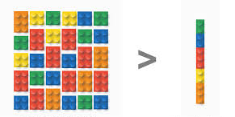
Data Collection and Knowledge-Based Reduction
The collected data
https://github.com/ryurko/nflscrapR-data/tree/master/play_by_play_data/regular_season
156 Attributes
45,000+ observations
After Knowledge-Based Reduction
18 Attributes (Including one, self made)
587 Observations
Further Knowledge Based Reduction
4 data sets created
Pass | Run
Offense | Defense
Notes:
All NFL data
A significant portion of the observation reduction was using only plays ran by the Jaguars.
NAs only occurred where the attribute did not align with the play (pass_location vs run_location).
The Y variable I created was based on the quality of the play which took yards gained, first downs, and scores into account which was unique depending on certain situations. An example of this is the quality of a play was hit harder when giving up scores further from the end than when a defense has their backs to the endzone.
All data was normalized before each analysis and for the Bayesian models, the data was also sectioned into 4 intervals and 4 quartiles.

Slide 4
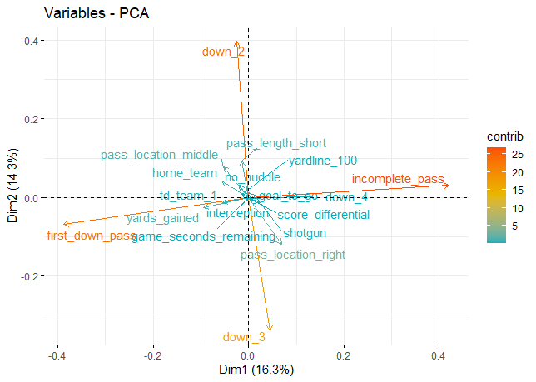
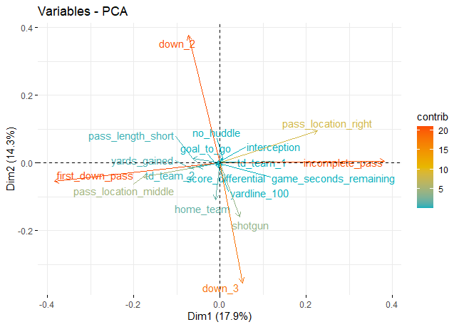
PCA for dimension reduction Passing
Offense
Defense
Notes:
The two graphs above are after most of the reduction already occurred. Safeties were eliminated in both of the above datasets while fourth downs were removed for the defense. Also, at this point in the analysis, the first dummy variable was eliminated as it was represented through the lack of the other categorical variables of the same type.
An immediate realization seen in this data is the first two PCA dimensions already show a tendency to explain obvious data instead of discovering harder to recognize pattens. It is obvious down_2 and down_3 will never be the same, however here we can see there is also a slight opposite contribution between pass_length_short and pass_location_right, meaning it is more likely when passing right the Jaguars threw a long pass in the second primary component of the offense.
For the defense, again many of the relationships were weak but you can see a slight positive relationship between teams passing to the right against the Jags as the game continued on in the first principal component.

Slide 5
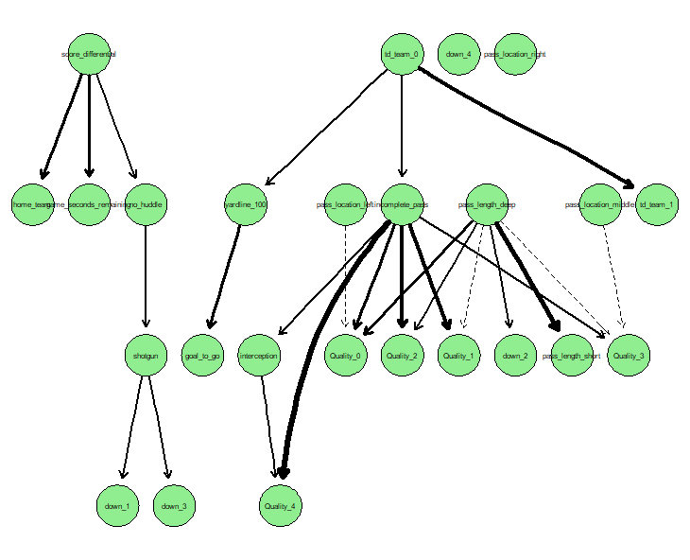
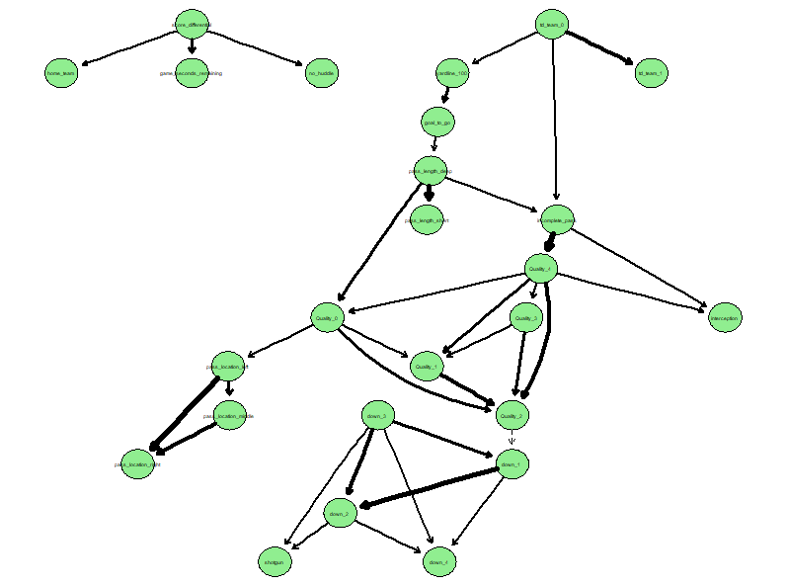
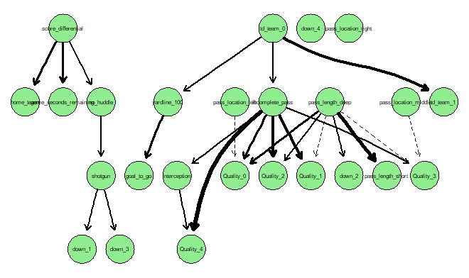
Bayesian Models Passing Offense
Notes:
The top two graphs are not as significant so don’t worry about not being able to read those. The top left graph was the first initial run. The top right graph was after removing obvious relationships like between the downs and pass locations. The final graph is the result of the top right graph having some of the arcs switched since the quality of a play is the result of all the other data. There is no way the quality of the play leads to a result.
In the bottom graph, we can see that many of the relationships to the qualities do not provide great insight. On offense, 0 is the strongest quality while 4 is the weakest. The relationship between deep pass and a quality of 4 makes since when deep passes connect they are going to be for a big gain. Even some of the weak relationships may be useful though.
Unfortunately, when using the above model to predict anything outside of the extremes, it is very poor at predicting an outcome. For qualities 1 – 3, all the predictions will be that the quality is not 1 – 3, which unfortunately has a decent accuracy because of only ~1/5th of the data belonging to a single quantity at a time.

Slide 6
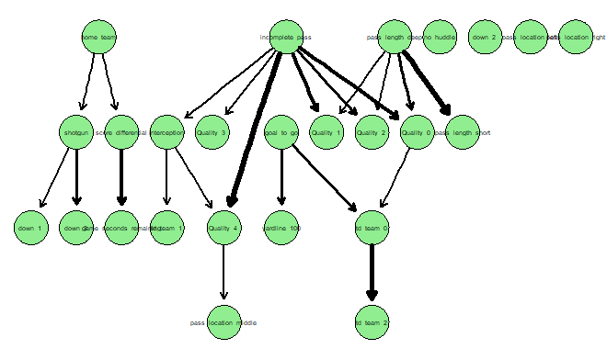
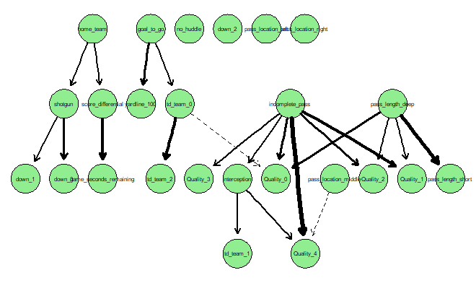
Bayesian Models Passing Defense
Notes:
For the defense, we used a similar blacklist as the offense except for a few variables that were either only present in the defense or just not as important. For defense, 0 is a very poor play while 4 is a great play. The right graph is after the arc direction changes to account for quality.
Again, this analysis did not provide great prediction values outside of the extreme values.

Slide 7
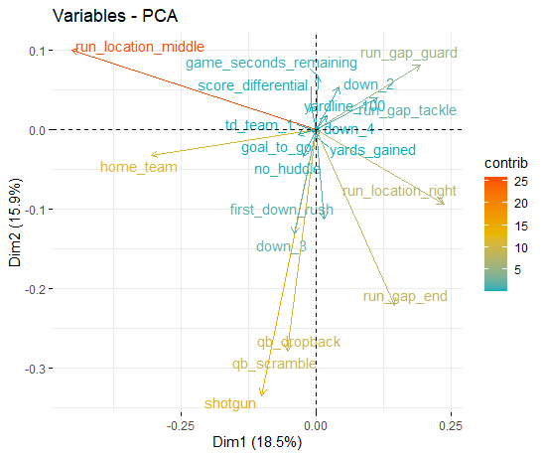
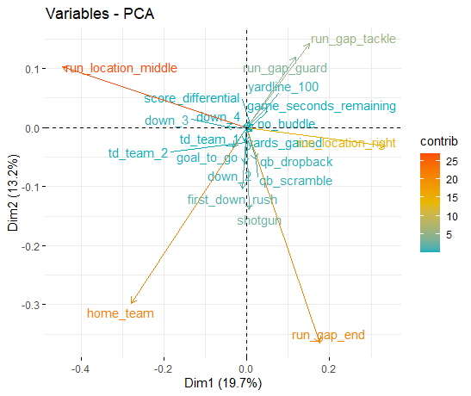
PCA for dimension reduction Rushing
Offense
Defense
Notes:
The dimension reduction was again already done here, but the first two PCA components appear to be more telling for rushing than for passing. While in passing it only seemed to provide obvious relationships, riushing is already giving some interesting insights outside of the run locations and run gaps being similar (run location middle will not be as common as left or right for the tackles and ends).
For the Jaguars offense, the first PC appears to state that the Jaguars rarely call a designed running play out of shotgun, but instead scramble with the QB. In the second component, there appears to be a relationship between running not at home (away) and running to the guard gap, the end gap, and running to the right.
For the second primary component, we can see similar relationship exists with the defense when not defending the run at home. They end up having more outside right runs to defend.

Slide 8
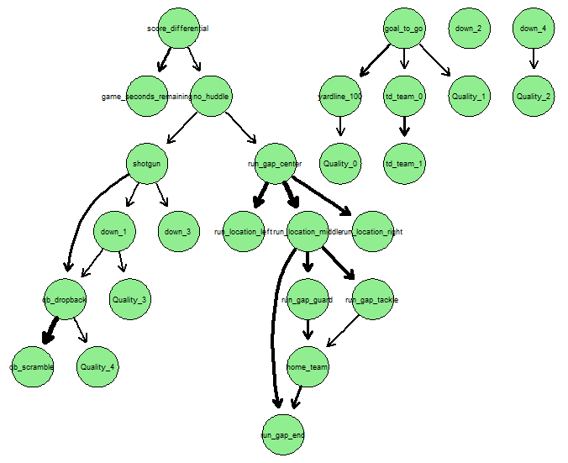
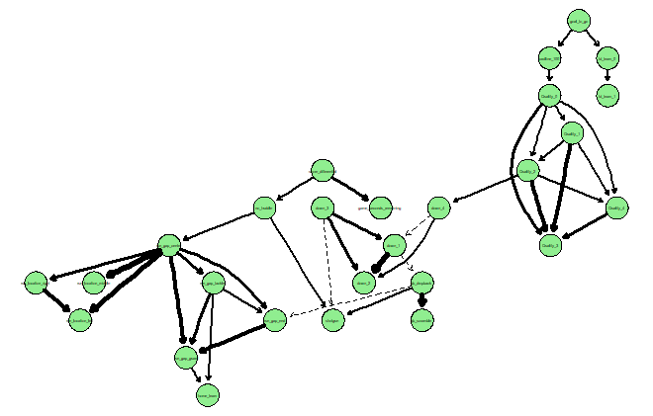
Bayesian models running offense
Notes:
The bottom graph was the initial offensive run graph. Then it was ran with the blacklist to prevent obvious relationships which already kept the qualities as the lowest nodes so no arcs needed to be adjusted.
The top graph shows some of the relationships mentioned from the initial PCA analysis witnessed during dimension reduction and shows that when the offense did scramble out of shotgun, it did not amount to a high-quality play. The Quarterback is Gardener Minshew, not Lamar Jackson.
The run gap association with the home team can also be seen.
Unfortunately, the model still suffers the same fate as passing where it is great at predicting extremes, but poor at predicting the mid qualities.

Slide 9
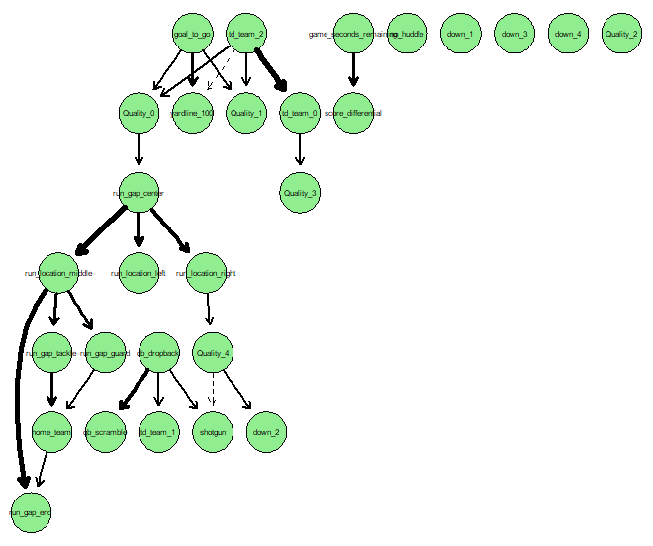
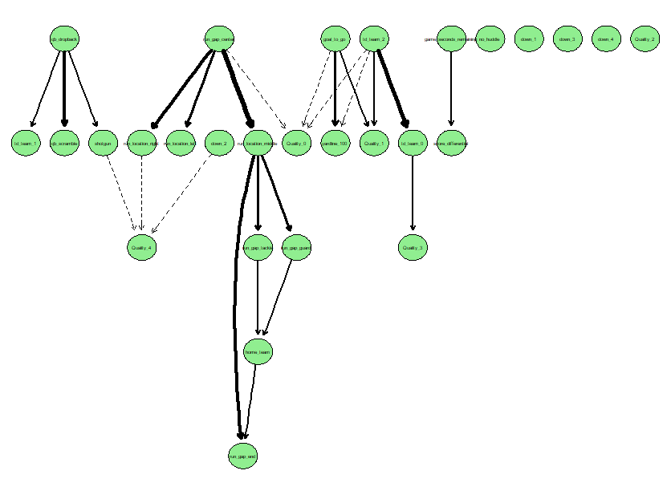
Bayesian Models Running Defense
Notes:
For the run defense was initialized using a blacklist, but required some arc swaps to ensure the quality did not lead to another variable. Most of these relationships are weak and do not provide too much insight.
Once again, the model did well predicting extremes but not middle mid-quality plays.
The reason all four models were great at predicting extremes is that we already have the result of the play as a touchdown or turnover, which heavily influence the quality of the play.

Slide 10
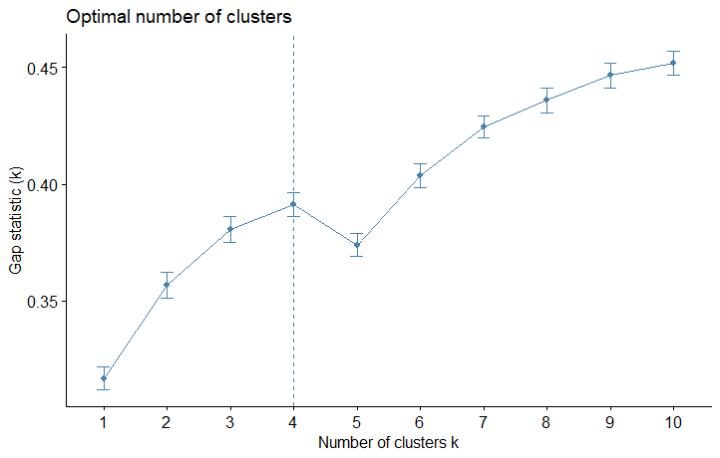
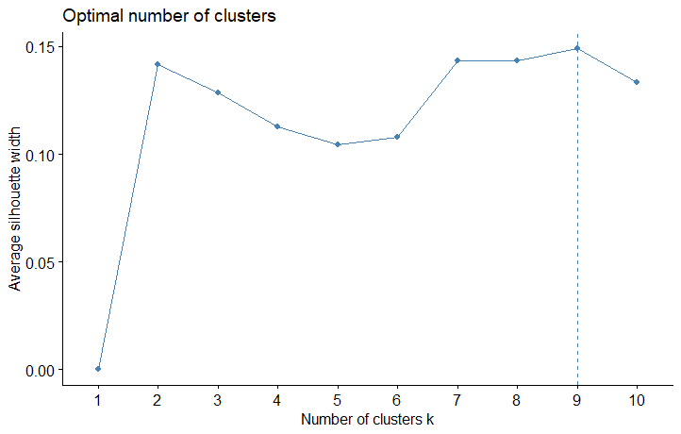
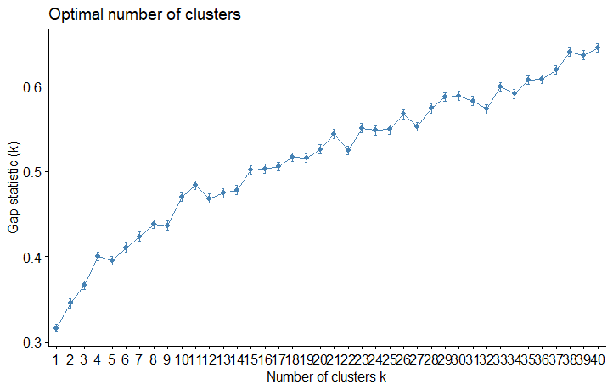
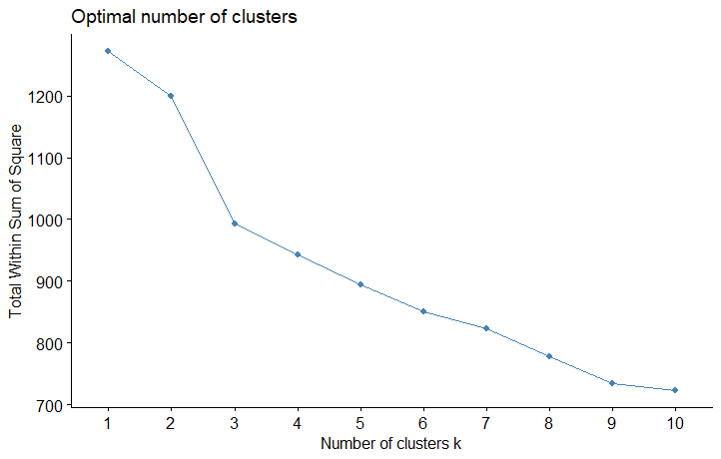
Cluster Analysis Passing Offense Optimal K
Notes:
The Bayesian models did not work as well as we hoped, so we moved onto cluster analysis.
Ideally, we would like to see 5 marked as the optimal number of clusters since we have 5 categories for the quality of play, but with 4 marked, it’s possible the quality of play could be reduced to four options. It’s also possible the clusters are not related to the quality whatsoever. To determine if the quality of play is found with this optimal k value, k means clustering was used on the principle component analysis.

Slide 11
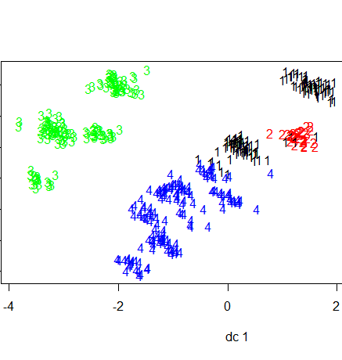
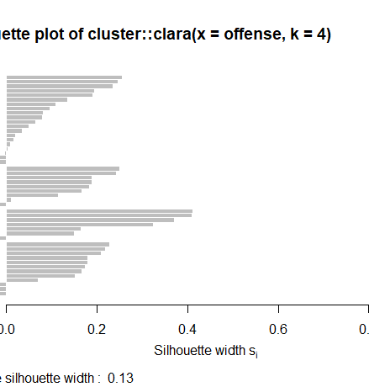
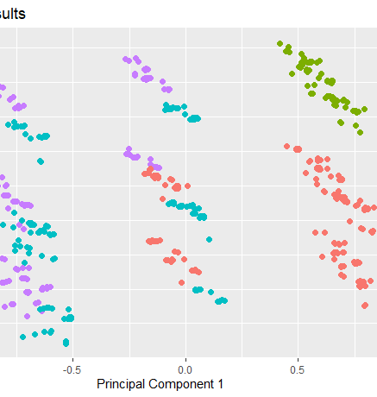
Cluster Analysis K = 4 Clusters Passing Offense
Notes:
In the left plot, it does appear that clusters 1 and two are very similar and don’t provide great distinction. In the right plot, the only completely unique cluster is cluster 2. The middle shows that most of the data is well explained by the clusters, but clusters 1 and 4 have a small portion that are not well explained by the clusters.

Slide 12
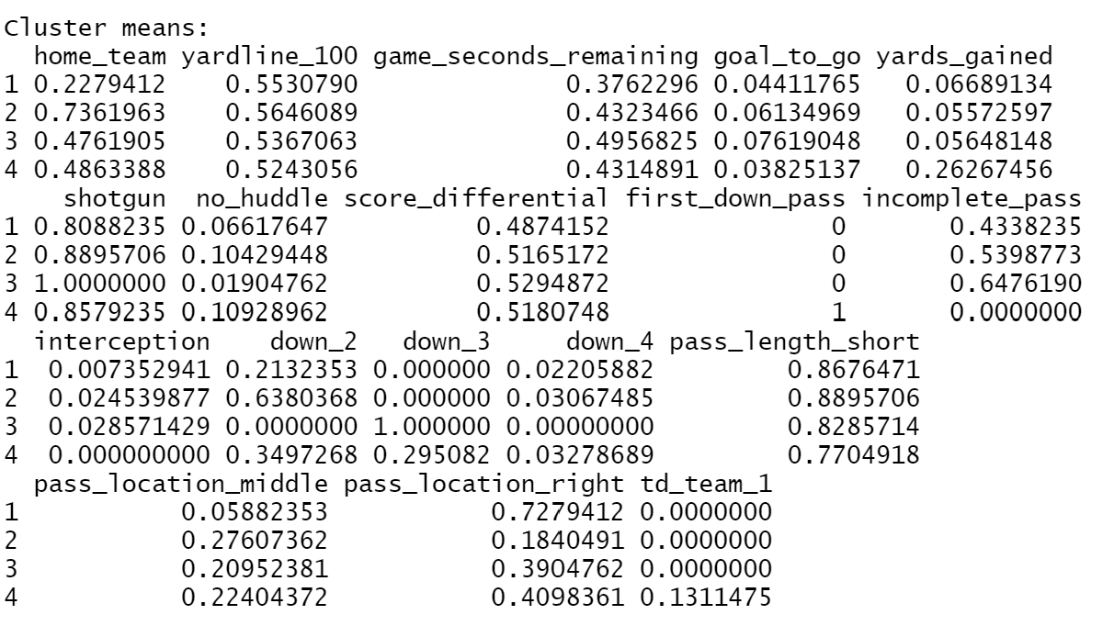
Cluster Analysis Pass Offense Results K-means clustering with 4 clusters
Sizes 136, 163, 105, 183
Most Attributes have widespread values.
Cluster 4 successful plays
Cluster 1 Away games
Cluster 2 home games
Notes:
The cluster distribution is decently spread out, with cluster 3 lacking a bit more than the others. The sum of squares shows there is an increase in the variability in clusters 2 and 4, but this is likely tied to the larger number of observations.
Cluster 4 has all the first down passes and no incomplete passes or interceptions. The yards gained appears higher than all the other clusters and it is the only cluster with offensive touchdowns.
So why might this be?
Well there appears to be more deep passes in this cluster than any others, but that is about the only significant difference between this cluster and the others.
Another interesting relationship caught in here is home and away games (clusters 1 and 2). The team appears to have far more first downs when playing away than at home. We can see this because all the downs in cluster 1 are closer to 0 while most downs in cluster 2 are second downs. This appears to conflict with the idea of home field advantage. Also, when away, the team appears throw to the right far more than when it is home.
Shows more positives overall for the offense than weaknesses, but also shows some tendencies that opponents may take advantage of.

Slide 13
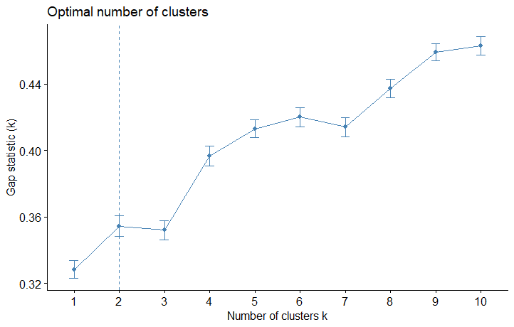
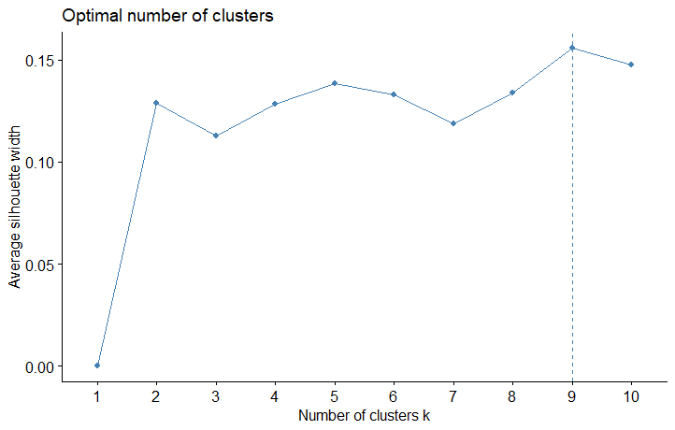
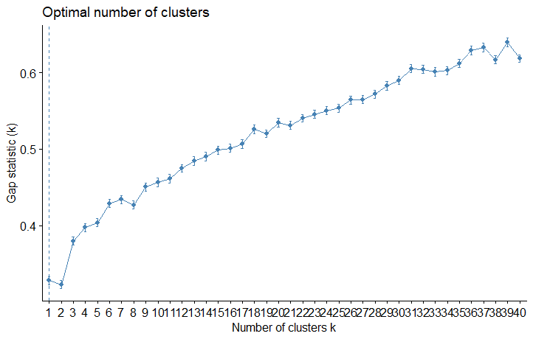
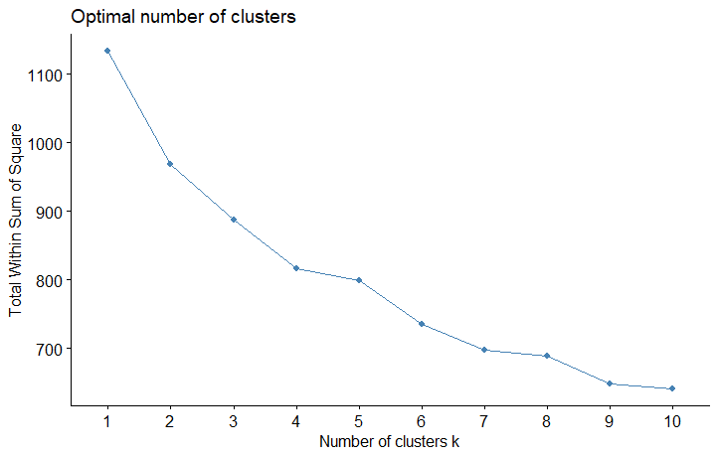
Cluster Analysis Passing Defense Optimal K
Notes:
Here, the silhouttes provide different values for the optimal k, so two k values were used, 5 and 9. Since ideally, we wanted 5 clusters to match the quality of play categories, we stuck with that.

Slide 14
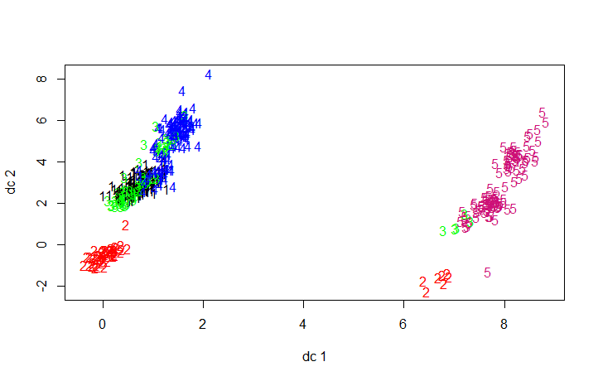
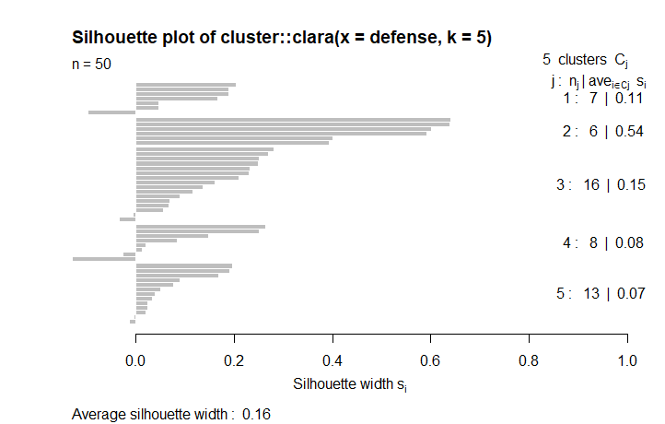
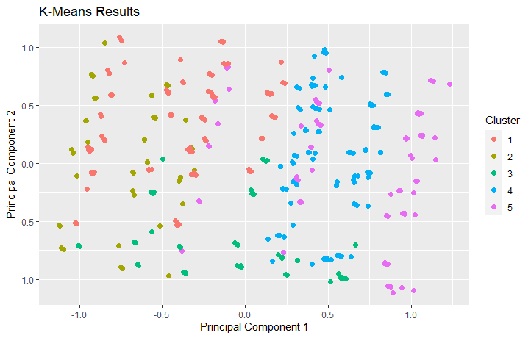
Cluster Analysis K = 5 Clusters Pass Defense
Notes:
While the clusters here look poorly mixed in the left and right image, the silhouette plot, outside of cluster 4, appears rather clean which seems to signal that the clusters are well grouped.

Slide 15
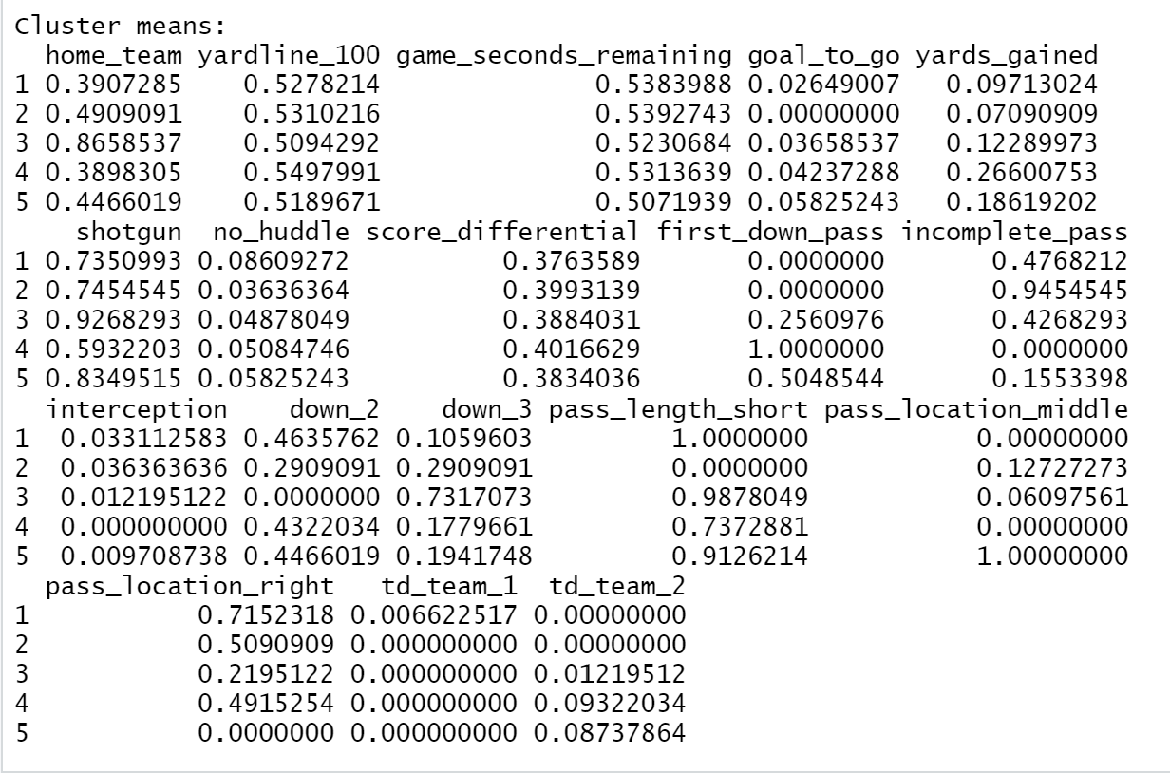
Cluster Analysis Pass Defense Results K-means clustering with 5 clusters
sizes 155, 55, 82, 118, 103
Most Attributes have widespread values.
Clusters 4 and 5 Weaknesses
Cluster 3 home games
Cluster 2 Strong Deep outside pass defense
Cluster 1 Strong short right pass defense
Notes:
Cluster 2 appears to be significantly smaller than the others, but also has the least variability likely due to the low number of observations in this cluster.
When looking at defense, the values associated with first down passes and td_team_2 should be low to be considered a successful play. Clusters 4 and 5 cluster together plays where the defense did not perform well. Why did the defense perform poorly?
In cluster 5, there is a strong relationship between short passes over the middle.
Cluster 4 does not appear to really have any uniqueness to it that would explain a potential weakness for the defense other than it is the cluster with the least amount of shotgun plays. So maybe the defense isn’t as prepared for passing plays when the offense is not in an obvious passing formation.
Cluster 3 shows team like to pass out of shotgun more when playing against the Jags in Jacksonville and slightly prefer passing to the short left more than any other cluster when on third down.
Cluster 1 shows short passes to the right were very unsuccessful, and the rest of the clusters appear to back this up too.

Slide 16
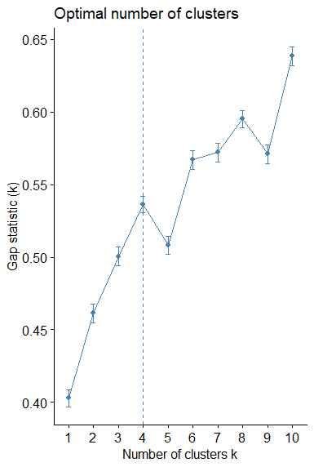
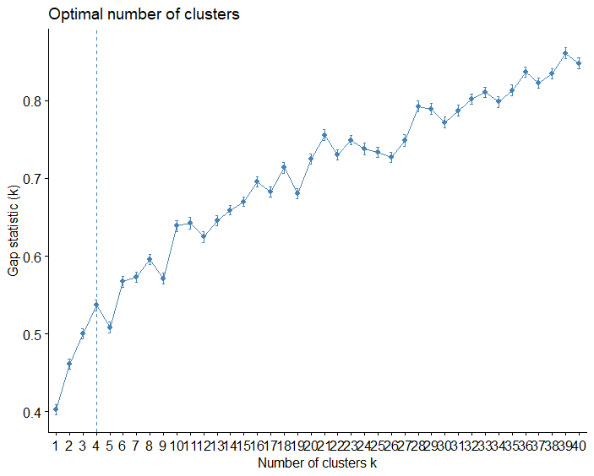
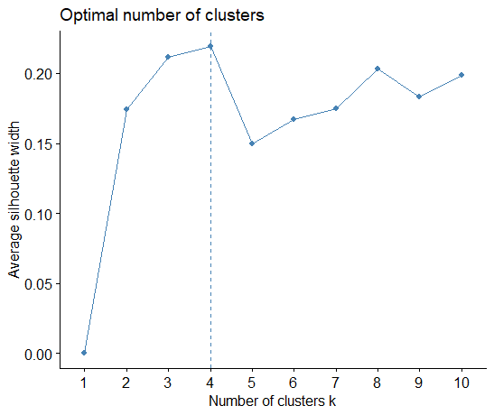
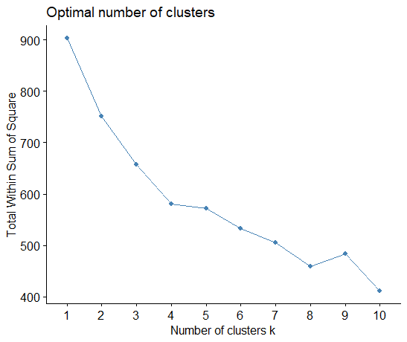
Cluster Analysis Rushing Offense Optimal K
Notes:
Just like the passing offense, the rushing offense also appears to have an optimal k value of 4.

Slide 17
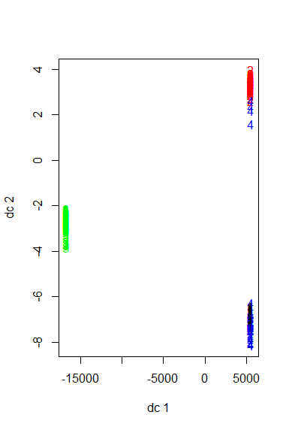
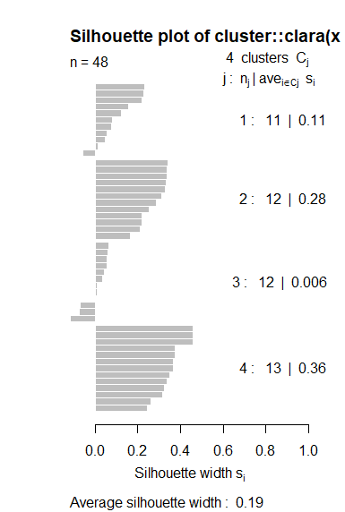
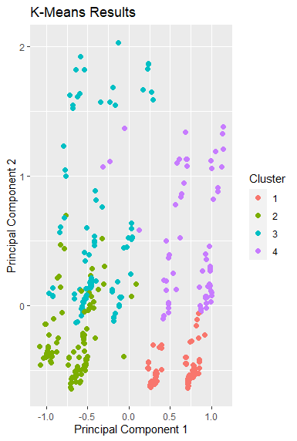
Cluster Analysis k = 4 clusters Rush Offense
Notes:
The different clusters provide seemingly inconsistent reports. The leftmost graph appears to blend clusters 1 and 4, while the rightmost graph blends clusters 2 and 3 the most. In both graphs there does appear to be a relatively strong distinction between most of the clusters though. The clara silhouette enforces this belief with low negative silhouette widths, meaning most of the data is well explained by the model.

Slide 18
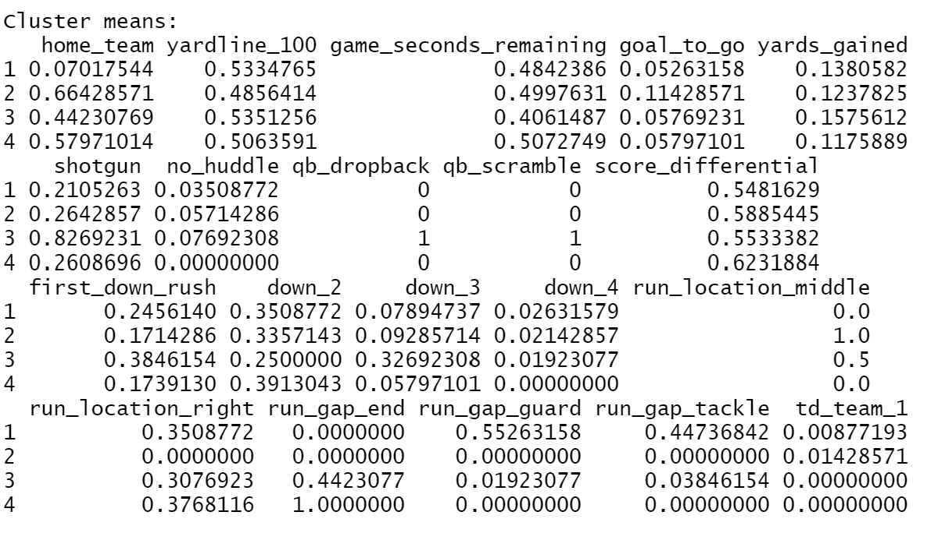
Cluster Analysis Run Offense Results K-means clustering with 4 clusters
sizes 114, 140, 52, 69
The Attributes are not too widespread.
Clusters 3 QB scrambles
Cluster 1 Away games and first downs
Cluster 2 runs up the middle
Notes:
Cluster sizes are more widespread than ideal.
There isn’t too much variability between the different clusters other than scrambles and away games.
Cluster 3 shows the QB scrambles, which appear to mostly happen on third down but still often failed to lead to a first down., although it was more successful at creating a first down the other types of rushes. This shows that the offense could be putting the QB at too much risk and could possibly benefit from better receivers that get open faster or a better offensive line to allow the QB to take time in the pocket.
Cluster 1 shows that the team is more likely to get first down rushes playing away. So far from the clustering, I would not be surprised to the team won more games away than at home.
Cluster 1 and 4 look similar yet have different first down results until you consider the gap. While both clusters focus on runs to the left, it appears the Jags are slightly more effective when running to the guard or tackle gap than when running around the edge. I believe this may be an indication of either poor run blocking by tight ends or tackles. To me this, this indicates the interior of the line is better at run blocking than the outside.
Cluster 2 produces the most touchdowns with runs up the middle, but it appears these runs are much more likely to be called when the team is already near the endzone. This does reinforce the idea that the interior line is stronger at run blocking though. When the team needs a tough run, they look to running up the middle rather than bouncing to the outside.

Slide 19
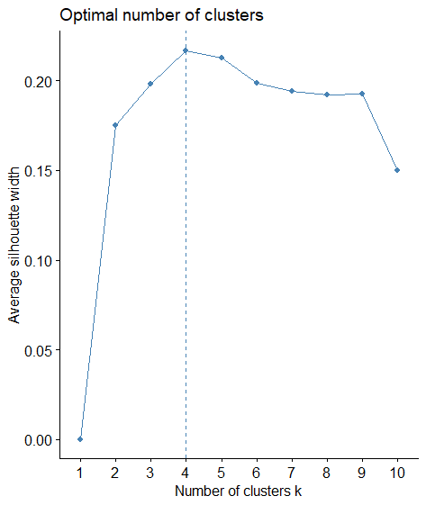
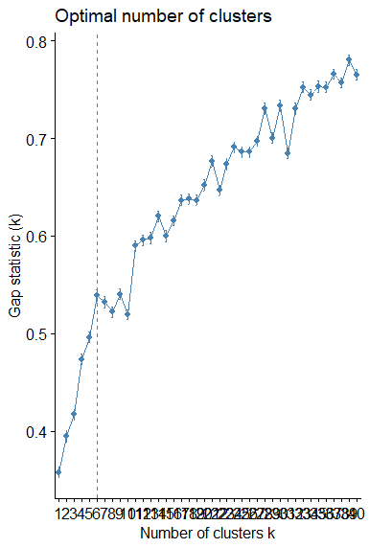
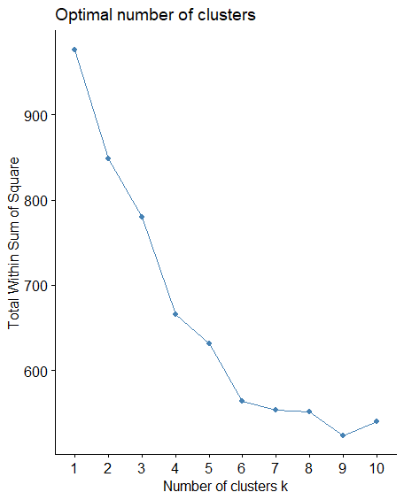
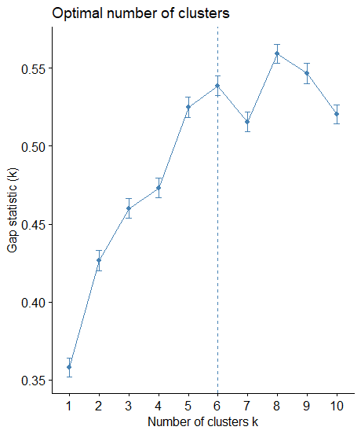
Cluster Analysis Rushing Defense Optimal K
Notes:
On rushing defense, we can see too possible k values, both of which are 1 away from our target value of clusters. It would seem more likely that the clusters would be less than the manually generated amount of qualities I created, so that will be analyzed instead. While I actually analyzed both k values and both turned out decent results, k = 4 appeared better so that is what I will present today.

Slide 20
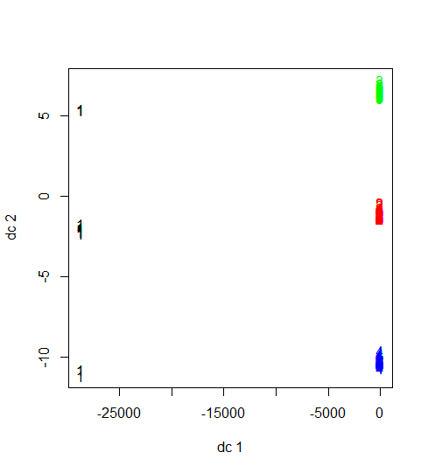
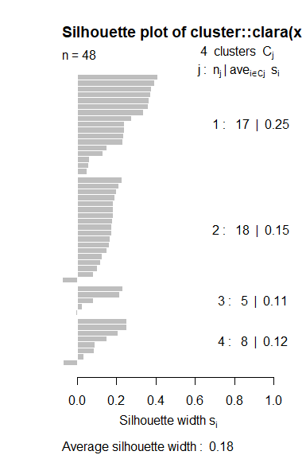
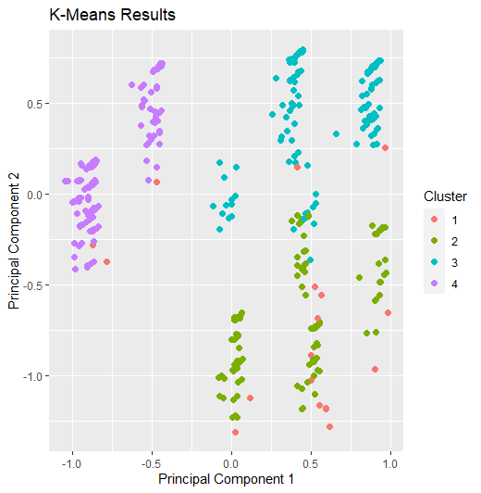
Cluster Analysis k = 4 clusters Rush Defense
Notes:
While the rightmost graph depicts cluster 1 as kind of all over the place, the leftmost graph gives us our first graph where the clusters are well defined. The silhouettes provided by clara also appear to be the cleanest yet.

Slide 21
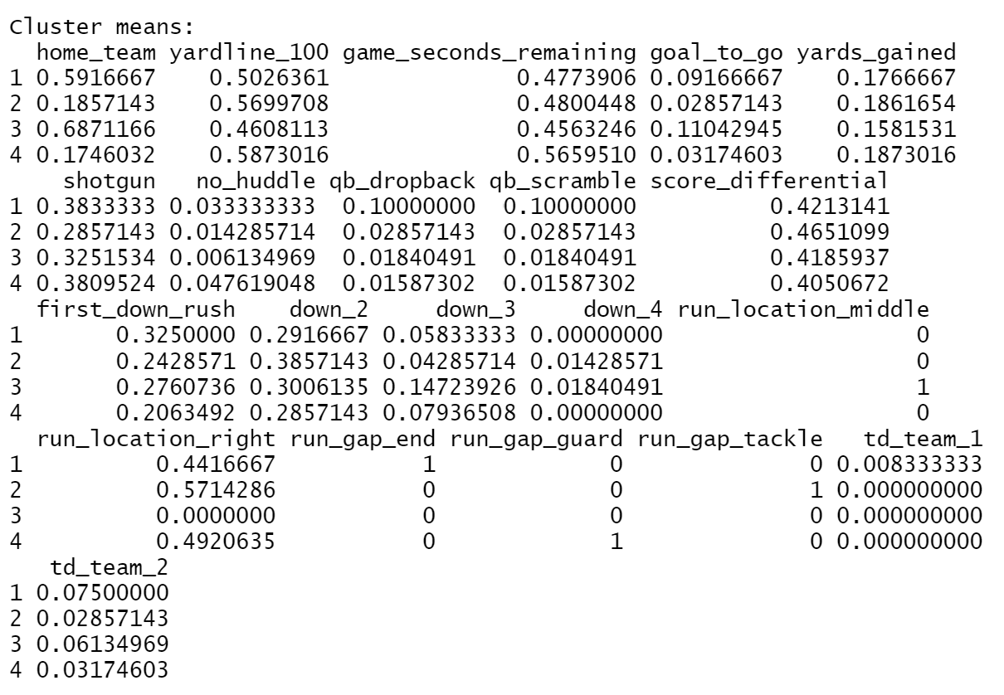
Cluster Analysis Run Defense Results K-means clustering with 4 clusters
sizes 120, 70, 163, 63
The Attributes are not too widespread, but do all appear to be based on the run gap
Cluster 1 End Gap
Cluster 2 Tackle Gap
Clusters 3 Center Gap
Cluster 4 Guard Gap
Notes:
Cluster sizes are more widespread than ideal again.
All clusters appear to be based on the gaps.
Cluster 1 is runs to edge. The most first downs and touchdowns are given up when running to the edge. More runs to edge are also to the left side of the defense, indicating the left outside linebacker or defensive lineman may not be fast enough to seal the edge.
Cluster 2 shows that when teams do run to the tackle gap against the Jags, they tend to run more to the right, likely because the outside defensive line is weaker there.
Cluster 3 isruns up the middle, which is where the second most TDs and first downs against the team occur. Runs up the middle also appear to occur more earlier in the game than later but has the least yards gained. This shows that teams are more likely to run the ball up the middle in short yardage situations and are decently successful at it relative to the other runs. Middle runs are also more likely when the Jags are home.
Cluster 4 The guard gap appears to be the most solid for the defense on both the left and right side. Although they give up the most yards (slightly), they give up the least first downs and second least touchdowns. The combination of cluster 2 and cluster 3 is a bit confusing because they both focus on the interior of the defense. What I would take out of this is the defense likely has strong linebackers in the middle to plug up the gaps, but maybe weaker interior linemen to prevent successful runs right up the middle.

Slide 22
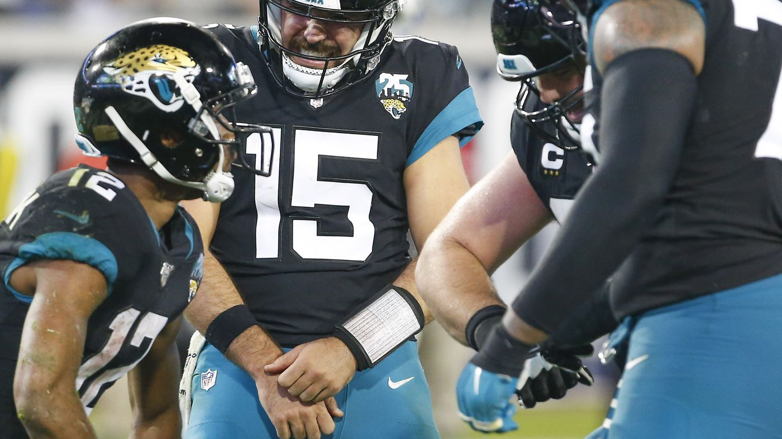
Consensus
Run Offense
Scramble too much on third downs without great success
More first downs when running in away games
Weak on the edges
Strong at the tackle and guard gap
Stronger interior line
Run Defense
Weak edge rush defense especially the left
Weak right tackle gap
Good at preventing first downs past the guards
Pass Offense
The pass locations seem oddly predictable when playing at home versus away.
More first downs when playing away
Pass Defense
Weak against passes to the short middle
Weak against passes not from shotgun
Weak against short left passes on third down, especially when home
Very strong against short passes to the right
Strong against deep outside passes
Notes:
A coach is likely able to better interpret this information as they understand the assignments of each player.

Slide 23
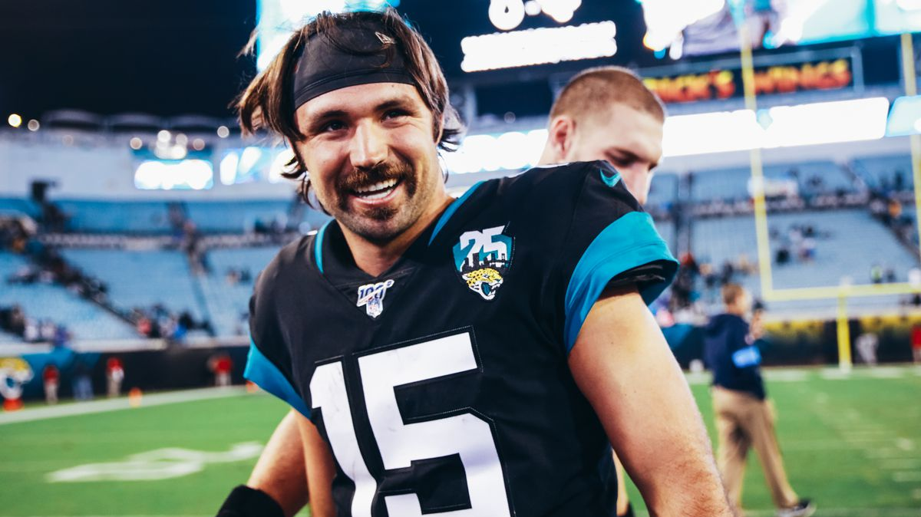
Future Improvements
Data Preprocessing
Place more emphasis on the players involved in each play
Keep track of injuries on the team
Analyze the data based on first string personnel
Data Analysis
Use more versions of clustering
Notes:
Place more emphasis on the players involved in each play – who made the catch, the tackle and where and in what game situation.
Keep track of injuries on the team – These likely have a decent impact on the result of plays. During the year, Jacksonville changed their starting QB at least 3 times between Nick Foles and Gardener Minshew.
Analyze the data based on 1st string personnel – There is so much variability between every play in the NFL that could also make it more difficult to predict plays. If we are more concerned with drafting starting caliber players, we should only make comparisons with the first string personnel.
Adding in model based clustering could provide more insights.
Also, using supervised clustering models like knn appears like it could really add more insight.

