Slide 1
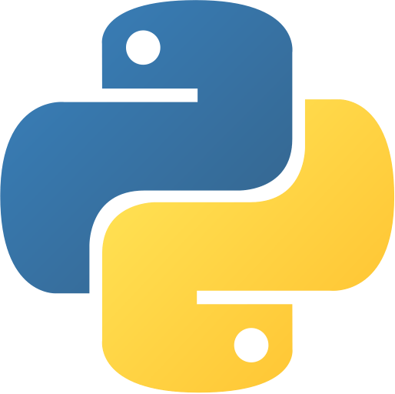
Python for Beginners Python Bangla Tutorials for Beginners
By Dark Hunter 141

Slide 2
Class No : 1
What is Programming Language?
Classification of Programming Languages
Introduction to python
Environment setup

Slide 3
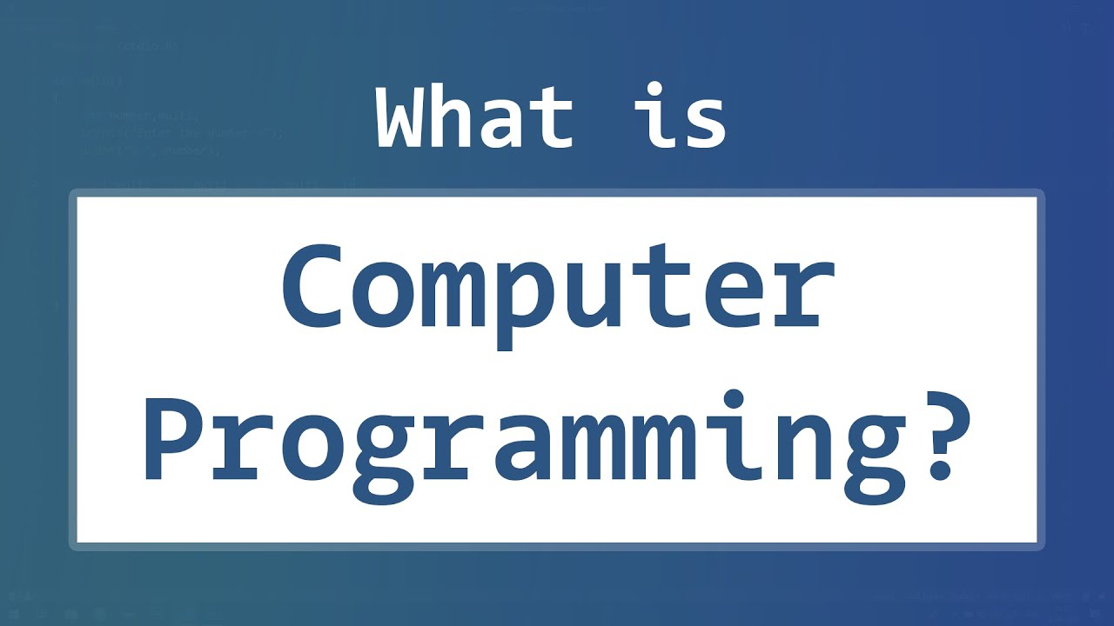
Programming language ?

Slide 4
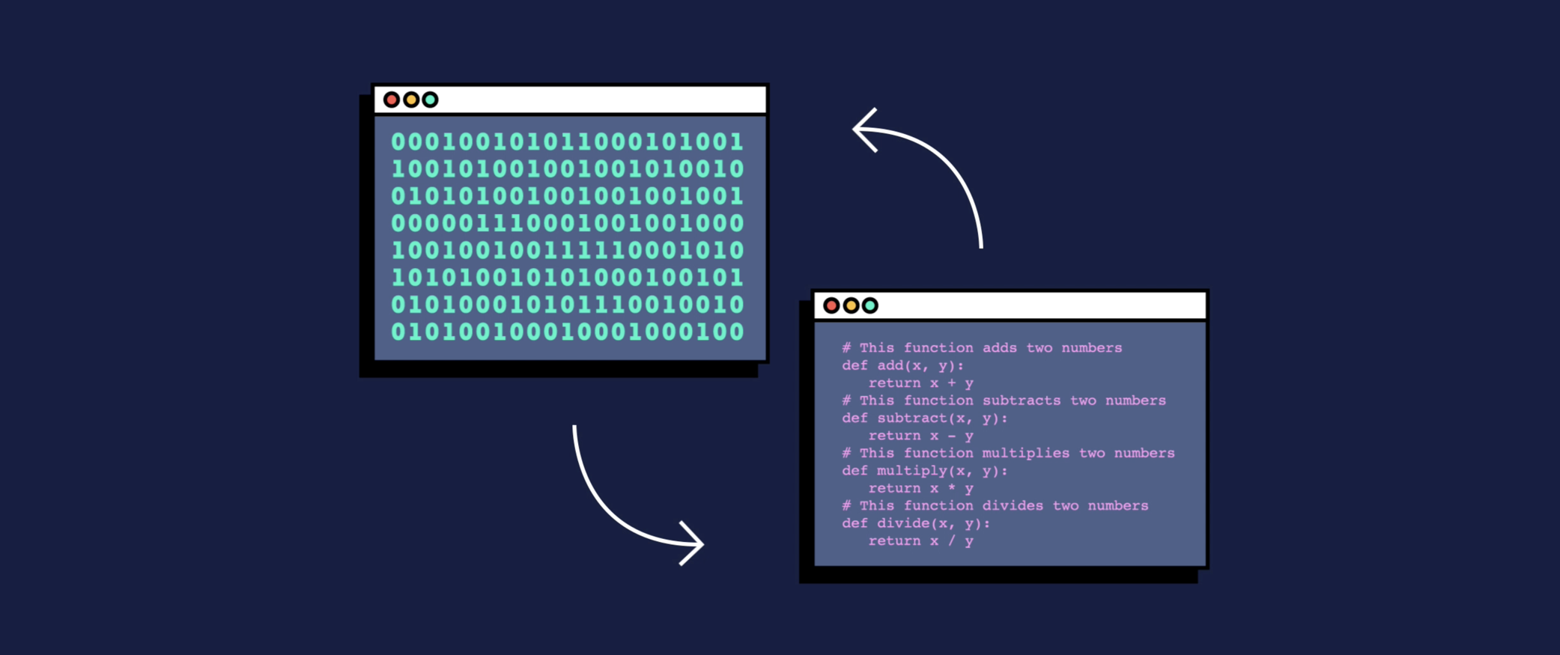

Slide 5
Classification of Programming Languages
Programming languages can be divided into two different levels:
High-level Languages – Python, Visual Basic, Java, C, C++, SQL and many more.
Low-level Languages – Hardware/Processor-specific assembly languages and machine code.

Slide 6
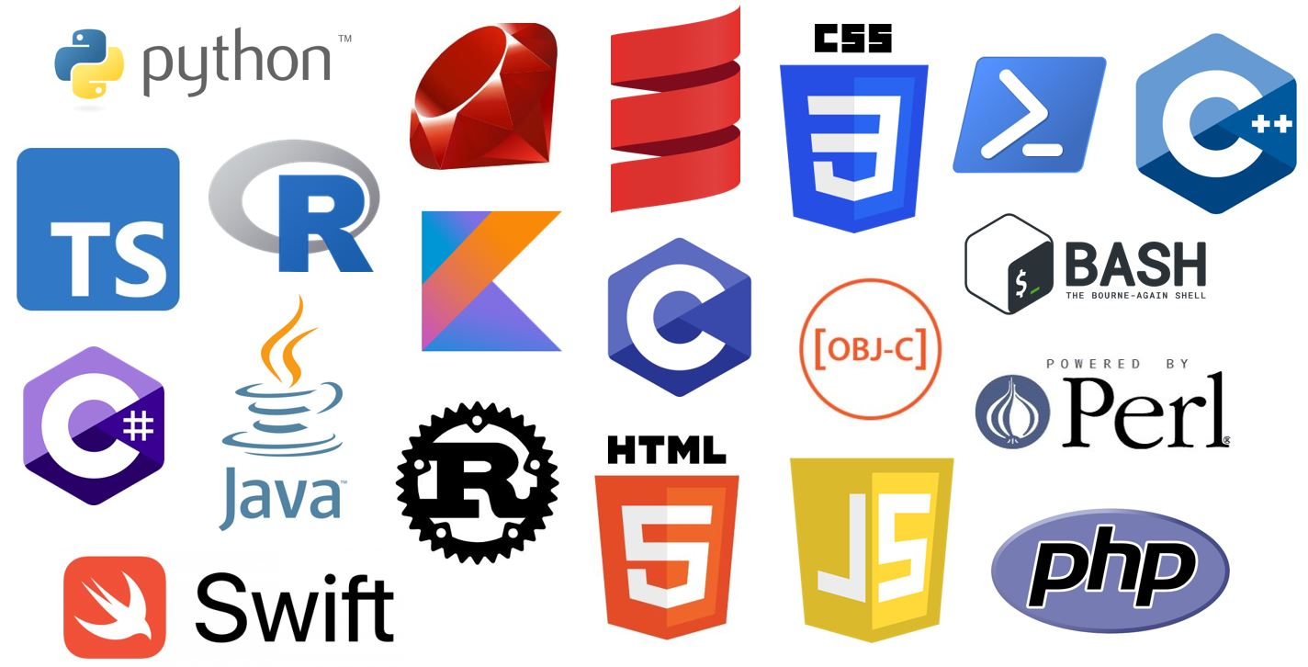

Slide 7
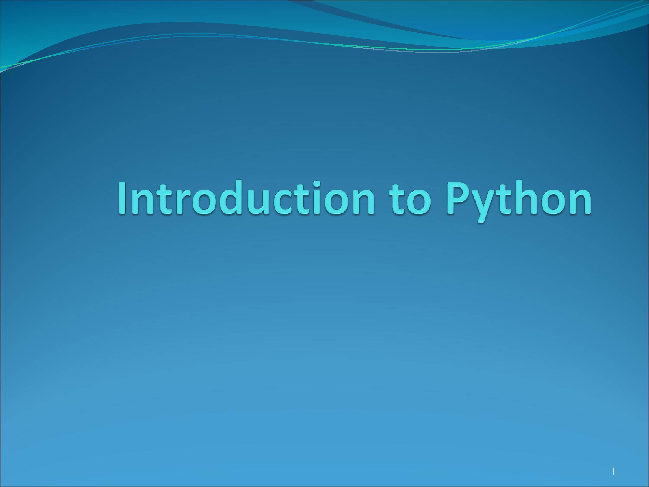
Introduction to Python

Slide 8
What is Python?
Why you should learn python?
Environment setup

Slide 9
What is Python ?
Python is an high-level programming language
Python is an interpreted
Python is an object-oriented

Slide 10
Why you should learn python?
Beginner Friendly, It has simple syntax similar to the English language
Write fewer lines than some other programming languages.
The most taught programming language in universities.
Python works on different platforms (Windows, Mac,Android, Linux, Raspberry Pi, etc).
Used by many popular organizations such as Google, NASA, the CIA, and Disney etc.

Slide 11

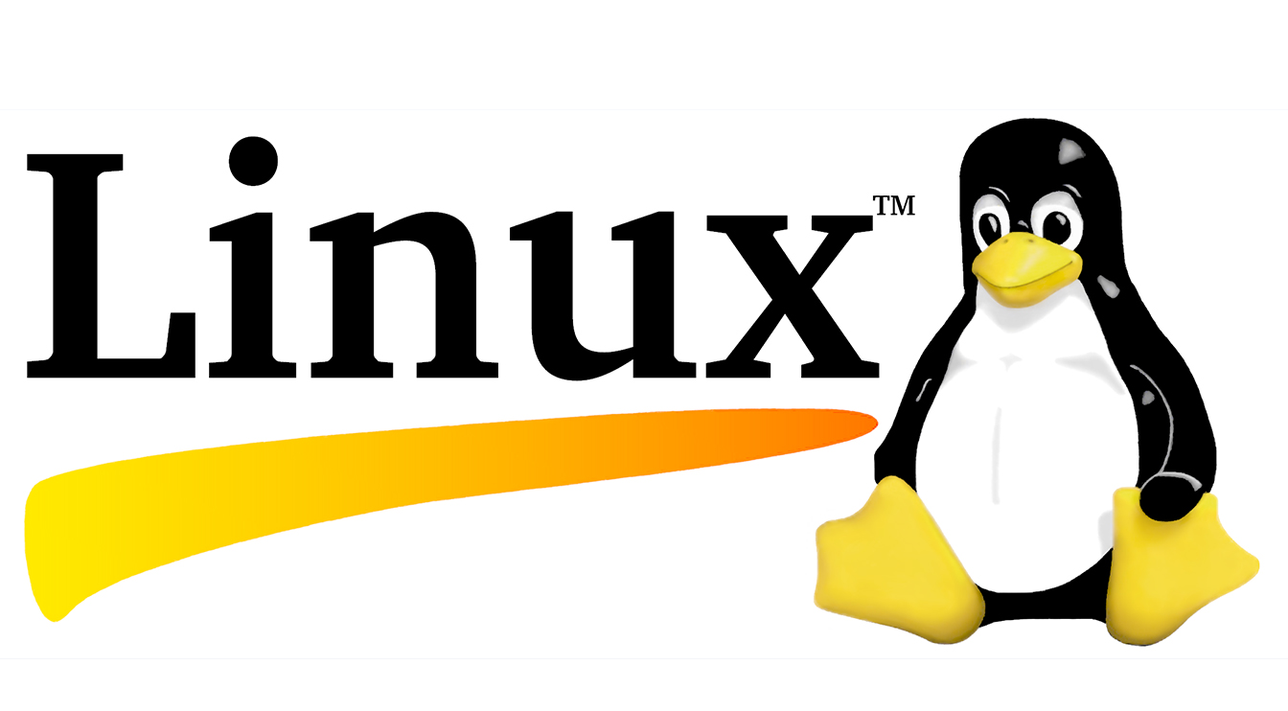

Setup a Proper Python Environment

Slide 13
Class No : 2
What is REPL?
First Python Tool
Comments
Module ,Pip

Slide 14
What is REPL ?
Full Form
REPL
read–eval–print loop

Slide 15
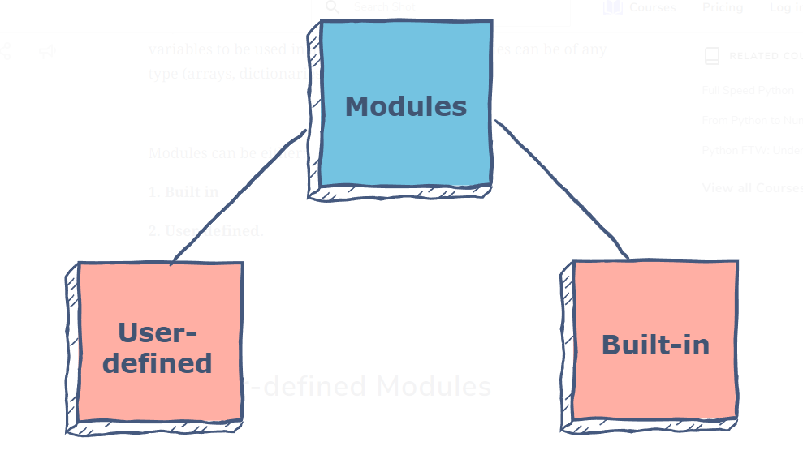
Module
A module is a containing code written by somebody else (usually) which can be imported and used in our programs.

Slide 16
