Slide 1
Data Mining - Final Project
Paul Kelly - George Washington University - DATS 6103 - 6/22/22

Slide 2
Which qualities indicate whether a mushroom is poisonous or edible?

Slide 3
Dataset
Source: UC Irvine Machine Learning repository
Includes descriptions of hypothetical samples corresponding to 23 species of gilled mushrooms in the Agaricus and Lepiota Family Mushroom drawn from The Audubon Society Field Guide to North American Mushrooms (1981).
23 variables; 8,124 observations
https://www.kaggle.com/datasets/uciml/mushroom-classification

Slide 4
Cleaning/Preprocessing
Replaced column names to eliminate hyphens
Replaced ‘?’ values with NaN
Located by checking unique column values
Dropped NAs
Left with 69% of the dataset
Changed datatypes from str to category for modelling (resulting in almost entirely categorical dataset)
Re-assign values with names (e.g. “e” becomes “edible”)
Memory intensive, but good for presenting results

Slide 5
Exploratory Data Analysis

Slide 6
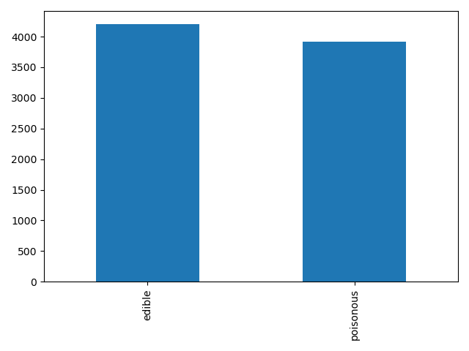
Notes:
A bar chart showing edible vs poisonous - dataset is pretty balanced.

Slide 7
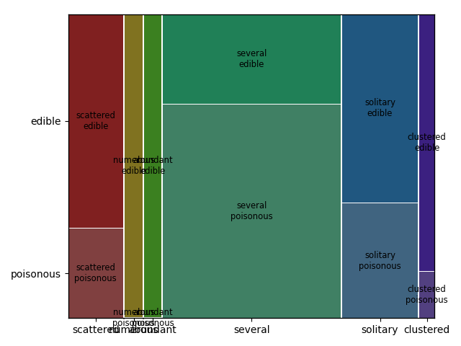
Notes:
A mosaic plot showing population vs. class. Edibles grow in numerous and abundant patterns, but poisonous do not.

Slide 8
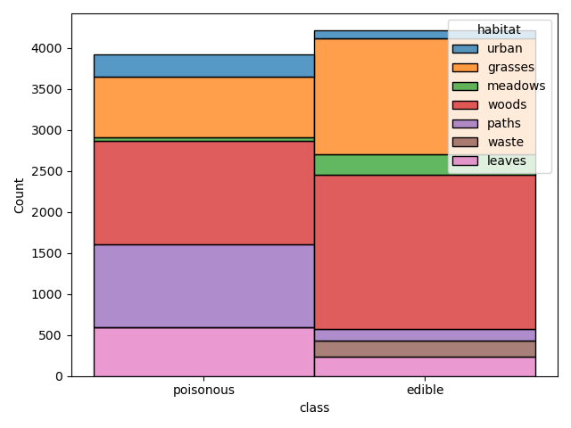
Notes:
Now for some catplots. Habitat vs. class - e.g. more likely to find poisonous mushrooms on a path than edible, more likely to find edible mushrooms in the woods than poisonous. Poisonous mushrooms never grow in “waste.”

Slide 9
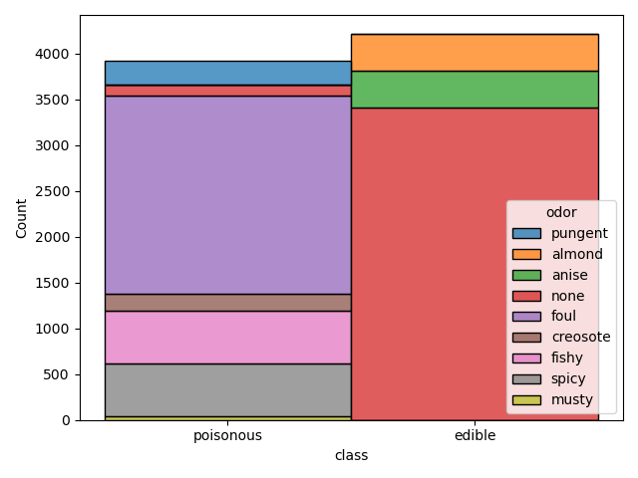
Notes:
Odor vs. class. Edible mushrooms are much more likely to be odorless or smell “pleasant”, while poisonous mushrooms are likely to smell foul.

Slide 10
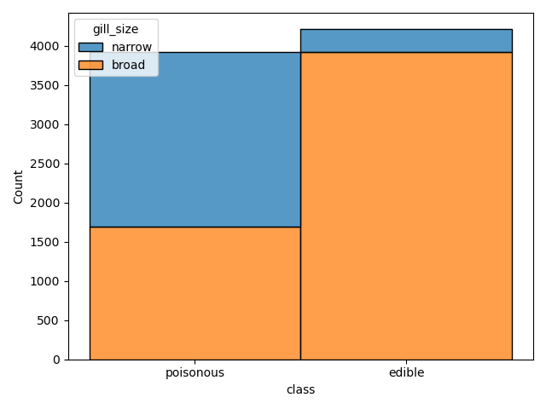
Notes:
Gill size vs. class. Edible mushrooms are more often have broad gills.

Slide 11
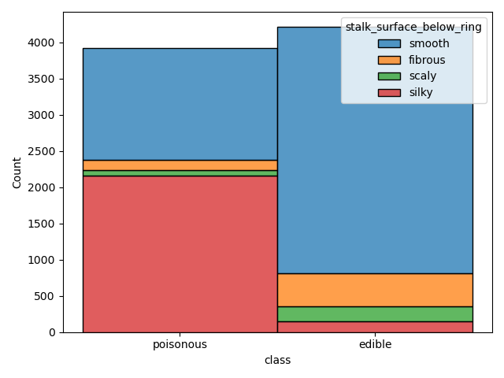
Notes:
Stalk surface below ring vs. class. Edibles are likely to have smooth surfaces, poisonous are likely to be silky.

Slide 12
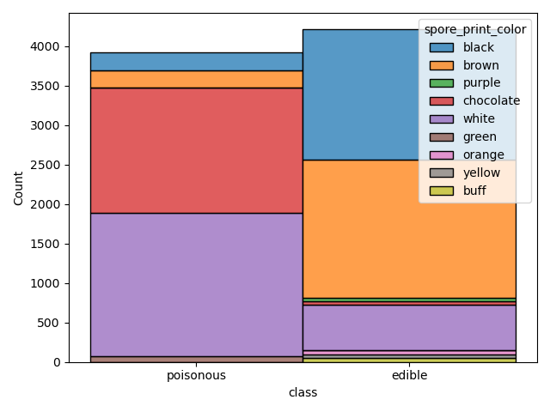
Notes:
Spore print color vs. class. If a mushroom has chocolate colored spore print, it’s likely poisonous, if it has black, it’s likely to be edible.

Slide 13
Algorithms
Selected based on relatively small size of dataset, and categorical values:
Decision Tree (as seen in GUI)
Random Forest (as seen in GUI)
Naive Bayes

Slide 14
Demo

Slide 15
Results
Set out with intention to use accuracy as evaluation metric because dataset was quite balanced, but cleaning/preprocessing may have skewed that
Naive Bayes: 75%; Decision Tree: 97%; Random Forest: 100%
According to correlation matrix and RF feature ranking, factors likely to be important in predicting mushroom class are odor, spore print color, stalk shape, stalk surface below ring, and gill size
Notes:
Of the 2 unboosted models, DT Gini is most accurate. When we further refine using RF, we get 100% accuracy. RF could be overfit, but who knows.

Slide 16
Lessons Learned
Too much time was devoted to getting the GUI working properly, but it felt like a valuable skill to hone for future projects
Potential issues with recoding categorical variables to numeric
Notes:
Had to recode categoricals to work correctly with sklearn (to, for example, run decision tree). Predictive quality high, but not particularly useful from an interpretation standpoint (e.g. what does it even mean to have a categorical value of, for example, 0.5?).

Slide 17
Thank you!

