Slide 1
To Do List Application with Swift & iOS
Paul Kelly, Jonathan Schild
CSCI 6221 - Summer 2024

Slide 2
App Overview
Built with SwiftUI and Firebase
Features:
User authentication
Create/read/update/delete tasks

Slide 3
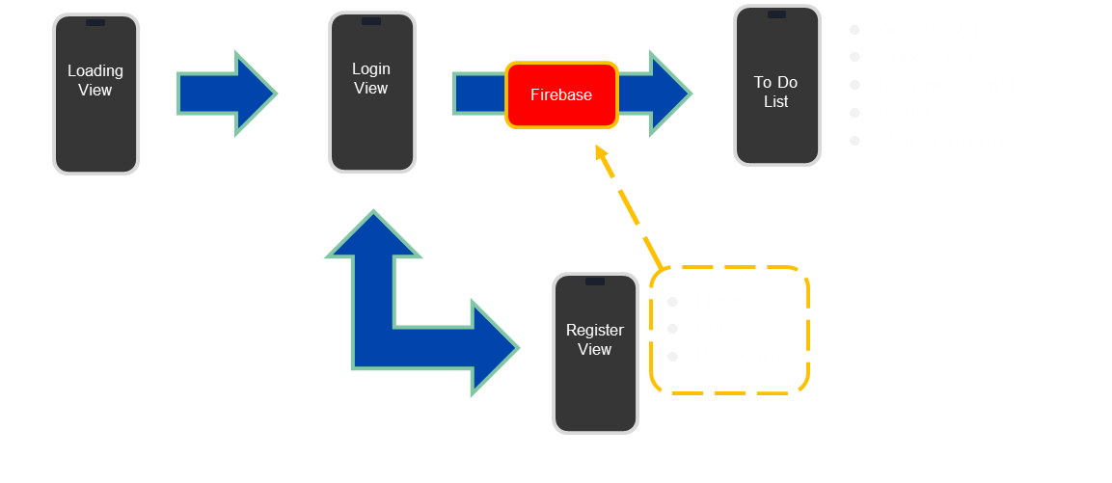
Application Map

Slide 4
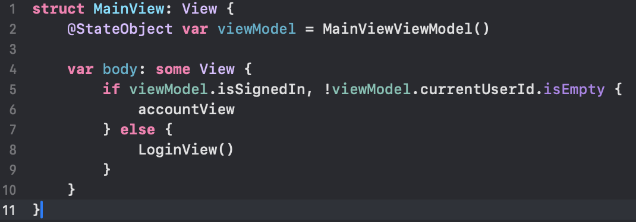
Structure
MVVM Architecture (Model-View-ViewModel)
Views, ViewModels, and Models for each component
Firebase for backend (Authentication and Firestore)

Slide 5
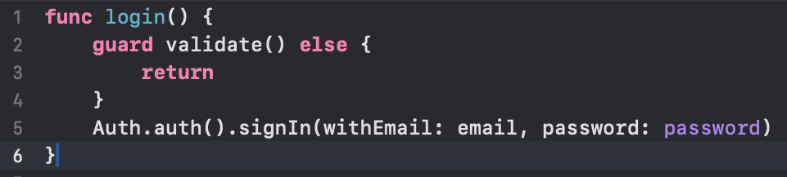
Authentication
Login and Registration screens
Firebase Authentication for user management
Persistence of login state

Slide 6
Main View
Tab-based interface
To-Do List tab and Profile tab

Slide 7
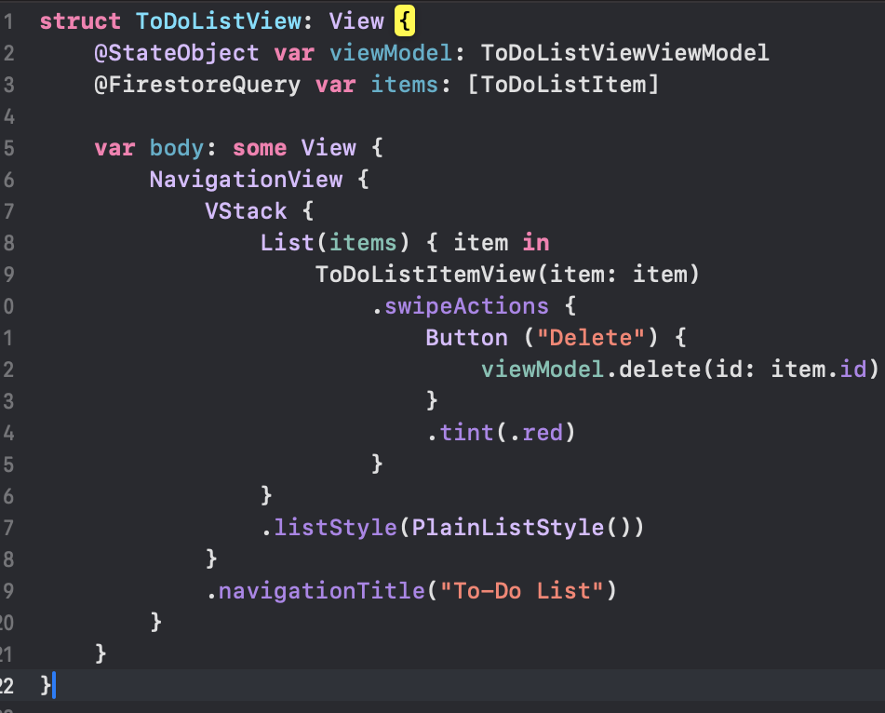
To-Do List View
Displays user's tasks
Real-time updates using Firestore query
Swipe-to-delete functionality

Slide 8
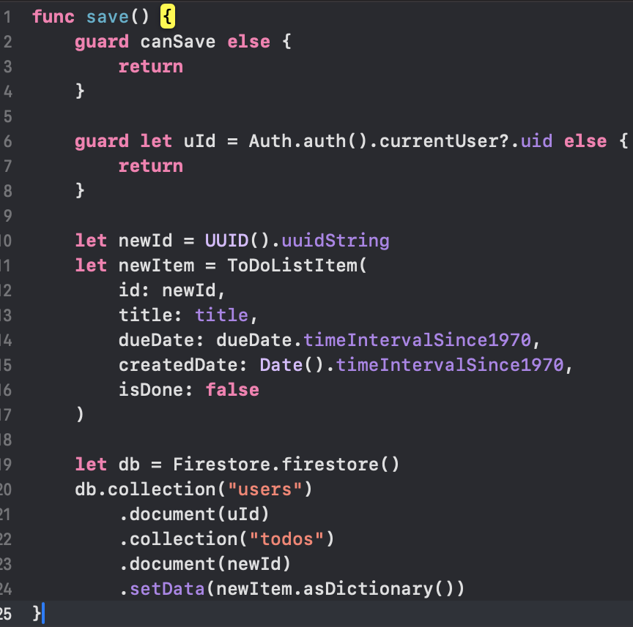
New Item View
Modal presentation for adding new tasks
Title and due date input
Basic input validation

Slide 9
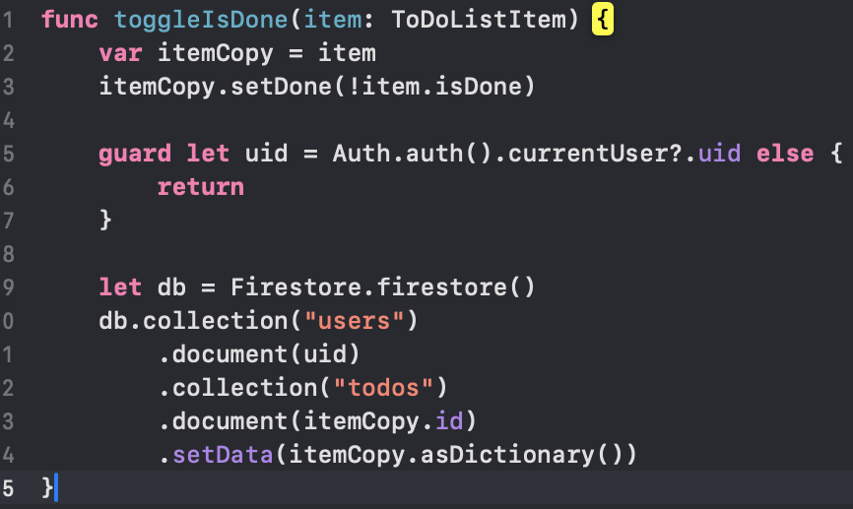
Task Interaction
Marking tasks as complete/incomplete
Updates Firestore in real-time
UI reflects task status instantly

Slide 10
Profile View
Displays user information
Fetches data from Firestore
Log out functionality

Slide 11
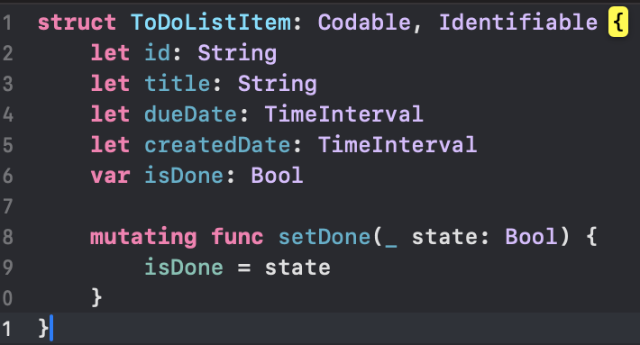
Data Model
User struct:
ID
Name
Email
Joined date
ToDoListItem struct:
ID
Title
dueDate
createdDate
isDone

Slide 12
Thank you!
https://github.com/darkivist/csci_6221

Slide 13
Demo

