Slide 1
Introduction to Swift
Paul Kelly, Jonathan Schild
CS 6221 - Summer 2024

Slide 2
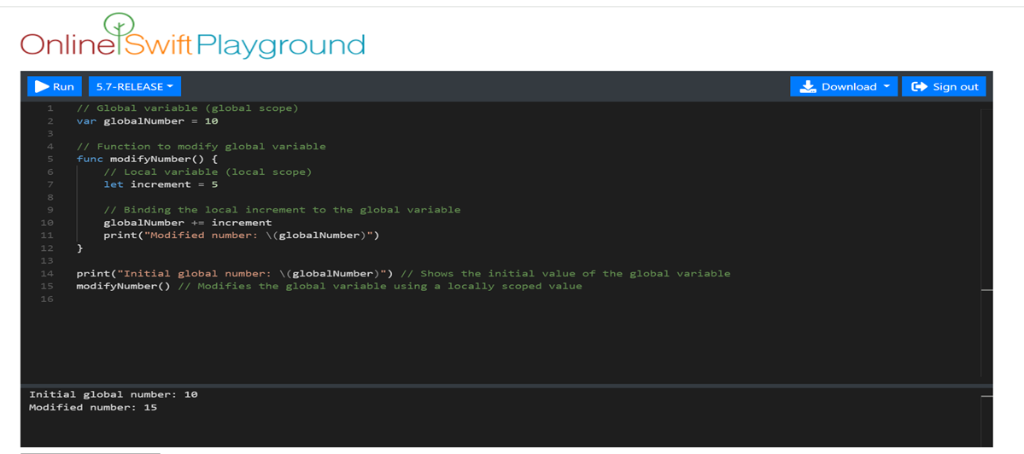
Introduction to Swift
Overview
A primarily object-oriented programming (OOP) language
Released by Apple in 2014
C-family programming language
OOP Features
Encapsulation & access controls
Classes, objects
Supports inheritance & polymorphism
Benefits of Swift
Fast, easy, safe

Slide 3
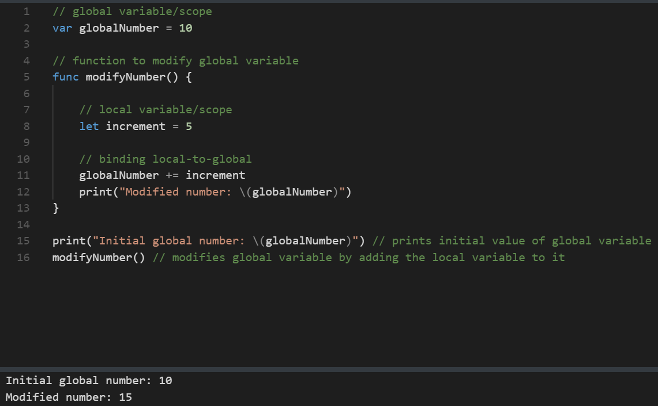
Programming Essentials:
Identifiers & Binding
Names
Constants, variables, functions, types
Must begin with letter or underscore
Static binding (primarily)
Local & global scope

Slide 4
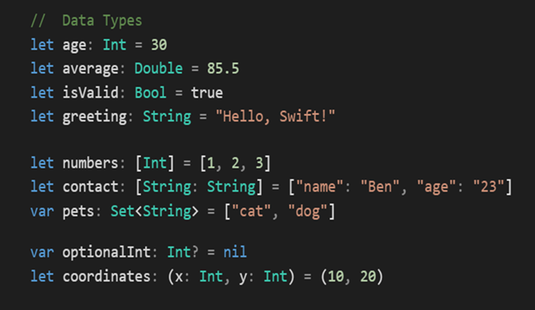
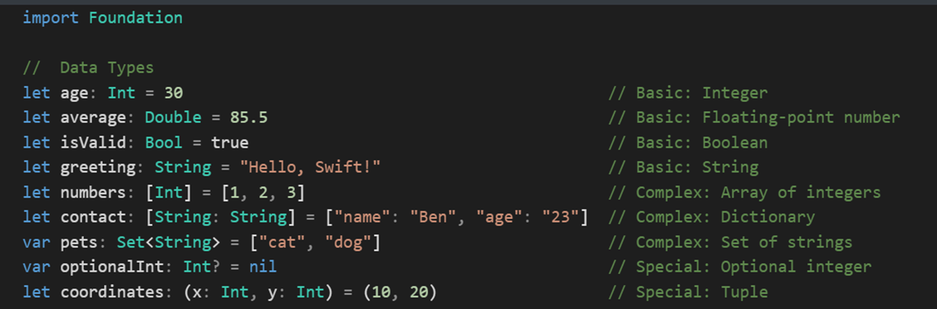
Data types
Basic
Int - integers to store whole numbers
Double/Float - numbers (decimals) for more precise computations
Bool - logical values, true and false
String - textual data
Complex
[DataType] - ordered collections of data/values
[Key:Value] - dictionary; unordered collections of key-value pairs
Set<DataType> - unordered collections of unique values
Special

Slide 5
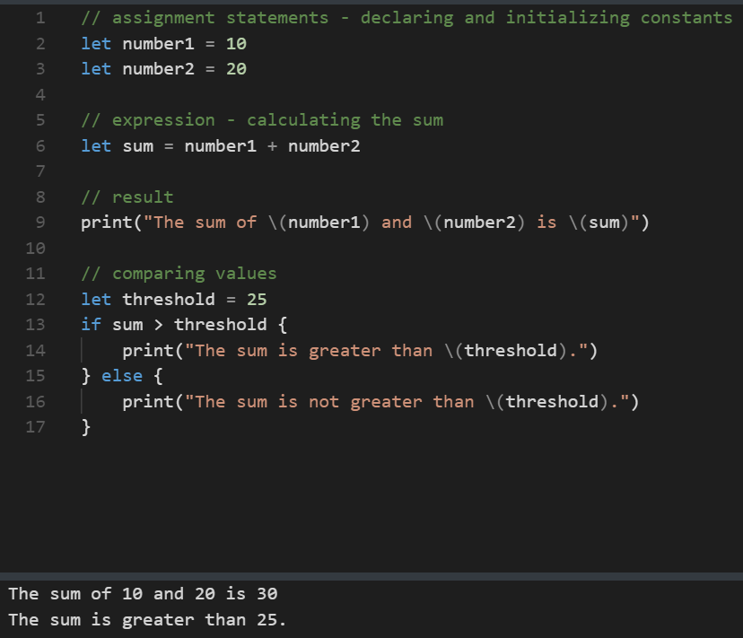
Fundamentals: Syntax, Types, Operations
Expressions
Prefix, infix, primary, postfix
Variables, constants, literals, operators
Type-safety enforced
Assignment statements syntax
Constants: let constantName = value
Variables: var variableName = value
Operators
Arithmetic: +, -, *, /
Comparisons: ==, !=, >, <, >=, <=
Logical: &&, ||, !

Slide 6
Concurrency
Feature | Description | Application
Asynchronous Functions | Can be suspended and resumed. Marked with async. Suspension points marked with await. | Performing network requests or database operations without blocking main thread.
Awaiting Asynchronous Calls | let photoNames = await listPhotos(inGallery: "Summer Vacation") | Using the result of an asynchronous function call in subsequent operations.
Parallel Calls | Use async let for running asynchronous functions in parallel. | Fetching multiple resources simultaneously to improve loading times.
Tasks and Task Groups | Structured concurrency with task groups and child tasks. Use withTaskGroup for dynamic task creation. | Coordinating multiple related tasks, such as batch processing a set of images.
Task Cancellation | Cooperative model. Use Task.checkCancellation() or Task.isCancelled. | Gracefully stopping tasks based on user actions or other conditions.
Actors | Safe sharing of information between concurrent code. Allow only one task to access mutable state at a time. | Ensuring data integrity when multiple tasks need to access and modify shared data.
Actor Isolation | Guarantees only one task at a time accesses an actor's state. | Preventing race conditions and data corruption in concurrent environments.

Slide 7
Exception/event handling
Feature | Description | Application
Optionals vs. Errors | Optionals represent the absence of a value. Errors provide information on failure causes for better response. | Differentiating between absence of a value and actual error condition.
Representing Errors | Errors conform to the Error protocol. Enums are suitable for grouping related errors with associated values. | Structuring and categorizing errors in a complex system such as a file handling or network communication module.
Throwing Errors | Use the throw statement to indicate an error. | Signaling issues during runtime like file access, data parsing, or network requests.
Handling Errors | Propagate errors, handle with do-catch, convert to optionals, or assert no error will occur. | Providing multiple strategies to handle errors depending on the context, such as user input validation or resource loading.
Propagating Errors | Mark functions with throws to indicate they can throw errors. Errors propagate to the calling scope unless handled. | Creating functions that perform operations with potential failures, ensuring the caller is aware and can handle such failures.
Using do-catch | Run a block of code and handle errors in catch clauses. | Managing failures gracefully without crashing the application.

Slide 8
Functional programming
Swift is a “multi-paradigm” language, meaning it can be used in both object-oriented and functional ways, sometimes simultaneously. As mentioned, it features classes, inheritance, polymorphism, and encapsulation for OOO but also the following functional aspects:
Constants (e.g. let)
Immutable data structures
Variables, arguments and closures
High-order functions (e.g. map, filter, reduce)
As beginners, though, we get the impression that it’s primarily OO.

Slide 9
Project

Slide 10
Objective
Create a simple “To-Do List” mobile app using Swift that helps the user better manage daily tasks.

Slide 11
Constraints/Limitations
Funds
Neither group member has a paid Apple developer account, so app cannot be deployed, only emulated locally
Time
App will be developed in short timeframe (around 2 weeks)
Skill
We’re both beginners, so we want to make sure our goals are realistic

Slide 12
Features
User will be able to add list items in “Pending” category
User will be able to perform the following actions on list items:
Delete
Edit
Complete
Each list item will be comprised of:
Title (text)
Description (text)
Deadline (date/time)

Slide 13
Technology
Project will be built using:
One Intel-based Macintosh computer
One Apple Silicon Macintosh computer
Xcode developer software

Slide 14
Applications
A To-Do List app could be useful in a range of settings including but not limited to:
Personal
Goal setting, fitness, daily tasks
Professional
Project management, meeting minutes
Educational
Homework and assignment management

Slide 15
Thank you!

