Slide 1
Mutual Fund Performance, Risk & Investor Analytics Platform
Data Analyst Internship Project
Name: Ashutosh Suryawanshi
June 2026
Python | SQLite | Power BI

Slide 2
Problem Statement
• Large volume of mutual fund data
• Difficulty tracking performance
• Need for risk-adjusted evaluation
• Limited investor retention insights
Objective:
Build an end-to-end analytics platform for performance,
risk, and investor behavior analysis.

Slide 3
Project Architecture
Raw Data
Data Cleaning
SQLite Database
Python Analytics
Power BI Dashboard
Business Insights

Slide 4
Dataset Overview
Dataset | Purpose
Fund Master | Fund Information
NAV History | Performance Tracking
Transactions | Investor Analysis
Benchmark Data | Market Comparison
Holdings | Portfolio Analysis
SIP Inflows | Investment Trends

Slide 5
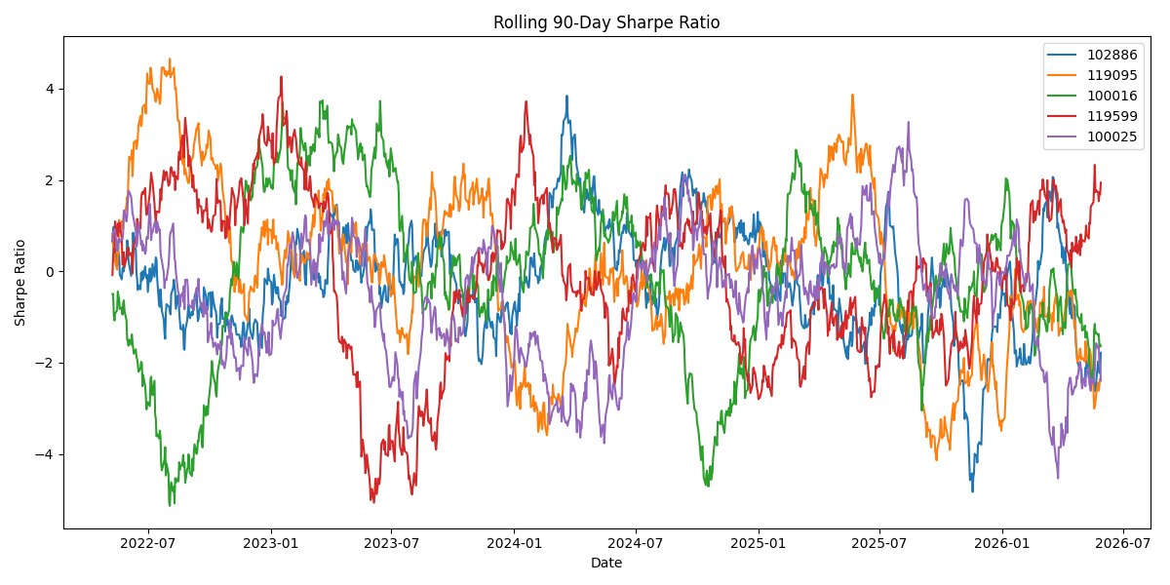
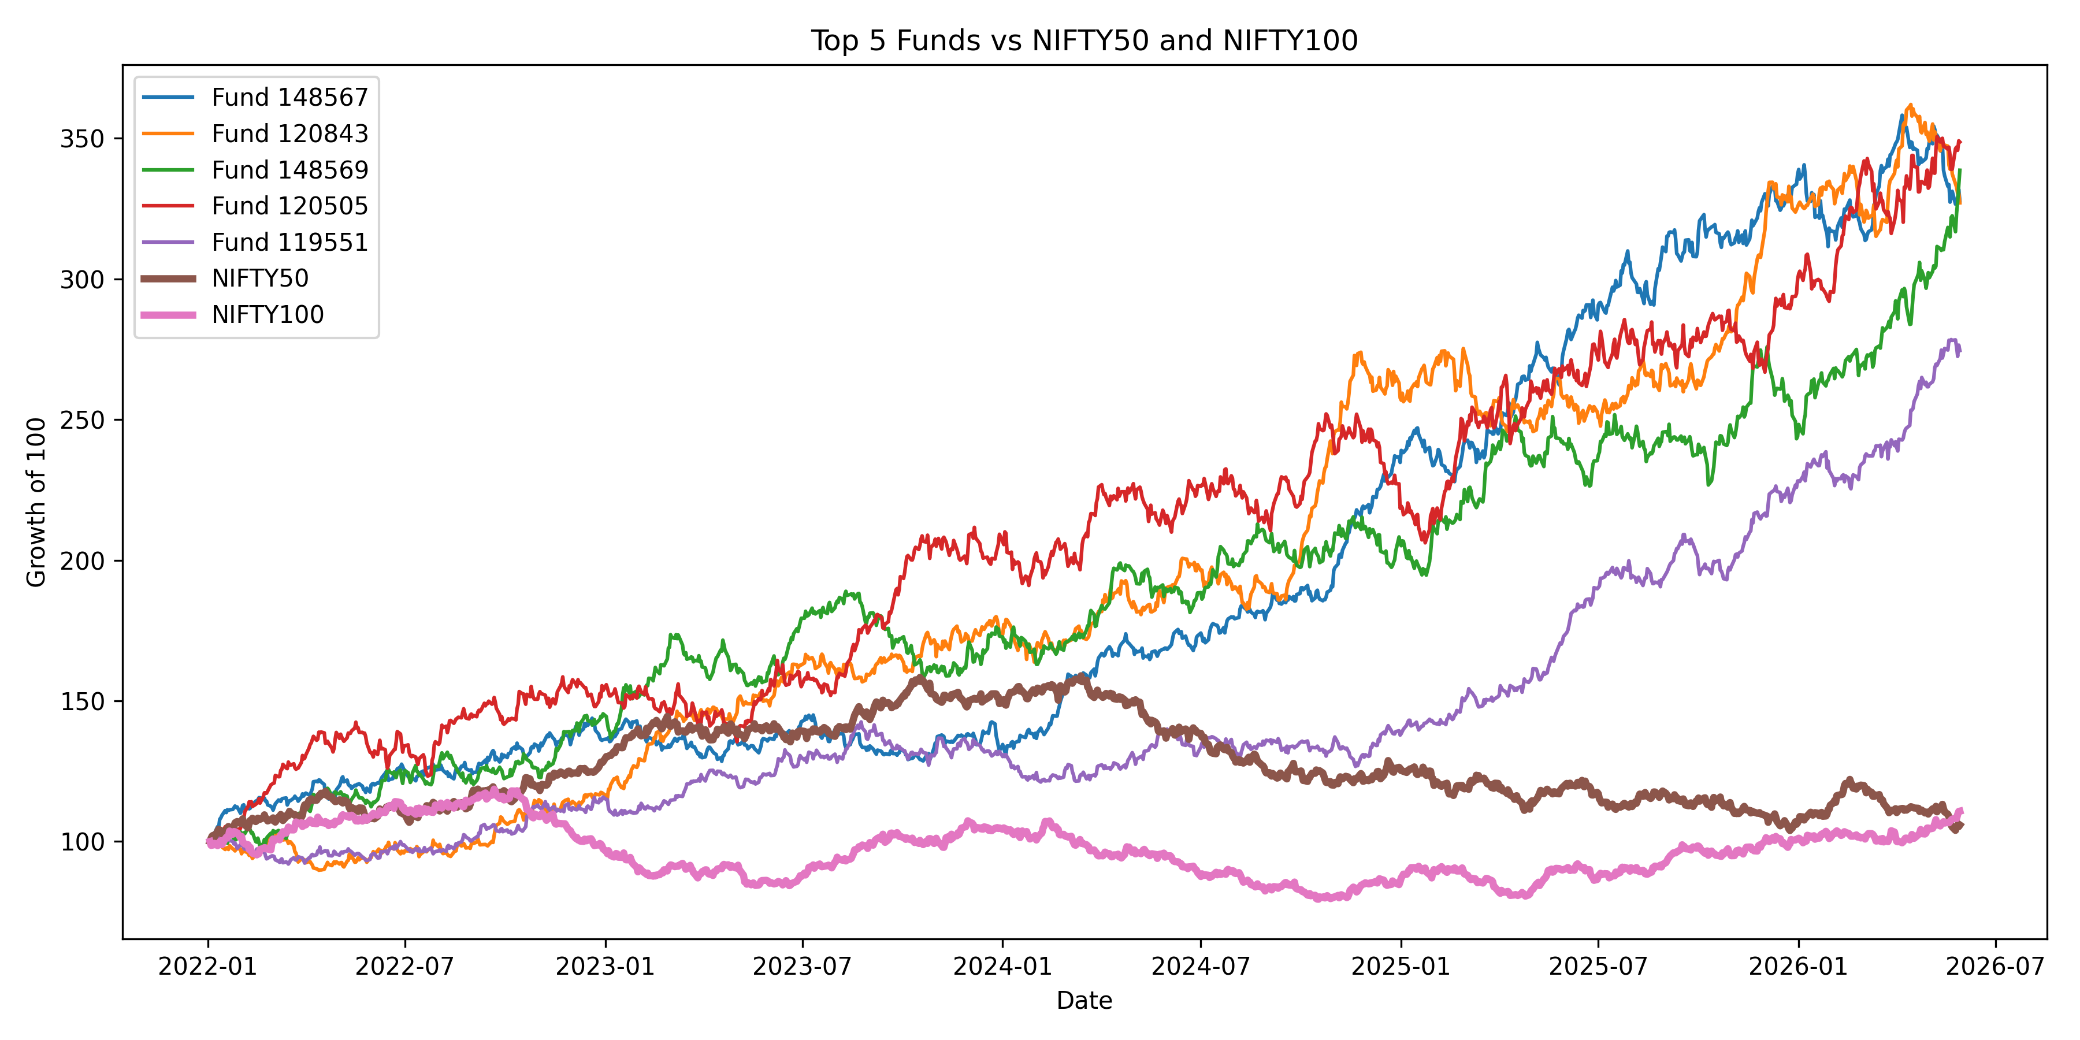
Performance Analytics
Key Metrics Calculated
• Alpha
Measures excess return over benchmark
• Beta
Measures market sensitivity
• Sharpe Ratio
Measures risk-adjusted return
• Benchmark Comparison
Compares fund performance against market indices

Slide 6
Risk Analytics
Risk Measures Implemented
• Value at Risk (VaR)
• Conditional VaR (CVaR)
• HHI Concentration Analysis
Outputs:
• var_cvar_report.csv
• hhi_concentration_report.csv
Goal:
Measure downside risk and portfolio concentration.

Slide 7
Investor Analytics
Analyses Performed
• Cohort Analysis
Groups investors based on their first investment period.
• SIP Continuity Analysis
Measures consistency of SIP investments over time.
Key Insights
• Investor activity is highest during initial months.
• Retention decreases gradually over time.
• Long-term investors contribute significantly to fund stability.
• SIP continuity helps identify loyal investors.
Business Insight:
Investor retention and SIP continuity are critical indicators of long-term mutual fund growth.

Slide 8
Fund Recommendation Engine
Developed using Python
Input:
• Fund Scorecard
• Risk Metrics
• Sharpe Ratio
Output:
Top-ranked mutual funds based on
risk-adjusted performance.

Slide 9
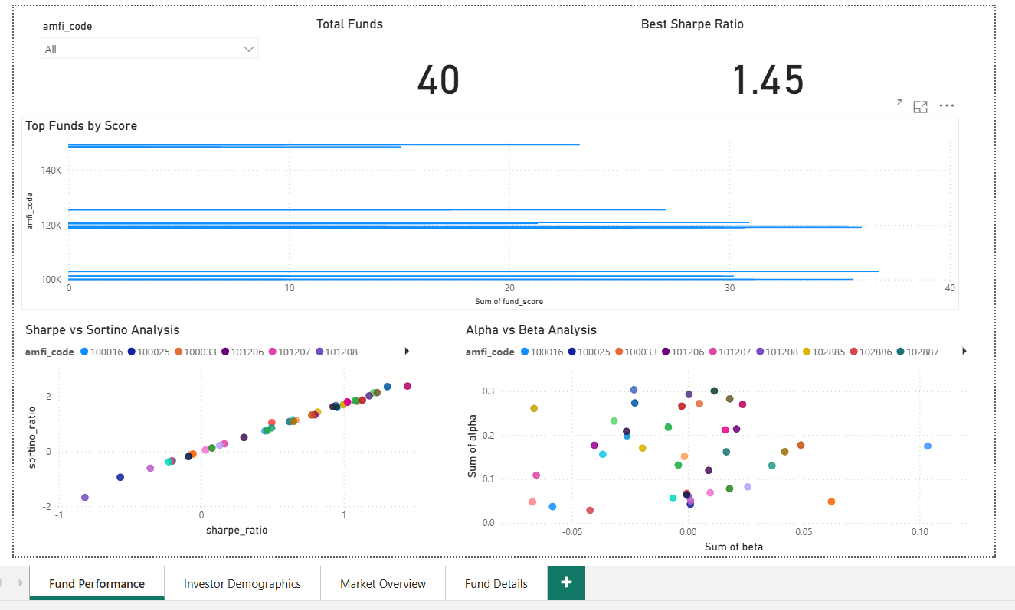
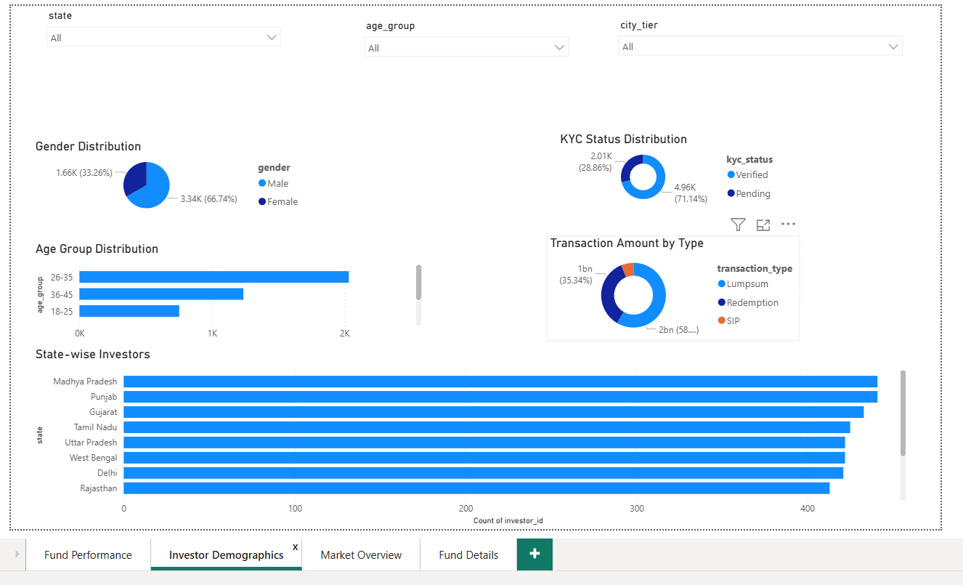
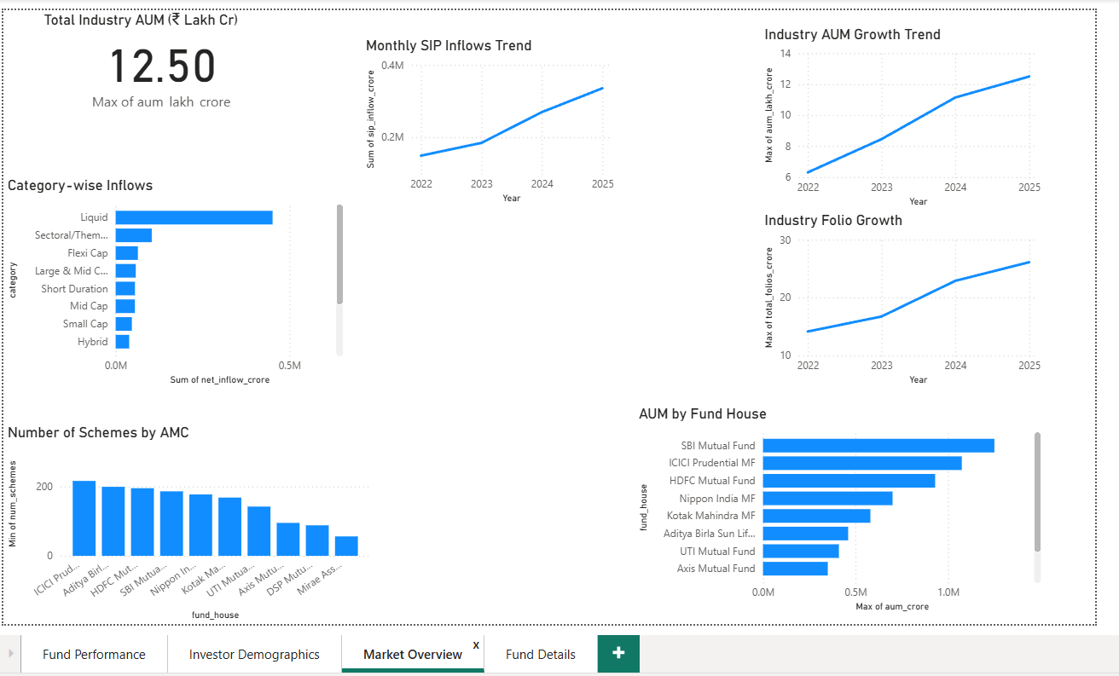
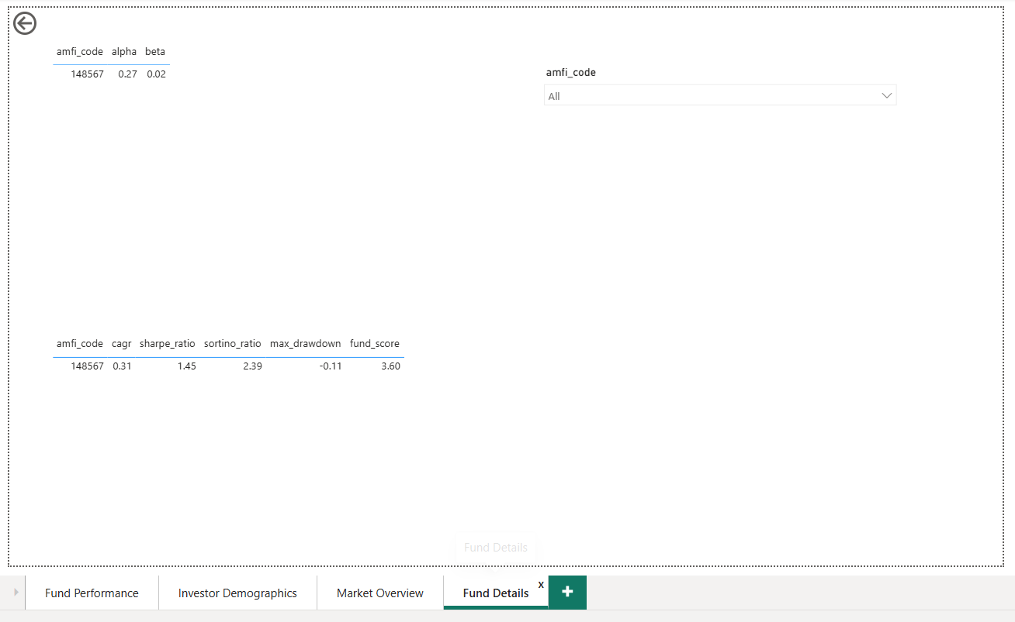
Power BI Dashboard
Business Impact:
• Interactive fund performance monitoring
• Investor segmentation and demographic analysis
• Market trend tracking and decision support

Slide 10
Project Outcomes & Conclusion
Key Achievements
✓ Data Cleaning & Validation
✓ SQLite Database Development
✓ Performance Analytics
✓ Risk Analytics (Alpha, Beta, VaR, CVaR)
✓ Investor Analytics
✓ Recommendation Engine
✓ Power BI Dashboard
Business Impact
• Better fund performance evaluation
• Improved risk assessment
• Investor retention insights
• Data-driven decision making
• Interactive business reporting
Mutual Fund Performance, Risk & Investor Analytics Platform
Thank You
Questions?

