Slide 1
Progetto corso TIW
2019/2020
Alessandro Villa – Matteo Visotto

Slide 2
Premesse: scelte primarie
Templating → Thymeleaf 3
Mappe → Mapbox (js api)
Server → Apache Tomcat 9
DB → MariaDB 10

Slide 3
Premesse: scelte secondarie
JS → (elementi di) jQuery
Hashing → argon2id (tramite libreria argon2-jvm)
Modalità notturna → CSS tramite “Dark Reader”
Libreria aggiuntive:
Apache Commons (https://commons.apache.org/)
MySQL connector 8.0.20
Apache Commons validator (mail address validation)

Slide 4
Schema ER

Slide 5
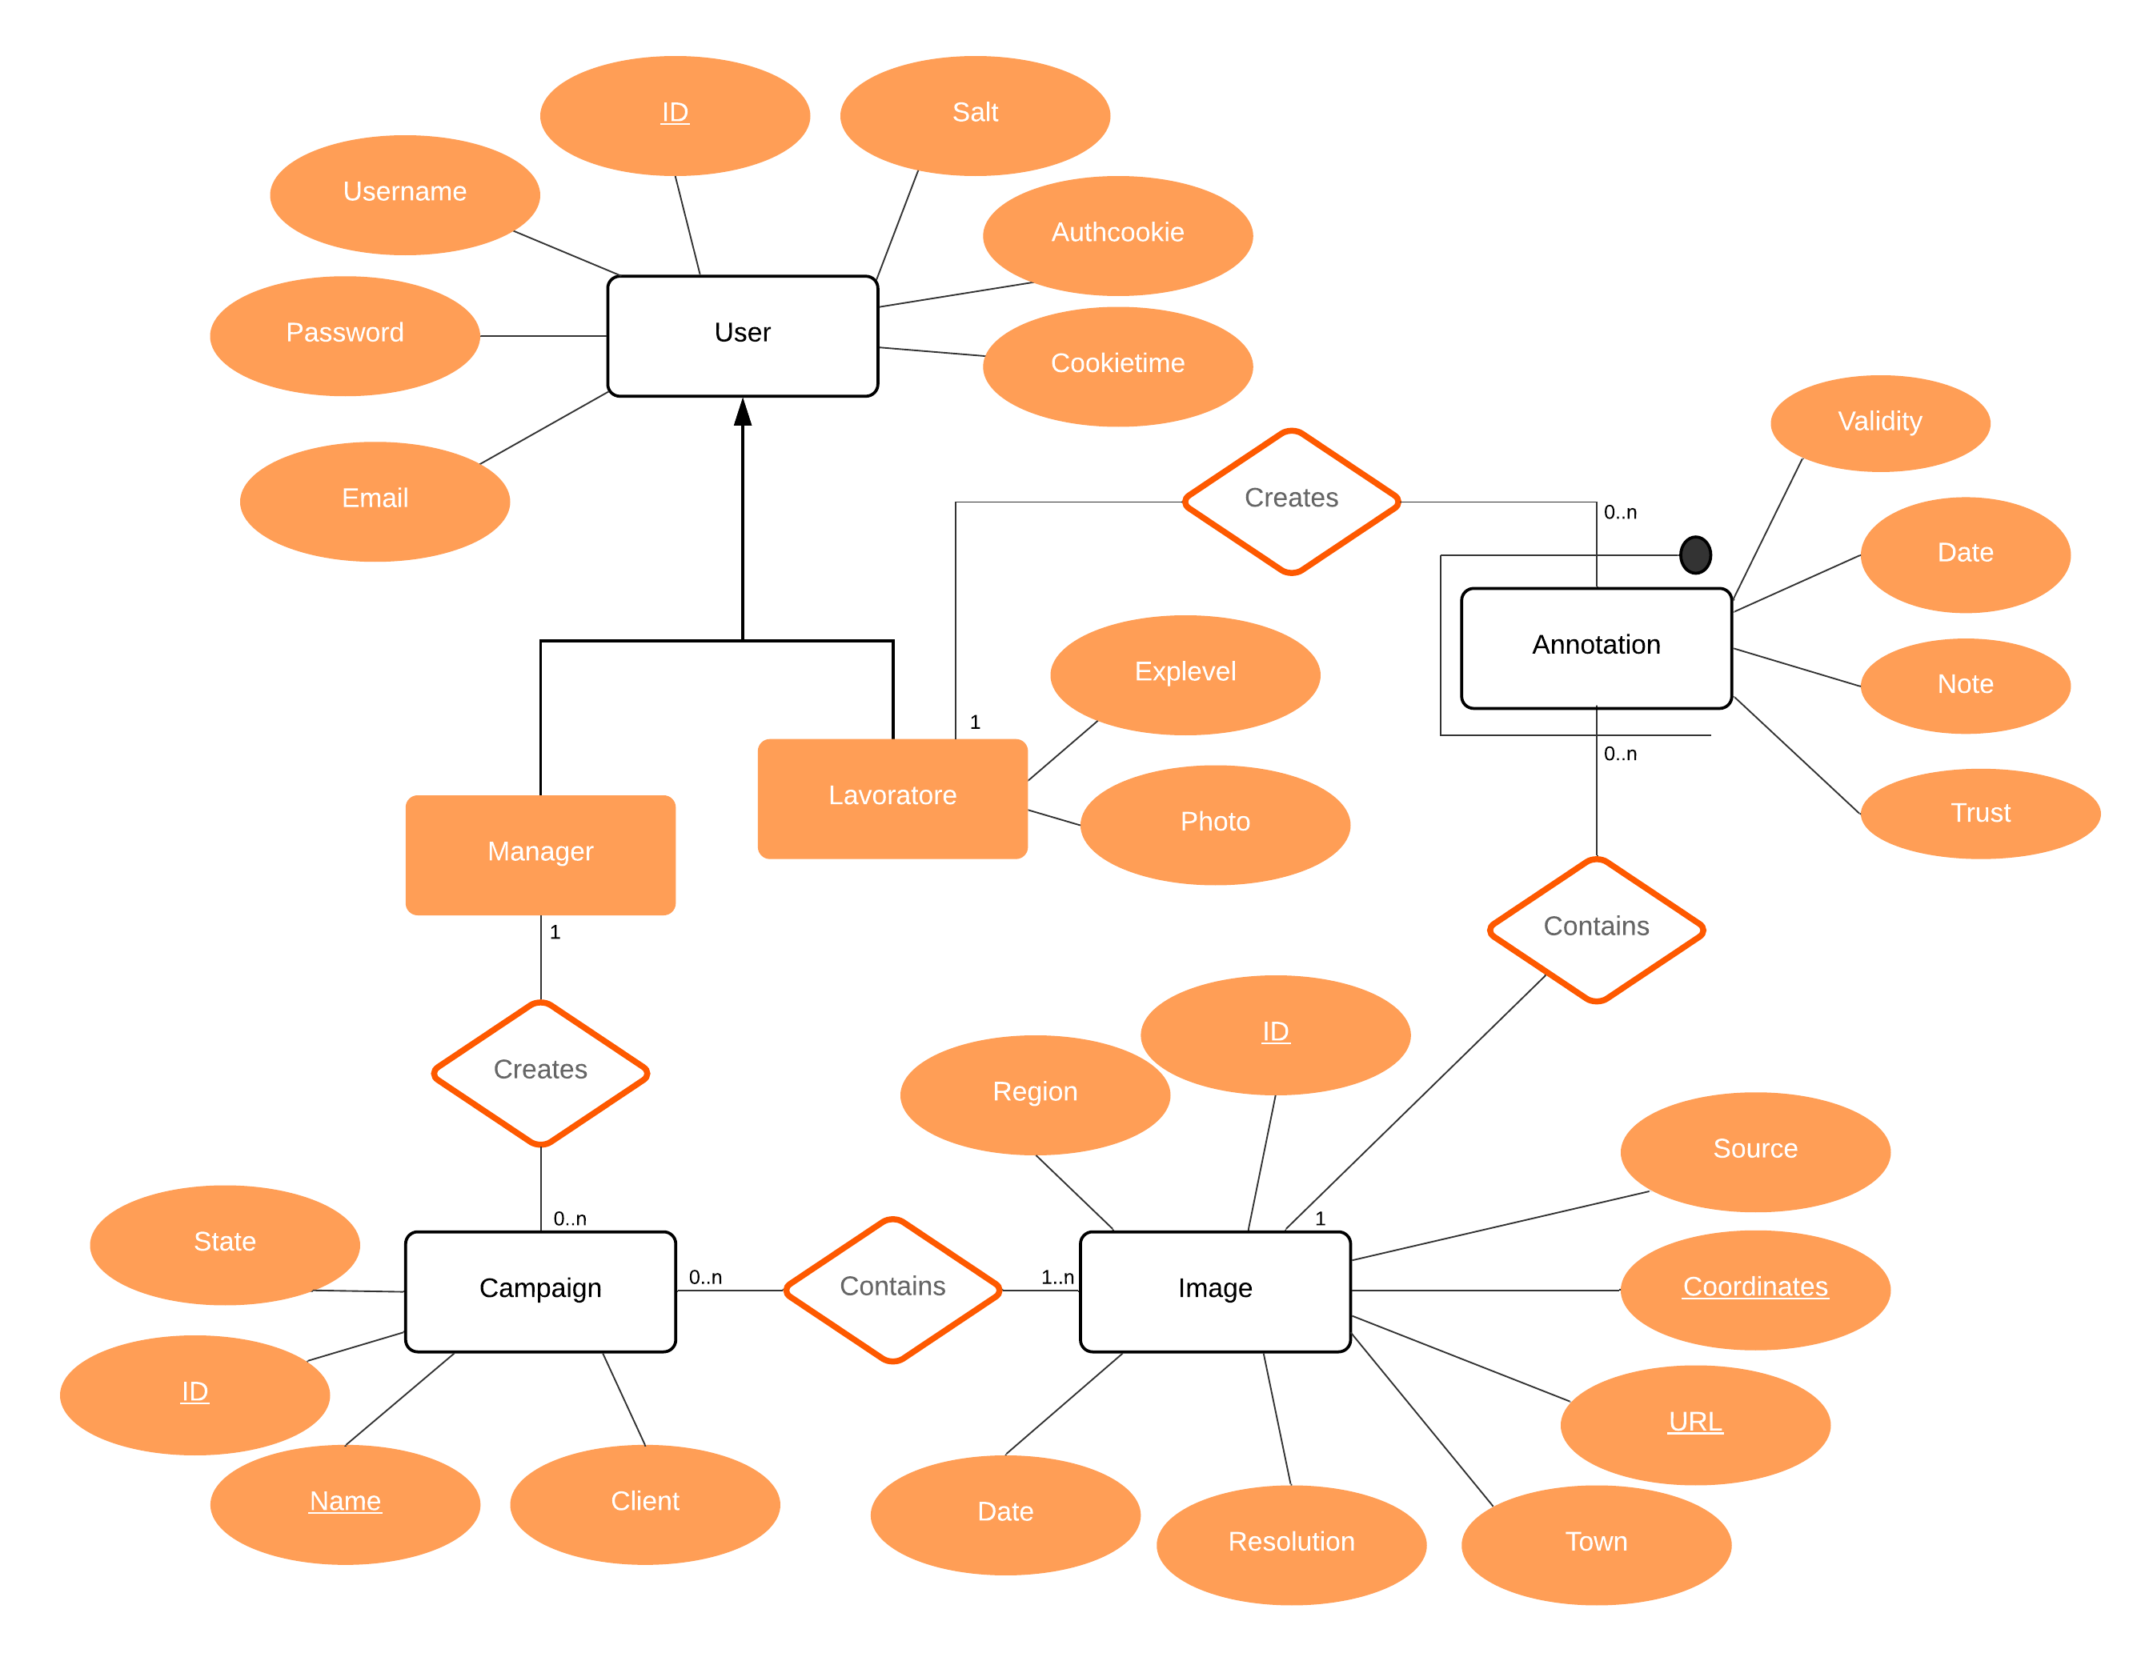

Slide 6
annotation(workerID, imageID, date, validity, trust,note)
campaign(id, managerID, name, client, state)
image(id, date, latitude, longitude, resolution, source, region, town, url)
imageCampaign(campaignID, imageID)
user(id, username, email, password, role, level, photo, salt, authcookie, cookietime)
workerCampaign(workerID, campaignID)

Slide 7
create table campaign ( id int auto_increment primary key, managerId int null, name varchar(255) not null, client varchar(255) not null, state varchar(50) default 'created' not null, constraint campaign_name_uindex unique (name), constraint campaign_manager_fk foreign key (managerId) references user (id) on update cascade on delete set null );
create table annotation ( workerId int not null, imageId int not null, date datetime not null, validity smallint default 0 not null, trust varchar(10) not null, note text null, primary key (workerId, imageId), constraint annotation_image_fk foreign key (imageId) references image (id) on update cascade on delete cascade, constraint annotation_user_fk foreign key (workerId) references user (id) on update cascade );

Slide 8
create table image ( id int auto_increment primary key, date date not null, latitude float not null, longitude float not null, resolution varchar(50) not null, source varchar(100) not null, region varchar(100) not null, town varchar(100) not null, url varchar(255) not null );
create table imageCampaign ( campaignId int not null, imageId int not null, primary key (campaignId, imageId), constraint imageCampaign_campaign_fk foreign key (campaignId) references campaign (id) on update cascade on delete cascade, constraint imageCampaign_image_fk foreign key (imageId) references image (id) on update cascade on delete cascade );

Slide 9
create table workerCampaign ( workerId int not null, campaignId int not null, primary key (workerId, campaignId), constraint workerCampaign_campaign_fk foreign key (campaignId) references campaign (id) on update cascade on delete cascade, constraint workerCampaign_worker_fk foreign key (workerId) references user (id) on update cascade on delete cascade );
create table user ( id int auto_increment primary key, username varchar(100) not null, email varchar(255) not null, password varchar(400) not null, role varchar(10) not null, level varchar(10) null, photo varchar(255) null, salt char(100) not null, authcookie varchar(255) null, cookietime datetime null, constraint user_authcookie_uindex unique (authcookie), constraint user_email_uindex unique (email), constraint user_username_uindex unique (username) );

Slide 10
Struttura Applicazione

Slide 11
Componenti
Beans
Alert
Annotation
Campaign
Image
User
Controllers (servlets)
CampaignActions
CampaignDetail
CampaignDetailMaps
CampaignReport
CreateCampaign
Gallery
GetCampaignImageData
GetGalleryImage
ImageUploader
Login
Logout
ManagerHome
Profile
Register
WorkerHome
Filters
CookieChecker
- primo, controlla cookies
Checker
- se non ci sono cookie, controlla la sessione
ManagerChecker, WorkerChecker
- gli altri rimandano ad uno dei due a seconda di che ruolo è stato riconosciuto all’utente
DAOs:
AnnotationDAO
CampaignDAO
ImageDAO
UserDAO

Slide 12
Login
Logout
Login page
username+ password
Login form [field: username
field: password]
Check Login
submit
role=manager
username+pwd errate
role=worker
Cookie/session errato(a) o
non presente
Check Cookie / Session
Manager HomePage
role=manager
session
Request
Worker HomePage
role=worker
session

Slide 13
Access rights (1)
CookieChecker
UserDAO
Client
ManagerChecker
WorkerChecker
GET
(/ || /login || /register)
[!(session.isNew || user == null)]
Role == Manager
Role == Worker
authcookie
cookie, cookietime
|| null
If cookie != null
Check validity
cookie OK: getUserFromCookie
user
else
HTTP 200

Slide 14
Access rights (2)
Checker
Client
ManagerChecker
WorkerChecker
GET
!(/ || /login || /register)
[!(session.isNew || user == null)]
Role == Manager
Role == Worker
else redirect(/login)

Slide 15
Access rights (3)
WorkerChecker
Client
GET
(/worker/smth)
[isWorker]
200 OK
else
[isManager]
redirect(/manager)
else
redirect(/index.html)

Slide 16
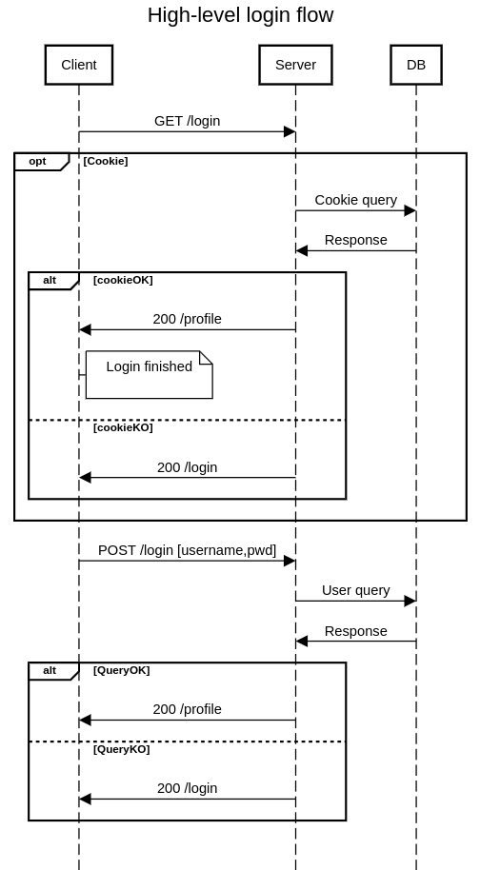
||( !session.isNew && user != null)
else

Slide 17
Registrazione
REGISTER PAGE
email, password, password confirm
submit
Register form
[field: email;
field: password; field: confirm;
field: role] && (if role == Worker) [field: photo: field: experience ]
Register
Login link
click
Registration result
LOGIN
PAGE

Slide 18
Manager Home
Logout
user
Click (on Logout)
ManagerHome
Click (on Account tab)
Profile
HOME
:List
[databinding: yourCampaigns]
Wizard
[field: Name
field: Client]
Error
CreateCampaign
create
CreateCampaign
OK
ManagerCampaign

Slide 19
Worker Home
Logout
user
user
Click (on Logout)
WorkerHome
Click (on Account tab)
Profile
HOME
:List
[databinding: availableCampaigns]
:List
[databinding: yourCampaigns]
Click
(on Details)
Id (of the campaign)
Gallery

Slide 20
Profile
Logout
user
Click (on Logout)
Profile
Click (on Home tab)
Home
Password change form
[field: oldPwd
field: newPwd
field: newPwdConf]
Submit button
KO
Image
[condition: user.role = worker]
[databinding: userImage]
Error alert
newPwdOK
Password change
User data
[databinding: Name
databinding: Email
databinding: Role
{condition: role = worker}
databinding: explevel]
Change image button
OK
KO
Error alert
KO
Image change
Error alert
Change data button
newDataOK
Data change

Slide 21
Manager Campaign
Logout
User, id
Click (on Logout)
ManagerCampaign
Click (on Account tab)
Profile
View switch button
If viewmode = grid
:List
[databinding: images]
ManagerCampaign/maps
Campaign report button
else
ManagerCampaign
Js: openDetail(id)
[condition: campaign.state == CREATED]
Add new image button
CampaignReport
Modal open
ImageUploader

Slide 22
Worker Campaign
Logout
User, id
Click (on Logout)
Gallery
Click (on Account tab)
Profile
:List
[databinding: images]
Js: openDetail(id)
Check annotation validity
OK
KO
Success popup, annotation added
Error alert

