Slide 1

GPG for Fun and Profit
(or A Tour Through My Encryption Adventure)
http://www.zdnet.com/article/encryption-is-here-to-stay-secure-messaging-app-telegram-hits-100-million-users/
Notes:
Just a quick look at using GPG
Mostly my experiences, a potpourri
My learned colleagues may have corrections
Images ripped shamelessly from web searches

Slide 2
Agenda
Encryption and Tools
Getting Started with GPG
Encrypting and Decrypting Files
Sharing Keys
Trusting Keys
An Application

Slide 3
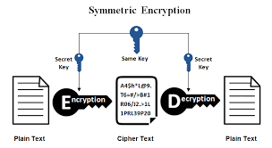
Simple Encryption
https://www.ssl2buy.com/wiki/symmetric-vs-asymmetric-encryption-what-are-differences
Notes:
One of the simplest encryption systems
Known since ancient times (“Caesar cipher”)
Easy to use and implement
Major problem: keeping the key safe

Slide 4
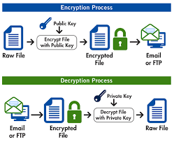
Public Key Encryption
https://www.goanywhere.com/managed-file-transfer/encryption/open-pgp
Notes:
The solution to the key interception problem
Use two different keys
One you make public, the other you keep secret
Relies on clever mathematical stuff
Public Key Cryptography is simple in concept
Lots of fiddly stuff to manage though
The solution to the solution?

Slide 5

http://shop.oreilly.com/product/9781565920989.do
Notes:
Pretty Good Privacy
Phil Zimmerman's encryption program
Developed in 1991
Colourful history

Slide 6

GPG
GNU Privacy Guard
Available on most Linux systems
Otherwise
apt-get install gnupg
yum install gnupg
http://www.patriceguay.com/livecd/gpg
Notes:
FLOSS version of PGP
Implements OpenPGP standard
Easy to get going, might already be installed

Slide 7
Getting started
Generate a new key
Actually two keys: one for signing only
You associate it with an user id
The longer the key the safer it is
You will need to generate a lot of randomness
Notes:
Demo:
ls -al .gnupg
gpg –gen-key
1
4096
1
y
Test User
test@example.com
o
ls -al .gnupg

Slide 8
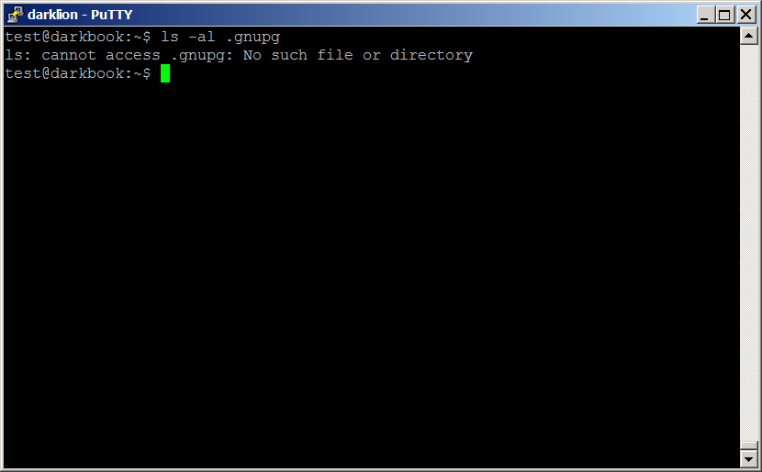
Demo: Before keygen

Slide 9
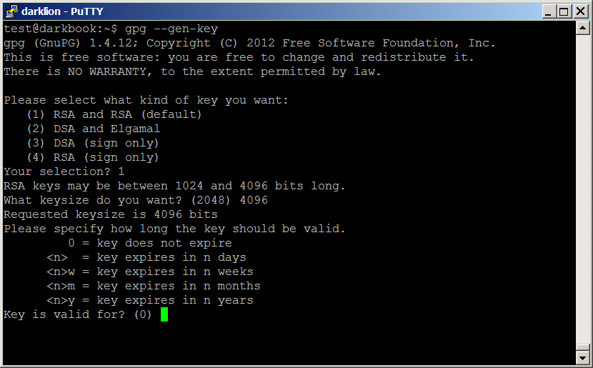
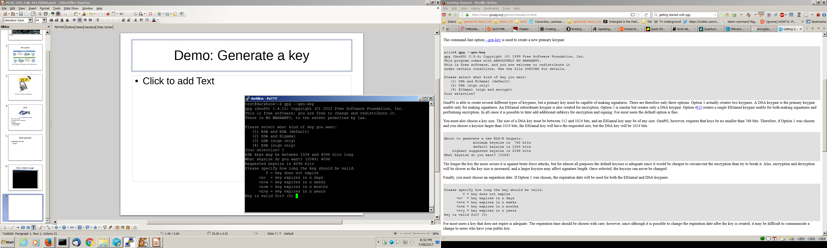
Demo: Generate a key (1)

Slide 10
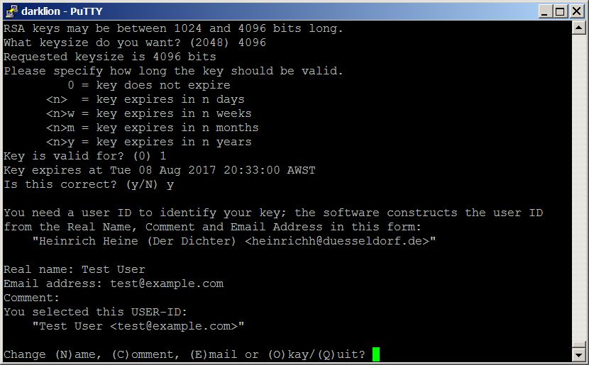
Demo: Generate a key (2)

Slide 11
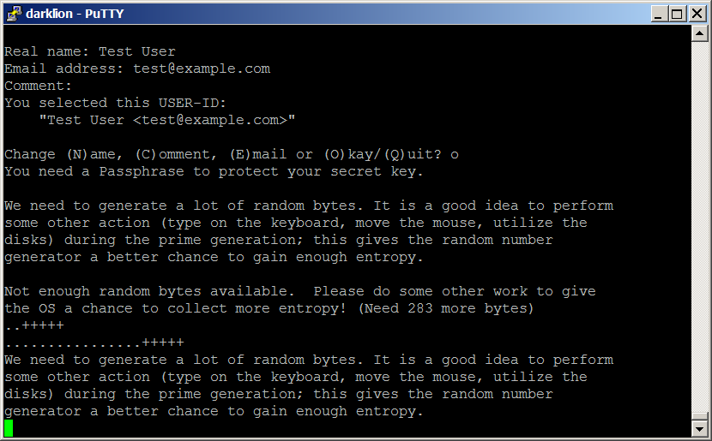
Demo: Generate a key (3)

Slide 12
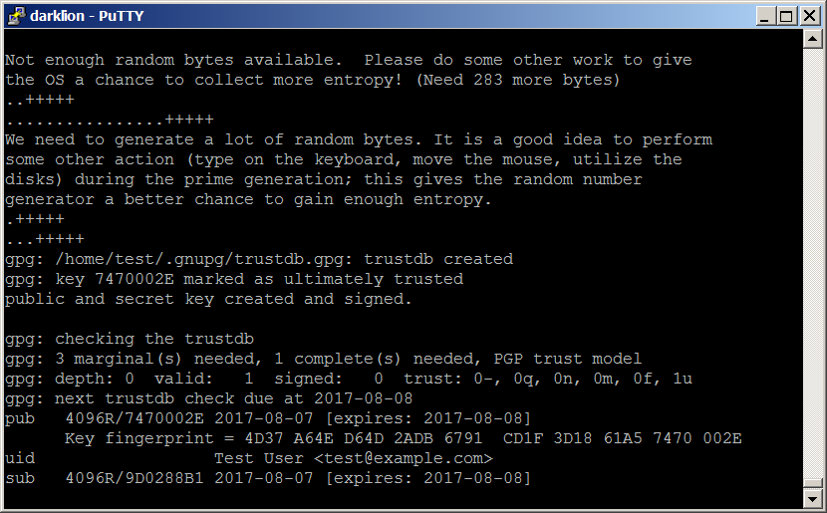
Demo: Generate a key (3)

Slide 13
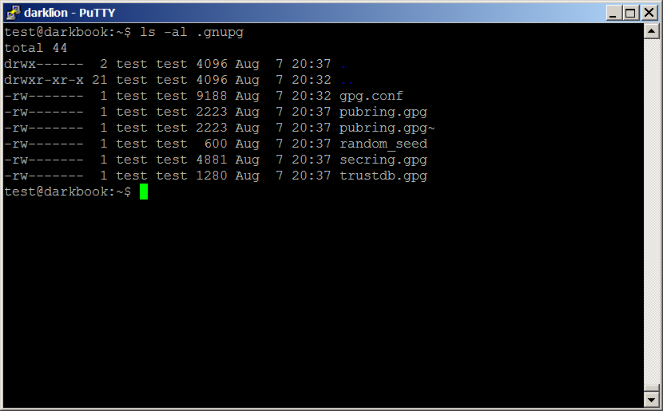
Demo: After key generation

Slide 14
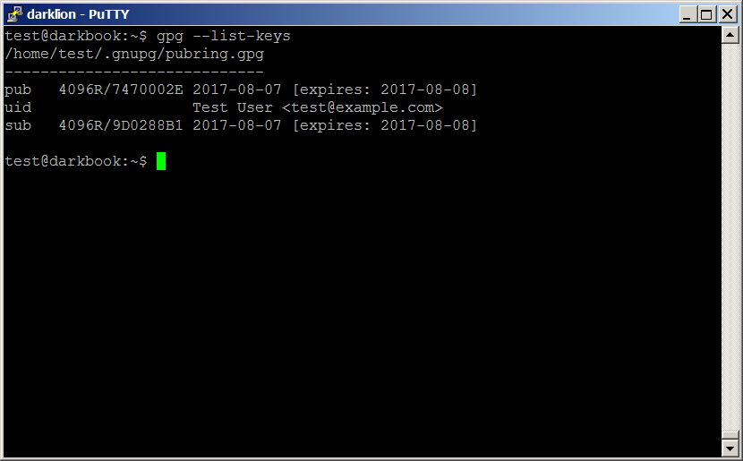
Demo: List keys

Slide 15
Encrypt a file
gpg --encrypt file
gpg –decrypt file.gpg
Notes:
Demo
cat > caesar
Beware the ides of March!
^D
gpg --encrypt caesar
test@example.com
clear
cat caesar.gpg
clear
gpg --decrypt caesar.gpg
test

Slide 16
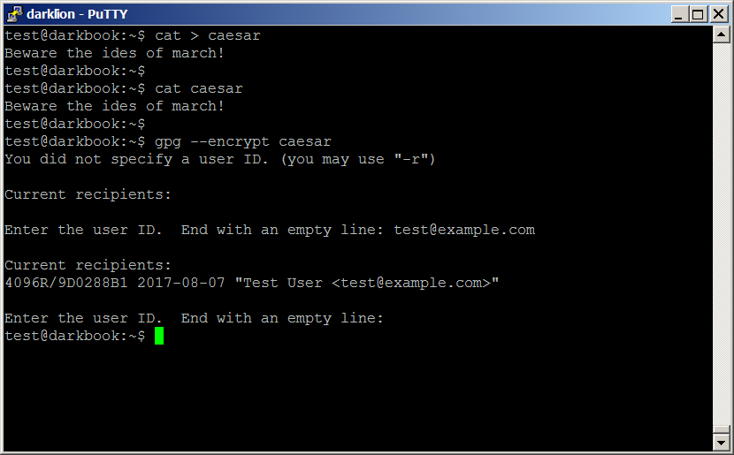
Demo: Encrypt a file

Slide 17
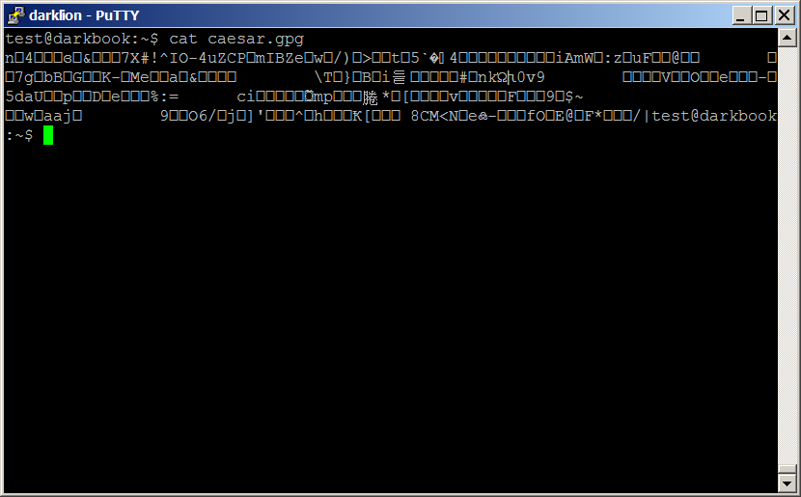
Demo: Encrypted File

Slide 18

Demo: Decrypt a file

Slide 19
Keyservers
Communicate your key to other people
Get other people's keys
To trust you must verify
Just check that the key fingerprint matches
Only verifies that its the “right key”
Only you can know if the
Notes:
Demo
Switch to peter a/c
gpg --list-keys contact@peterlyons.com.au
gpg --send-keys B2C4FB78
gpg --send-keys --keyserver pgp.mit.edu B2C4FB78
Switch to test a/c
cat fingerprint.txt
gpg --recv-keys B2C4FB78
gpg --list-keys --with-fingerprint

Slide 20
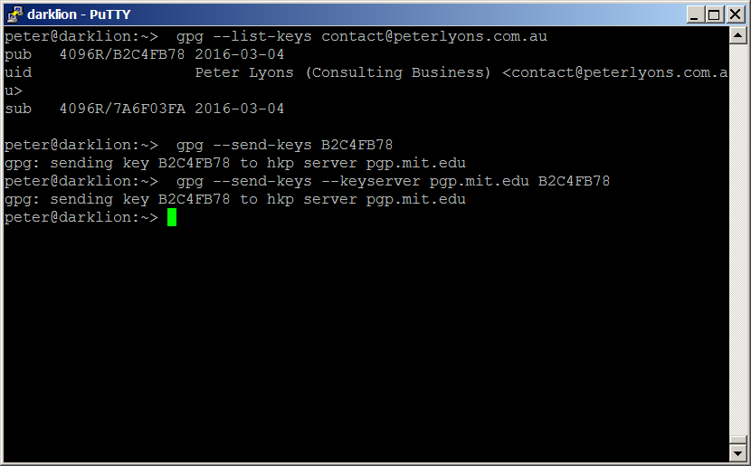
Demo: Upload a key

Slide 21
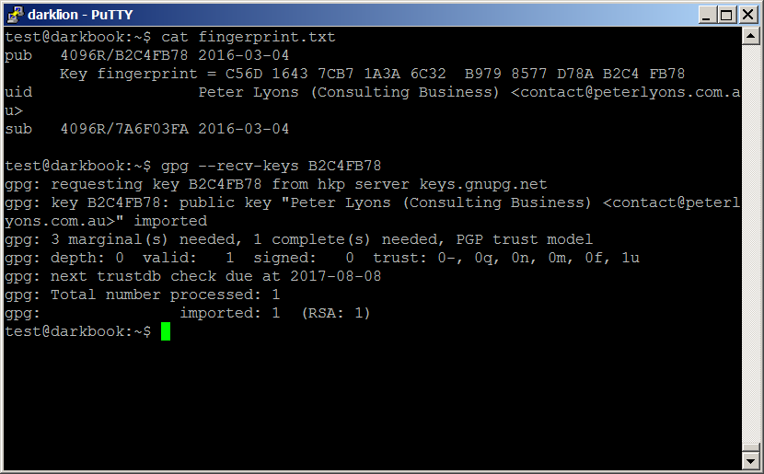
Demo: Download a key

Slide 22

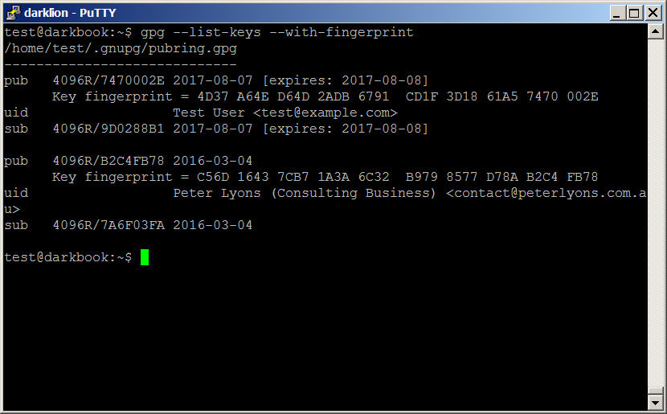
Demo: Verify a key

Slide 23
Trusting Keys
Web of Trust
Assign a value to how much you trust the key
Sign a key to assert that you vouch for it

Slide 24
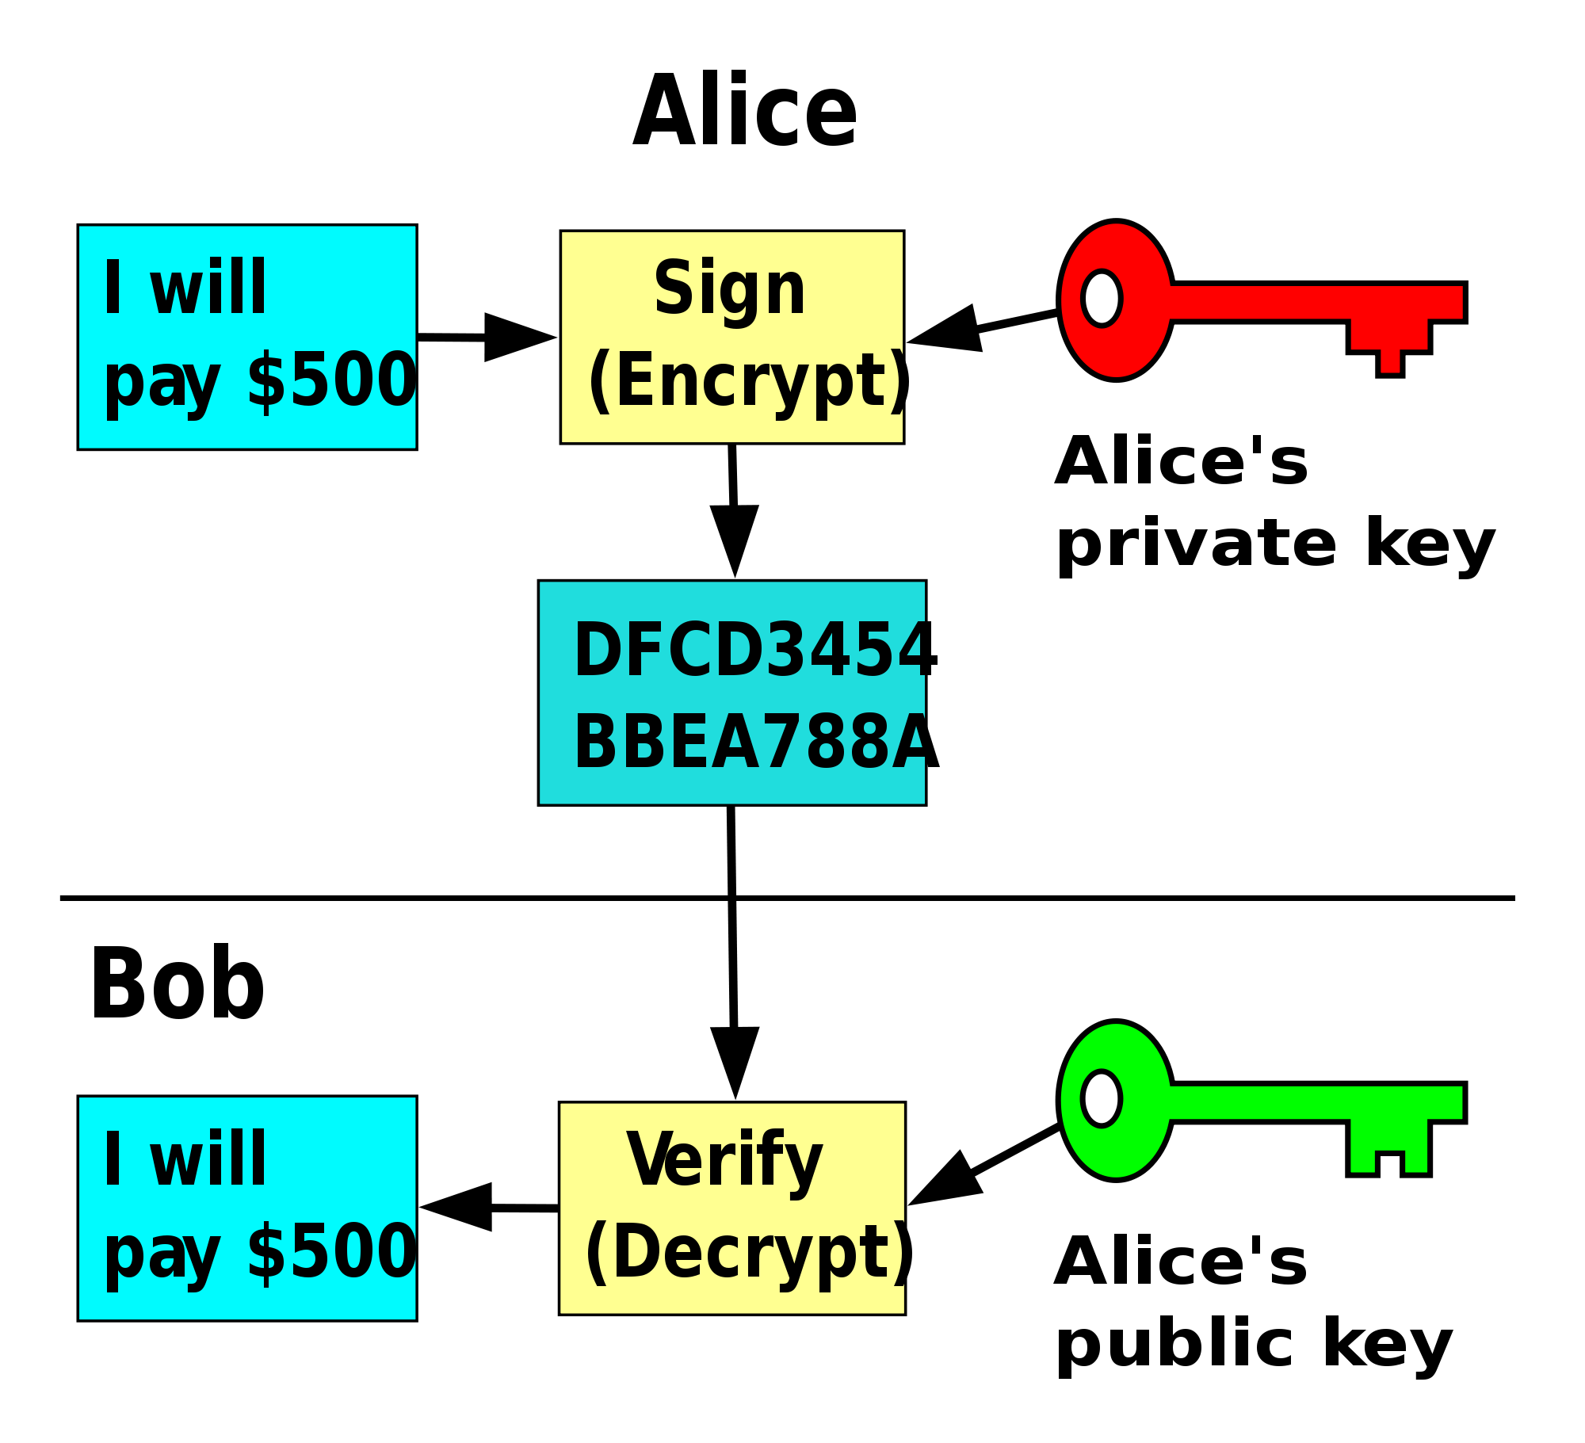
Public Key Signing
https://commons.wikimedia.org/wiki/File:Public_key_signing.svg
Notes:
Public Key Cryptography is asymmetric
But you can still apply it in “reverse”
If you encrypt with your secret key only your public key can decrypt it
So only you could have done the encryption

Slide 25
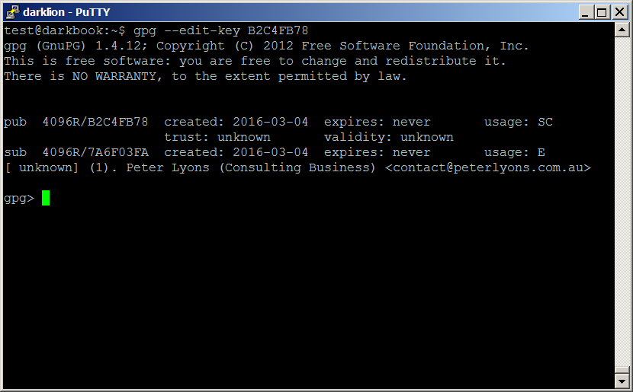
Demo: Edit Key

Slide 26
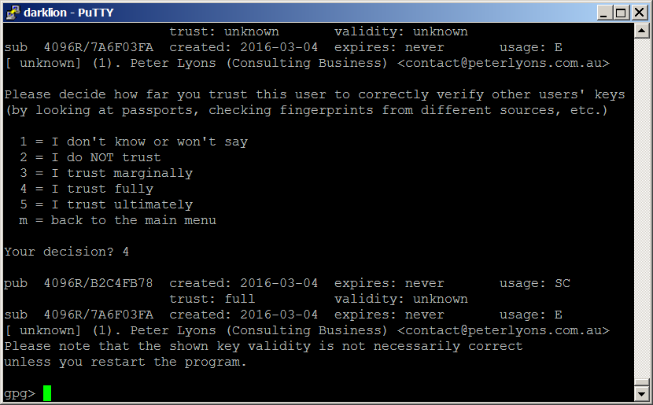
Demo: Trust a key

Slide 27
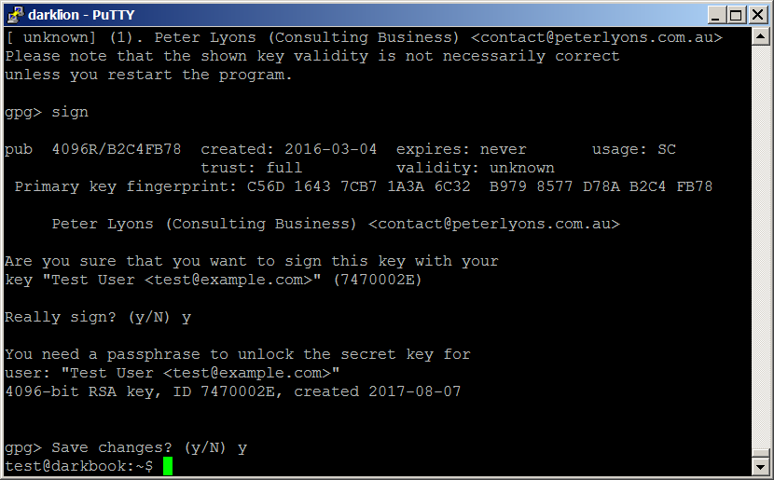
Demo: Sign a key

Slide 28
Long Key IDs
The key IDs shown in the listings are shortened versions of the real ones
Why does this matter?
There are attacks possible
So use “--keyid-format long”
You can put it into the config file
Notes:
Demo
gpg --list-keys --keyid-format long

Slide 29
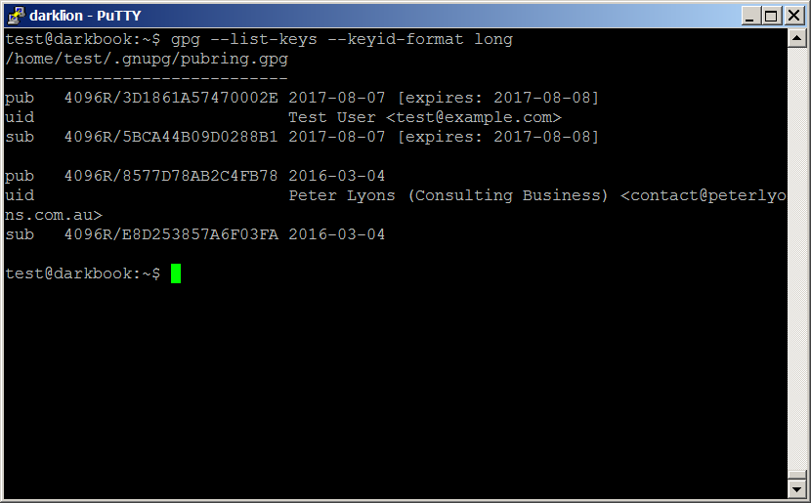
Demo: Long Key ID

Slide 30
Application: Verify your debian
Download an ISO
But has it been tampered with?
Download a MD5/SHA1/SHA256 sum
But has the sum been tampered with?
Debian signs the sum files
Use gpg to verify the signing
Need to get the debian signing key
Now you know its safe
If you trust the key you downloaded
Notes:
Demo
ls -l *MD5*
cat debian.txt
gpg --recv-keys --keyserver keyserver.debian.org 6294BE9B
gpg --fingerprint 6294BE9B
gpg --verify debian-6.0.2.1-i386-CD-MD5SUMS.sign

Slide 31
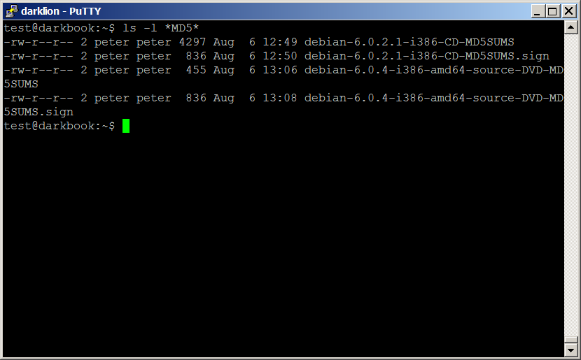
Demo: Some MD5 sums

Slide 32
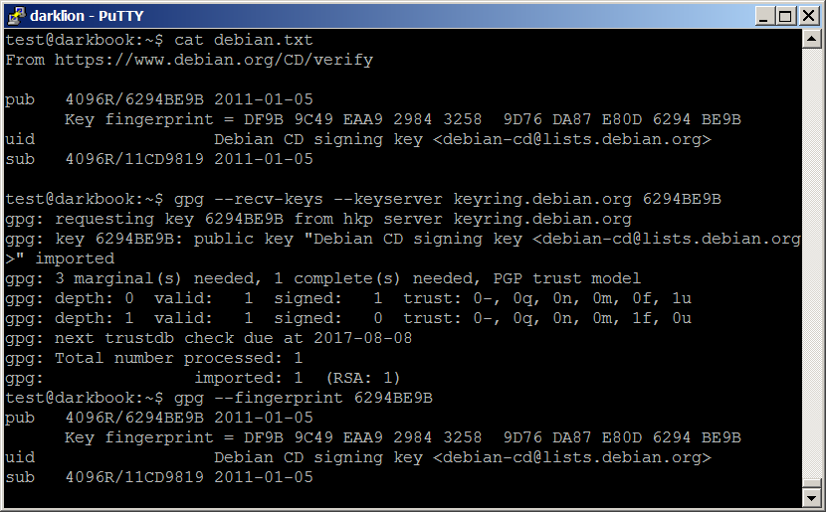
Demo: Get the Signing Key

Slide 33
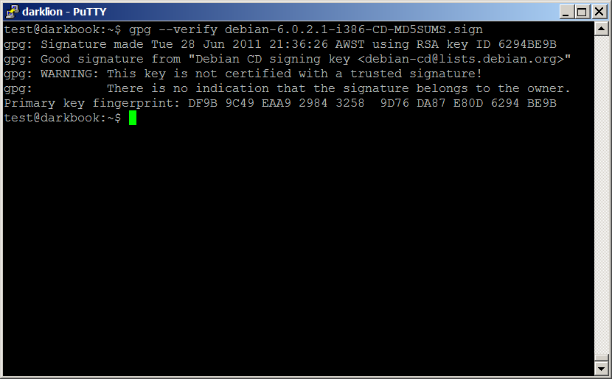
Demo: Verify a MD5 sum file

Slide 34
Stuff I haven't talked about
Trust and the Web of Trust in depth
Integrating gpg into your mail client
Mutt
Thunderbird
Key signing parties
Meet people, exchange key fingerprints, and check their passports

Slide 35
Questions?

Slide 36

http://looneytunes.wikia.com/wiki/That's_All_Folks

