Slide 1
CoM3D-ACE Progress & Experiment Plan
Multi-UAV MarineCity perception, 3D reconstruction, and LLM re-observation pipeline
Current state
• VisDrone baseline sweep complete
• Proposed detector ablation mostly complete
• L-size YOLO comparison running
• Windows Isaac benchmark prep ready
Next focus
• Add recent detector comparisons
• Add fine-grained drone dataset
• Start MarineCity Isaac export in early June
• Run 3D generation + reasoner ablations
Generated: 2026-05-26 | Branch: server-baseline-pipeline

Slide 2
1. Executive Summary
What is already stable and what still needs experiments
Detector evidence generator
Proposed module
VisDrone full comparison is established with seed repeats, p-values, dashboard, and model-size grouping.
YOLO11s-based ablations are running/completing: wavelet stem, SE, CBAM, partial deformable neck, full proposed.
Benchmark/system
Paper path
Windows MarineCity Isaac dry-run now creates multi-UAV capture plan and 3D benchmark split.
Detector table + MarineCity system experiment can support a full paper, not just a detector paper.

Slide 3
2. Current Server Status
Live detector training is continuing while this deck is generated
Active tmux sessions: server-large-comparison, server-baseline-monitor, server-live-viewer, server-training-dual-view
Current GPU state: GPU0 active for large comparison; GPU1 intentionally idle/low-use due prior CUDA allocation issue
Large comparison currently running: YOLOv8l family queue, batch=2, imgsz=1280, epochs=100
Completed detector baseline table: 15 models / 45 seed runs on VisDrone
MarineCity Windows dry-run: 36 planned frames across 4 scenes, weather, altitude, and view-angle splits
Monitoring commands
tmux attach -t server-training-dual-view
tmux attach -t server-large-comparison
Browser viewer
http://192.168.0.103:8766/
Large queue outputs update live CSV/dashboard.

Slide 4
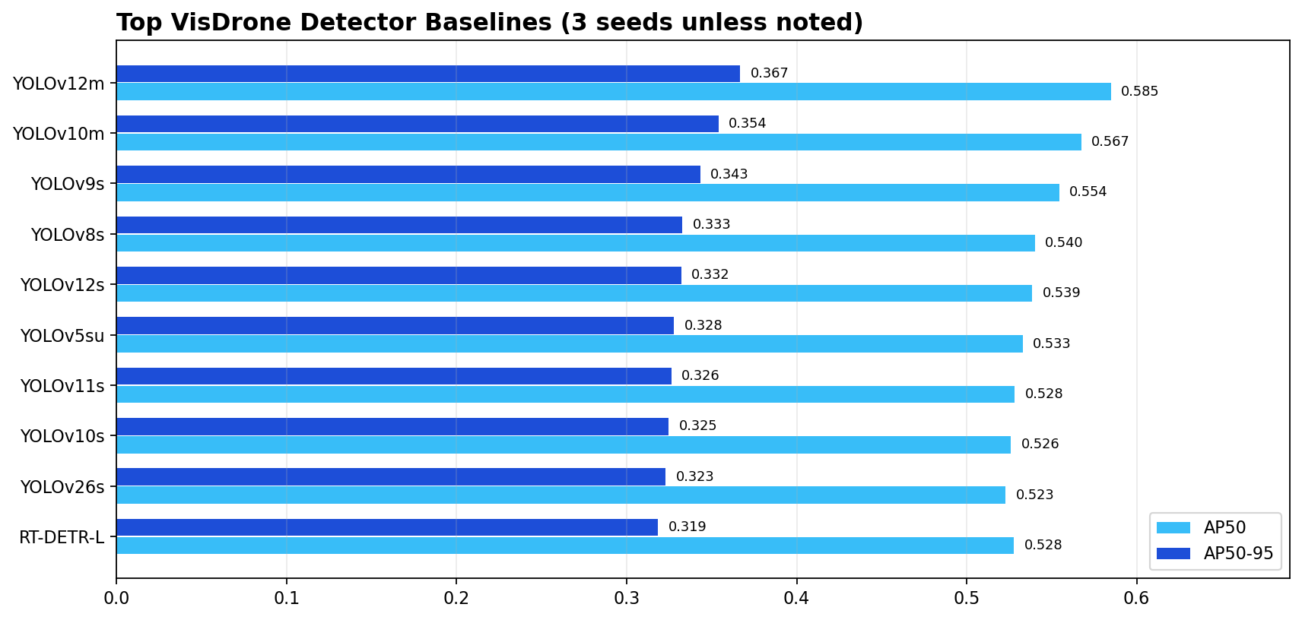
3. VisDrone Baseline Results
YOLO size sweep and RT-DETR anchor, sorted by AP50-95

Slide 5
4. Baseline Takeaways
What the detector table currently says
1. YOLOv12m: AP 0.367, AP50 0.585, F1 0.613, 20.1M params
2. YOLOv10m: AP 0.354, AP50 0.567, F1 0.597, 16.5M params
3. YOLOv9s: AP 0.343, AP50 0.554, F1 0.587, 7.3M params
4. YOLOv8s: AP 0.333, AP50 0.540, F1 0.577, 11.1M params
5. YOLOv12s: AP 0.332, AP50 0.539, F1 0.575, 9.3M params
6. YOLOv5su: AP 0.328, AP50 0.533, F1 0.570, 9.1M params
Current best overall
YOLOv12m: AP 0.367 / AP50 0.585
Current best lightweight
YOLOv9s: AP 0.343 / AP50 0.554
Large anchor in progress
YOLOv8l first seed already AP about 0.377 live

Slide 6
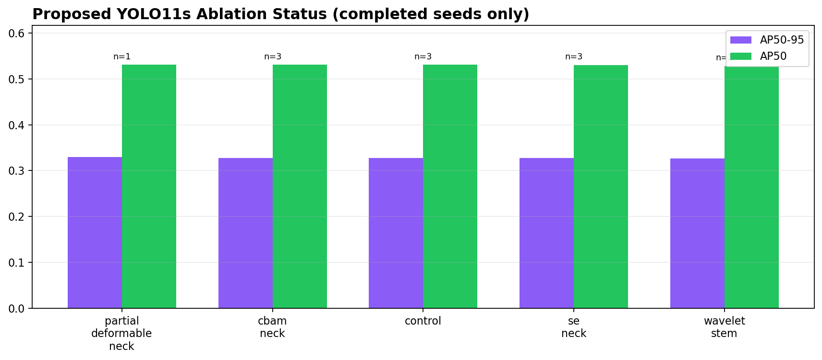
5. Proposed Detector Ablation
Completed runs so far; remaining full variants still matter
Interpretation: early single-module ablations are near YOLO11s control; CBAM and partial-deformable variants are the variants to watch before deciding the final proposed detector.

Slide 7
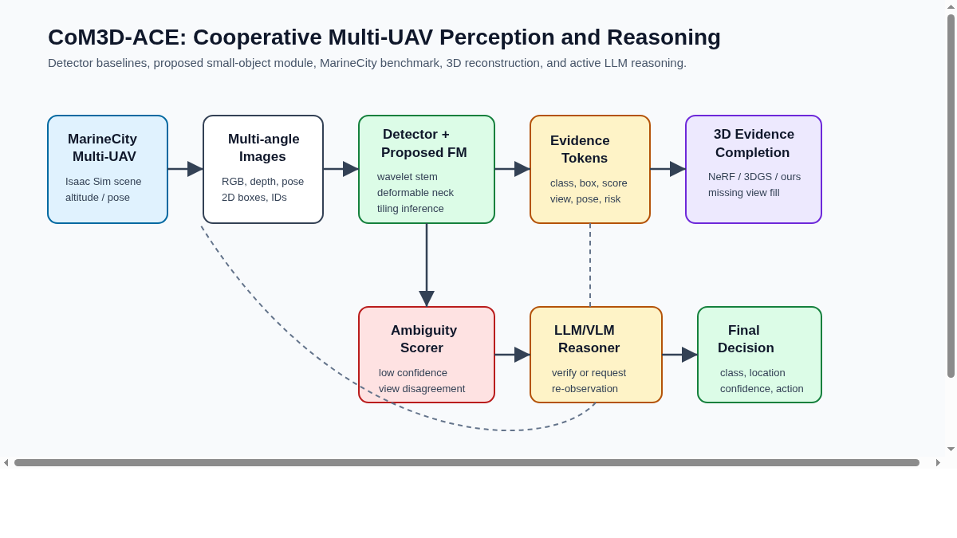
6. Proposed System Figure
Overall CoM3D-ACE: detector evidence, 3D reconstruction, graph reasoning, LLM decision, re-observation

Slide 8
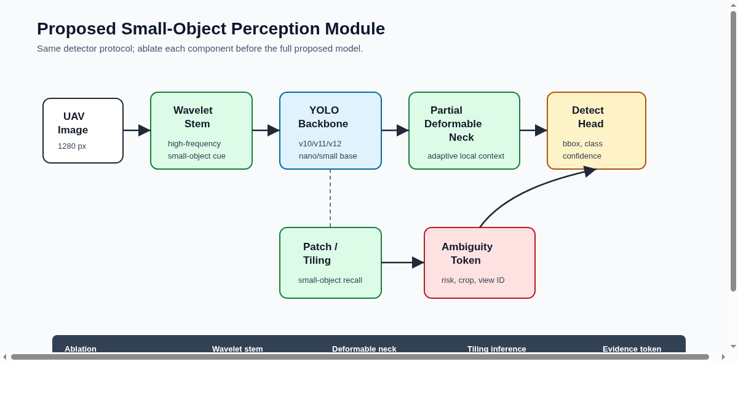
7. Proposed Detector Module
YOLO11 small-object perception module: wavelet/high-frequency stem, attention neck, partial deformable refinement

Slide 9
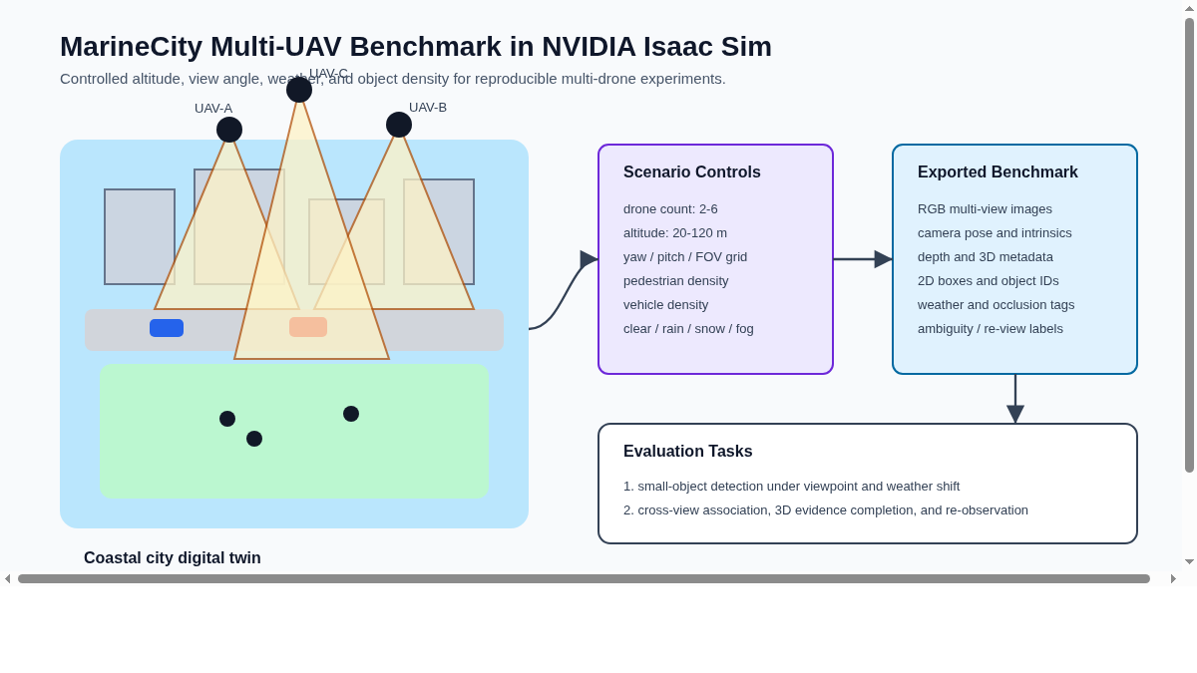
8. MarineCity Multi-UAV Benchmark
Isaac Sim/Cesium-style coastal city with synchronized multi-UAV RGB/depth/pose/bbox export

Slide 10
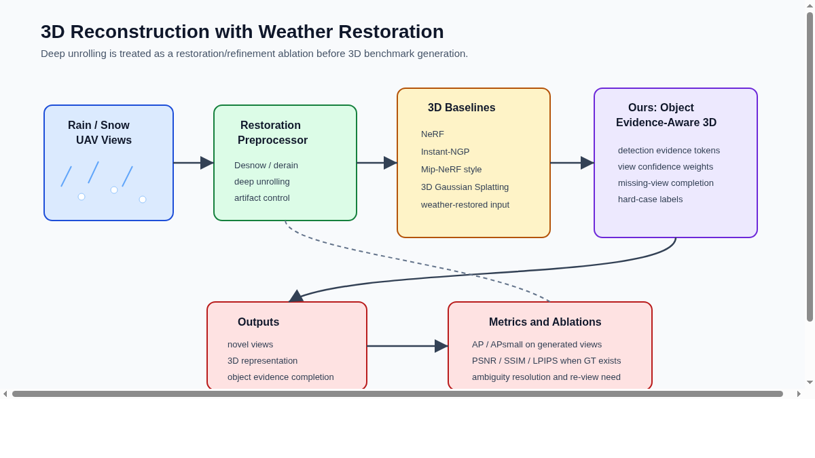
9. Weather + 3D Reconstruction
Rain/snow degradation, restoration path, NeRF/Instant-NGP/3DGS comparison, downstream detector metrics

Slide 11
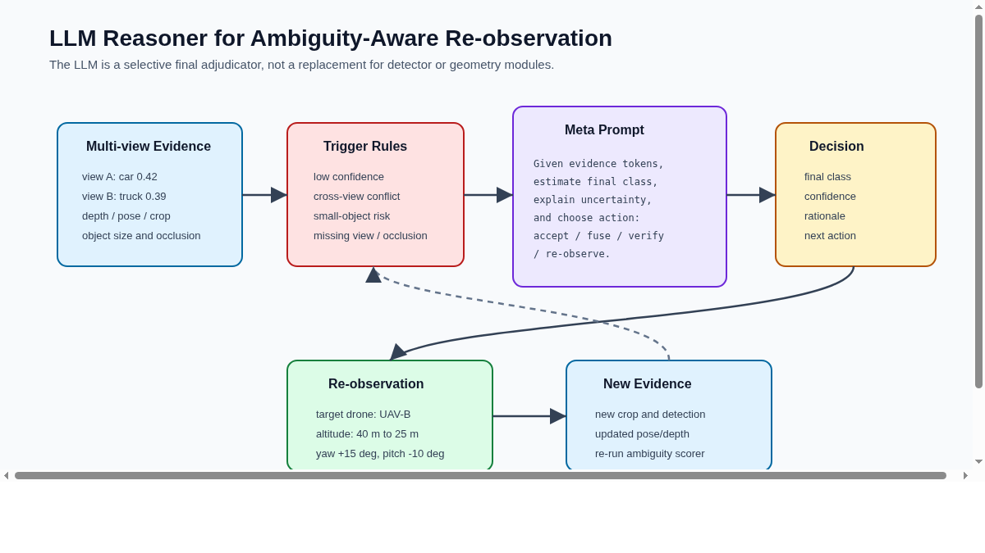
10. LLM Reasoner + Re-observation
Ambiguity diagnosis, confidence calibration, and selecting which UAV/view should re-capture evidence

Slide 12
11. Dataset and Comparison Plan
Use VisDrone as main detector benchmark; add fine-grained UAV dataset for stronger defense
VisDrone2019-DET: full detector sweep, seed statistics, p-values, AP/AP50/Recall/F1/FPS/GFLOPs
DroneVehicle: fine-grained UAV vehicle validation with selected models only
MarineCity-Isaac: multi-UAV, multi-angle, 3D reconstruction, ambiguity/re-observation system benchmark
Optional: AI-TOD-v2 for tiny-object robustness; HIT-UAV for thermal/low-light ambiguity
YOLO family: n/s/m/l grouped by model size
Recent detectors: D-FINE, LW-DETR, RF-DETR, LRDS-YOLO or HF-D-FINE if reproducible
Selected cross-dataset models: YOLOv9s, YOLOv12m, recent detector, ours
Final proposed compared against best lightweight and best overall baseline

Slide 13
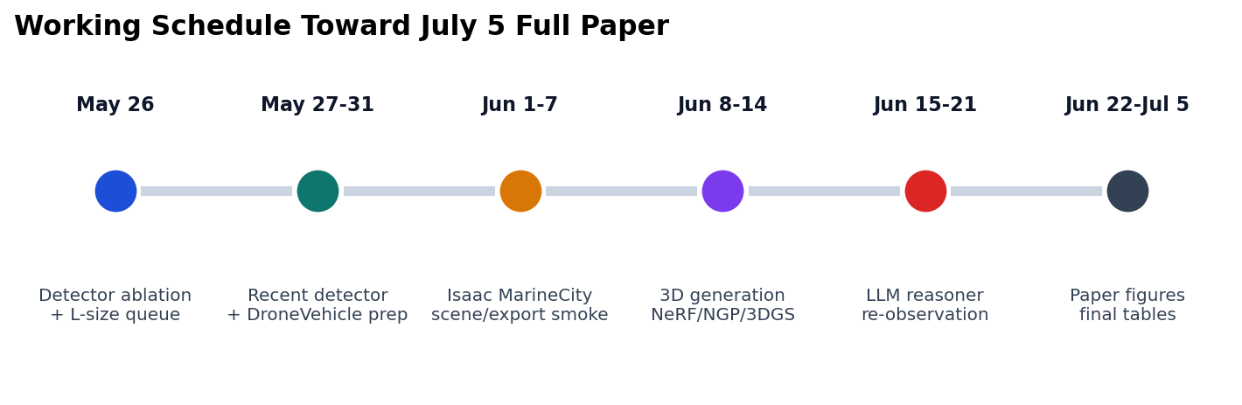
12. Windows Isaac Benchmark Preparation
Ready for the user machine workflow
MarineCity dry-run manifest: 36 frames / 4 scenes
Splits: train 24, val 9, test unseen angle 3
Views: nadir, front oblique, side view, rear oblique
Weather: clear / rain / snow; Altitudes: 60m / 100m / 150m
Windows commands
scripts\25_prepare_marinecity_windows_benchmark.bat
set ISAAC_ROOT=C:\path\to\isaacsim
scripts\26_launch_isaac_marinecity_visible.bat

Slide 14
13. Future Experiment Roadmap
Concrete order after current detector queues finish
Finish current L-size YOLO comparison; collect live large baseline report
Collect proposed ablation results and choose final detector candidate
Add recent detector comparison: D-FINE / LW-DETR / RF-DETR / UAV-specific model
Prepare DroneVehicle selected-model experiment for fine-grained UAV vehicle validation
Start Windows Isaac Sim MarineCity export smoke test, then real RGB/depth/pose capture
Run 3D generation comparison: NeRF, Instant-NGP, Mip-NeRF 360, 3D Gaussian Splatting
Run ambiguity scorer + LLM reasoner + re-observation ablation on MarineCity benchmark
Freeze tables/figures and write paper from early June onward

