Slide 1
html

Slide 2
Audio tag
The <audio> tag is used to embed sound content in a document, such as music or other audio streams.
The <audio> tag contains one or more <source> tags with different audio sources. The browser will choose the first source it supports.
The text between the <audio> and </audio> tags will only be displayed in browsers that do not support the <audio> element.
There are three supported audio formats in HTML: MP3, WAV, and OGG.

Slide 3
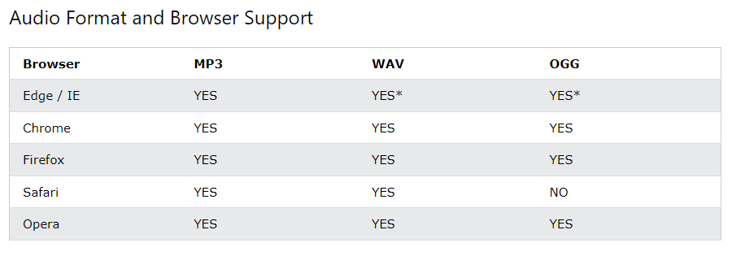

Slide 4
<audio controls> <source src="horse.ogg" type="audio/ogg"> <source src="horse.mp3" type="audio/mpeg"> Your browser does not support the audio tag. </audio>

Slide 5
Attribute | Value | Description
autoplay | autoplay | Specifies that the audio will start playing as soon as it is ready
controls | controls | Specifies that audio controls should be displayed (such as a play/pause button etc)
loop | loop | Specifies that the audio will start over again, every time it is finished
muted | muted | Specifies that the audio output should be muted
preload | auto metadata none | Specifies if and how the author thinks the audio should be loaded when the page loads
src | URL | Specifies the URL of the audio file

Slide 6
Canvas tag
The <canvas> tag is used to draw graphics, on the fly, via scripting (usually JavaScript).
The <canvas> tag is transparent, and is only a container for graphics, you must use a script to actually draw the graphics.
Any text inside the <canvas> element will be displayed in browsers with JavaScript disabled and in browsers that do not support <canvas>.

Slide 7
Attribute | Value | Description
height | pixels | Specifies the height of the canvas. Default value is 150
width | pixels | Specifies the width of the canvas Default value is 300

Slide 8
<canvas id="myCanvas"> Your browser does not support the canvas tag. </canvas> <script> let canvas = document.getElementById("myCanvas"); let ctx = canvas.getContext("2d"); ctx.fillStyle = "#FF0000"; ctx.fillRect(0, 0, 80, 80); </script>

Slide 9
Caption tag
The <caption> tag defines a table caption.
The <caption> tag must be inserted immediately after the <table> tag.
Tip: By default, a table caption will be center-aligned above a table. However, the CSS properties text-align and caption-side can be used to align and place the caption.

Slide 10
<table> <caption>Monthly savings</caption> <tr> <th>Month</th> <th>Savings</th> </tr> <tr> <td>January</td> <td>$100</td> </tr> </table>

Slide 11
Dd tag
The <dd> tag is used to describe a term/name in a description list.
The <dd> tag is used in conjunction with <dl> (defines a description list) and <dt> (defines terms/names).
Inside a <dd> tag you can put paragraphs, line breaks, images, links, lists, etc.

Slide 12
<dl> <dt>Coffee</dt> <dd>Black hot drink</dd> <dt>Milk</dt> <dd>White cold drink</dd> </dl>

Slide 13
Dialog tag
The <dialog> tag defines a dialog box or subwindow.
The <dialog> element makes it easy to create popup dialogs and modals on a web page.
Attribute | Value | Description
open | open | Specifies that the dialog element is active and that the user can interact with it
<dialog open>This is an open dialog window</dialog>

Slide 14
Details tag
The <details> tag specifies additional details that the user can open and close on demand.
The <details> tag is often used to create an interactive widget that the user can open and close. By default, the widget is closed. When open, it expands, and displays the content within.
Any sort of content can be put inside the <details> tag.
Tip: The <summary> tag is used in conjunction with <details> to specify a visible heading for the details.

Slide 15
<details> <summary>Epcot Center</summary> <p>Epcot is a theme park at Walt Disney World Resort featuring exciting attractions, international pavilions, award-winning fireworks and seasonal special events.</p> </details>

Slide 16
Legend tag
The <legend> tag defines a caption for the <fieldset> element.

Slide 17
<form action="/action_page.php"> <fieldset> <legend>Personalia:</legend> <label for="fname">First name:</label> <input type="text" id="fname" name="fname"><br><br> <label for="lname">Last name:</label> <input type="text" id="lname" name="lname"><br><br> <label for="email">Email:</label> <input type="email" id="email" name="email"><br><br> <label for="birthday">Birthday:</label> <input type="date" id="birthday" name="birthday"><br><br> <input type="submit" value="Submit"> </fieldset> </form>

Slide 18
Video tag
The <video> tag is used to embed video content in a document, such as a movie clip or other video streams.
The <video> tag contains one or more <source> tags with different video sources. The browser will choose the first source it supports.
The text between the <video> and </video> tags will only be displayed in browsers that do not support the <video> element.
There are three supported video formats in HTML: MP4, WebM, and OGG.

Slide 19
Browser | MP4 | WebM | Ogg
Edge | YES | YES | YES
Chrome | YES | YES | YES
Firefox | YES | YES | YES
Safari | YES | YES | NO
Opera | YES | YES | YES

Slide 20
Attribute | Value | Description
autoplay | autoplay | Specifies that the video will start playing as soon as it is ready
controls | controls | Specifies that video controls should be displayed (such as a play/pause button etc).
height | pixels | Sets the height of the video player
loop | loop | Specifies that the video will start over again, every time it is finished
muted | muted | Specifies that the audio output of the video should be muted
poster | URL | Specifies an image to be shown while the video is downloading, or until the user hits the play button
preload | auto metadata none | Specifies if and how the author thinks the video should be loaded when the page loads
src | URL | Specifies the URL of the video file
width | pixels | Sets the width of the video player

Slide 21
<video width="320" height="240" controls> <source src="movie.mp4" type="video/mp4"> <source src="movie.ogg" type="video/ogg"> Your browser does not support the video tag. </video>

Slide 22
Wbr tag
The <wbr> (Word Break Opportunity) tag specifies where in a text it would be ok to add a line-break.
Tip: When a word is too long, the browser might break it at the wrong place. You can use the <wbr> element to add word break opportunities.
<p>To learn AJAX, you must be familiar with the XML<wbr>Http<wbr>Request Object.</p>

Slide 23
Time tag
The <time> tag defines a specific time (or datetime).
The datetime attribute of this element is used translate the time into a machine-readable format so that browsers can offer to add date reminders through the user's calendar, and search engines can produce smarter search results.
Attribute | Value | Description
datetime | datetime | Represent a machine-readable format of the <time> element

Slide 24
<p>Open from <time>10:00</time> to <time>21:00</time> every weekday.</p> <p>I have a date on <time datetime="2008-02-14 20:00">Valentines day</time>.</p>

Slide 25
The <progress> tag represents the completion progress of a task.
Tip: Always add the <label> tag for best accessibility practices!
Note: The <progress> tag is not suitable for representing a gauge (e.g. disk space usage or relevance of a query result). To represent a gauge, use the <meter> tag instead.
Attribute | Value | Description
max | number | Specifies how much work the task requires in total. Default value is 1
value | number | Specifies how much of the task has been completed

Slide 26
<label for="file">Downloading progress:</label> <progress id="file" value="32" max="100"> 32% </progress>

