Slide 1

Ethics in Information Technology, Third Edition
Chapter 7
Software Development

Slide 2
Objectives
As you read this chapter, consider the following questions:
  Why do companies require high-quality software in business systems, industrial process control systems, and consumer products?
  What potential ethical issues do software manufacturers face in making trade-offs between project schedules, project costs, and software quality?
  What are the four most common types of software product liability claims?
Ethics in Information Technology, Third Edition

Slide 3
Objectives (cont’d.)
  What are the essential components of a software development methodology, and what are the benefits of using such a methodology?
  How can the Capability Maturity Model Integration improve an organization’s software development process?
  What is a safety-critical system, and what special actions are required during its development?
Ethics in Information Technology, Third Edition

Slide 4
Strategies for Engineering
Quality Software
High-quality software systems:
  Perform quickly and efficiently
  Operate safely and reliably
  Meet their users’ needs
  Required to support the fields of:
    Air traffic control
    Nuclear power
    Automobile safety
    Health care
    Military and defense
    Space exploration
Ethics in Information Technology, Third Edition

Slide 5
Strategies for Engineering
Quality Software (cont’d.)
Increased demand for high-quality software
Software defect
  Could cause a system to fail to meet users’ needs
  Impact may be trivial or very serious
  Subtle and undetectable or glaringly obvious
Software quality
  Degree to which software meets the needs of users
Ethics in Information Technology, Third Edition

Slide 6
Strategies for Engineering
Quality Software (cont’d.)
Quality management
  Defines, measures, and refines the quality of the development process and products developed
  Objective
    Help developers deliver high-quality systems that meet the needs of users
Deliverables are products such as:
  Statements of requirements
  Flowcharts
  User documentation
Ethics in Information Technology, Third Edition

Slide 7
Strategies for Engineering
Quality Software (cont’d.)
Primary cause for poor software quality:
  Many developers do not know how to design quality into software from the start
  Or do not take the time to do so
Developers must:
  Define and follow rigorous engineering principles
  Learn from past mistakes
  Understand systems’ operating environment
  Design systems relatively immune to human error
Ethics in Information Technology, Third Edition

Slide 8
Strategies for Engineering
Quality Software (cont’d.)
Programmers make mistakes in turning design specifications into code
  About one defect for every 7-10 lines of code
Extreme pressure to reduce time to market
First release of software
  Organizations avoid buying the first release
  Or prohibit its use in critical systems
  Usually has many defects
Established software products can also falter:
  When operating conditions change
Ethics in Information Technology, Third Edition

Slide 9
The Importance of Software Quality
Business information systems
  Set of interrelated components including:
    Hardware
    Software
    Databases
    Networks
    People
    Procedures
  Collect and process data and disseminate the output
Ethics in Information Technology, Third Edition

Slide 10
The Importance of Software Quality (cont’d.)
Business information system examples
  Manufacturer’s order-processing system
  Bank’s electronic-funds transfer system
  Airline’s online ticket reservation system
Decision support system (DSS)
  Used to improve decision making
Software is used to control industrial processes
Software controls the operation of many industrial and consumer products
Ethics in Information Technology, Third Edition

Slide 11
The Importance of Software Quality (cont’d.)
Mismanaged software can be fatal to a business
Ethical questions
  How much effort and money to invest to ensure high-quality software
  Whether products could cause damage and what the legal exposure would be if they did
Ethics in Information Technology, Third Edition

Slide 12
Software Product Liability
Product liability
  Liability of manufacturers, sellers, lessors, and others for injuries caused by defective products
  There is no federal product liability law
    Mainly state law
    Article 2 of the Uniform Commercial Code
Strict liability
  Defendant held responsible for the injury
  Regardless of negligence or intent
Ethics in Information Technology, Third Edition

Slide 13
Software Product Liability (cont’d.)
Strict liability
  Plaintiff must prove only that the software product is defective or unreasonably dangerous and that the defect caused the injury
  No requirement to prove that the manufacturer was careless or negligent or to prove who caused the defect
  All parties in the chain of distribution are liable
    Manufacturer
    Subcontractors
    Distributors
Ethics in Information Technology, Third Edition

Slide 14
Software Product Liability (cont’d.)
Legal defenses used against strict liability
  Doctrine of supervening event
  Government contractor defense
  Expired statute of limitations
Negligence
  A supplier is not held responsible for every product defect that causes a customer or third-party loss
  Responsibility is limited to defects that could have been detected and corrected through “reasonable” software development practices
Ethics in Information Technology, Third Edition

Slide 15
Software Product Liability (cont’d.)
Negligence
  Area of great risk for software manufacturers
  Defense of negligence may include:
    Legal justification for the alleged misconduct
    Demonstration that the plaintiffs’ own actions contributed to injuries (contributory negligence)
Ethics in Information Technology, Third Edition

Slide 16
Software Product Liability (cont’d.)
Warranty
  Assures buyers or lessees that a product meets certain standards of quality
  May be expressly stated or implied by law
Breach of warranty claim
  When the product fails to meet the terms of its warranty
  Plaintiff must have a valid contract that the supplier did not fulfill
  Can be extremely difficult to prove because the software supplier writes the warranty to limit liability
Ethics in Information Technology, Third Edition

Slide 17
Software Product Liability (cont’d.)
Intentional misrepresentation
  Seller or lessor either misrepresents the quality of a product or conceals a defect in it
  Forms of representation
    Advertising
    Salespersons’ comments
    Invoices
    Shipping labels
Ethics in Information Technology, Third Edition

Slide 18
Software Development Process
Large software project roles
  System analysts
  Programmers
  Architects
  Database specialists
  Project managers
  Documentation specialists
  Trainers
  Testers
Ethics in Information Technology, Third Edition

Slide 19
Software Development Process (cont’d.)
Software development methodology
  Standard, proven work process
  Controlled and orderly progress
  Defines activities in software development process
  Defines individual and group responsibilities
  Recommends specific techniques for activities
  Offers guidelines for managing the quality of software during various stages of development
Ethics in Information Technology, Third Edition

Slide 20
Software Development Process (cont’d.)
Easier and cheaper to avoid software problems at the beginning than to attempt to fix damages after the fact
  Cost to identify and remove a defect in an early stage can be up to 100 times less than removing a defect in distributed software
  Identify and remove errors early in the development process
    Cost-saving measure
    Most efficient way to improve software quality
Ethics in Information Technology, Third Edition

Slide 21
Software Development Process (cont’d.)
Effective methodology protects from legal liability
  Reduces the number of software errors
  If an organization follows widely accepted development methods, negligence on its part is harder to prove
Software quality assurance (QA) refers to methods within the development cycle
  Guarantee reliable operation of product
  Are applied at each stage in the development cycle
  Include testing before the product ships
Ethics in Information Technology, Third Edition

Slide 22
Software Development Process (cont’d.)
Dynamic testing
  Black-box testing
    Tester has no knowledge of code
  White-box testing
    Testing all possible logic paths in the software unit, with thorough knowledge of the logic
    Makes each program statement execute at least once
Ethics in Information Technology, Third Edition

Slide 23
Software Development Process (cont’d.)
Static testing
  Static analyzers are run against the new code
  Looks for suspicious patterns in programs that might indicate a defect
Integration testing
  Occurs after successful unit testing
  Software units are combined into an integrated subsystem
  Ensures that all linkages among various subsystems work successfully
Ethics in Information Technology, Third Edition

Slide 24
Software Development Process (cont’d.)
System testing
  Occurs after successful integration testing
  Various subsystems are combined
  Tests the entire system as a complete entity
User acceptance testing
  Independent testing performed by trained end users
  Ensures that the system operates as they expect
Ethics in Information Technology, Third Edition

Slide 25
Capability Maturity Model Integration
Process improvement approach
Defined by the Software Engineering Institute
  At Carnegie Mellon University in Pittsburgh
Defines essential elements of effective processes
General enough to evaluate and improve almost any process
Frequently used to assess software development practices
Ethics in Information Technology, Third Edition

Slide 26
Capability Maturity Model Integration (cont’d.)
Defines five levels of software development maturity
Identifies issues most critical to software quality and process improvement
Organization conducts an assessment of its software development practices
  Determines where they fit in the capability model
  Identifies areas for improvement
    Action plans are needed to upgrade the development process
Ethics in Information Technology, Third Edition

Slide 27
Capability Maturity Model Integration (cont’d.)
Maturity level increases
  Organization improves its ability to deliver good software on time and on budget
CMMI-Development
  Set of guidelines for 22 process areas related to systems development and maintenance
  Organizations that do these 22 things well will have an outstanding software development and maintenance process
Ethics in Information Technology, Third Edition

Slide 28
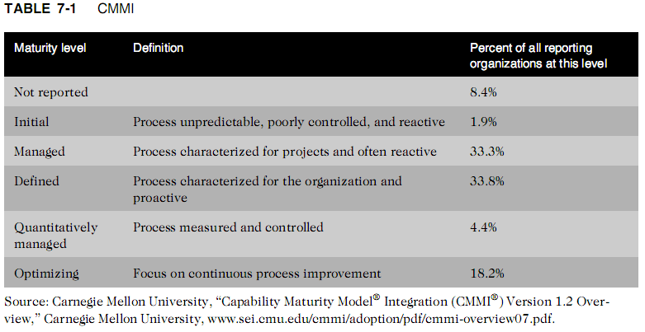
Capability Maturity Model Integration (cont’d.)
Ethics in Information Technology, Third Edition

Slide 29
Key Issues in Software Development
Consequences of software defects in certain systems can be deadly
  Companies must take special precautions
Ethical decisions involve a trade-off between quality and cost, ease of use, and time to market
Ethics in Information Technology, Third Edition

Slide 30
Development of Safety-Critical Systems
Safety-critical system
  A system whose failure may cause injury or death
  Examples
    Automobile’s antilock brakes
    Nuclear power plant reactors
    Airplane navigation
    Roller coasters
    Elevators
    Medical devices
Ethics in Information Technology, Third Edition

Slide 31
Development of Safety-Critical Systems (cont’d.)
Key assumption
  Safety will not automatically result from following the organization’s standard development methodology
Requires a more rigorous and time-consuming development process than other kinds of software
All tasks require:
  Additional steps
  More thorough documentation
  Vigilant checking and rechecking
Ethics in Information Technology, Third Edition

Slide 32
Development of Safety-Critical Systems (cont’d.)
Project safety engineer
  Explicit responsibility for the system’s safety
  Uses a logging and monitoring system:
    To track hazards from the project’s start to finish
Hazard log
  Used at each stage of the software development process to assess how it has accounted for detected hazards
Ethics in Information Technology, Third Edition

Slide 33
Development of Safety-Critical Systems (cont’d.)
Safety reviews
  Held throughout the development process
Robust configuration management system
  Tracks all safety-related documentation
Formal documentation required
  Including verification reviews and signatures
Key issues
  Ethical dilemmas re: increased time and expense
  Deciding when QA staff has performed enough testing
Ethics in Information Technology, Third Edition

Slide 34
Development of Safety-Critical Systems (cont’d.)
Risk
  Probability of an undesirable event occurring times the magnitude of the event’s consequences
  Consequences include:
    Damage to property
    Loss of money
    Injury to people
    Death
Ethics in Information Technology, Third Edition

Slide 35
Development of Safety-Critical Systems (cont’d.)
Redundancy
  Provision of multiple interchangeable components to perform a single function
  Used to cope with failures and errors
N-version programming
  Form of redundancy
  Involves the execution of a series of program instructions simultaneously by two different systems
  Uses different algorithms to execute instructions that accomplish the same result
Ethics in Information Technology, Third Edition

Slide 36
Development of Safety-Critical Systems (cont’d.)
N-version programming (cont’d.)
  Results from the two systems are compared
  If a difference is found, another algorithm is executed to determine which system yielded the correct result
  Instructions for the two systems can be:
    Written by programmers from two different companies
    Run on different hardware devices
  Rationale
    Both systems are highly unlikely to fail at the same time under the same conditions
Ethics in Information Technology, Third Edition

Slide 37
Development of Safety-Critical Systems (cont’d.)
Decide what level of risk is acceptable
  Difficult and controversial decision
  Make system modifications if level of risk is judged to be too great
Mitigate the consequences of failure
  Devise emergency procedures and evacuation plans
Decide whether to recall a product:
  When data indicates a problem
Ethics in Information Technology, Third Edition

Slide 38
Development of Safety-Critical Systems (cont’d.)
Reliability
  Probability of a component or system performing without failure over its product life
Human interface
  Important and difficult area of safety-critical system design
  Should leave the operator little room for erroneous judgment
  Poor design of a system interface can greatly increase risk
Ethics in Information Technology, Third Edition

Slide 39
Quality Management Standards
ISO 9000 standard
  Guide to quality products, services, and management
  Organization must submit to an examination by an external assessor
  Requirements
    Written procedures for everything it does
    Follow those procedures
    Prove to the auditor the organization fulfilled the first two requirements
Ethics in Information Technology, Third Edition

Slide 40
Quality Management Standards (cont’d.)
Failure mode and effects analysis (FMEA)
  Technique used to evaluate reliability and determine the effect of system and equipment failures
  Failures are classified by:
    Impact on a project’s success
    Personnel safety
    Equipment safety
    Customer satisfaction and safety
  Goal
    Identify potential design and process failures early in a project
Ethics in Information Technology, Third Edition

Slide 41
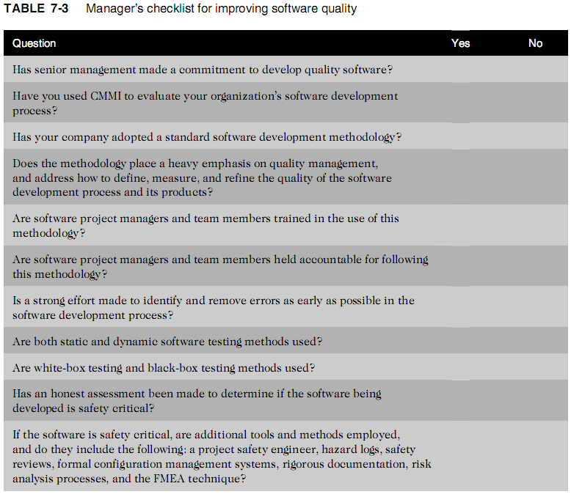
Ethics in Information Technology, Third Edition

Slide 42
Summary
Demand for high-quality software is increasing
Developers are under extreme pressure to reduce time to market of products
Software product liability claims are frequently based on:
  Strict liability
  Negligence
  Breach of warranty
  Misrepresentation
Ethics in Information Technology, Third Edition

Slide 43
Summary (cont’d.)
Software development methodology
  Defines activities in the development process
  Defines individual and group responsibilities
  Recommends specific techniques
  Offers guidelines for managing product quality
CMMI
  Defines five levels of software development maturity
Safety-critical system
  Failure may cause injury or death
Ethics in Information Technology, Third Edition

Slide 44
Summary (cont’d.)
ISO 9000 standard is a guide to quality products, services, and management
Failure mode and effects analysis (FMEA) is an important technique used to develop ISO 9000-compliant quality systems
Ethics in Information Technology, Third Edition

