Slide 1
MP FLASHLOADER TOOL
USER GUIDE
VERTEXCOM © 2020

Slide 2
Raspberry Pi pinout

Slide 3
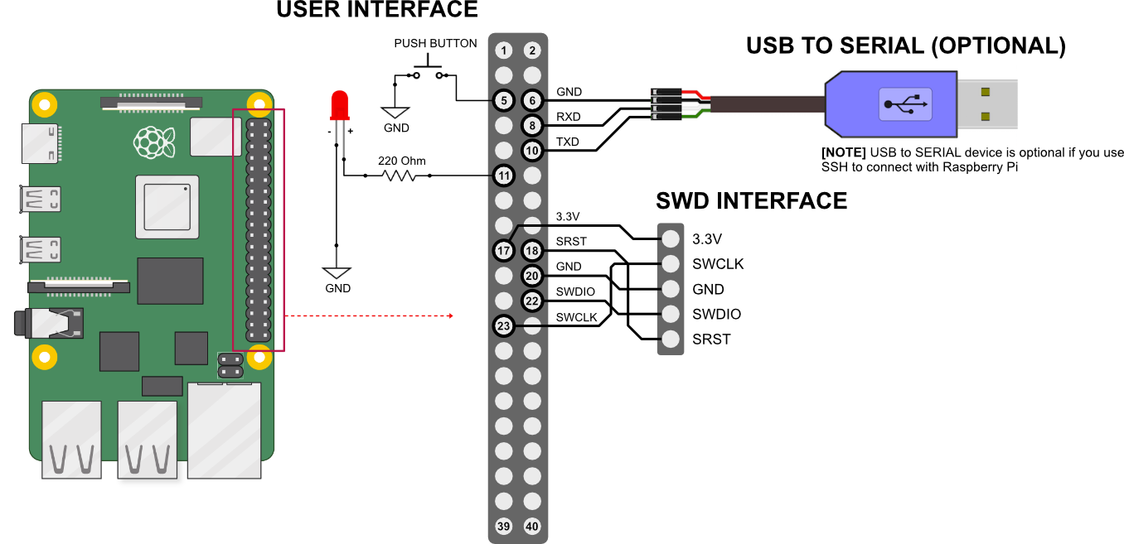
Hardware Setup

Slide 4


Software Setup
Copy flashloader_bundle_v1.tgz to raspberry pi
Extract the bundle: tar xvfz flashloader_bundle_v1.tgz
This bundle contains:
flashloader.py (python script to run the flashloader)
source folder (this folder contains openocd source files)
test2.bin (binary file example, you can replace it with your own)
Install openocd:
prerequisite:
sudo apt-get update
sudo apt-get install git autoconf libtool make pkg-config libusb-1.0-0 libusb-1.0-0-dev
cd source/openocd (change to openocd directory)
Inside openocd directory run the following commands:
./bootstrap
./configure --enable-sysfsgpio --enable-bcm2835gpio
make
sudo make install
openocd --version (see whether the installation is succeed or not)
Running flashloader.py script:
cd to flashloader.py directory
NOTE IMPORTANT: make sure your “image.bin” on the same directory with flashloader.py
run: python flashloader.py your_image.bin
At this point you should see the led is “breathing” on and off, meaning that its ready to flash the image.
Push the button and wait until the led is breathing again and we are ready for the next round.

Slide 5
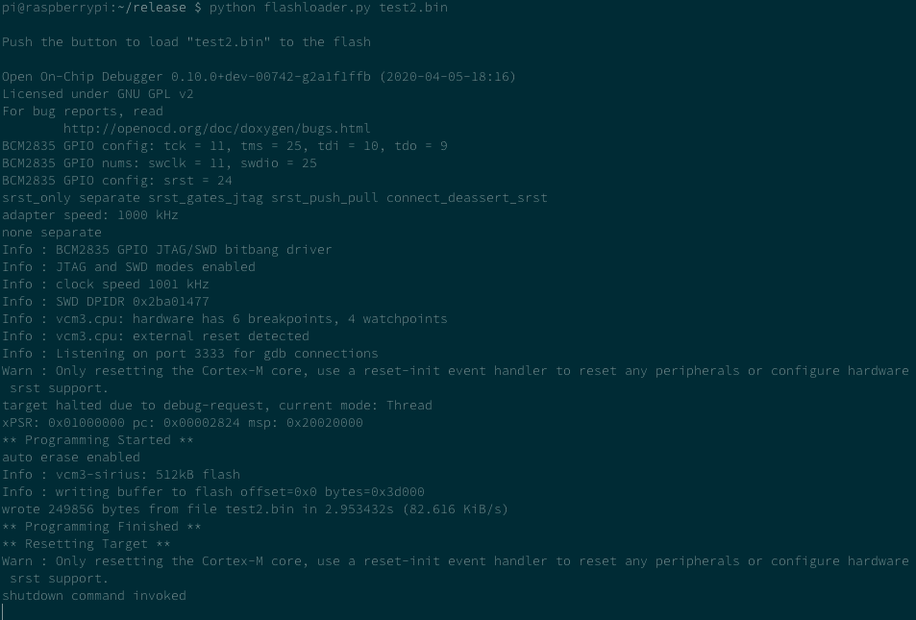
Software Setup
If everything run smoothly you should see something like this:

