Slide 1


For CSE 4C Students

Slide 2

It is designed to handle the details involved in I/O processing
It fetches and execute is own instructions
Instruction offers
  I/O operations
  Data transfer operations
  Arithmetic and Logical Operations
  Branching, searching and translating

Slide 3

CPU communicates with memory based control blocks.
CPU performs Control blocks that describes the task to be performed.
Channel Program
  The IOP reads the control blocks to locate a program sequence called a channel program which is written in 8089 instruction set.

Slide 4

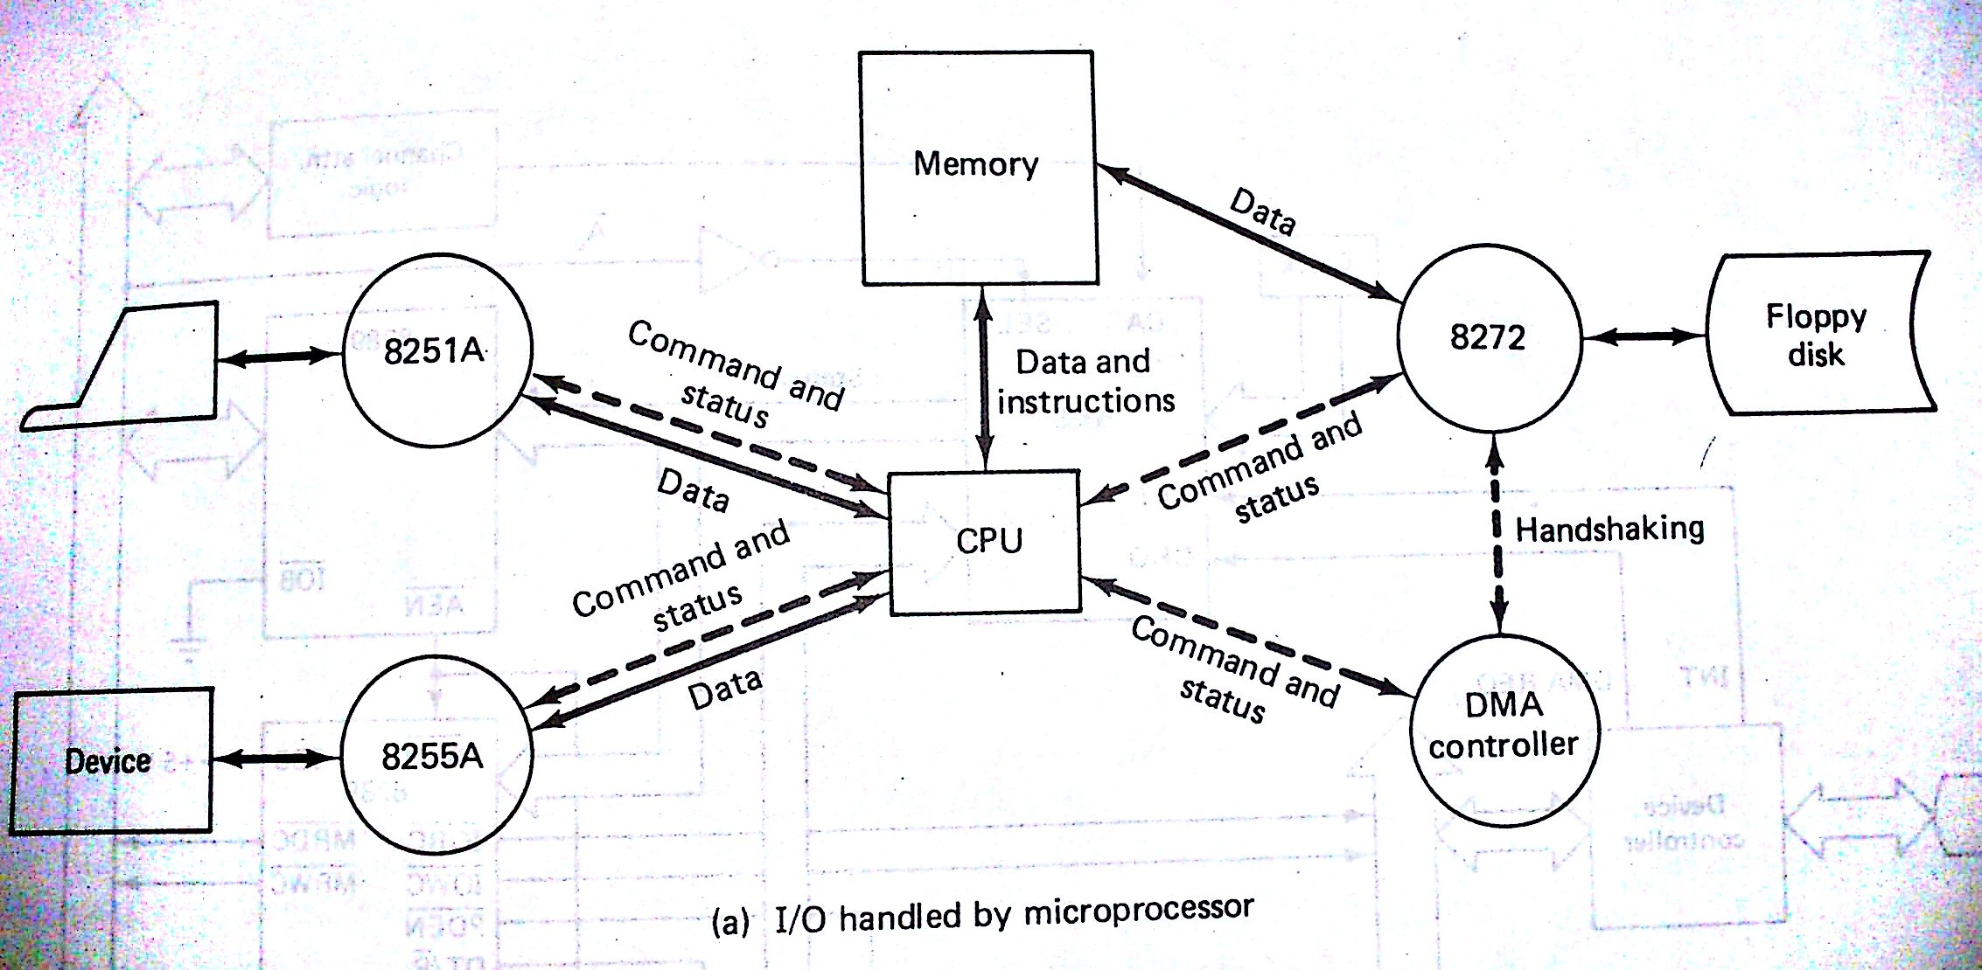

Slide 5

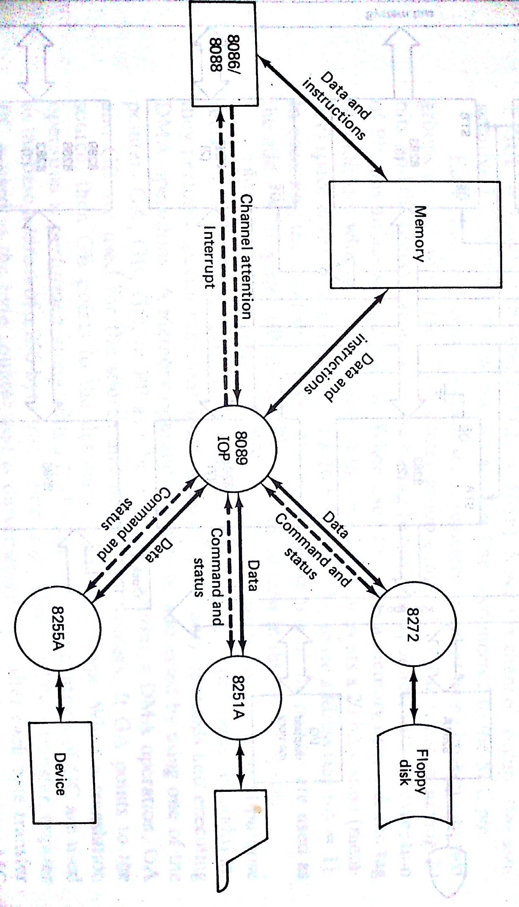

Slide 6

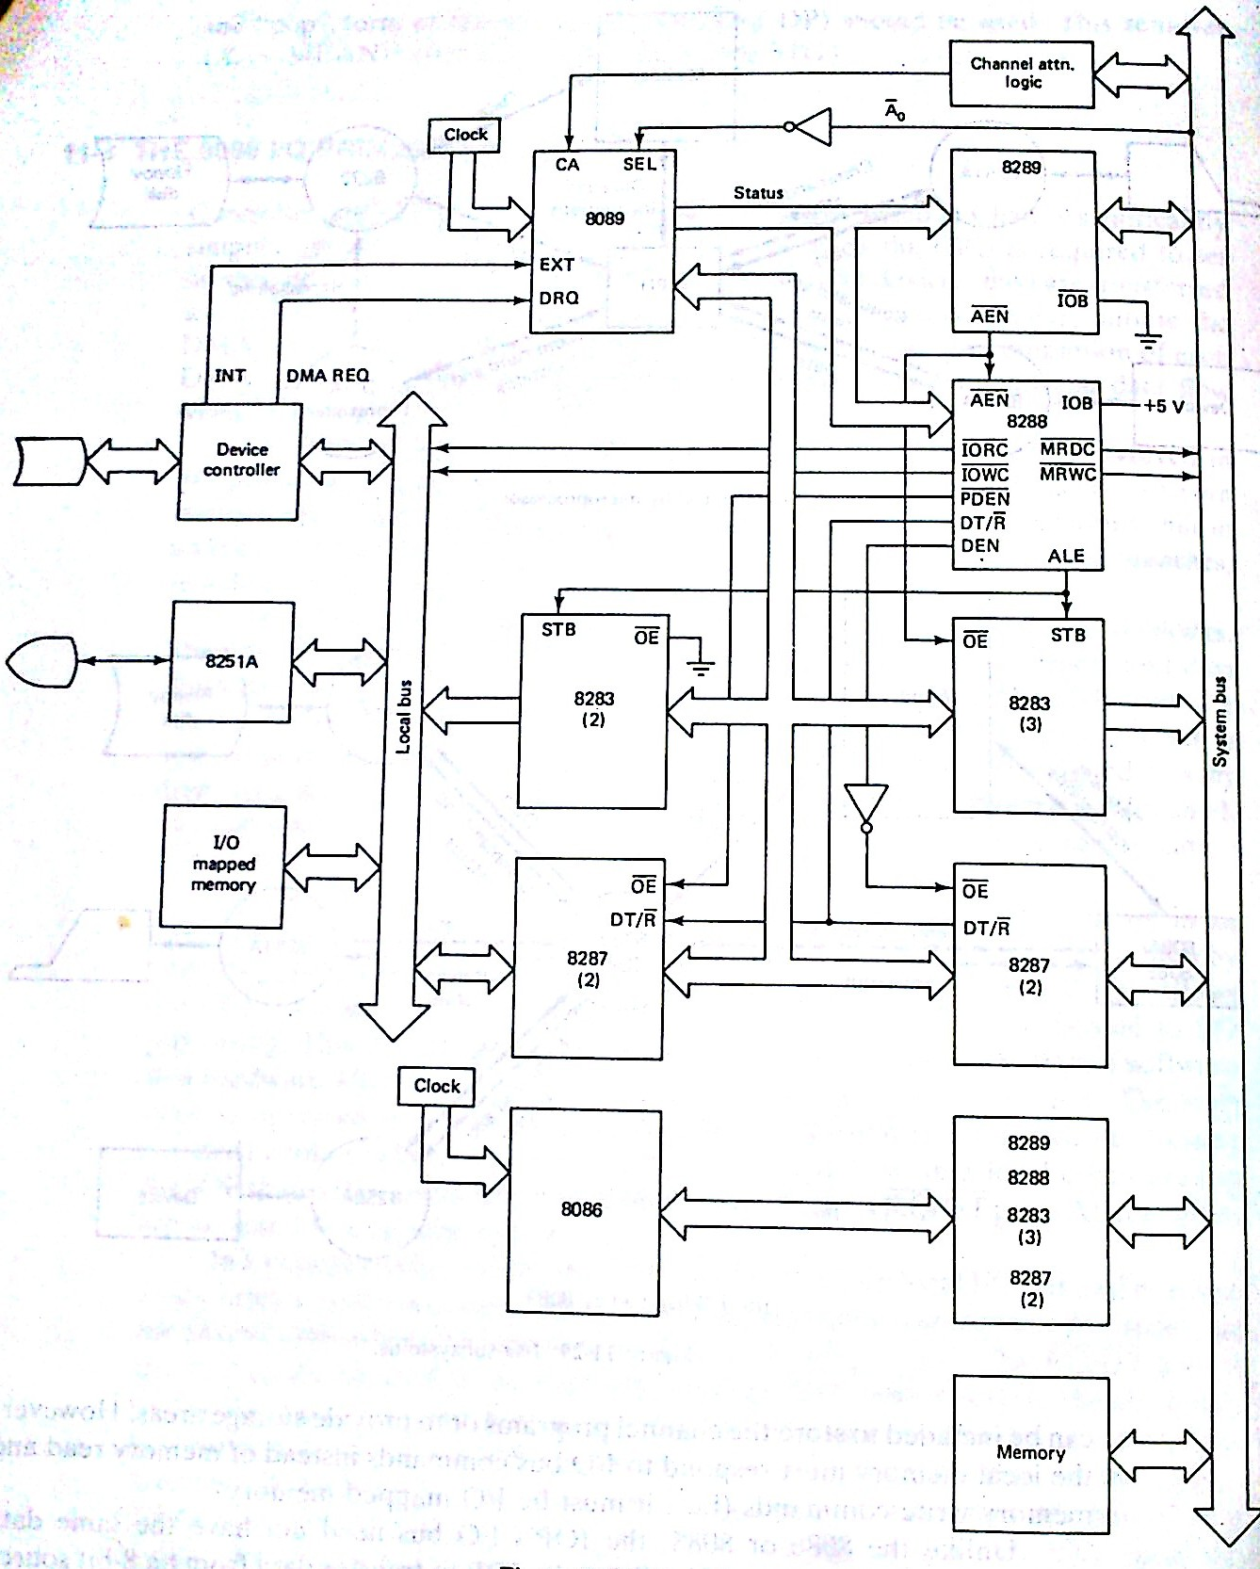

Slide 7

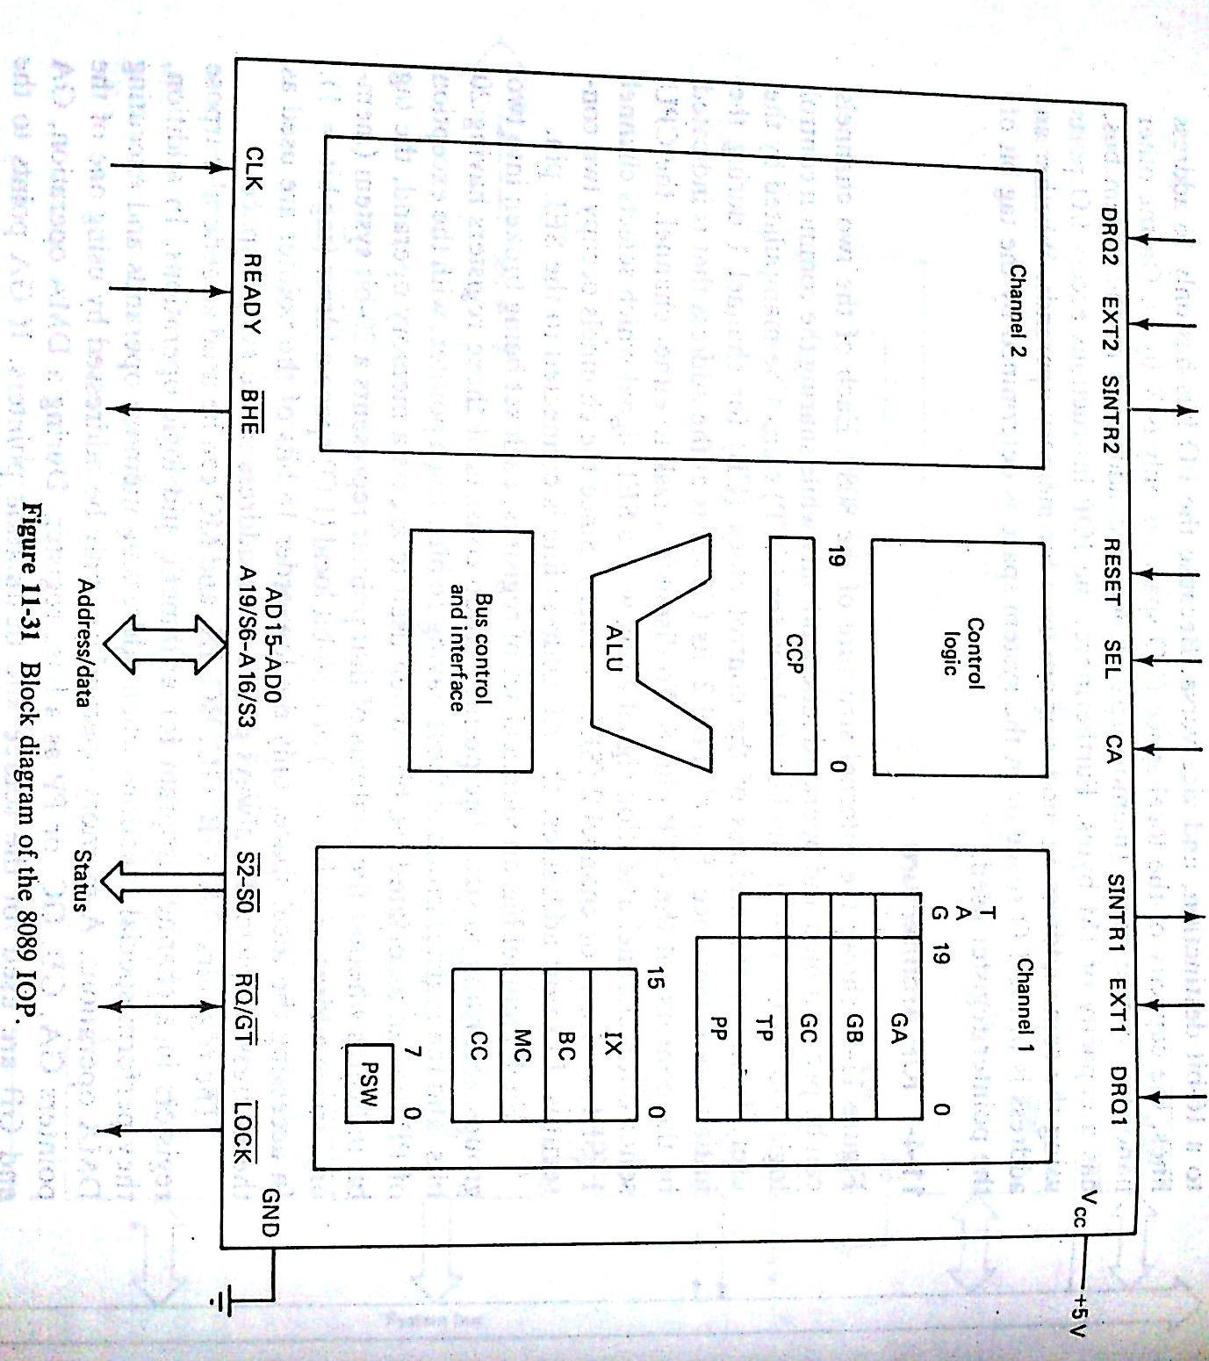

Slide 8

Two Channels can be operated independently.
Sharing common control logic and ALU.
CCP(Channel Control Pointer)
Cannot be manipulated by the user
Stores the Control Block address of channel 1 (during initialization)
For channel 2 CB address=[CCP+8]

Slide 9
To dispatch task to either channel CPU uses channel attention signal(CA) and SEL signals.
SEL=0(Low) Channel 1
SEL=1(High)Channel 2
Channel reserves two consecutive IO port Addresses the A0 connected with SEL bit.
Registers
Pointer Group (20 Bits)
Register Group (16 Bits)

Slide 10
Task Pointer = PC
PP –Parameter Pointer stores the address of the parameter block
PSW which denotes
Source and destination address widths
Channel activity
Interrupt control and servicing
Bus load limit
Priority

Slide 11
Channel Control Register Format
Function Control (Bits 15 and 14)
11-Memory to memory
10-IO port to Memory
01-Memory to IO port
00-IO port to IO port
Translation Mode (bit 13)
  1-Indicates data bytes are to be translated through a 256 byte look up table

Slide 12
Synchronization control bits(Bit 12 and 11)
00- Unsynchronized Transfer
01 Source Synchronized transfer
10 Destination Synchronized transfer
Source Destination Indicator (bit 10)
0-GA used as source pointer
1-GA used as destination pointer

Slide 13

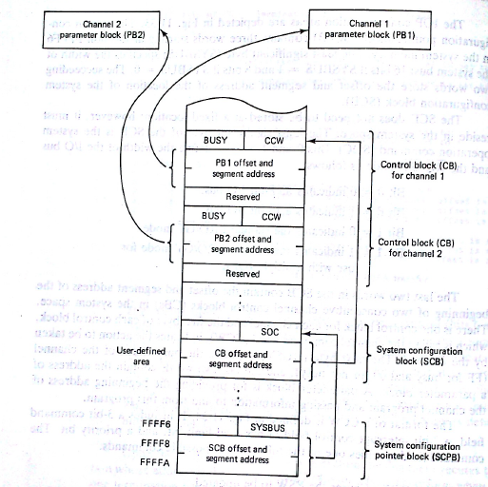

Slide 14

2 Marks
1. List any 8 assembler directives.
2. What is a recursive Procedure?
3. What are Macros?
4.Give the comparison between procedures and Macros.
5. What are the advantages of Multi processor systems?
6. What are the basic multi processor configurations?
7. What are the Bus arbitration schemes in Loosely Coupled Configuration?
8. In what ways are a standard microprocessor and a coprocessor different from each other?

Slide 15
9.Give short notes on Daisy chaining.
10.Draw the status flag of NDP and mention its names.
16 Marks
Explain the arithmetic group and Shift and Rotate group of the instruction set of Intel 8086 with five examples in each group?
Explain in detail the closely coupled and loosely coupled configurations with neat diagrams.

Slide 16
Write an assembly language program using 8086 instruction set to do the following arithmetic operations of the two 16 bit numbers stored from the memory locations 1200H to 1203H and store the result in the locations given against.
a) Addition –Sum in 1400H and 1401H
b) Subtraction – Difference in 1402H and 1403H
c) Multiplication – Product from 1404H to 1407H
d) Division - Quotient in 1408H & 1409H , Remainder in 140AH & 140BH

Slide 17
Explain in detail the closely coupled and loosely coupled configurations with neat diagrams.
Explain in detail about Macros and Procedures.
Write an assembly language program to find the maximum and minimum numbers from an array of numbers.
Explain the architecture of the NDP 8087 with a diagram
Explain the architecture of IOP 8089 with a diagram

Slide 18
Write an assembly language program using 8086 instruction set to find and store the number of odd and even numbers in an array of 100 bytes starting from the memory location 1200H and store the result in 1300H(for odd numbers) and in 1301H(for even numbers)

Slide 19



