Slide 1
Database Design
Normalization

Slide 2
Pitfalls in relational database design
1.Repitition of data
2.Inability to represent certain information

Slide 3
The Purpose of Normalization
Normalization is a technique for producing a set of relations with desirable properties, given the data requirements of an enterprise.
The process of normalization is a formal method that
identifies relations based on their primary or candidate
keys and the functional dependencies among their
attributes.

Slide 4
Update Anomalies
Relations that have redundant data may have problems called update anomalies, which are classified as ,
Insertion anomalies
Deletion anomalies
Modification anomalies

Slide 5
Example of Update Anomalies
To insert a new staff with branchNo B007 into the StaffBranch relation;
To delete a tuple that represents the last member of staff located at a branch B007;
To change the address of branch B003.
StaffBranch
staffNo | sName | position | salary | branchNo | bAddress
SL21 | John White | Manager | 30000 | B005 | 22 Deer Rd, London
SG37 | Ann Beech | Assistant | 12000 | B003 | 163 Main St,Glasgow
SG14 | David Ford | Supervisor | 18000 | B003 | 163 Main St,Glasgow
SA9 | Mary Howe | Assistant | 9000 | B007 | 16 Argyll St, Aberdeen
SG5 | Susan Brand | Manager | 24000 | B003 | 163 Main St,Glasgow
SL41 | Julie Lee | Assistant | 9000 | B005 | 22 Deer Rd, London
Figure 1 StraffBranch relation

Slide 6
Example of Update Anomalies (2)
Staff
staffNo | sName | position | salary | branceNo
SL21 | John White | Manager | 30000 | B005
SG37 | Ann Beech | Assistant | 12000 | B003
SG14 | David Ford | Supervisor | 18000 | B003
SA9 | Mary Howe | Assistant | 9000 | B007
SG5 | Susan Brand | Manager | 24000 | B003
SL41 | Julie Lee | Assistant | 9000 | B005
Branch
branceNo | bAddress
B005 | 22 Deer Rd, London
B007 | 16 Argyll St, Aberdeen
B003 | 163 Main St,Glasgow
Figure 2 Straff and Branch relations

Slide 7
Functional Dependencies
Functional dependency describes the relationship between
attributes in a relation.
For example, if A and B are attributes of relation R, and B is
functionally dependent on A ( denoted A B), if each value of
A is associated with exactly one value of B. ( A and B may each
consist of one or more attributes.)
A
B is functionally
B
dependent on A
Determinant
Refers to the attribute or group of attributes on the left-hand side of the arrow of a functional dependency

Slide 8
Functional Dependencies (2)
FD is a way of representing relationship among attributes in a relation.
Notation
  X → Y where both X and Y can be a group of attributes.
  We say that
    X uniquely determines Y
    For a given value of X, there is at most one value of Y associated with X at a time.

Slide 9
Functional Dependencies (3)
Trival functional dependency means that the right-hand
side is a subset ( not necessarily a proper subset) of the left-
hand side.
For example:
staffNo, sName → sName
staffNo, sName → staffNo
They do not provide any additional information about possible integrity constraints on the values held by these attributes.
We are normally more interested in nontrivial dependencies because they represent integrity constraints for the relation.

Slide 10
Functional Dependencies (3)
Main characteristics of functional dependencies in normalization
Have a one-to-one relationship between attribute(s) on the left- and right- hand side of a dependency;
hold for all time;
are nontrivial.

Slide 11
Exercise
EMP_DEPT(ENAME, SSN, BDATE, DNUMBER, DNAME, DMGRSSN, DLOC)
The FDs in this relation are:
1) SSN → ENAME, BDATE, ADDRESS, DNUMBER
2) DNUMBER → DNAME, DMGRSSN, DLOC
Note: Each table much represent only one concept.

Slide 12
How to find meaningful FDs?
  List only most direct FDs, not indirect FD. (e.g., SSN → DLOC is an indirect FD)
  List only meaningful FDs that we want to enforce as IC (e.g., SSN → SSN is a trivial FD)
  Do not include redundant attributes in an FD in either LHS or RHS

Slide 13
Functional Dependencies (4)
Identifying the primary key
Functional dependency is a property of the meaning or
semantics of the attributes in a relation. When a functional
dependency is present, the dependency is specified as a
constraint between the attributes.
An important integrity constraint to consider first is the
identification of candidate keys, one of which is selected to
be the primary key for the relation using functional dependency.

Slide 14
Finding a key (Osburn’s algorithm)
  Find attributes not appearing in the RHS of any FDs. Then, these are part of any candidate keys.
  Check whether they can determine all other attributes by using FDs.
  If not, what other attributes do I need to add to determine all other attributes?

Slide 15
Examples
  STORE(SNAME, ADDR, ZIP, ITEM, PRICE)
  FDs: SNAME → ADDR
      ADDR → ZIP
      SNAME, ITEM → PRICE
Finding a key:
  SNAME does not appear in RHS, so SNAME must be a part of the key.
  Since SNAME → ADDR → ZIP, we know SNAME → ADDR, ZIP
  But SNAME alone cannot determine any more.
    How can we determine ITEM and PRICE?
    If we have ITEM, them we can determine PRICE
    So, SNAME, ITEM → SNAME, ADDR, ZIP, ITEM, PRICE. So it satisfies the definition of the key

Slide 16


Lossless Decomposition
Decomposition means dividing a table into multiple tables
Decomposition is lossless (or nonloss) if it is possible to reconstruct R from decomposed relations using JOINs.
Condition for lossless join when R was decomposed into R1, R2, … Rn.
  R = R1 R2 R3 …. Rn, where means JOIN operation.
Lossy decomposition
  R R1 R2 R3 …. Rn

Slide 17
Why need it?
  To maintain the accurate database
What if not?
  Cause wrong answers for queries
How to check?
  It is sufficient if any Ri contains a candidate key of R when we used the normalization algorithms for 3NF/BCNF.
  This means that if any of the decomposed relation contains a complete CK (or PK) of the original relation, then the decomposition is called lossless. This means by joining all the decomposed relations, we can reconstruct the original relation.

Slide 18
Example 1
LOAN_ACC(L#, AMT, ACC#, BAL)
  L# → AMT
  ACC# → BAL
Key? L# + ACC#
Possible decomposition:
  R1(L#, AMT) R2(ACC#, BAL)
  The decomposition is not loss-less since R1 and R2 do not have a candidate key.

Slide 19
Example 2
WORK(EMP#, DEPT, LOC)
  EMP# → DEPT
  DEPT → LOC
Key? EMP# since EMP# → DEPT, LOC
Decomposition:
  R1(EMP#, DEPT) R2(DEPT, LOC)
  The decomposition is loss-less since R1 contains a candidate key.

Slide 20
Functional Dependencies (5)
Armstrong’s axioms
  Theorem: Armstrong’s axioms are sound and complete
  Soundness: any result derived by applying the Armstrong’s axiom is always correct.
  Completeness: Armstrong’s axiom can derive all the FDs that are necessary for computation of normalization.
    We can fine all candidate keys by using Armstrong’s axiom.
    We can compute the minimal cover of relations using Armstrong’s axiom.

Slide 21
Functional Dependencies (6)
Inference Rules
A set of all functional dependencies that are implied by a given
set of functional dependencies X is called closure of X, written
X⁺. A set of inference rule is needed to compute X⁺ from X.
Armstrong’s axioms
Relfexivity: If B is a subset of A, them A → B
Augmentation: If A → B, then A, C → B
Transitivity: If A → B and B → C, then A→ C
Self-determination: A → A
Decomposition: If A → B,C then A → B and A→ C
Union: If A → B and A → C, then A→ B,C
Composition: If A → B and C → D, then A,C→ B,D

Slide 22
Functional Dependencies (6)
Minial Sets of Functional Dependencies
A set of functional dependencies X is minimal if it satisfies
the following condition:
Every dependency in X has a single attribute on its
right-hand side
We cannot replace any dependency A → B in X with
dependency C →B, where C is a proper subset of A, and
still have a set of dependencies that is equivalent to X.
We cannot remove any dependency from X and still have a set of dependencies that is equivalent to X.

Slide 23
The Process of Normalization
Normalization is often executed as a series of steps. Each step
corresponds to a specific normal form that has known properties.
As normalization proceeds, the relations become progressively
more restricted in format, and also less vulnerable to update
anomalies.
For the relational data model, it is important to recognize that
it is only first normal form (1NF) that is critical in creating
relations. All the subsequent normal forms are optional.

Slide 24
Normalizing Data
Data normalization: Methodology for organizing attributes into tables to eliminate redundancy among nonkey attributes
Goals:
  Each resultant table describes single entity type or single many-to-many relationship
  Foreign keys appear exactly where needed
  Properly structured relational database
Notes:
Copyright by John Wiley and Sons, 2006

Slide 25
Normalization Techniques
Two types of input needed for data normalization process
    List of all attributes to be incorporated in database, including intersection data attributes
    List of functional dependencies: all defining associations between attributes
In functional dependencies, one attribute (determinate attribute) defines value of another attribute
    Salesperson Number → Salesperson Name
Notes:
Copyright by John Wiley and Sons, 2006

Slide 26
Normalizing Data
Normal forms: Rules for data normalization
Three main normal forms
    First normal form
    Second normal form
    Third normal form
Normalization:
    Uses normal forms to step through “decomposition process” that decomposes attributes into subgroups
In third normal form, group of tables is well-structured relational database with no data redundancy
Notes:
Copyright by John Wiley and Sons, 2006

Slide 27
Normalizing Data
First normal form:
    Eliminates multiple values
Second normal form:
    Eliminates partial functional dependencies (data dependent on part of primary key)
    Every nonkey attribute must be fully functionally dependent on entire key of table
Third normal form:
    Eliminates transitive dependencies (one nonkey attribute is functionally dependent on another)
    Nonkey attributes are not allowed to define other nonkey attributes
Notes:
Copyright by John Wiley and Sons, 2006

Slide 28
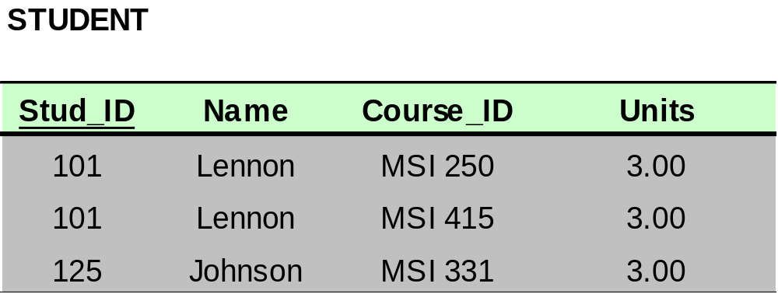
Dependencies: Definitions
Multivalued Attributes (or repeating groups): non-key attributes or groups of non-key attributes the values of which are not uniquely identified by (directly or indirectly) (not functionally dependent on) the value of the Primary Key (or its part).

Slide 29

Dependencies: Definitions
Partial Dependency – when an non-key attribute is determined by a part, but not the whole, of a COMPOSITE primary key.
Partial Dependency

Slide 30
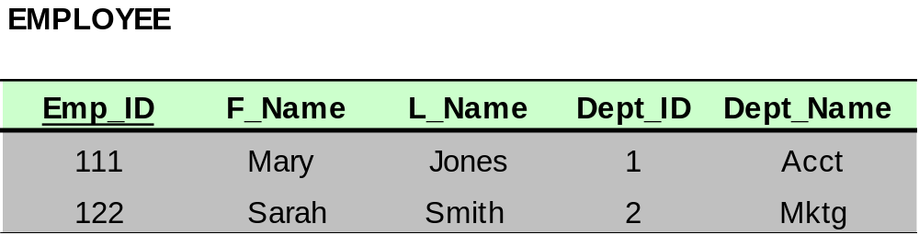
Dependencies: Definitions
Transitive Dependency – when a non-key attribute determines another non-key attribute.
Transitive Dependency

Slide 31
HIGHER NORMAL FORMS
1NF
2NF
3NF
BCNF
4NF
5NF
functional
dependencies
multivalued
dependencies
join
dependencies

Slide 32
Normal Forms: Review
Unnormalized – There are multivalued attributes or repeating groups
1 NF – No multivalued attributes or repeating groups.
2 NF – 1 NF plus no partial dependencies
3 NF – 2 NF plus no transitive dependencies

Slide 33
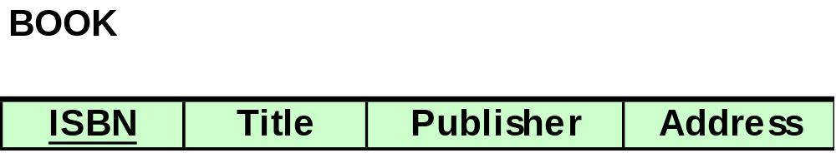
Example 1: Determine NF
All attributes are directly or indirectly determined by the primary key; therefore, the relation is at least in 1 NF
ISBN → Title
ISBN → Publisher
Publisher → Address

Slide 34
Example 1: Determine NF
The relation is at least in 1NF. There is no COMPOSITE primary key, therefore there can’t be partial dependencies. Therefore, the relation is at least in 2NF
ISBN → Title
ISBN → Publisher
Publisher → Address

Slide 35
Example 1: Determine NF
Publisher is a non-key attribute, and it determines Address, another non-key attribute. Therefore, there is a transitive dependency, which means that the relation is NOT in 3 NF.
ISBN → Title
ISBN → Publisher
Publisher → Address

Slide 36
Example 1: Determine NF
We know that the relation is at least in 2NF, and it is not in 3 NF. Therefore, we conclude that the relation is in 2NF.
ISBN → Title
ISBN → Publisher
Publisher → Address

Slide 37
Example 1: Determine NF
In your solution you will write the following justification:
No M/V attributes, therefore at least 1NF
No partial dependencies, therefore at least 2NF
There is a transitive dependency (Publisher → Address), therefore, not 3NF
Conclusion: The relation is in 2NF
ISBN → Title
ISBN → Publisher
Publisher → Address

Slide 38
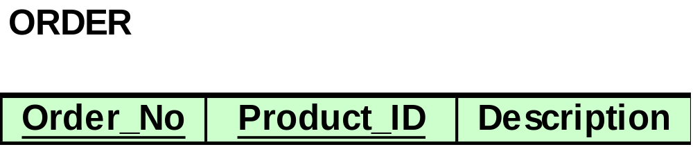
Example 2: Determine NF
Product_ID → Description
All attributes are directly or indirectly determined by the primary key; therefore, the relation is at least in 1 NF

Slide 39
Example 2: Determine NF
Product_ID → Description
The relation is at least in 1NF.
There is a COMPOSITE Primary Key (PK) (Order_No, Product_ID), therefore there can be partial dependencies. Product_ID, which is a part of PK, determines Description; hence, there is a partial dependency. Therefore, the relation is not 2NF. No sense to check for transitive dependencies!

Slide 40
Example 2: Determine NF
Product_ID → Description
We know that the relation is at least in 1NF, and it is not in 2 NF. Therefore, we conclude that the relation is in 1 NF.

Slide 41
Example 2: Determine NF
Product_ID → Description
In your solution you will write the following justification:
1) No M/V attributes, therefore at least 1NF
2) There is a partial dependency (Product_ID → Description), therefore not in 2NF
Conclusion: The relation is in 1NF

Slide 42
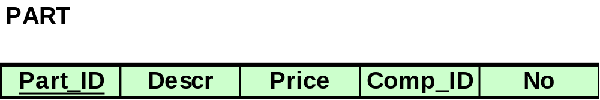
Example 3: Determine NF
Comp_ID and No are not determined by the primary key; therefore, the relation is NOT in 1 NF. No sense in looking at partial or transitive dependencies.
Part_ID → Description
Part_ID → Price
Part_ID, Comp_ID → No

Slide 43
Example 3: Determine NF
In your solution you will write the following justification:
There are M/V attributes; therefore, not 1NF
Conclusion: The relation is not normalized.
Part_ID → Description
Part_ID → Price
Part_ID, Comp_ID → No

Slide 44

Bringing a Relation to 1NF

Slide 45
Bringing a Relation to 1NF
Option 1: Make a determinant of the repeating group (or the multivalued attribute) a part of the primary key.
Composite Primary Key

Slide 46

Bringing a Relation to 1NF
Option 2: Remove the entire repeating group from the relation. Create another relation which would contain all the attributes of the repeating group, plus the primary key from the first relation. In this new relation, the primary key from the original relation and the determinant of the repeating group will comprise a primary key.

Slide 47
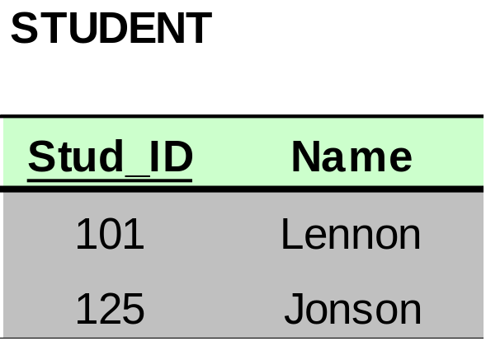
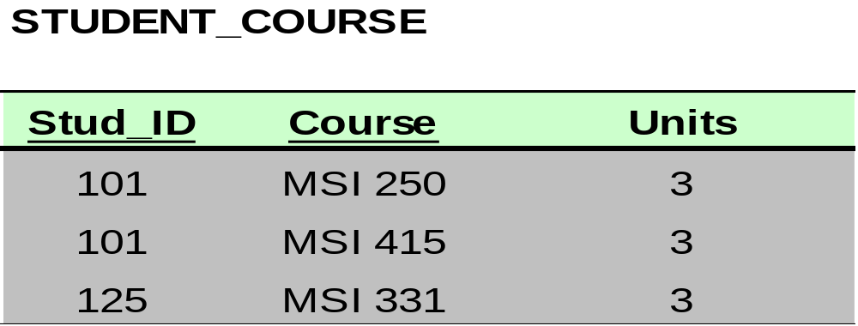
Bringing a Relation to 1NF

Slide 48
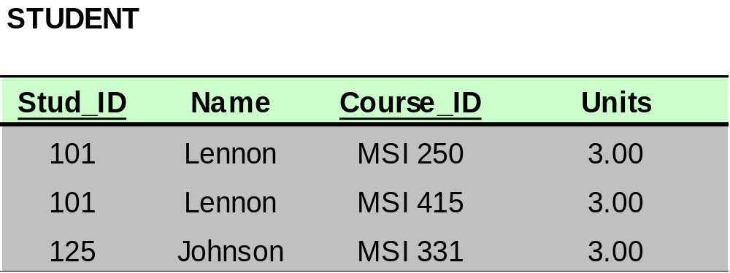
Bringing a Relation to 2NF
Composite Primary Key

Slide 49
Bringing a Relation to 2NF
Goal: Remove Partial Dependencies
Partial Dependencies
Composite Primary Key

Slide 50
Bringing a Relation to 2NF
Remove attributes that are dependent from the part but not the whole of the primary key from the original relation. For each partial dependency, create a new relation, with the corresponding part of the primary key from the original as the primary key.

Slide 51
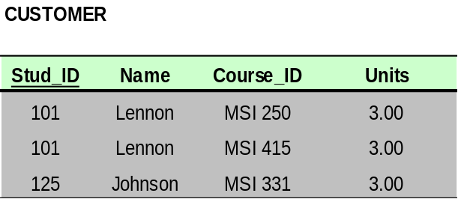

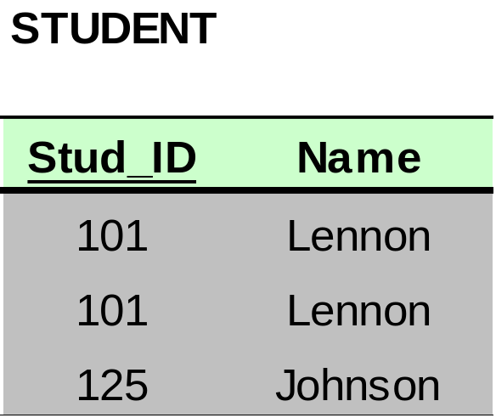

Bringing a Relation to 2NF

Slide 52
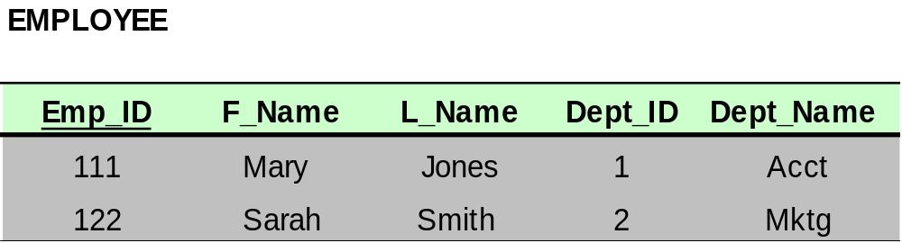
Bringing a Relation to 3NF
Goal: Get rid of transitive dependencies.
Transitive Dependency

Slide 53
Bringing a Relation to 3NF
Remove the attributes, which are dependent on a non-key attribute, from the original relation. For each transitive dependency, create a new relation with the non-key attribute which is a determinant in the transitive dependency as a primary key, and the dependent non-key attribute as a dependent.

Slide 54
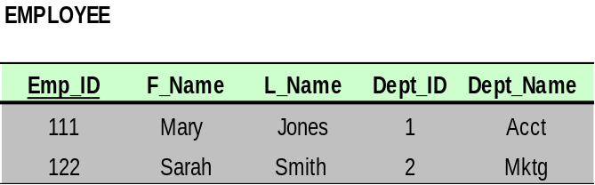
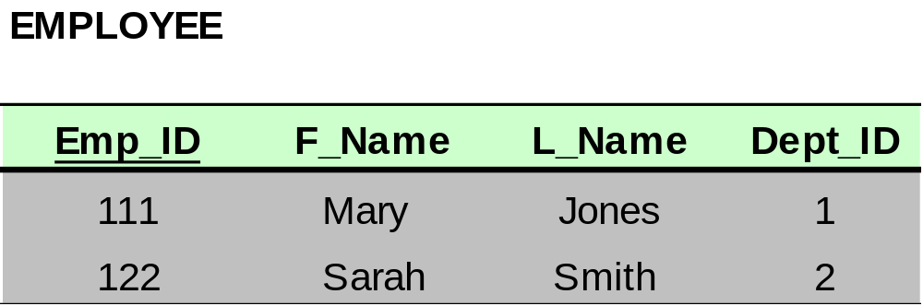
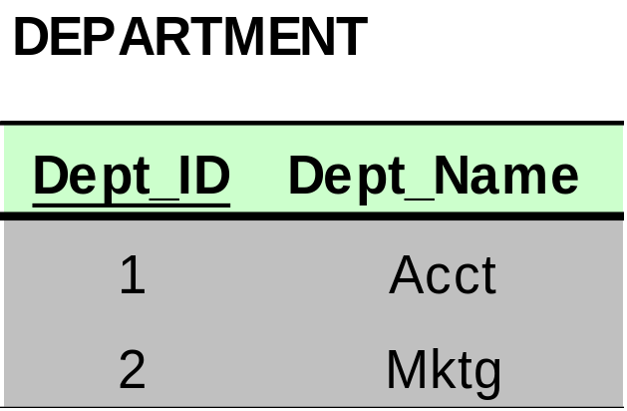
Bringing a Relation to 3NF

Slide 55

Salesperson Entity Attributes
Notes:
Copyright by John Wiley and Sons, 2006

Slide 56
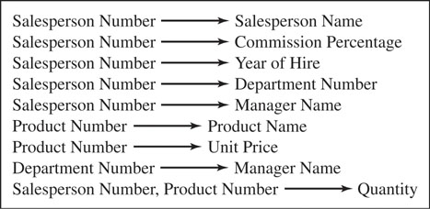
Salesperson Entity Functional Dependencies
Notes:
Copyright by John Wiley and Sons, 2006

Slide 57
Example: Defining Attributes and Functional Dependencies
Quantity is defined by two combined attributes
Manager is defined independently by two attributes
  Department Number and Salesperson Number
Salesperson Number also defines Department Number
Notes:
Copyright by John Wiley and Sons, 2006

Slide 58
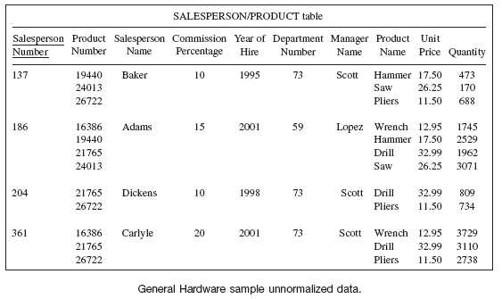
Example: Unnormalized Data
Notes:
Copyright by John Wiley and Sons, 2006

Slide 59
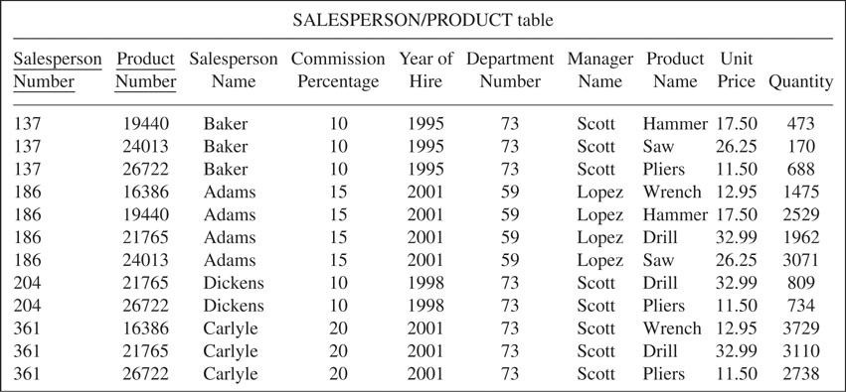
First Normal Form
Notes:
Copyright by John Wiley and Sons, 2006

Slide 60
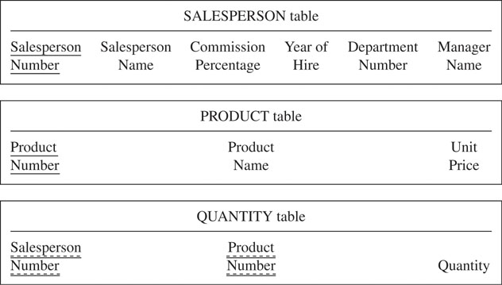
Second Normal Form
Notes:
Copyright by John Wiley and Sons, 2006

Slide 61
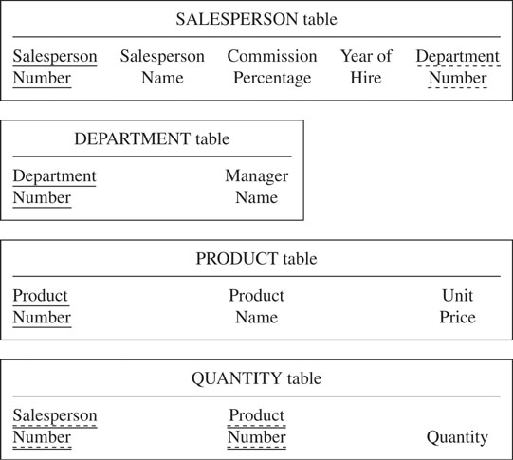
Third Normal Form
Notes:
Copyright by John Wiley and Sons, 2006

Slide 62
OTHER NORMAL FORMS
BCNF – 3 NF plus for every FD X --> A, X must be a candidate key.
4 NF – 3 NF plus no multivalued dependencies
5 NF – 4NF plus no JOIN dependencies

Slide 63
Boyce-Codd Normal Form (BCNF)
Boyce-Codd normal form (BCNF)
A relation is in BCNF, if and only if, every determinant is a
candidate key.
The difference between 3NF and BCNF is that for a functional
dependency A → B, 3NF allows this dependency in a relation
if B is a primary-key attribute and A is not a candidate key,
whereas BCNF insists that for this dependency to remain in a
relation, A must be a candidate key.

Slide 64
Example of BCNF
fd1 clientNo, interviewDate → interviewTime, staffNo, roomNo (Primary Key)
fd2 staffNo, interviewDate, interviewTime→ clientNo (Candidate key)
fd3 roomNo, interviewDate, interviewTime → clientNo, staffNo (Candidate key)
fd4 staffNo, interviewDate → roomNo (not a candidate key)
As a consequece the ClientInterview relation may suffer from update anmalies.
For example, two tuples have to be updated if the room No need be changed for staff No SG5 on the 13-May-02.
ClientInterview
ClientNo | interviewDate | interviewTime | staffNo | roomNo
CR76 | 13-May-02 | 10.30 | SG5 | G101
CR76 | 13-May-02 | 12.00 | SG5 | G101
CR74 | 13-May-02 | 12.00 | SG37 | G102
CR56 | 1-Jul-02 | 10.30 | SG5 | G102
Figure 8 ClientInterview relation

Slide 65
Example of BCNF(2)
To transform the ClientInterview relation to BCNF, we must remove the violating functional dependency by creating two new relations called Interview and SatffRoom as shown below,
Interview (clientNo, interviewDate, interviewTime, staffNo)
StaffRoom(staffNo, interviewDate, roomNo)
Interview
ClientNo | interviewDate | interviewTime | staffNo
CR76 | 13-May-02 | 10.30 | SG5
CR76 | 13-May-02 | 12.00 | SG5
CR74 | 13-May-02 | 12.00 | SG37
CR56 | 1-Jul-02 | 10.30 | SG5
StaffRoom
staffNo | interviewDate | roomNo
SG5 | 13-May-02 | G101
SG37 | 13-May-02 | G102
SG5 | 1-Jul-02 | G102
Figure 9 BCNF Interview and StaffRoom relations

Slide 66
Multi-Valued Dependencies
A multi-valued dependency occurs when a determinant determines more than one dependent, and the dependents are independent of each other
Example course implies teacher; course implies text, where teacher and text are independent
A relation with course, instructor and text is all key, and exhibits redundancy, but is in 3NF
Updates can exhibit anomalies
course ->->teacher/text
Source Date C.J. Introduction to Data Bases, 8th ed

Slide 67
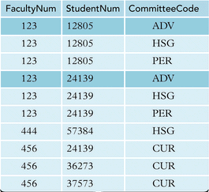
4NF EXAMPLE
Here
Faculty num->student num
Faculty num->committee code
Hence
Multivalued dependency exists
Faculty num->-> stunum/committee code
Not in 4nf.

Slide 68
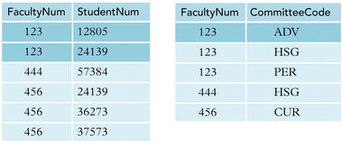

Slide 69
Fifth Normal Form
A relation R is in 5NF – also called projection-join normal form(PJNF), if and only if every nontrivial join dependency that is satisfied by R is implied by the candidate key(s) of R
In the general case, SPJ is not in 5NF, but SP, PJ, and JS are in 5NF
5NF is a generalization of 4NF, which is a generalization of 3NF
It is the most general form possible for projection-based normalization
Source Date C.J. Introduction to Data Bases, 8th ed

Slide 70

Join Dependencies and Fifth Normal Form
Definition:
A join dependency (JD), denoted by JD(R₁, R₂, ..., R_{n}), specified on relation schema R, specifies a constraint on the states r of R. The constraint states that every legal state r of R should have a non-additive join decomposition into R₁, R₂, ..., R_{n}; that is, for every such r we have
* (π_{R1}(r), π_{R2}(r), ..., π_{Rn}(r)) = r
Note: an MVD is a special case of a JD where n = 2.
A join dependency JD(R₁, R₂, ..., R_{n}), specified on relation schema R, is a trivial JD if one of the relation schemas R_{i} in JD(R₁, R₂, ..., R_{n}) is equal to R.

Slide 71

Join Dependencies and Fifth Normal Form
Definition:
A relation schema R is in fifth normal form (5NF) (or Project-Join Normal Form (PJNF)) with respect to a set F of functional, multivalued, and join dependencies if, for every nontrivial join dependency
  JD(R₁, R₂, ..., R_{n}) in F⁺ (that is, implied by F), every R_{i} is a superkey of R.

Slide 72
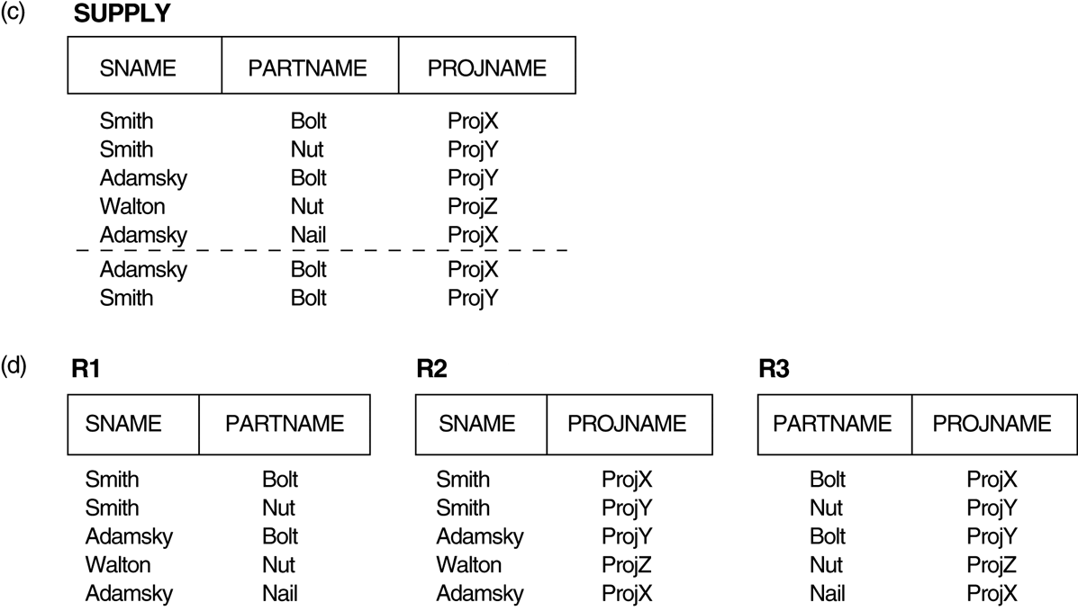
Relation SUPPLY with Join Dependency and conversion to Fifth Normal Form
(c) The relation SUPPLY with no MVDs is in 4NF but not in 5NF if it has the JD(R1, R2, R3).
(d) Decomposing the relation SUPPLY into the 5NF relations R1, R2, and R3.

Slide 73
THANK YOU
ANY QUERIES??????

