Slide 1
Infosys
Enterprise GPT
AI Knowledge Assistant
A document based assistant with citations and access control
Capstone presentation · September 2026
Notes:
Introduce the project as a capstone prototype. Explain the question-to-cited-answer workflow before opening the live product.

Slide 2
Infosys
ENTERPRISE GPT
Project objective
Finding the right answer should not depend on knowing the right file name.
01
02
03
The problem
The goal
The control
Policies, SOPs and runbooks are spread across files and teams.
Answer questions from approved passages and show the source.
Check each user’s scope before a passage can support an answer.
02
Notes:
The assistant looks up document passages, cites them, and withholds content outside the signed-in user’s scope.

Slide 3
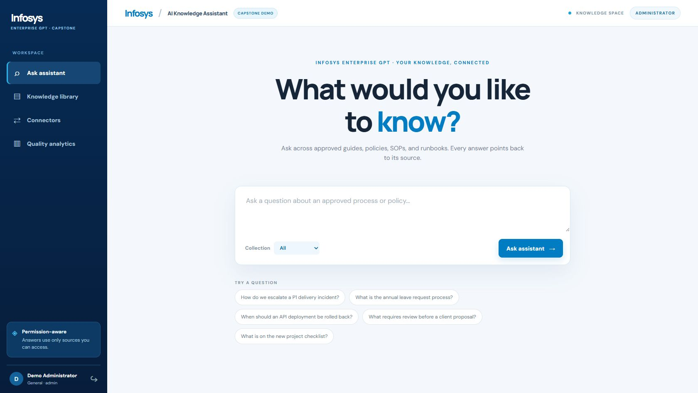
Infosys
ENTERPRISE GPT
The product at a glance
One place to ask, verify and manage knowledge
01
Employees
Ask a question and open the cited source.
02
Administrators
Add documents and review usage signals.
Assistant home page
03
Notes:
Point to the question box and left navigation. Administrators additionally see upload and quality pages.

Slide 4
Infosys
ENTERPRISE GPT
How the system is connected
Browser UI
Python API
Knowledge layer
Document store
→
→
→
static/
app.py
knowledge.py
SQLite + FTS5
Question, login and citations
Session, route and answer
Search, access and analytics
Documents, chunks and logs
HR question → MCP tool in mcp_server.py → permission check
Optional Gemini writes from permitted passages; the local extractive path also works.
04
Notes:
The browser calls app.py. The API calls knowledge.py for local retrieval or the read-only MCP tool for HR. SQLite stores passages and activity. Gemini is optional after access filtering.

Slide 5
Infosys
ENTERPRISE GPT
Document ingestion pipeline
An administrator uploads a file and describes who may use it.
01
Validate
TXT, MD, DOCX or PDF; size and duplicate checks
02
Extract
Read text, sections and document metadata
03
Chunk
Split long text into searchable passages
04
Index
Store passages in SQLite and FTS5
05
Notes:
Each passage retains the document title, section, owner, department, classification and relevant dates. These fields support citations and access checks.

Slide 6
Infosys
ENTERPRISE GPT
Question to answer
01
02
03
04
05
06
Question
→
Route
→
Retrieve
→
Filter
→
Decide
→
Answer
Employee asks
HR uses MCP
Find passages
Check access
Enough evidence?
Cite the source
If the passages support the question, the app returns a cited answer.
If they do not, it returns a clear no-answer result and records the gap.
06
Notes:
The API classifies the question, retrieves passages, checks permissions and document freshness, then either constructs a cited answer or declines.

Slide 7
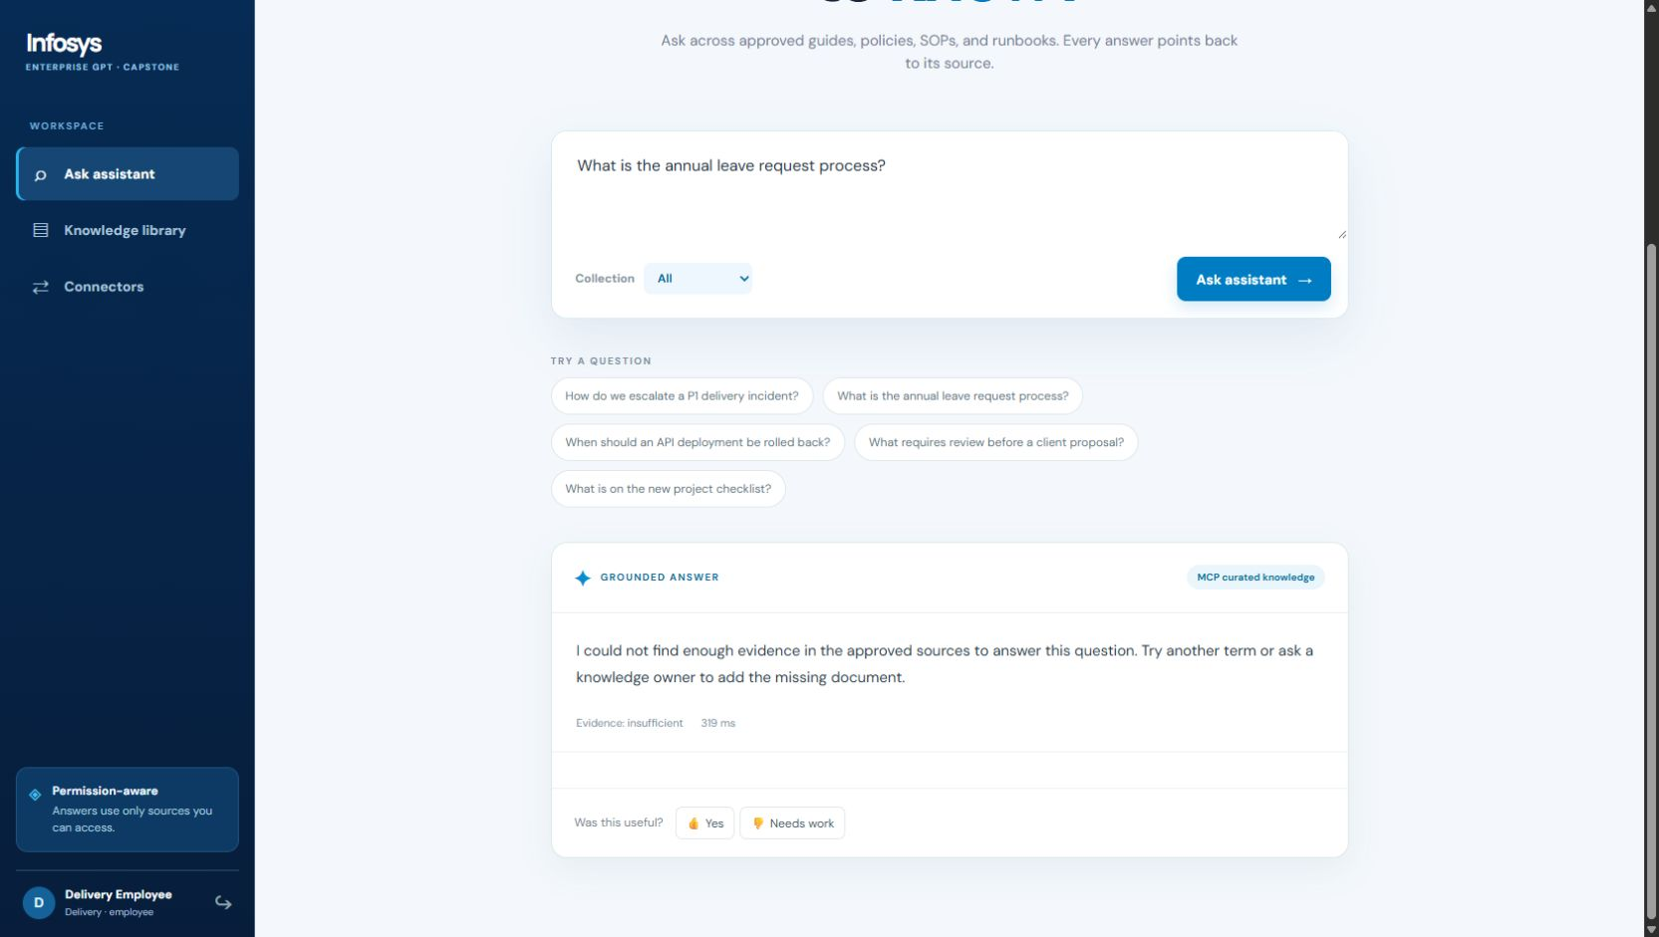
Infosys
ENTERPRISE GPT
Access control in action
Same HR question. Different access.
Administrator
Can receive a cited leave policy passage.
Delivery employee
Receives no HR passage or HR citation.
Delivery employee response to an HR question
07
Notes:
Access is checked inside retrieval and again after the MCP tool returns. Source preview uses the same role check.

Slide 8
Infosys
ENTERPRISE GPT
Technology by component
PART
FILE / TECHNOLOGY
PURPOSE
Frontend
static/index.html, style.css, app.js
Forms, navigation, answers and dashboards
Backend
app.py · Python HTTP server
Login, API routes, query flow and sessions
Knowledge
knowledge.py · SQLite FTS5
Upload, chunks, search, access and analytics
Connector
mcp_server.py · JSON-RPC
Read-only HR search route
Answering
Gemini API or local extraction
Writes a short response from permitted passages
08
Notes:
Point out that the app uses a small static frontend and Python backend. The key and database stay server side.

Slide 9
Infosys
ENTERPRISE GPT
Code spotlight: routing and scope
The API chooses the search route, then checks connector results again.
department = k.classify_query(question, requested_department)
route = "MCP curated knowledge" if department == "HR" else "Local hybrid index"
# After the MCP call returns:
matches = [s for s in matches if k.can_access(user, s)]
app.py · HR questions take the MCP route; returned passages still pass the app’s access check.
09
Notes:
This is a short excerpt from app.py. The API never trusts connector output without applying the user scope.

Slide 10
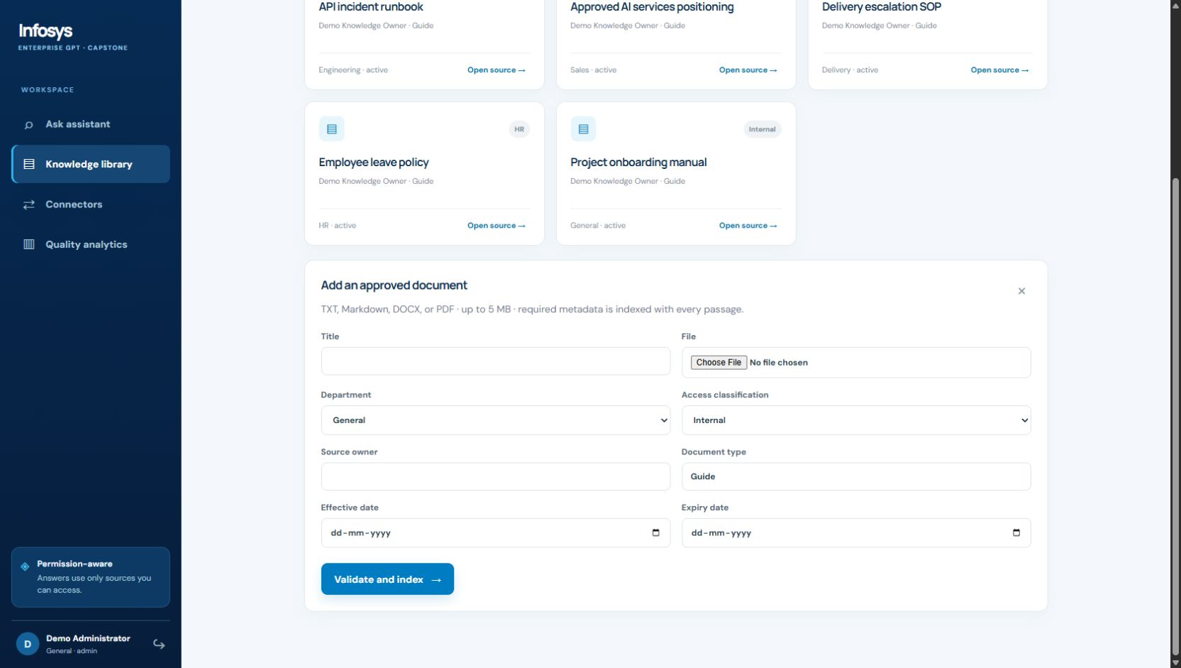
Infosys
ENTERPRISE GPT
How an administrator adds knowledge
01
Sign in
Use the Administrator demo account.
02
Open the library
Choose Add document.
03
Describe the file
Set title, owner, department, classification and dates.
Document upload form
10
Notes:
The backend validates the upload, extracts text, creates section passages and stores their metadata and search terms.

Slide 11
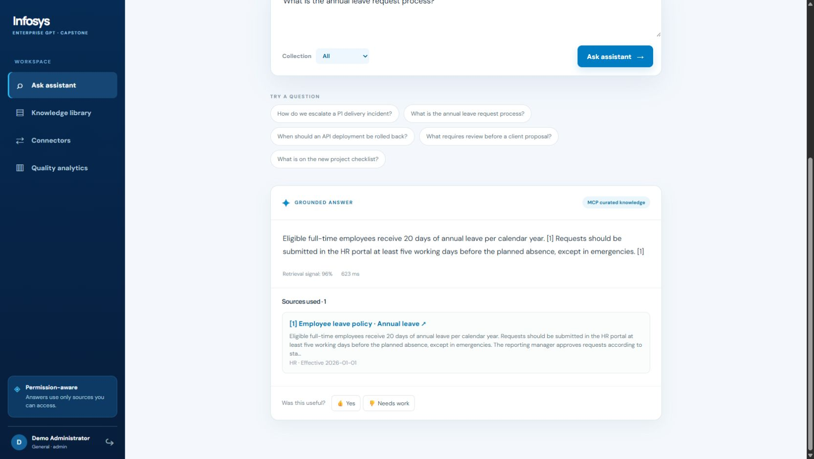
Infosys
ENTERPRISE GPT
How an employee asks a question
“What is the annual leave request process?”
1 Enter the question
2 Read the cited answer
3 Open source [1]
4 Rate the response
Answer with numbered source citation
11
Notes:
The answer is built from permitted retrieved passages. Point to the route, citation, source card and feedback controls.

Slide 12
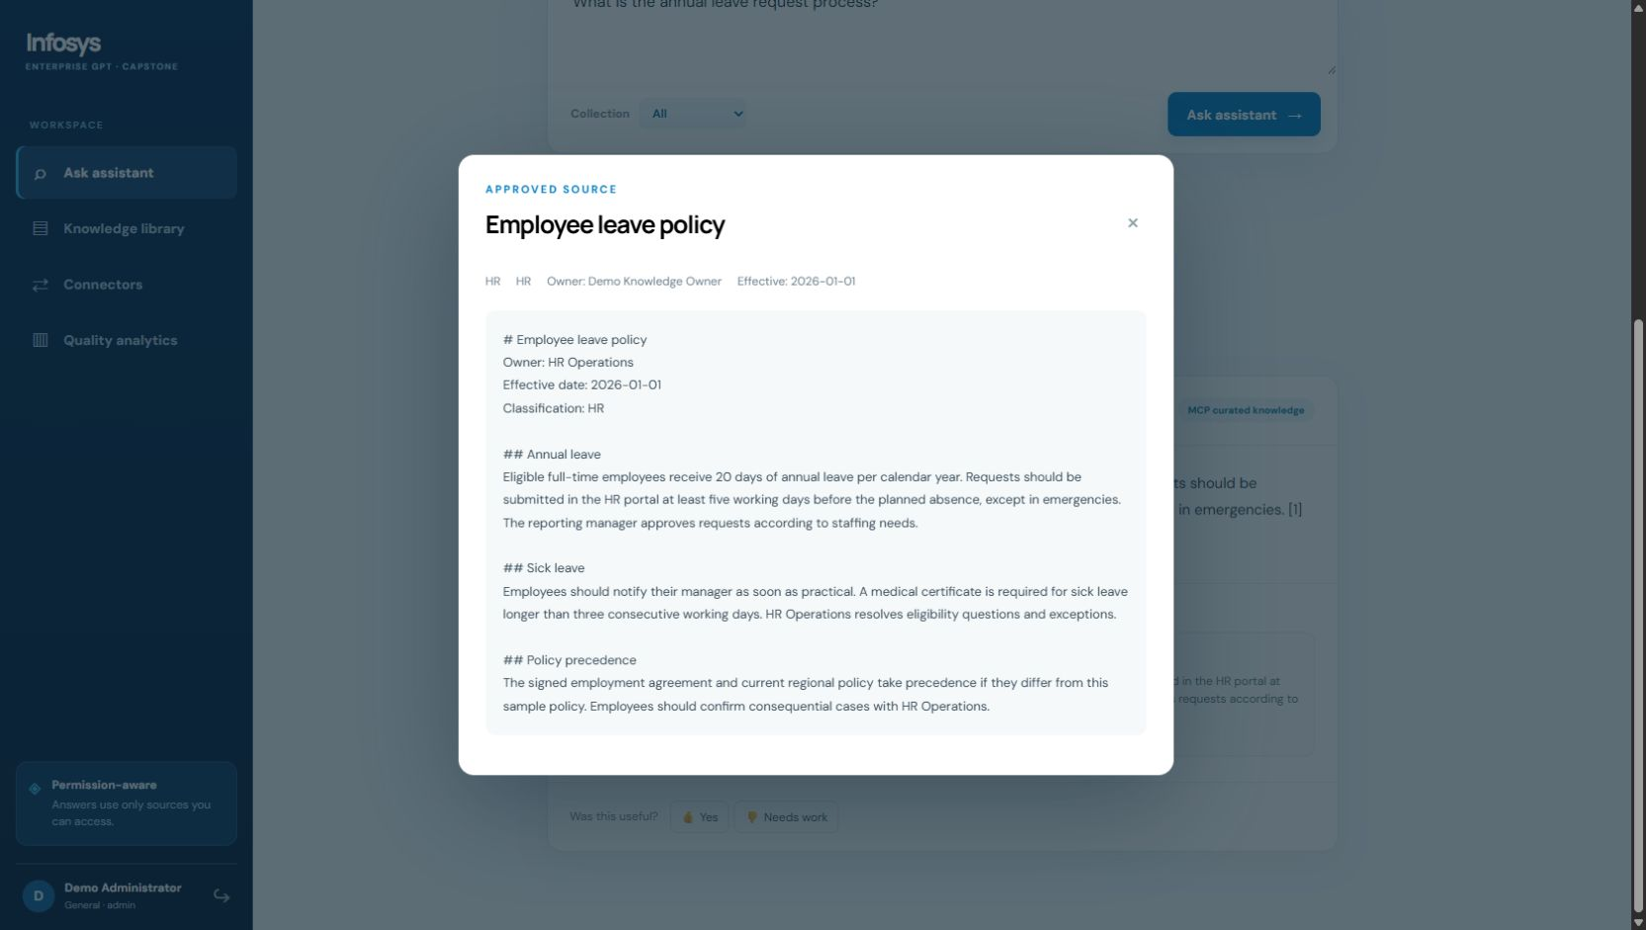
Infosys
ENTERPRISE GPT
What a citation lets you verify
The source opens beside the answer.
Policy lookup
Check the exact passage before acting.
Operational runbooks
Find the section relevant to an incident.
Document context
See owner, department, dates and classification.
Source preview with passage and metadata
12
Notes:
Open citation [1] in the live demo. The API checks authorization again before returning the source preview.

Slide 13
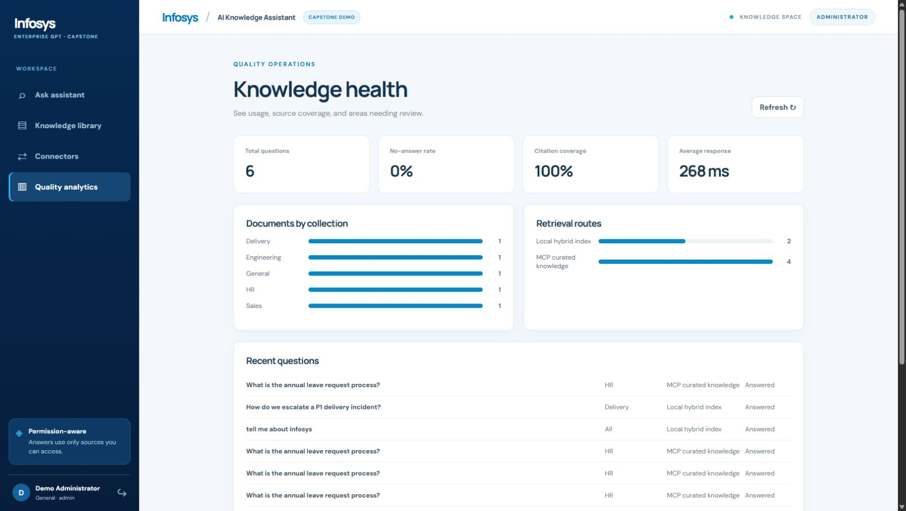
Infosys
ENTERPRISE GPT
Quality analytics
Where people ask — and where the knowledge bank needs work
Questions and routes
See which searches used MCP or local retrieval.
Citations and no-answer results
Find questions that lacked enough source evidence.
Feedback and connector events
Question, citation and retrieval activity
13
Notes:
These are operational usage signals. Explain how the administrator can use no-answer questions and feedback to improve the document collection.

Slide 14
Infosys
ENTERPRISE GPT
Deployment and next steps
Live review app
infosys-enterprise-gpt-demo.onrender.com
01
02
Current deployment
Before enterprise use
Render Free runs the Python app with server-side environment variables.
Add company sign-in, durable storage, approved connectors and deeper evaluation.
14
Notes:
The public app is a review environment. Render Free storage is ephemeral, so uploads and activity can reset after restart. Secrets remain in Render environment variables.

Slide 15
Infosys
ENTERPRISE GPT
Five-minute product walkthrough
1
Sign in as Administrator
Ask the annual leave question.
2
Open citation [1]
Show the source passage and metadata.
3
Visit Knowledge library
Show upload fields and seeded documents.
4
Open Quality analytics
Point out routes, citations and no-answer activity.
5
Switch to Delivery employee
Ask the same HR question and compare the result.
15
Notes:
Use the deployed product for the live walkthrough. The shared demo password should be given to reviewers separately.

Slide 16
Infosys
Thank You
Project makers
01 [Name 1]
02 [Name 2]
03 [Name 3]
04 [Name 4]
05 [Name 5]
06 [Name 6]
07 [Name 7]
08 [Name 8]
Questions and discussion
Notes:
Replace all eight name placeholders with the actual makers before presenting. Thank the audience and invite questions.

