Slide 1

Infosys
Enterprise GPT
AI knowledge assistant
Project architecture, product workflow and enterprise value
Capstone presentation • September 2026
Notes:
Conceptual cover illustration generated for this deck; it is not a product screenshot. Source for project description: README.md and docs/architecture.md.

Slide 2
Project objective
The problem
The objective
Employees search across policies, SOPs and runbooks. Answers can be slow to find, hard to verify, or outside a person’s access scope.
Give employees a direct answer from approved documents, show the evidence, and enforce access before the answer is assembled.
Capstone scope: a working governed retrieval prototype with fictional sample data
INFOSYS ENTERPRISE GPT / CAPSTONE PROTOTYPE
02
Notes:
Source: README.md. Included documents are fictional project examples, not real Infosys policies or records.

Slide 3
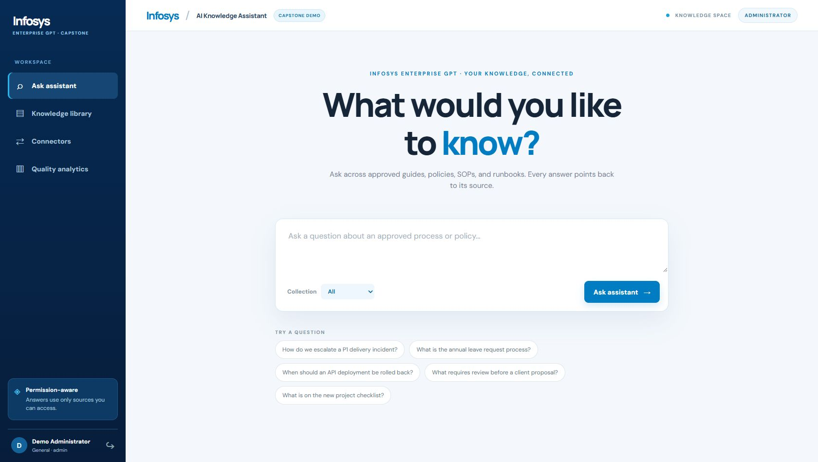
Who uses the product
Employee
Asks a question and opens the cited source before acting.
Administrator
Adds approved documents and reviews quality activity.
The seeded accounts are demo identities.
INFOSYS ENTERPRISE GPT / CAPSTONE PROTOTYPE
03
Notes:
Source: README.md, static/index.html and product capture 01_assistant_home.png. The seeded accounts are demo identities; the image records the local demo UI.

Slide 4
How the parts connect
MCP tool
HR knowledge
Python HTTP API
login + query flow
SQLite
documents + index + audit
Browser UI
Route decision
Local search
other queries
After retrieval: permission check, evidence threshold, cited answer and logging
INFOSYS ENTERPRISE GPT / CAPSTONE PROTOTYPE
04
Notes:
Sources: docs/architecture.md; app.py answer_query and mcp_search; knowledge.py search. Diagram simplifies the return path. MCP is a read-only local stdio JSON-RPC server, not a live external HR system.

Slide 5
Document ingestion pipeline
Approved file
TXT, MD, DOCX, PDF
Validate
size, type, duplicate
Extract text
sections and metadata
Create chunks
overlapping passages
Index
FTS5 + lexical vectors
Each chunk keeps its document, section, owner, department, classification and effective dates.
Why it matters: retrieval can point to a specific passage and reject content that is stale or out of scope.
INFOSYS ENTERPRISE GPT / CAPSTONE PROTOTYPE
05
Notes:
Source: knowledge.py create_document, extract_document, split_sections and search. DOCX extraction uses XML; PDF parsing uses pypdf. Upload limit is 5 MB. Lexical vectors are hashed token features, not model embeddings.

Slide 6
Question-to-answer pipeline
Employee
question
Classify
department
Search
MCP or local
Filter
access + expiry
Evidence sufficient?
Safe no-answer
+ knowledge gap
Cited answer
+ source preview
Optional Gemini writes from permitted passages. Otherwise the app extracts cited sentences.
INFOSYS ENTERPRISE GPT / CAPSTONE PROTOTYPE
06
Notes:
Sources: app.py answer_query; knowledge.py classify_query, search, gemini_answer and extractive_answer. Threshold is a retrieval score and is not a calibrated probability of correctness.

Slide 7
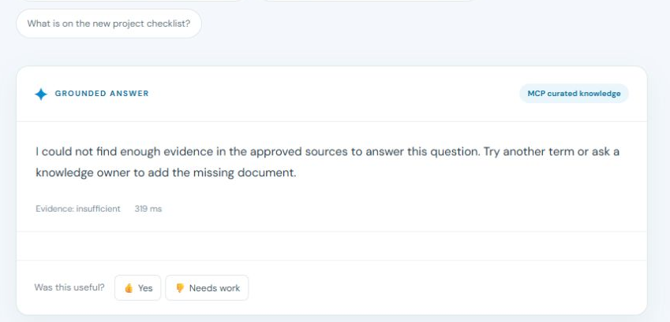
Access control in action
Same HR question, different scope
Administrator: a cited leave-policy answer.
Delivery employee: no HR passage or citation.
The MCP server and API both check the user’s access.
The no-answer screen still needs a distinct heading.
INFOSYS ENTERPRISE GPT / CAPSTONE PROTOTYPE
07
Notes:
Sources: docs/architecture.md, app.py mcp_search and answer_query, knowledge.py can_access/search, product capture 10_employee_access_boundary.png. The screenshot shows a fresh HR query by a Delivery employee. These are prototype controls, not production security approval.

Slide 8
Technology by component
PART
TECHNOLOGY
ROLE IN THE PRODUCT
Interface
HTML, CSS, JavaScript
Question form, citations, source preview, admin screens
Application
Python standard library HTTP server
Authentication, API endpoints, routing, answer workflow
Knowledge store
SQLite with FTS5
Documents, passages, search terms, queries and audit records
Connector
MCP over stdio JSON-RPC
Read-only HR search demonstration
Answering
Extractive synthesis; optional Gemini
Cited response from retrieved permitted passages
INFOSYS ENTERPRISE GPT / CAPSTONE PROTOTYPE
08
Notes:
Sources: README.md and source files. PDF uploads need pypdf. Hashed lexical vectors are local token features rather than semantic model embeddings.

Slide 9
Code spotlight: route and scope
In app.py, HR questions use the MCP route. Other questions use the local index.
department = k.classify_query(question, requested_department)
route = "MCP curated knowledge" if department == "HR" else "Local hybrid index"
# After the MCP call:
matches = [s for s in matches if k.can_access(user, s)]
The second access check protects the application even after data crosses the connector boundary.
INFOSYS ENTERPRISE GPT / CAPSTONE PROTOTYPE
09
Notes:
Source: app.py lines in classify_query, route selection and mcp_search. The excerpt combines exact lines from the same file with a comment for readability.

Slide 10
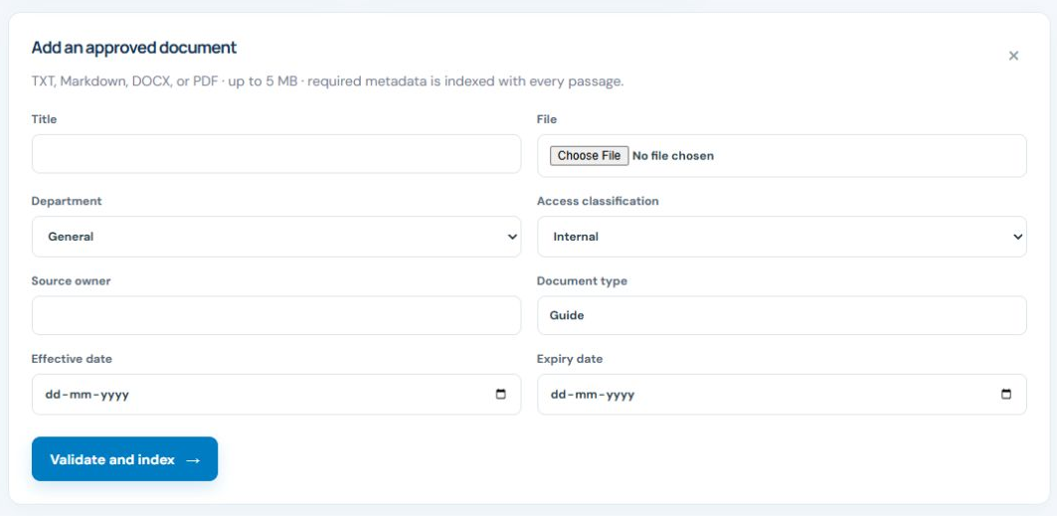
How to use: prepare knowledge
1 Sign in as administrator
2 Open Knowledge library
3 Set department, access and owner
4 Validate and index
The screen shows the demo upload form. Use only approved material.
INFOSYS ENTERPRISE GPT / CAPSTONE PROTOTYPE
10
Notes:
Sources: static/index.html, docs/demo_script.md and product capture 05_document_ingestion.png. The screenshot is from the local prototype, not a public deployment.

Slide 11
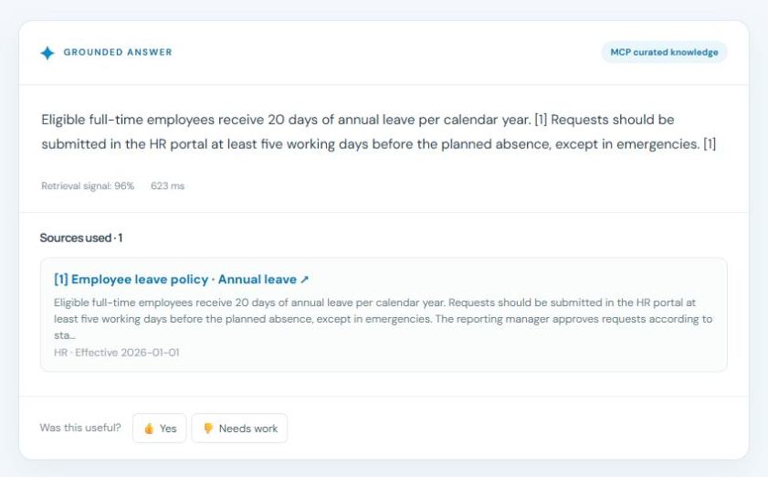
How to use: ask and verify
1 Enter a question
2 Read the answer and route
3 Open citation [1] for the source
4 Rate the answer
Example: annual leave, answered from a fictional HR policy.
INFOSYS ENTERPRISE GPT / CAPSTONE PROTOTYPE
11
Notes:
Sources: static/index.html, docs/demo_script.md and product capture 02_cited_hr_answer.png. The answer shown is from fictional sample HR material; retrieval signal is not calibrated answer accuracy.

Slide 12
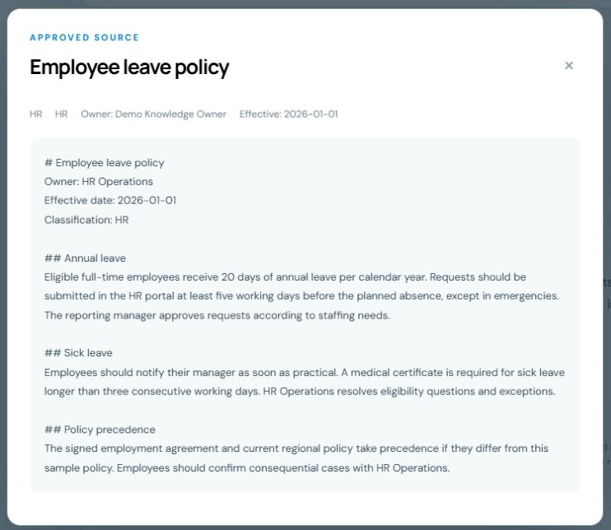
Enterprise problems it can address
Policy lookup
Find a procedure, then inspect the cited policy passage.
Operational knowledge
Open the right runbook section during an incident.
Controlled access
Keep department material outside other teams’ answers.
Source preview from fictional demo content
INFOSYS ENTERPRISE GPT / CAPSTONE PROTOTYPE
12
Notes:
Sources: README.md, fictional data/sample_* documents, docs/demo_script.md and product capture 03_source_preview.png. These are illustrative use cases, not measured enterprise outcomes.

Slide 13
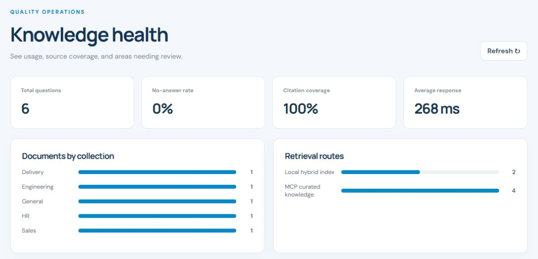
Quality signals and verification
The product records
Questions, retrieval routes, citations, no-answer outcomes, connector events and feedback.
The codebase checks
Seven workflow tests pass. Six evaluation questions support repeatable local review.
Demo activity snapshot. These metrics do not prove accuracy on real company content.
INFOSYS ENTERPRISE GPT / CAPSTONE PROTOTYPE
13
Notes:
Sources: tests/, docs/evaluation_queries.csv, knowledge.py analytics, product capture 07_quality_analytics.png. The captured metrics describe demo activity, not measured accuracy. Seven unit tests were rerun and passed in this workspace.

Slide 14
Deployment and production path
Current state
Before real company content
Local runnable prototype. A Render blueprint is prepared. No public app URL is recorded in the project yet.
Add enterprise SSO, managed storage and secrets, document scanning, stronger evaluation, privacy review and approved connectors.
Immediate demo fixes: clear prior answers on account switch, label no-answer distinctly, and align source-owner metadata.
INFOSYS ENTERPRISE GPT / CAPSTONE PROTOTYPE
14
Notes:
Sources: README.md, docs/deployment.md, docs/security_notes.md and the supplied local product captures. The repo contains render.yaml but public deployment has not been completed or verified. In the captured role switch sequence, the previous administrator answer remained in client state until a fresh employee query replaced it. The source preview also shows a metadata owner that differs from the owner named in the sample document text. These should be corrected before a final demonstration.

Slide 15
Project makers
Add names and roles before submission
01 Project maker 1
05 Project maker 5
02 Project maker 2
06 Project maker 6
03 Project maker 3
07 Project maker 7
04 Project maker 4
08 Project maker 8
INFOSYS ENTERPRISE GPT / CAPSTONE PROTOTYPE
15
Notes:
Replace each placeholder with the actual project maker name and, if desired, responsibility. No contributor names were available in the workspace.

