Slide 1
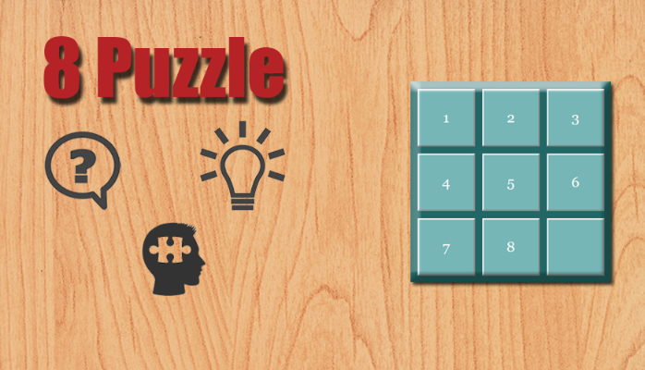

Slide 2
Abdullah Al Masud Tushar
2013-3-60-041
Artificial Intelligence
Dept. of Computer Science
&
Engineering
East West University

Slide 3

What is 8 puzzle ???

Slide 4
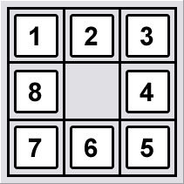
A simple game consisting of a 3 x 3 grid including one of the squares is empty

Slide 5
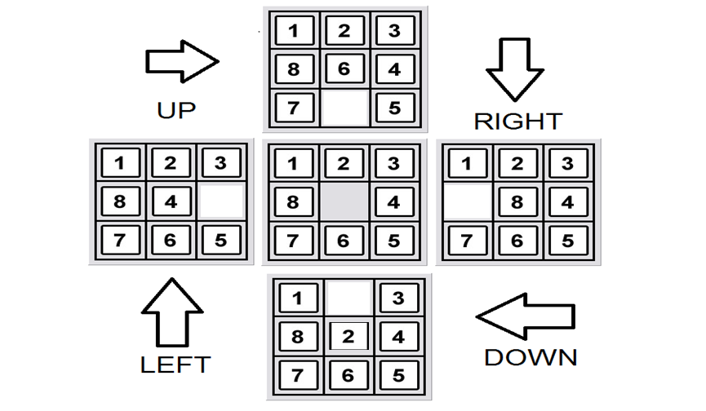
Possible Moves

Slide 6
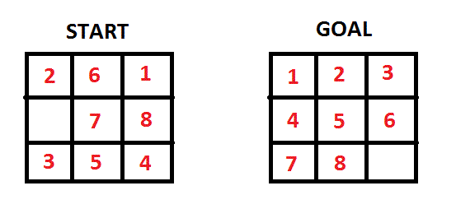
Main objective
Reach from initial state to goal state

Slide 7

Attacking Strategy

Slide 8
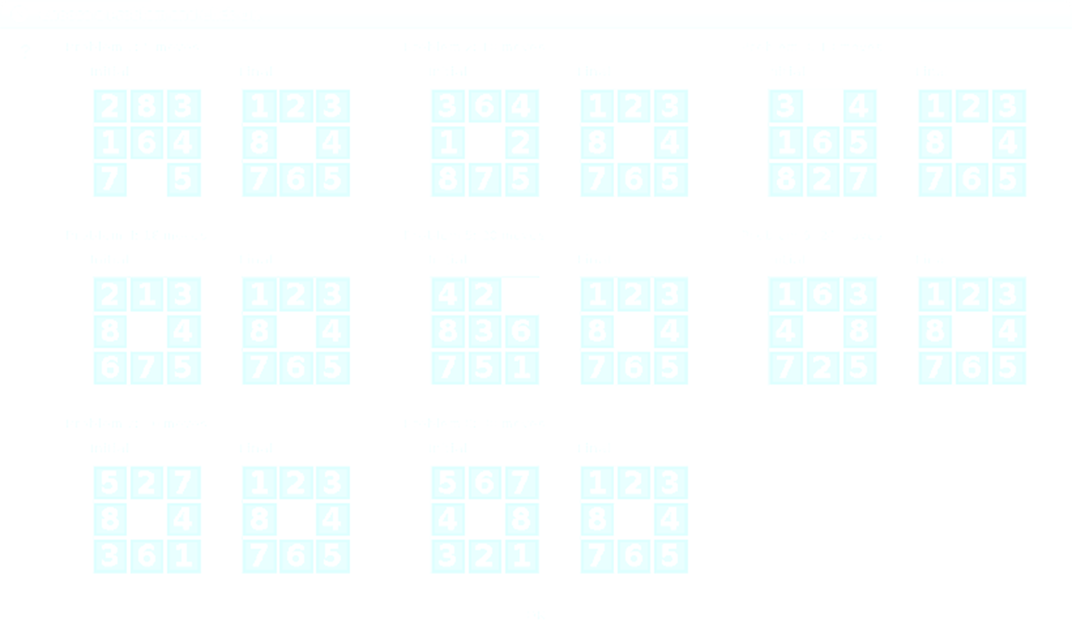
Problem Info
Variable: 1,2,3,4,5,6,7,8,0 (blank grid)
Domain: Left , Right, Up, Down
Goal : Sorted variables in ascending order
Total Grid = 9
Total 9! = 362880 Possible states

Slide 9
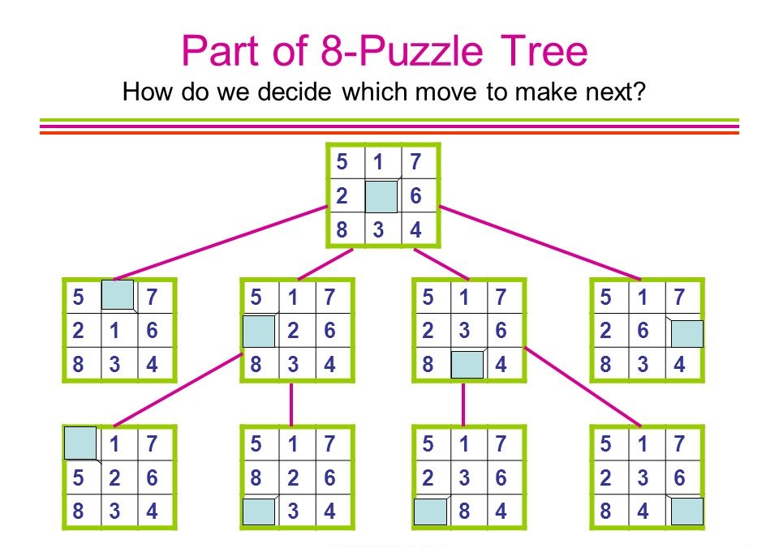

Slide 10
Required Weapons
Searching method: A* Search
Hueristics : Manhattan distance
Hashing : Modified Additive hash

Slide 11
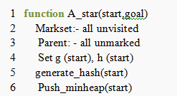
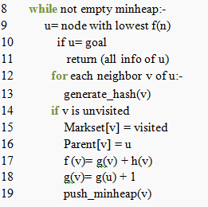
A* search psudocode

Slide 12
Cost function of each state
f(n) = g(n) + h(n)
g(n) = Depth of the state
h(n) = Hueristics value

Slide 13
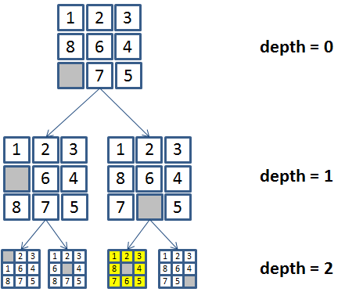
Depth calculation
g(n1) = 0
g(n2) = 0 + 1= 1
g(n3) = 1 + 1 = 2

Slide 14
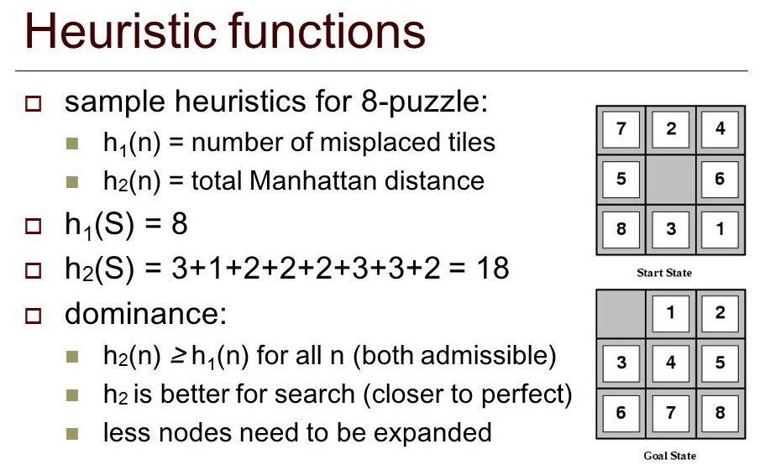
Why Manhattan distance ?

Slide 15
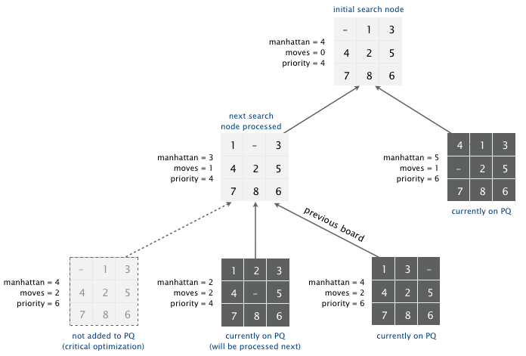
Calculation of arbitrary state

Slide 16
Program Overview

Slide 17
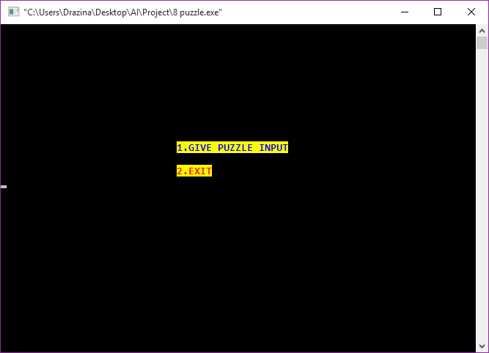

Slide 18
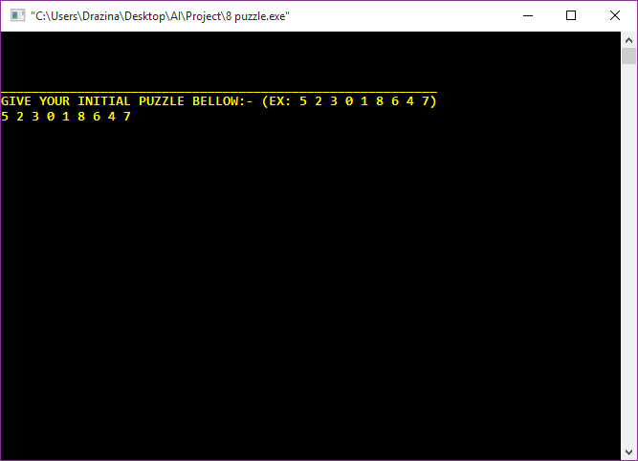

Slide 19
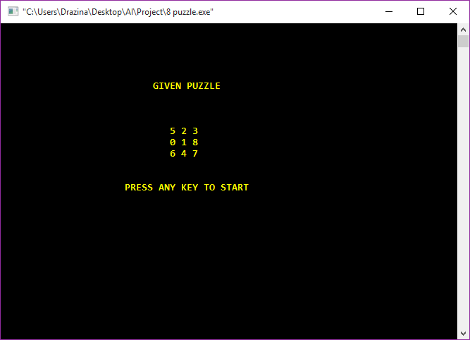

Slide 20
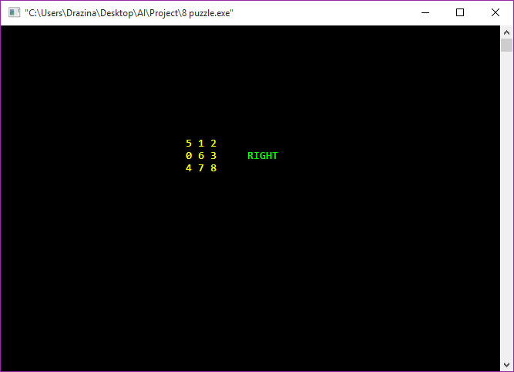

Slide 21
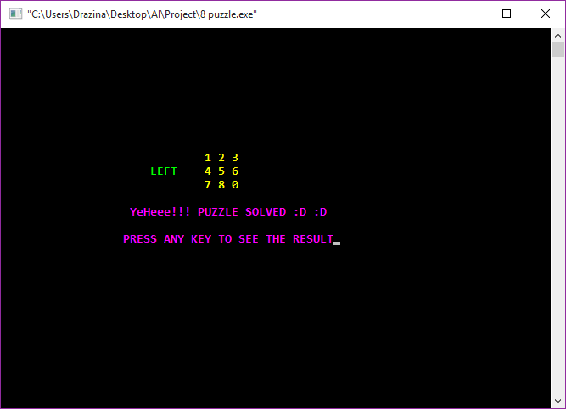

Slide 22

Data Analysis

Slide 23
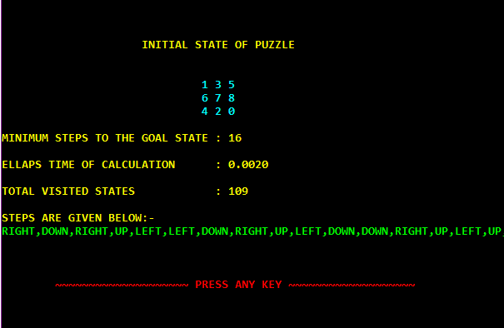

Slide 24
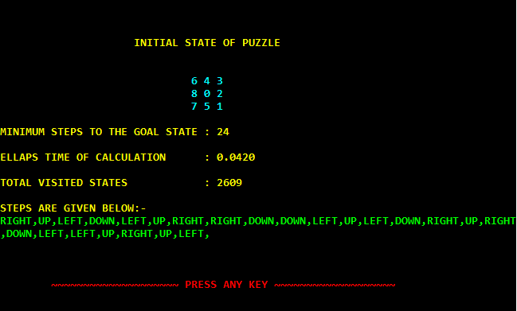

Slide 25
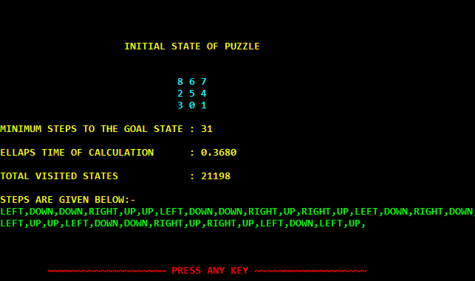

Slide 26
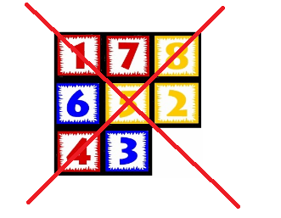
Unsolvability
Puzzle is unsolvable
if total number of inversion of initial state is odd

Slide 27
Benefits of Puzzle Solving
Enhances visual perception
Improves memory
Develops critical thinking
Increases dopamine production in the brain
Stimulates the whole brain

Slide 28
Objective and Features
Helps an user to solve a random puzzle
Checks a puzzles validity and solvability
Solve the puzzle in minimum moves
Very much time efficient
High accuracy of results

Slide 29

THANK YOU

