Slide 1
Big Data Applications Symposium - Fall 2017
Project Name: A Study on the Relationship Between Housing Prices and the Air Quality, Metro Stations and Crimes in New York City
Team:
Taikun Guo tg1539@nyu.edu
Yi Zhang yz3940@nyu.edu
Abstract: In this study, we mainly focus on the factors of the air quality, metro stations and crimes, and exploit how they influenced the housing prices in New York City from 2010 till now.

Slide 2
A Study on the Relationship Between Housing Prices and the Air Quality, Metro Stations and Crimes in New York City
Motivation
Who are the users of this application? House Buyer, Apartment Seeker, City Government
Who will benefit from this application? House Buyers and Housing Prices researchers
Why is this application important?
Housing prices has been one of the most important things that need to be considered by people in the United States especially in NYC since this is always a heavy burden for young people. And housing prices are largely related to the environments around them. Thus, this study will help consumers to have a vision on how prices are affected by crimes, subway stations and Air Quality.

Slide 3
A Study on the Relationship Between Housing Prices and the Air Quality, Metro Stations and Crimes in New York City
Remediation
What actuation(s) or remediation actions are performed by the application?
From our study, we will be able to get a model which reflects the relations between housing prices and the other factors. Therefore, we will be able to get predict prices by running the model on some areas and compare them to the actual prices. From there, we will get some insights on whether these areas are worth the prices or whether these areas are special compare to all other areas. And this is useful when someone is buying a house or renting an apartment. He or she can use this insight to decide if a house is worth the price. Also, real estate researchers can do further researches to find out why the price of a certain area is different from the prediction.

Slide 4
A Study on the Relationship Between Housing Prices and the Air Quality, Metro Stations and Crimes in New York City
Data Sources
Name: Property Valuation and Assessment Data in 2017
Description: Property valuation and assessment data for NYC.
Size of data: 455 MB
Name: Air Quality 2010 - 2017
Description: The AQI of NYC different areas from 2010 to 2017.
Size of data: 1 MB
Name: Subway Entrances in NYC
Description: The data contains all the subway entrances in NYC.
Size of data: 1 MB
Name: NYPD Complaint Map 2016 - 2017
Description: All the complaints received by NYPD in NYC during 2016 - 2017
Size of data: 89 MB

Slide 5
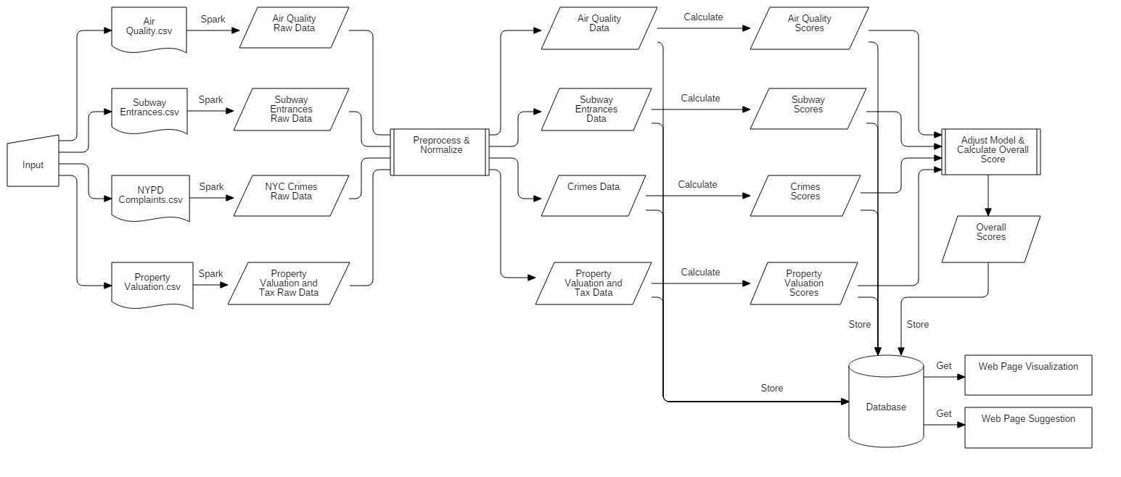
A Study on the Relationship Between Housing Prices and the Air Quality, Metro Stations and Crimes in New York City
Design Diagram
Platform(s) on which the application runs:
We majorly ran our application on the Cloudera Quick start VM. For some tasks including fetching Air Quality data, we used the Dumbo server.

Slide 6
A Study on the Relationship Between Housing Prices and the Air Quality, Metro Stations and Crimes in New York City
Experiments/Results
1. After analyzing our model, we can find that most of the residential or non-busy district in NYC fit in the model very well. However, for some financial and busy districts such as major part of Manhattan and downtown Brooklyn, these areas can not fit into the model very well. We believe that there must be some other factors we need to consider, for example, the prosperity, surrounding facilities, cultural environment and residential class of the blocks.
2. We found the Air Quality Index does not have a very huge influence on the property price in NYC, which is different then we expected. We think that, since AQI in different areas of NYC are close. That may not be a primary consideration while purchasing a house. And we are interested in running our model in a different place where Air Quality is a major concern to see if it has a great impact on housing prices.

Slide 7
A Study on the Relationship Between Housing Prices and the Air Quality, Metro Stations and Crimes in New York City
Obstacles
1. The Air Quality data we found at first used a unique way to reference all the locations in NYC, which does not match the ways other data sets are using. So we have to consider finding another one.
2. We found an AirNow API which gives us nice AQI data based on geo coordinates. However, since it’s a free API, it limits the max calls to 500 per hour. So we have to develop a script to fetch 500 records every hour and have it run on server for almost 2 days.
3. It cost us some time to make Maven work with Scala. We tried a couple Maven archetypes that are already outdated.

Slide 8
A Study on the Relationship Between Housing Prices and the Air Quality, Metro Stations and Crimes in New York City
Summary
Crimes, Metro stations and Air Quality does effect NYC’s housing prices. Although some of the factors do not matter that much in some areas which is different then we thought, we do believe that future researches need to be done using our model again on some different cities which are way different from New York City.
Acknowledgements
This study was supported by our professor Suzanne McIn- tosh (mcintosh@cs.nyu.edu). We also thank the High Per- formance Computing department in NYU for supporting the computing resources, and most parts of our program was run on Dumbo.
We thank CartoDB for providing a visualization web page to show our processed data and give a direct vision for our users to help them and give them advises.
We also thank AirNow API for providing an API to enable us to fetch the historical AQI data in NYC, though the air quality in NYC is really good and there is hardly difference among all the historical records.

Slide 9
A Study on the Relationship Between Housing Prices and the Air Quality, Metro Stations and Crimes in New York City
References
[1] Glaeser, Edward L., Joseph Gyourko, and Raven Saks. Why have housing prices gone up?. No. w11129. National Bureau of Economic Research, 2005.
[2] Chiarazzo, Vincenza, et al. "The effects of environmental quality on residential choice location." Procedia-Social and Behavioral Sciences 162 (2014): 178-187.
[3] Pope, Devin G., and Jaren C. Pope. "Crime and property values: Evidence from the 1990s crime drop." Regional Science and Urban Economics 42.1 (2012): 177-188.
[4] Glaeser, Edward L., Joseph Gyourko, and Raven Saks. "Why is Manhattan so expensive? Regulation and the rise in housing prices." The Journal of Law and Economics 48.2 (2005): 331-369.
[5] Agostini, Claudio A., and Gastón A. Palmucci. "The anticipated capitalisation effect of a new metro line on housing prices." Fiscal studies 29.2 (2008): 233-256.

Slide 10
A Study on the Relationship Between Housing Prices and the Air Quality, Metro Stations and Crimes in New York City
Thank you!

