Slide 1

A Study on the Relationship Between Housing Prices
and the Air Quality, Metro Stations
and Crimes in New York City
Big Data Applications Symposium - Fall 2017
Taikun Guo tg1539@nyu.edu
Yi Zhang yz3940@nyu.edu

Slide 2
1
Overview
CONTENTS
2
Data Sources
3
Design
4
Summary

Slide 3
PART 01
Overview
Relationship Between Housing Prices and Air Quality, Metro Stations and Crimes
©2017 Yi Zhang, Taikun Guo

Slide 4
Abstract
Focused on how the factors of the Air Quality, Metro Stations and Crimes influenced on the Housing Prices in NYC
Calculated the scores for each data, and train the linear regression model to find the abnormal points
Give relationship among them and provide advices for users
⬧
Relationship Between Housing Prices and Air Quality, Metro Stations and Crimes
©2017 Yi Zhang, Taikun Guo

Slide 5
Motivation
Users: House Buyers, Apartment Seekers, Investors
Beneficiary: House Buyers, Investors, Housing Prices Researchers
Why important?
Hard to choose a “good” house
Need vision on how factors influence housing price
Air quality, metro stations and crime situations are important environment factors
⬧
Relationship Between Housing Prices and Air Quality, Metro Stations and Crimes
©2017 Yi Zhang, Taikun Guo

Slide 6
Remediation
The application runs linear regression on the environment data and train a model which reflects the relations between these factors and housing prices.
The linear regression model can be used to predict housing prices and compared with the actual prices.
By comparing the predicts and actual prices, we are able to generate insights on if a housing price is reasonable, and give advices
⬧
Relationship Between Housing Prices and Air Quality, Metro Stations and Crimes
©2017 Yi Zhang, Taikun Guo

Slide 7
PART 02
Data Sources
Relationship Between Housing Prices and Air Quality, Metro Stations and Crimes
©2017 Yi Zhang, Taikun Guo

Slide 8
1. Property Valuation and Assessment Data
Fetched from DOF
Contains Property Valuation, Assessment and BBL information from 2016 to 2017
Size: 455 MB
Count: 362,894 Records
⬧
Relationship Between Housing Prices and Air Quality, Metro Stations and Crimes
©2017 Yi Zhang, Taikun Guo

Slide 9
2. Air Quality Index 2010 - 2017
Fetched from AirNow API
Contains the historical air quality data for each zip code in NYC from 2010 to 2017
Size: 1 MB
Count: 18,761 Records
⬧
Relationship Between Housing Prices and Air Quality, Metro Stations and Crimes
©2017 Yi Zhang, Taikun Guo

Slide 10
3. Subway Entrances in NYC
Fetched from MTA
Contains all the metro stations’ entrances in NYC
Size: 1 MB
Count: 1,928 Records
⬧
Relationship Between Housing Prices and Air Quality, Metro Stations and Crimes
©2017 Yi Zhang, Taikun Guo

Slide 11
4. NYPD Complaints Map 2016 - 2017
Fetched from NYPD Crime Statistics
Contains all the crime reports in NYC during 2010 to 2017
Size: 89 MB
Count: 351,492 Records
⬧
Relationship Between Housing Prices and Air Quality, Metro Stations and Crimes
©2017 Yi Zhang, Taikun Guo

Slide 12
5. Borough Block Lot Data
Fetched from DOF and Carto DB
Contains the borough block lot data in NYC
Used to visualize data on NYC map
Size: 142 MB
Count: 857,532 Records
⬧
Relationship Between Housing Prices and Air Quality, Metro Stations and Crimes
©2017 Yi Zhang, Taikun Guo

Slide 13
PART 03
Design
Relationship Between Housing Prices and Air Quality, Metro Stations and Crimes
©2017 Yi Zhang, Taikun Guo

Slide 14
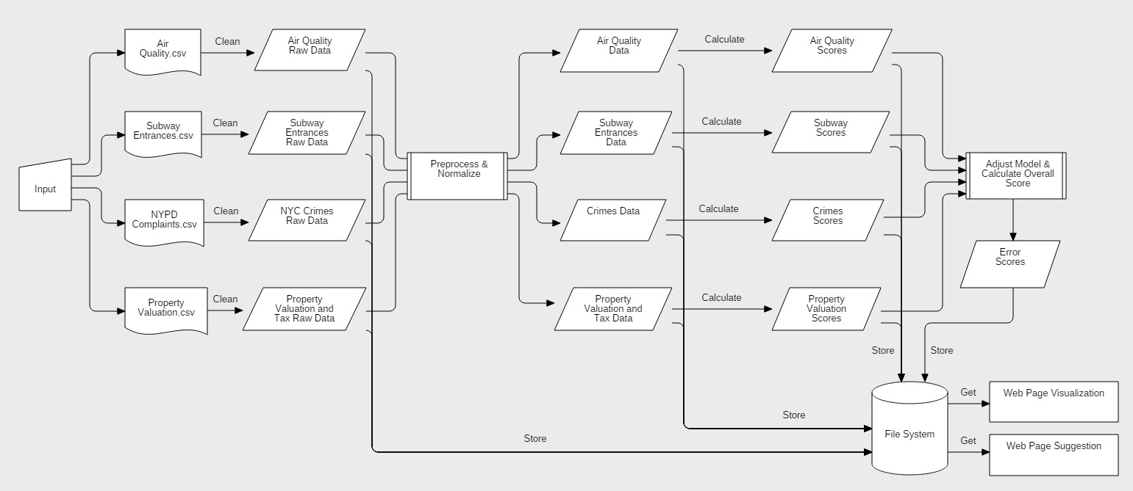
Design Diagram
⬧
Relationship Between Housing Prices and Air Quality, Metro Stations and Crimes
©2017 Yi Zhang, Taikun Guo

Slide 15
Steps
Fetch Data Java
Profile & Clean
Preprocess
Score
Train Model
Visualize Carto DB
Dumbo & Spark on HPC Clusters
⬧
Relationship Between Housing Prices and Air Quality, Metro Stations and Crimes
©2017 Yi Zhang, Taikun Guo

Slide 16
PART 04
Summary
Relationship Between Housing Prices and Air Quality, Metro Stations and Crimes
©2017 Yi Zhang, Taikun Guo

Slide 17
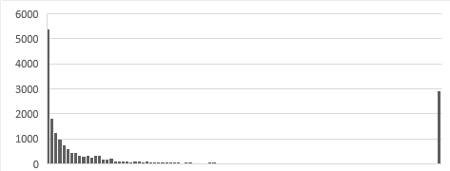
Experiments & Results
Average Chi-Squared error: 1.209
Model Error Distribution
⬧
Relationship Between Housing Prices and Air Quality, Metro Stations and Crimes
©2017 Yi Zhang, Taikun Guo

Slide 18
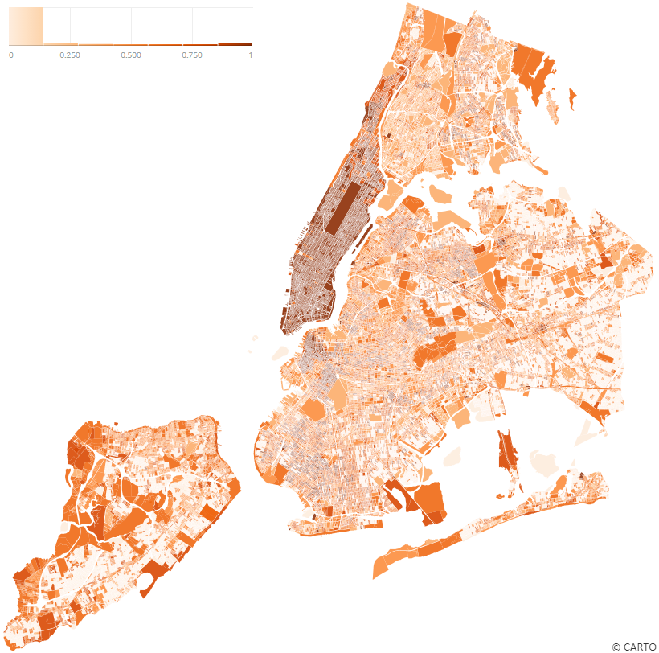
Data on Map
Show data on NYC map by Carto DB
Model errors on map
View Pages https://darkpursuer.carto.com/builder/08f06fbf-31b2-4505-8640-0ea273461d3c/embed
⬧
Relationship Between Housing Prices and Air Quality, Metro Stations and Crimes
©2017 Yi Zhang, Taikun Guo

Slide 19
Conclusion
Metro and crimes factors influence housing prices significantly
Most residential or non-busy blocks fit model well
Downtown blocks don’t fit model well
AQI has a small impact on housing prices
Other factors, such as development level, economic status, cultural factors, need to be considered
⬧
Relationship Between Housing Prices and Air Quality, Metro Stations and Crimes
©2017 Yi Zhang, Taikun Guo

Slide 20
Obstacles
Hard to find proper data sets, e.g. Air Quality Data
It’s a tough work to find the proper normalize functions to score each type of data
Unfamiliar with creating Maven project in Scala
⬧
Relationship Between Housing Prices and Air Quality, Metro Stations and Crimes
©2017 Yi Zhang, Taikun Guo

Slide 21
Summary
Crimes, metro stations and air quality do effect NYC’s housing prices
Although some of the factors do not matter that much in some areas
Future researches need to be done in some different cities to find more crucial factors
⬧
Relationship Between Housing Prices and Air Quality, Metro Stations and Crimes
©2017 Yi Zhang, Taikun Guo
Notes:
Crimes, Metro stations and Air Quality does effect NYC’s housing prices. Although some of the factors do not matter that much in some areas which is different then we thought, we do believe that future researches need to be done using our model again on some different cities which are way different from New York City.

Slide 22
Acknowledgements
Thank Prof. McIntosh for supporting our project
Thank HPC in NYU for computing resources
Thank CartoDB for providing visualization platform
Thank AirNow API for providing AQI historical data
⬧
Relationship Between Housing Prices and Air Quality, Metro Stations and Crimes
©2017 Yi Zhang, Taikun Guo

Slide 23
References
[1] Glaeser, Edward L., Joseph Gyourko, and Raven Saks. Why have housing prices gone up?. No. w11129. National Bureau of Economic Research, 2005.
[2] Chiarazzo, Vincenza, et al. "The effects of environmental quality on residential choice location." Procedia-Social and Behavioral Sciences 162 (2014): 178-187.
[3] Pope, Devin G., and Jaren C. Pope. "Crime and property values: Evidence from the 1990s crime drop." Regional Science and Urban Economics 42.1 (2012): 177-188.
[4] Glaeser, Edward L., Joseph Gyourko, and Raven Saks. "Why is Manhattan so expensive? Regulation and the rise in housing prices." The Journal of Law and Economics 48.2 (2005): 331-369.
[5] Agostini, Claudio A., and Gastón A. Palmucci. "The anticipated capitalisation effect of a new metro line on housing prices." Fiscal studies 29.2 (2008): 233-256.
⬧
Relationship Between Housing Prices and Air Quality, Metro Stations and Crimes
©2017 Yi Zhang, Taikun Guo

Slide 24
THANK YOU
Relationship Between Housing Prices and Air Quality, Metro Stations and Crimes
©2017 Yi Zhang, Taikun Guo

