Slide 1
NICNET-Role of Nationalwide Networking in E-Governance
Presented by: Manisha kc
Symbol No: 20809/075

Slide 2
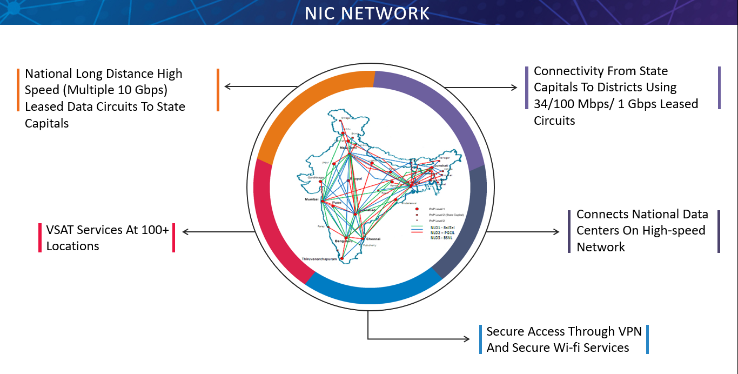
NICNET (National Informatics Centre Network)
The National Informatics Centre (NIC) is an attached office under the Ministry of Electronics and Information Technology (MeitY) in the Indian government. The NIC provides infrastructure to help support the delivery of government IT services and the delivery of some of the initiatives of Digital India. 6

Slide 3
It provides solutions in the area of e­-governance particularly for the sectors that fall under Government of
India. It can be made available to all organizations (both public
and private) organizations engaged in specific projects and programs. NICNET
produced the enabling facilities for supporting added activities, projects and
programs in the special work areas.

Slide 4
NICNET-Role of Nationalwide Networking in E-Governance
Through NICNET, NIC has been facilitating improvement in Government services, wider transparency, promoting decentralized planning and management, resulting in better efficiency and accountability to the people of India.
Peering with Google, Microsoft and Akamai Content Delivery Network has facilitated faster access to Google services and other important International web sites.
Re-structuring of Videoconferencing network has enabled to minimize delay and handle large scale important video conferencing such as PRAGATI of Hon’ble Prime Minister, GST Council Meetings by Hon’ble Finance Minister among others.
NIC offers telecommunications-networking services including Kuband (TDMA, FDMA, SCPC & satellite broadband) VSATs, wireless metropolitan-area networks(MANs) and local-area networks(LANs) with gate ways for Internet-and Intranet-resource sharing.

Slide 5
NIC involved in implementing “E-Governance agenda” of the Central Government with respect to the following:
Internet/Intranet Infrastructure (PCs, Office productivity tools, Portals on Business allocation) up to Section officers levels 42 IT Projects in India
IT empowerment of Officers or Officials & Capacity Building
ICT enabled Services (G2G, G2E, G2C and G2B)
ICT plans for Sectoral Informatics Development Services profiles, among the others, include the following:
Network services (WAN, MAN, LAN)
Data mining and data warehousing
Total ICT Solutions
Video Conferencing & web services
Certification Authority and PKI Services
Domain (gov.in) Registrar

Slide 6
NIC implemented and developed a very large number of projects for various State and Central Government Ministries and Organizations. Many of these projects are carried out by the divisions of NIC at New Delhi Headquarters and State/District centres in the country. The following are some of such projects:
Agricultural Marketing Information Network (AGMARKNET)
Community Information Centres (CICs)
Court Information System (COURTIS)
Department of Agriculture Network (DACNET)
Examination Results Portal
Land Records Information System (LRIS)
National Hazardous Waste Information System (NHWIS)
Training
Video Conferencing

Slide 7


