Slide 1
Design of a Shared Parking System
With special attention to security aspects
Simon Englert
Supervisor: Prof. Dmitrienko

Slide 2
Structure
Introduction (PIBA)
Related work and literature
Expected results
System Design
Timetable

Slide 3
Overview
Problem:
Amount of parking spaces limited, amount of cars steadily increasing
Creation of new parking spaces difficult and expensive
Idea:
More efficient use of existing parking spots
Benefit:
Less frustration when searching for parking sport, fewer trafic jams
Less air pollution, less petrol use
Action:
Shared Parking
-> Different people are able to use the same parking spot at different times

Slide 4
Related work and literature
Great amount of scientific work about ‚intelligent parking systems‘
Nearly no scientific work about ‚Shared Parking‘
Few amount of apps that realize Shared Parking
Not really successful (success is city based)
No information on security aspects

Slide 5
Expected Results
Bachelor thesis (40 to 50 pages)
Android app for the end user Central database server for storing data

Slide 6
Expected Results – Must Features
Main Use Cases
Parking place rental
Register a car Search for parking spot
Book or reserve parking spot
Parking place offering
Register parking spot Create offer (regular or one-time)

Slide 7
Expected Results – Can Features
Most Important
Rate Report
Nice to have
View History
Rental extension
Choice between ‘direct booking’ and ‘conformation needed’

Slide 8
System Design - Important concepts
Keep installation and operating cost low
No hardware requirements
Pure Software realization
Easy and intuitive to use
No focus on legal aspects
For private parking spaces and parking lots of companies in downtime

Slide 9
System Design – Payment System
Balance within the app Rechargeable and cashable via the specified payment method For each lease concluded, the operator will take a certain percentage of the payment Bookings can only be made with sufficient balance In case of cancellation only part of the price will be refunded

Slide 10
System Design – Scam Prevention
Rating System
After a lease has been completed, both parties (tenants and landlords) have the possibility to rate each other Provides an incentive to be as friendly and accommodating as possible and eliminates scammers quickly
Reporting System
Any user can report scammers:
Parking Offenders Own parking spaces offered by other user Inappropriate description or images
Manual intervention necessary

Slide 11
System Design - Scammer
How do you detect scammers?
Parking lot occupied by scammers
Report System
Verification of received reports by other users (e.g. by promising bonus credits)
False Reports will be fined
How do you punish scammers,...?
... which are part of the system
Fining (possibly by deducting credits) In case of negative balance, charging is necessary before further actions
... which are not part of the system
The same as before

Slide 12
System Design – Injured Party
Booked/own parking lot occupied
Spare parking is sought out and provided to the injured party Landlord of the replacement parking place receives payment instead Any additional costs will be paid by the operator, which will be covered by penalties
Missing out on revenue due to fraud
Missing revenue will be paid by the operator, which will be covered by penalties

Slide 13
System Design – Optional Ideas
Manually checking new registrations (photo of passport)
Manually checking new registered parking spaces Monitoring of the parking lot by another user (e.g. neighbors) (booking information will be shared)

Slide 14
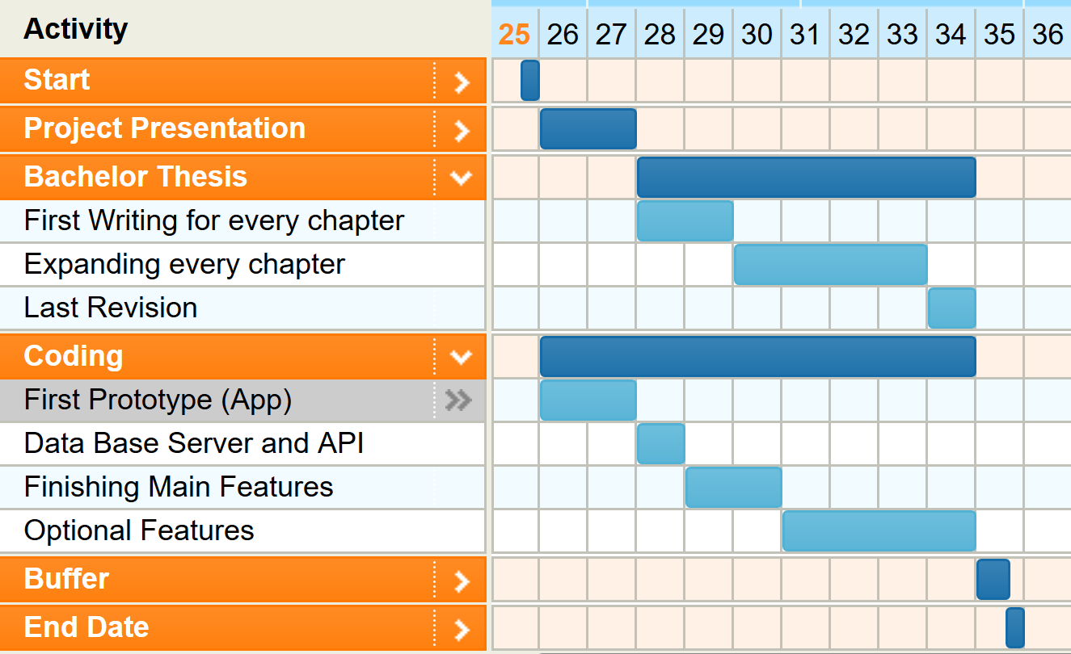
Timetable

Slide 15
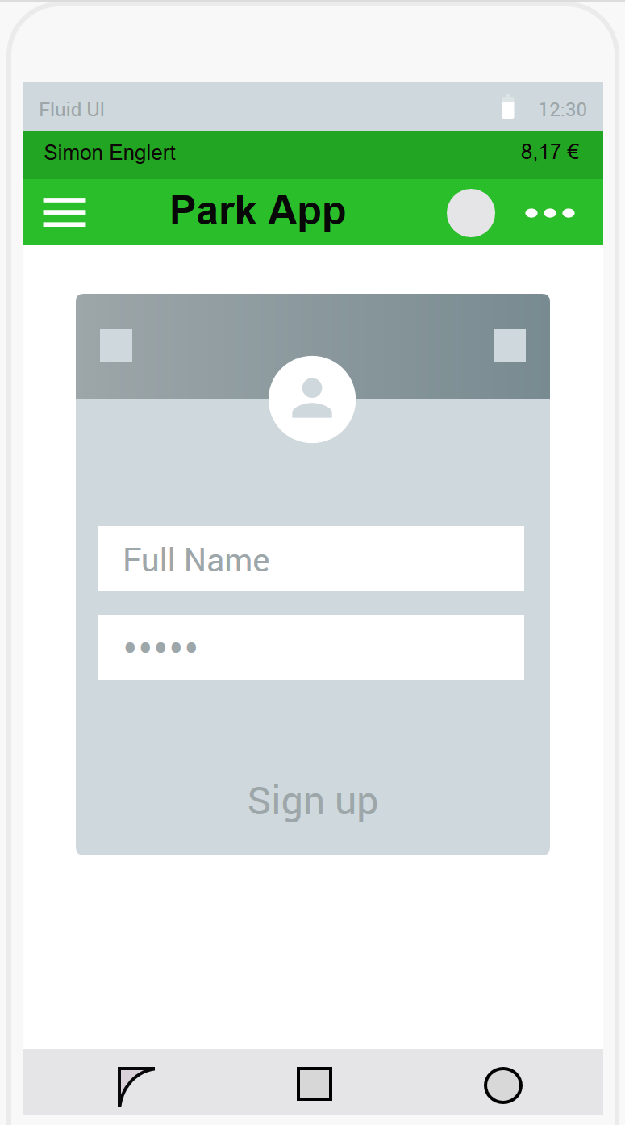
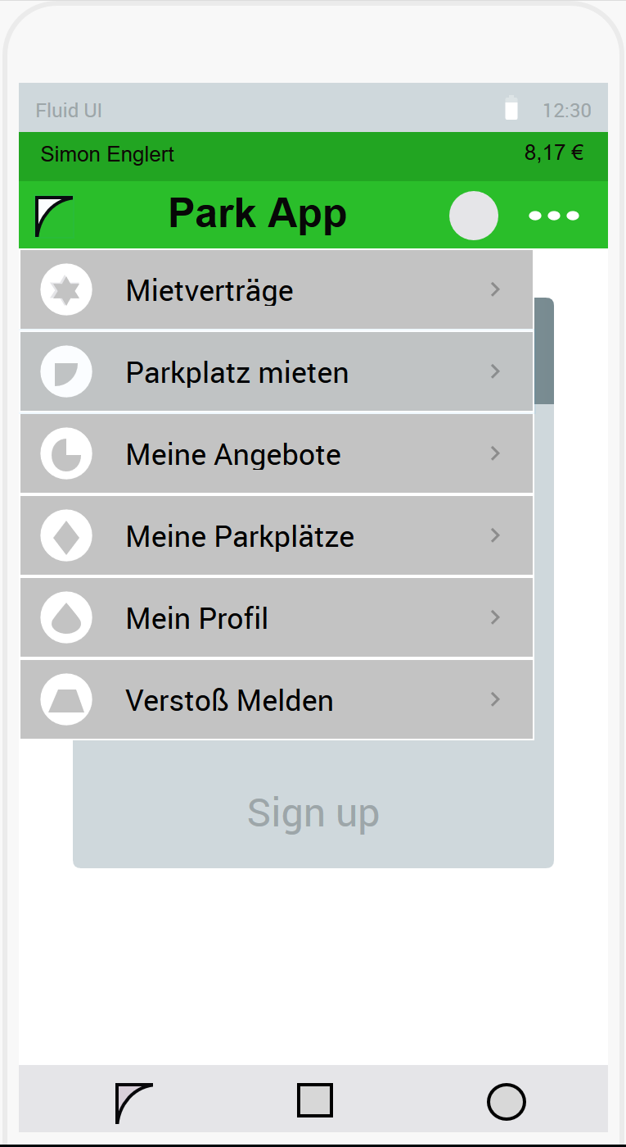
User Interface

Slide 16
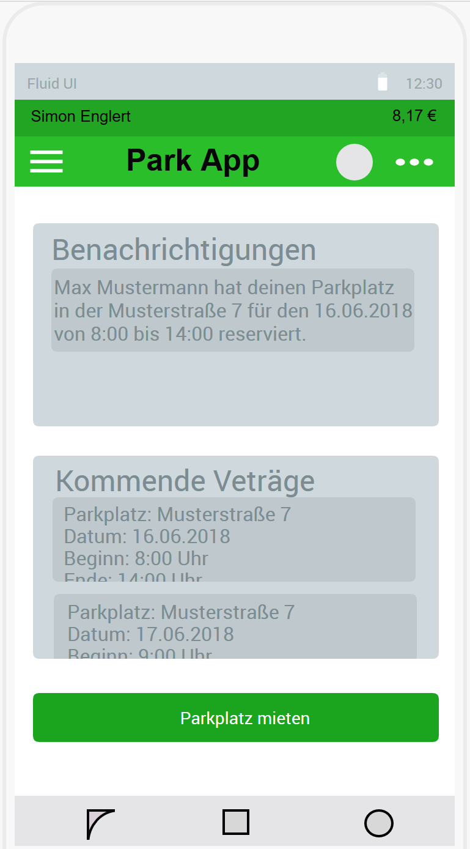
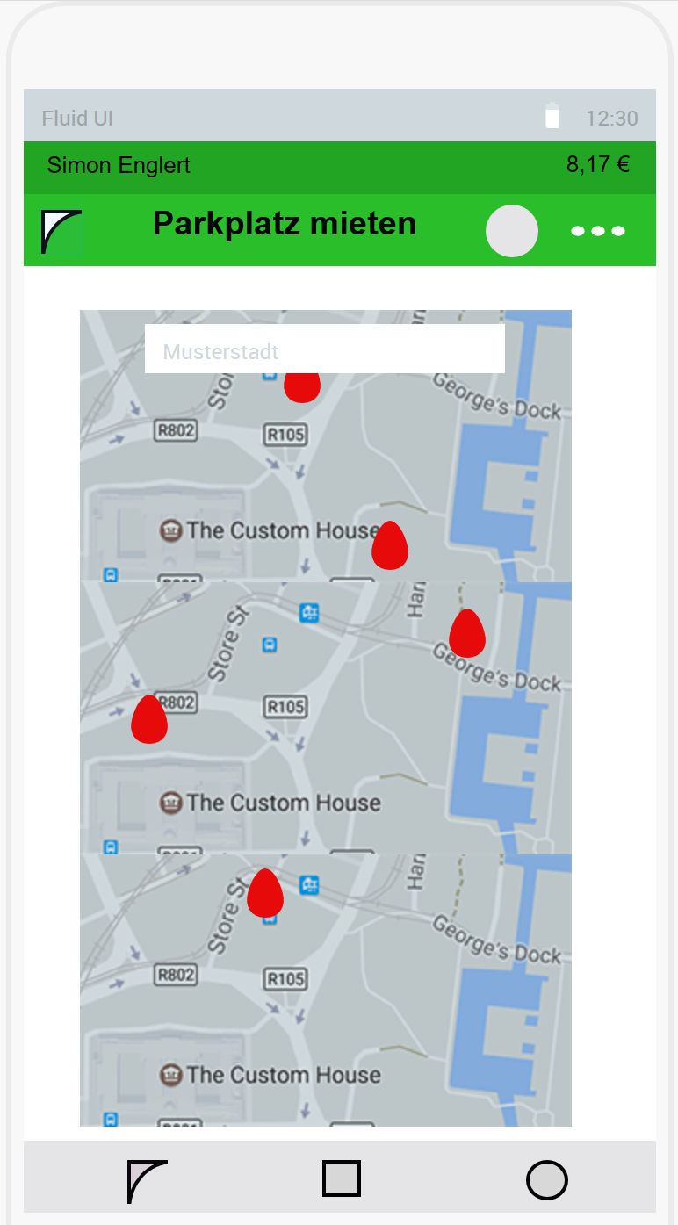
User Interface

