Slide 1




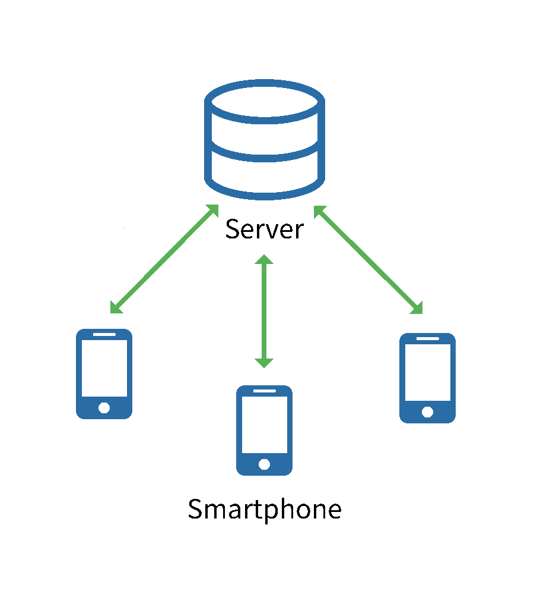
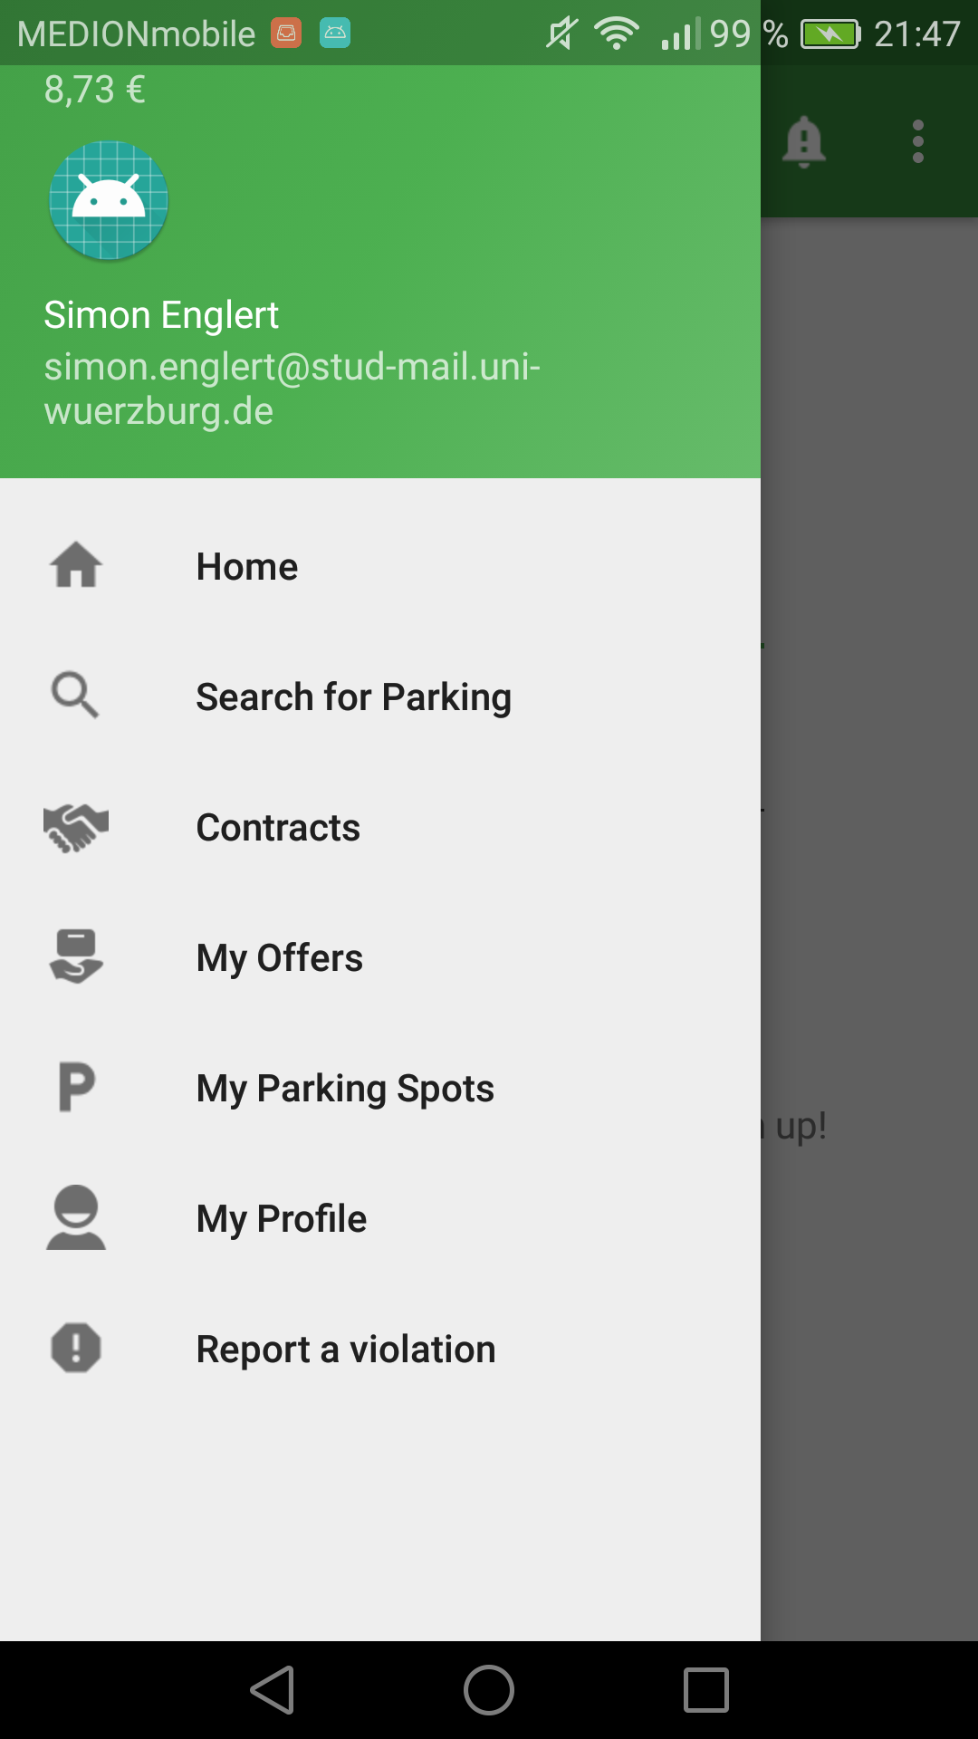
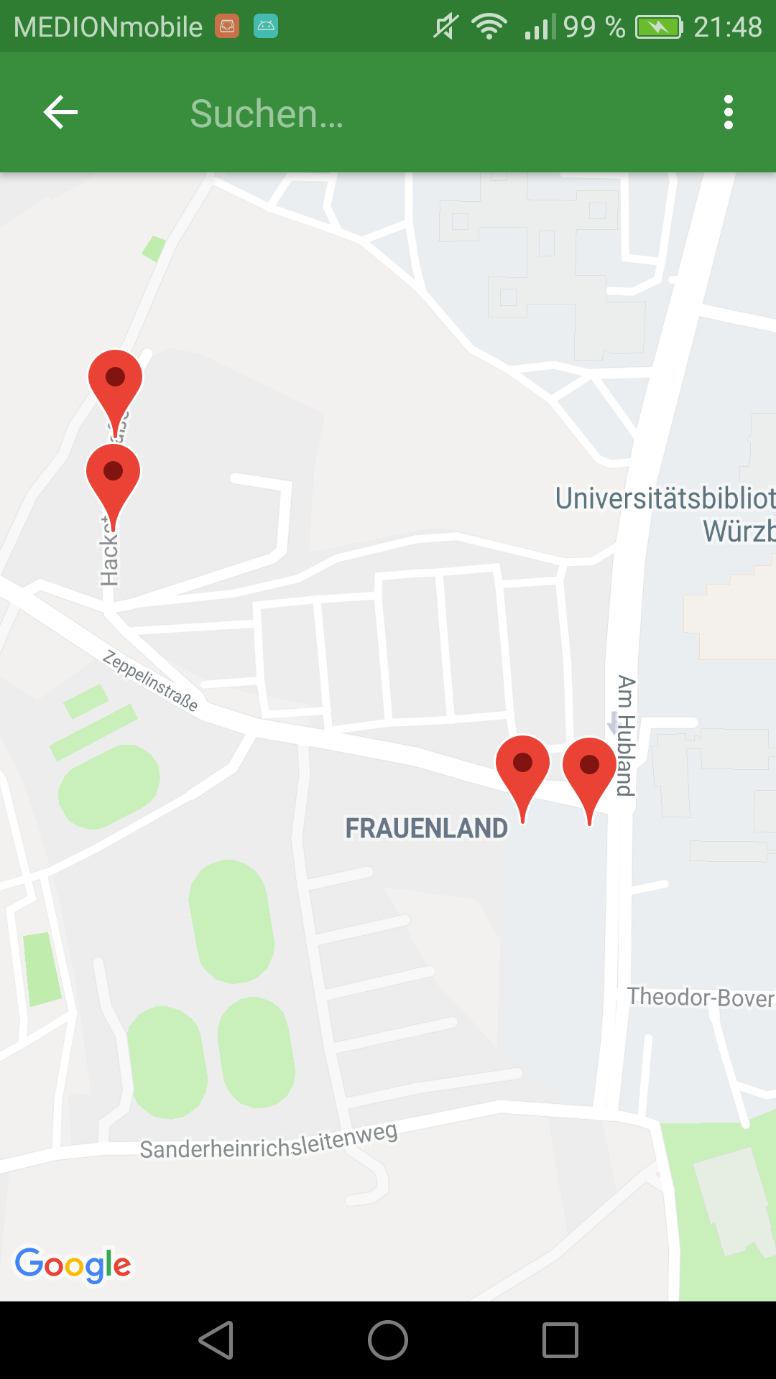



Design of a Shared Parking System
with special attention to security aspects
Simon Englert
Parking Problem
As big cities are growing more and more, the parking situation in those cities is becoming more precarious than ever. Parking demand already exceeds the limited amount of parking spaces available, and thus people searching for a place to park generate a significant part of those cities´ traffic. This leads to frustration with drivers, more traffic jams, unnecessary use of petrol and further air pollution. The creation of new parking spaces is often either difficult or very expansive, which means existing parking spots have to be used more efficiently. Intelligent parking systems are trying to solve that problem. This thesis is focused on Shared Parking, a special kind of intelligent parking system, which opens the possibility of sharing a parking place between different people. This work features the design and implementation of such a system with special attention given to security aspects.
2
blocks
pays
3
books
reports
1
pays fine
veryfies
violation
provides new spot
uses new spot
pays
4
Implementation
Scam Punishment
The Shared Parking System will be implemented after the Server-Client-Model. One conceptual design choice was to make using the app as easy as possible. Neither the operator nor the user do need any special hardware besides the servers (operator) and a smartphone (user). Users should be able to book a spot or create an offer within minutes.
How to detect scammers?
Users report scammers when spotting them.
Report gets verified by other, independent users, who in return earn a bonus.
How to punish scammers?
People outside the system get punished like before.
Users within the system get fined by deducting from their balance.
How to compensate the injured party?
If possible provide new parking spot.
Lost revenue gets compensated
Money spent by the operator due to compensation gets drawn in from the scammer.
The server is used as a central database and provides an interface via REST API for the client smartphones on which the app is installed.
Screenshot of the Prototype showing the main menu and screen for the parking spot search.
Acknowledgement
Special thanks to my advisor Prof. Dr.-Ing. Alexandra Dmitrienko of the Secure Software Systems Research Group, University of Würzburg and the City of Würzburg, who supported this Bachelor Thesis.
Contacts
Simon Englert
simon.englert@stud-mail.uni-wuerzburg.de

