Slide 1

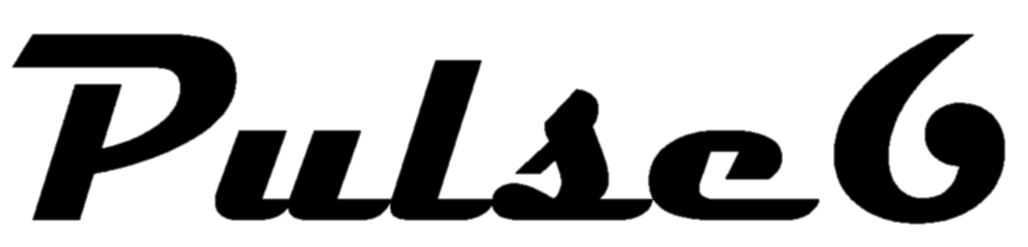

Slide 2
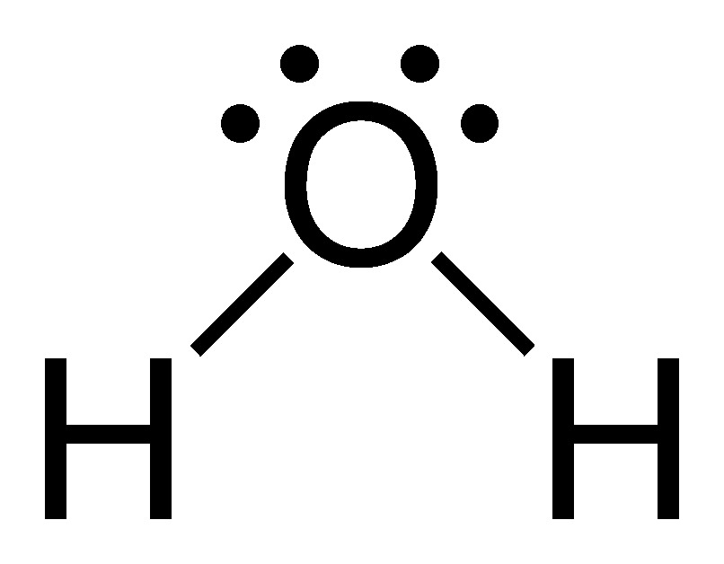
Water - H₂O
Density: 1000 kg/m²
Molar Mass: 18.015 g/mol
Melting Point: 0.0ºC
Boiling Point: 99.98ºC
Triple Point Temperature: 0.01ºC
Touch Here For Additional Info

Slide 3
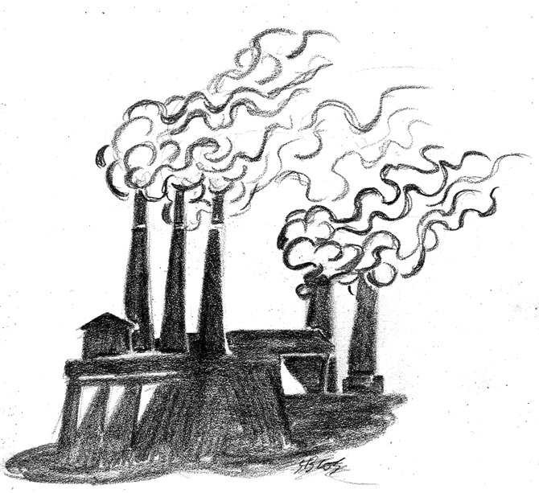
Carbon Dioxide – CO₂
Molar Mass: 44.01 g/mol
Melting Point: -78ºC
Boiling Point: -57ºC
Soluble in: Water
Drug Class: Radiographic Contrast Agent
Touch Here For Additional Info

Slide 4

Oxygen – O₂
Molar Mass: 16.00 g/mol
Melting Point: -218.79ºC
Boiling Point: -182.96ºC
Triple Point Temperature: -218.79ºC
Soluble in: Water
Touch Here For Additional Info

Slide 5
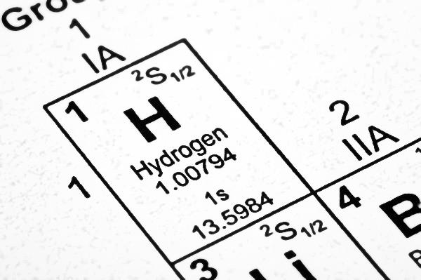
Hydrogen – H₂
Molar Mass: 2.00 g/mol
Melting Point: -259.16ºC
Boiling Point: -252.879ºC
Triple Point Temperature: -259.35ºC
Soluble in: Water
Touch Here For Additional Info

Slide 6
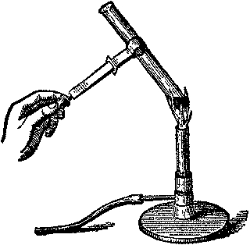
Heat
(Energy Form)
Touch Here For Additional Info

Slide 7
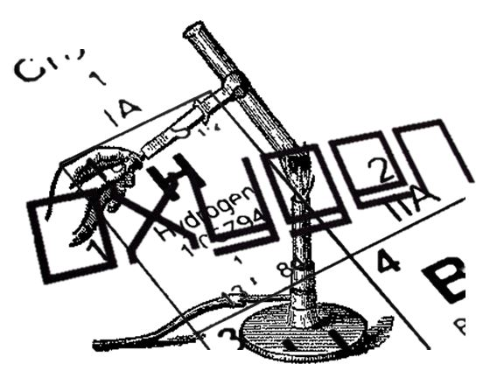
TRANSPARENCY OVERLAP

