Slide 2
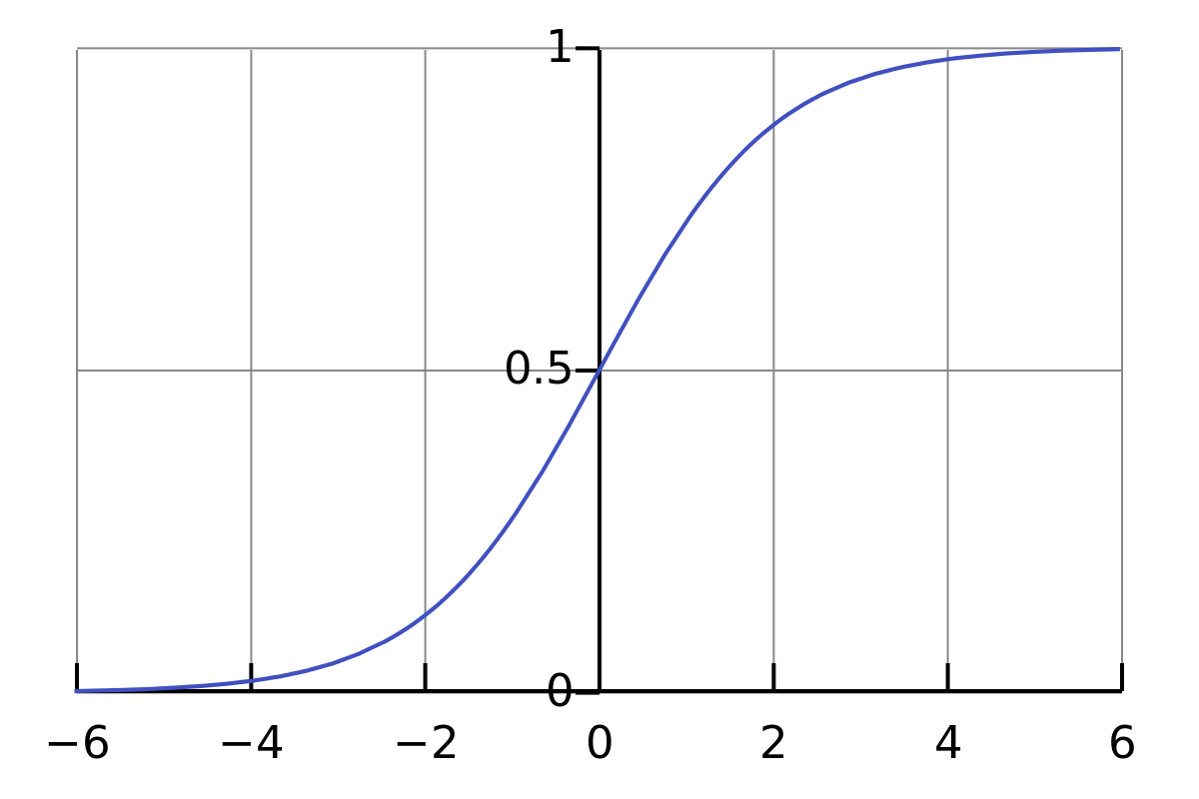

Slide 9
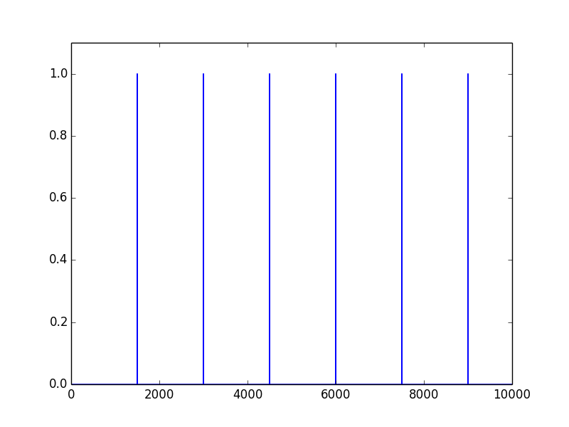
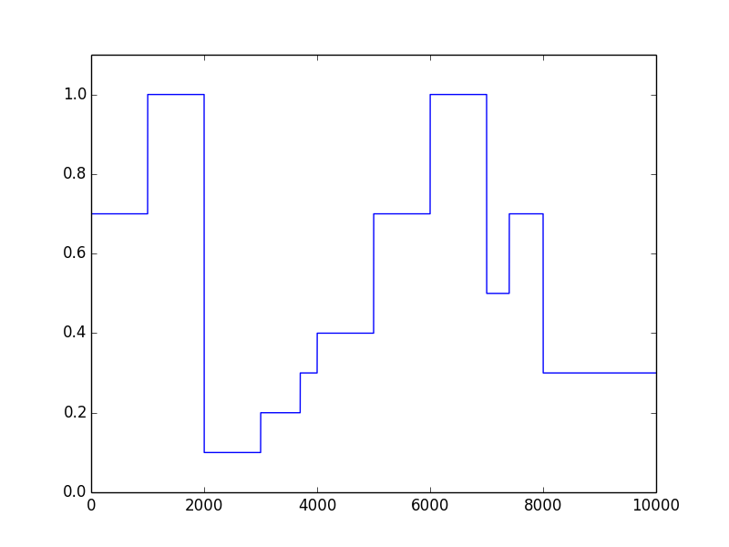
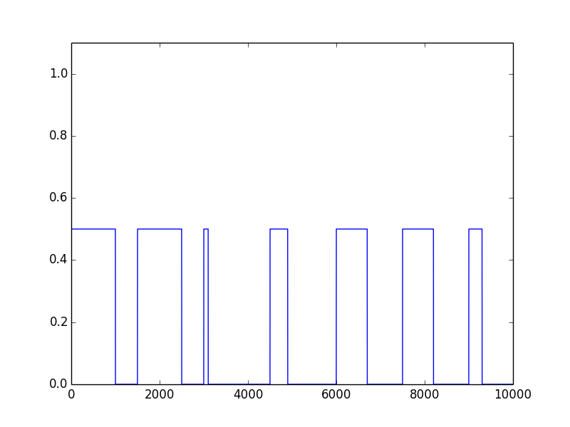

Slide 10
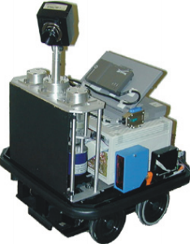
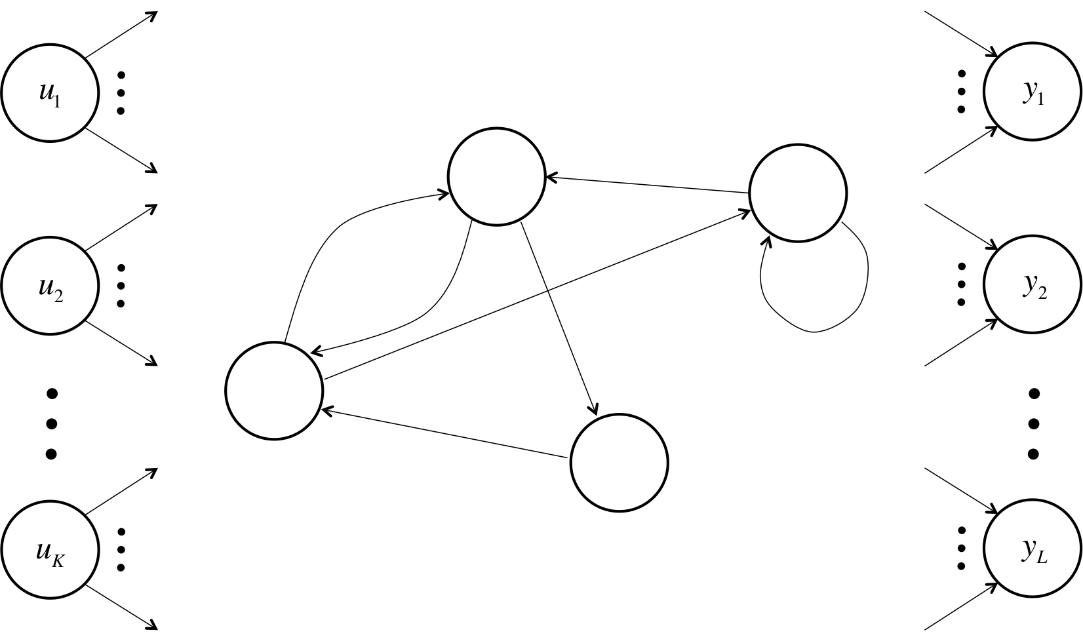
Observe
Model
Learn

Slide 12
Keep
Gate
Write
Gate
Memory
Cell
Read
Gate

Slide 13
Keep
0
Keep
1
Keep
1
Keep
0
Memory
4.2
Memory
4.2
Memory
4.2
Write
1
Read
0
Write
0
Read
0
Write
0
Read
1
4.2
4.2

Slide 16
10-way
Softmax
28 x 28
inputs

