Slide 1
IMAGE TO SPEECH TRANSLATION WITH SUPERVISED LEARNING
Supervisor – Ms Ruhi Mahajan

Slide 2
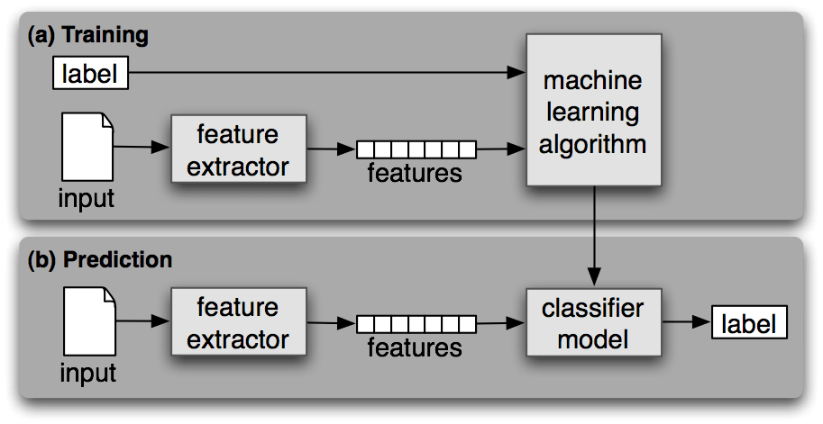
INTRODUCTION
This project is aimed to adapt a machine learning based architecture which consist of primarily three components :
Optical character recognizer (OCR)
Language translator
Speech synthesizer
Notes:
Here in optical character recogniser (OCR) powered by the concepts of image analysis / computer vision & mathematical morphology
Language translator and speech synthesiser uses the paradigm of natural language processing

Slide 3
Literature Review Optical Character Recognizer Ivan Dervisevic December 18 , 2006

Slide 4
Abstract
Success of optical character recognition depends on a number of factors, two of which are feature extraction and classification algorithms. In this paper we look at the results of the application of a set of classifiers to datasets obtained through various basic feature extraction methods.

Slide 5
Current OCR software can achieve an accuracy of more than 97% in cases of typewritten text , 80-90% for clearly handwritten text on clear paper, while recognition of cursive text is an active area of research.
In this paper clustering techniques are used to help in improving our result , though as a whole we see this problem as a classification problem.

Slide 6
Classifiers Used
NaïveBayes
ComplementNaïveBayes
SMO
C4.5
J48

Slide 7
Classifier Evaluation
Most commonly used method is “n runs of k-fold cross-validation”
Measures used for evaluation of the success of a classifier are :
Precision
Recall
F-measure
K-statistic
True negative rate
Accuracy

Slide 8
Stages of generic OCR algorithm
Extraction of character region form an image
Segmentation of image into text and background
Conditioning of the image
Segmentation of characters
Normalisation of character size
Feature detection
Classification
Verification

Slide 9
Result & Analysis / Terminology Used
Sparse vector – used for image representation
Eigen vector
Structure tensors
Hessian matrix

Slide 10
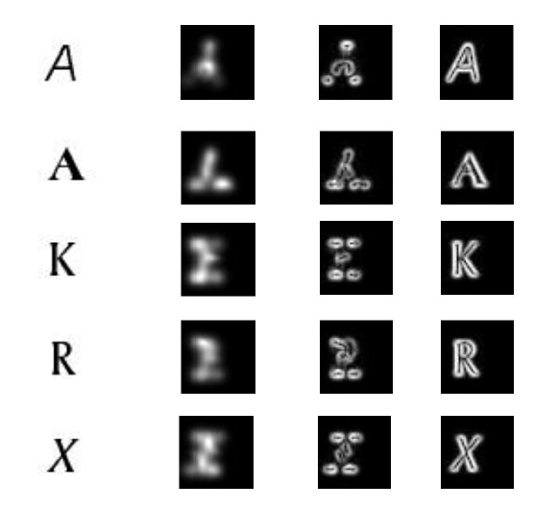

Slide 11
Review On Text To Speech Synthesizer
Suhas R. Mache
Manasi R. Baheti
C. Namrata Mahender
8 August, 2015

Slide 12
Abstract
The paper tries to explore various Text-to-Speech synthesis techniques.
This paper aims to give an overview of speech synthesis in Indian languages, summarizes and compares the characteristics of various synthesis techniques used.

Slide 13
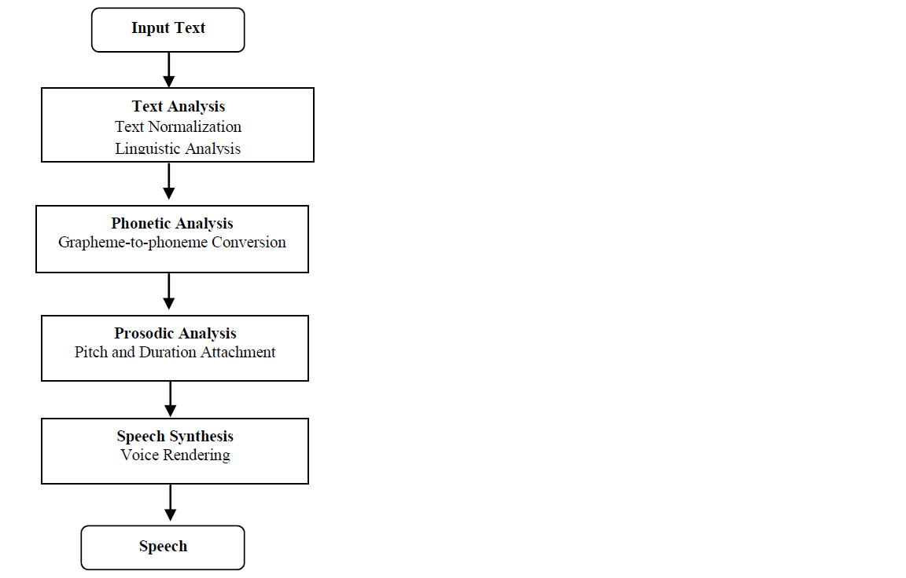
Block diagram of Text-to-Speech Synthesis

Slide 14
INTRODUCTION
Digital speech processing plays a vital role in modern speech communication research and applications.
Text to speech system (TTS) converts text into voice using a speech synthesizer , and that is implemented in both software and hardware form like ARM7 microcontroller which converts Text to Speech and Speech to Text

Slide 15
Text To Speech System
Main phases –
Text processing –
Text processing , text normalisation , linguistic analysis
2. Speech generation –
Phonetic analysis
Prosodic analysis

Slide 16
SPEECH SYNTHESIS TECHNIQUES
Symbolic prosody data is used by the synthesizer to generate speech using a specific method.
There are three main categories of speech synthesis techniques.
i. Articulator synthesis
ii. Formant synthesis
iii. Concatenative synthesis

Slide 17
Conclusion
Test-to-Speech synthesizer has steadily developed from last few decades to gain the current shape. The three basic methods of speech synthesis are Articulator, Formant and Concatenative synthesis used in various synthesizers.
Many new applications are developed, but intelligibility and comprehensibility of synthetic speech has not reached the acceptable level.
Even in India some research organizations are also working on Text-to-Speech in regional languages like Marathi, Hindi, Telugu, Punjabi, Kannada etc. But all these systems do not replicate the human natural speech. There is huge scope in improvement in the synthesis to achieve a high level of natural and emotion aspect.

