Slide 1

Sail
Team Phoenyx
Avi Glozman, Owen Cheung, Terrance Li

Slide 2
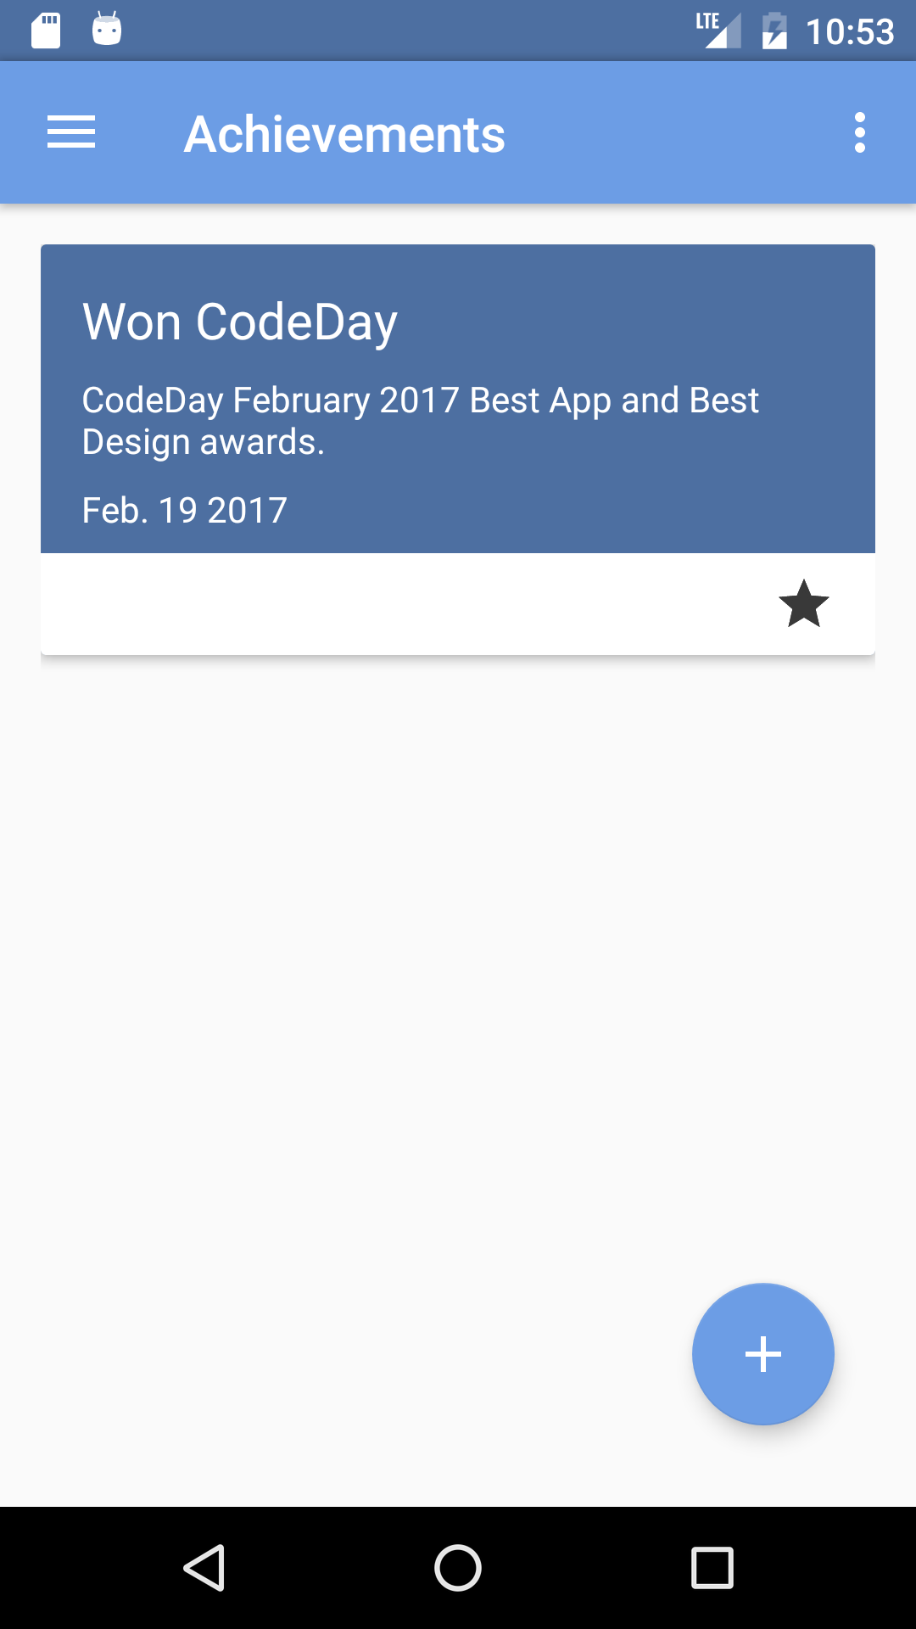
What is sail?
A little app for storing:
Goals
Promises
Major life events
Achievements

