Slide 1


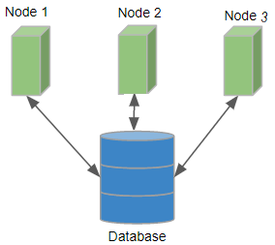
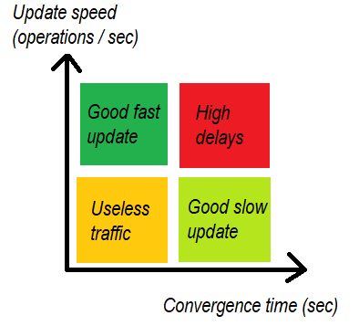
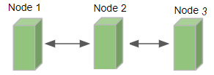


Divergence visualization in Lasp program execution
Creupelandt Grégory 59191300 Advisor: Peter Van Roy
1. Context:
Usual approach: Distributed variables are handled by a database:
Causality is important
Message order is important (scheduler)
2. How does it work ?
4. Update speed VS Convergence speed
CRDT is for Conflictfree Replicated Data Type.
It’s a datastructure with values and metadatas.
From time to time, nodes send it to their peers.
Is it useful to have a system that converges in 5ms when we update the value only once per minute? Probably not.
Consensus is required !
Important notion: it is CONVERGENT: Information is diffused everywhere Messages are comutative
Useless high network traffic…
Is it useful to have a system that converges in 10 sec when we update the value every 5 ms ? Probably not.
Every node eventually end up with the same state !
Huge delays…
New approach: Distributed variables are handled by CRDT (peer-to-peer):
Causality is automatically handled by metadatas
Message order has no impact (no scheduler required)
3. Lasp: an Erlang solution for distributed application using CRDT
Interesting relation to explore between these two notions !
Fully automated, developer has very little control.
Consensus is not required !
My job: Develop an API to allow more control: Tools to visualize the convergence time. Tools to modify the convergence time. Use these tools to test some hard cases.
No need for database server ! Much less cumbersome algorithms ! Already Adopted by some big companies:

