Slide 1

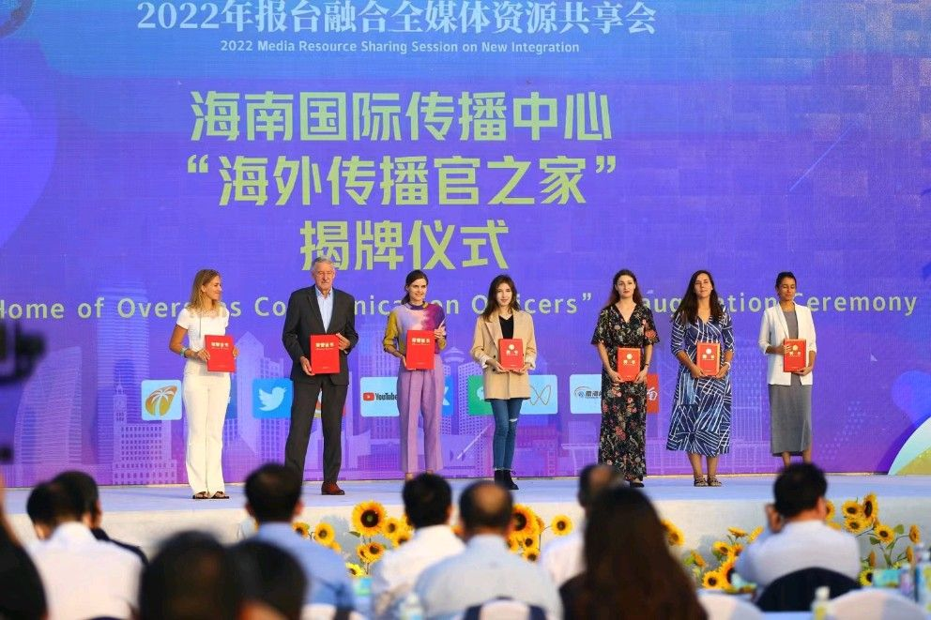

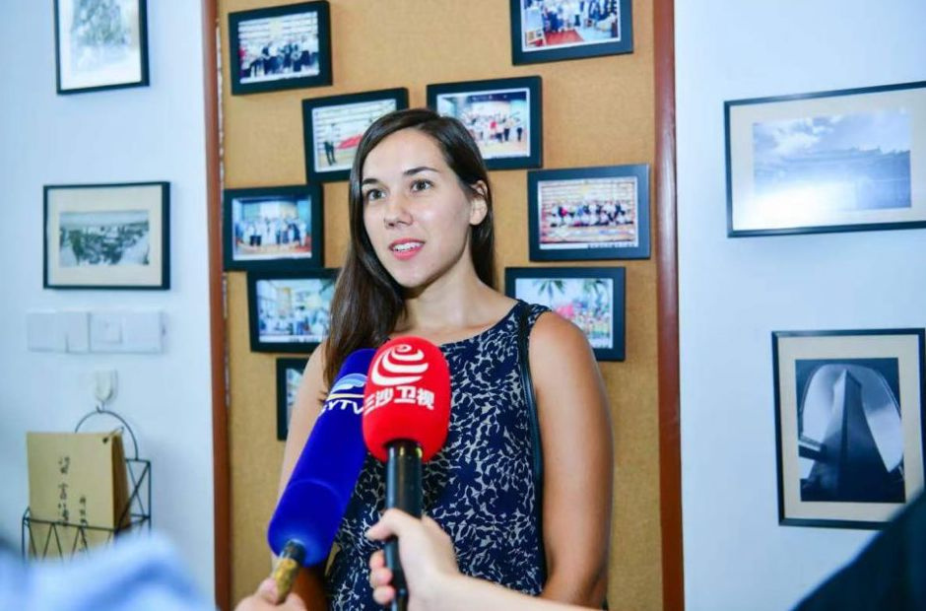

ByteBlink AI
Discovering Hidden Data
PRESENTED BY
Vanessa Jencks, Owner & CEO
Turning hidden data into smarter business decisions.

Slide 2







The Cost of Inefficiency
BUSINESSES WASTE MONEY ON OUTDATED MARKETING — LOSING TRAFFIC, TARGETING, AND GROWTH OPPORTUNITIES.
Wasted Ad Spend
Inaccurate Local Targeting
Lost Website
Traffic
Strategic
Leadership Gap
Ads waste money when targeting the wrong audience.
Door-knocking & mailer companies need accurate, hyper-local targeting.
70%+ of website traffic is lost without follow-up.
Scaling requires a CMO's strategy, but most can't afford one.

Slide 3



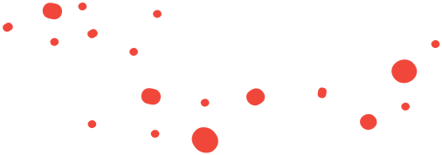

Freezing Leads
Customers not in market, picked based on demographics, and without awareness of your company
Basic Premise
Warm Leads
RECOGNIZING FREEZING, WARM, AND HOT LEADS HELPS ALIGN MARKETING STRATEGIES WITH REAL BUYER INTENT
Customers looking for your industry services, refined based on demographics, but without awareness of your company
Hot Leads
Customers actively seeking your services, qualified by demographics, aware of your company, and reached through referrals or marketing channels.

Slide 4

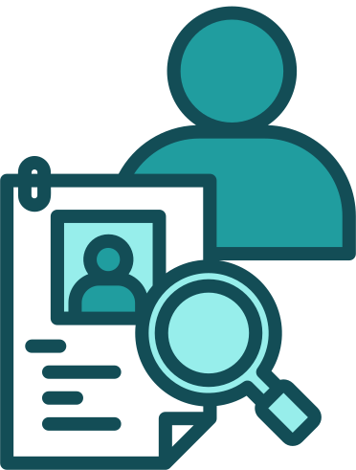


ByteBlink AI Solutions
SMART TOOLS FOR SMARTER MARKETING
Maps & Leads By Zip Code
Bulk Intent Data
Actionable lIsts for outreach
Power Facebook Ads, cold email, LinkedIn
Website Deanonymization
Fractional CMO Services
Conver hidden traffic into leads
Strategy + Execution without a full-time hire

Slide 5




What is Intent Data?
SIGNALS THAT REVEAL WHEN CUSTOMERS ARE READY TO BUY.
Collecting Signals
Scoring Intent
Building Profiles
Driving Results
Online activity, searches, and buying behaviors tracked daily.
Filters genuine purchase intent vs. casual browsing.
Connects data across platforms into actionable buyer insights.
Use insights to target the right people at the right time.
Refreshed daily within 1–10 days of behavior

Slide 6
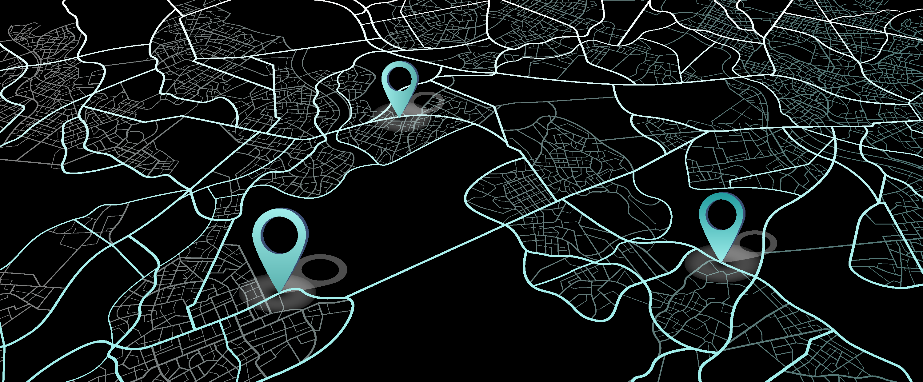

Zip Code & Map Pricing
TARGET CUSTOMERS WHERE THEY LIVE WITH ACCURATE, AFFORDABLE DOOR-KNOCKING & MAILER-READY LISTS.
$30
per zip code
$360
minimum spend
Standard Services
Perfect for door-knocking, flyers, and mail campaigns.
$50
per zip code
$350
minimum spend
Real Estate Services
Hyper-local targeting for realtors & investors.

Slide 7
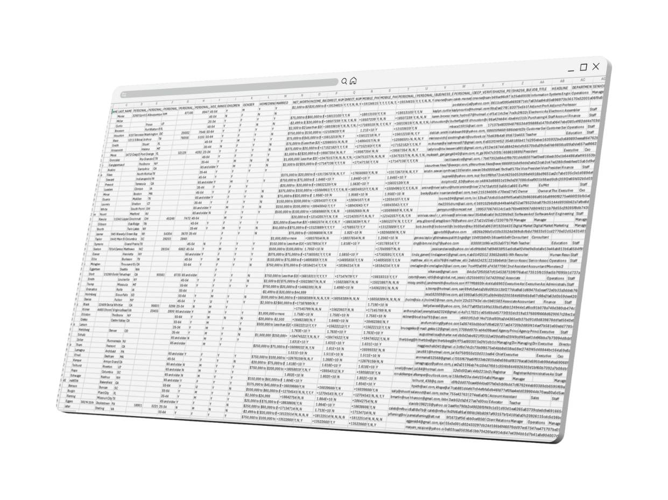


Bulk Intent Data
UNLOCK VALUABLE INSIGHTS WITH OUR BULK INTENT DATA, ENSURING MORE EFFECTIVE TARGETING AND INCREASED CONVERSION RATES.
Direct Integration
Plug directly into ad platforms & outreach systems.
Always Current
Updated continuously for relevance.
Bulk Intent Data access starting at $2,000/month — scale smarter with always-current insights.

Slide 8
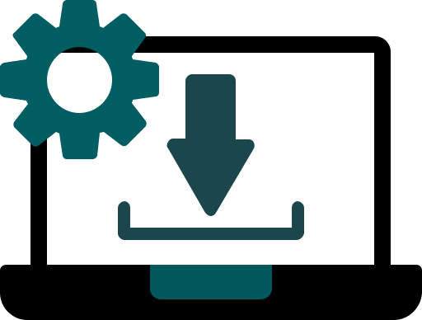


Website Deanonymization Services
UNLOCK VALUABLE INSIGHTS BY REVEALING ANONYMOUS VISITORS, ENSURING MORE EFFECTIVE MARKETING STRATEGIES AND ENHANCED ENGAGEMENT.
Install
Identify
Recover
Simply install one line of code onto your website.
Identify 30-40% of anonymous visitors.
Recover past traffic for 2-3x more leads.

Slide 9







Turn Lost Traffic Into Leads
TURN ANONYMOUS VISITORS INTO QUALIFIED LEADS WITH PIXEL-POWERED DATA MATCHING.
WITHOUT PIXEL
10K Visitors
5% CTR
500 Anonymous Leads
Leads Lost
WITH PIXEL
10K Visitors
30% CTR
3K Deanomynized Leads
150 Booked Calls
5% of 150 Re-Book

Slide 10






Smarter Targeting With Data Matching
WE REFINE NEW INTENT AUDIENCE DATA BY COMPARING IT AGAINST PAST SUCCESSFUL AND FAILED LEADS — ENSURING OUTREACH ONLY TARGETS PROFILES MOST LIKELY TO CONVERT.
NEW INTENT DATA AUDIENCE
Compare to failed leads
Compare to successful leads
Optimized Audience
Omni-Channel
Outreach

Slide 11



Fractional CMO Services
OUR FRACTIONAL CMO SERVICES PROVIDE EXPERT MARKETING GUIDANCE TAILORED TO YOUR BUSINESS NEEDS AT AN AFFORDABLE PRICE.
Strategic Leadership
Without the $200k salary.
Full-Service Execution
Build campaigns, oversee execution, optimize spend
Nine American Marketing Experts – Additional Global Tech Support & VA Staff

Slide 12


What We Need To Solve
GROWTH REQUIRES ALIGNMENT: THE RIGHT MESSAGE, THE RIGHT AUDIENCE, AND AN OPTIMIZED FUNNEL.
Message
Audience
Funnel
Is your message spot on?
Is your audience spot on?
Is your funnel optimized?
We start with a goal instead of charing for a flat fee service like SEO / FB ads.

Slide 13
Fractional CMO Services
THE FRACTIONAL CMO UMBRELLA
Data
Strategy
Systems
Intent Data
Lookalikes
Website Traffic
SEO/ AISO / GMB
Facebook Ads
Google Ads
Google LSA
Organic Takedown
Referral &
Customer ads
Social Media
Branding
Amazon PPC
Ecommerce
B2B Email
Linkedin Automation
Website &
Automations

Slide 14

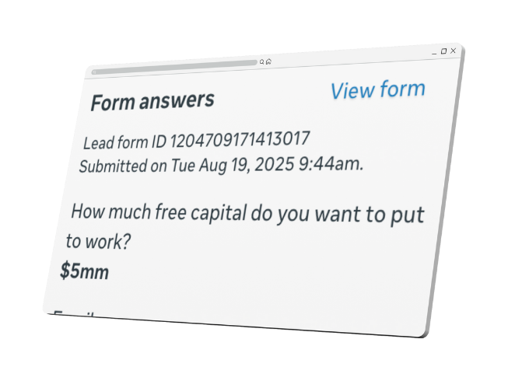
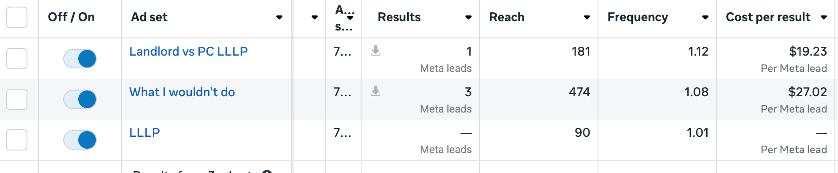
Proven Success Stories
Customer
Miami Hedge Fund with PC LLLP
OUR CASE STUDIES SHOWCASE HOW BYTEBLINK AI HAS TRANSFORMED BUSINESSES WITH MEASURABLE RESULTS AND CLIENT SATISFACTION.
CAMPAIGN PERFORMANCE METRICS
For a Miami hedge fund, our campaigns generated qualified leads at just $19–$27 per lead—delivering high-value prospects, including investors ready to commit $5M.

Slide 15
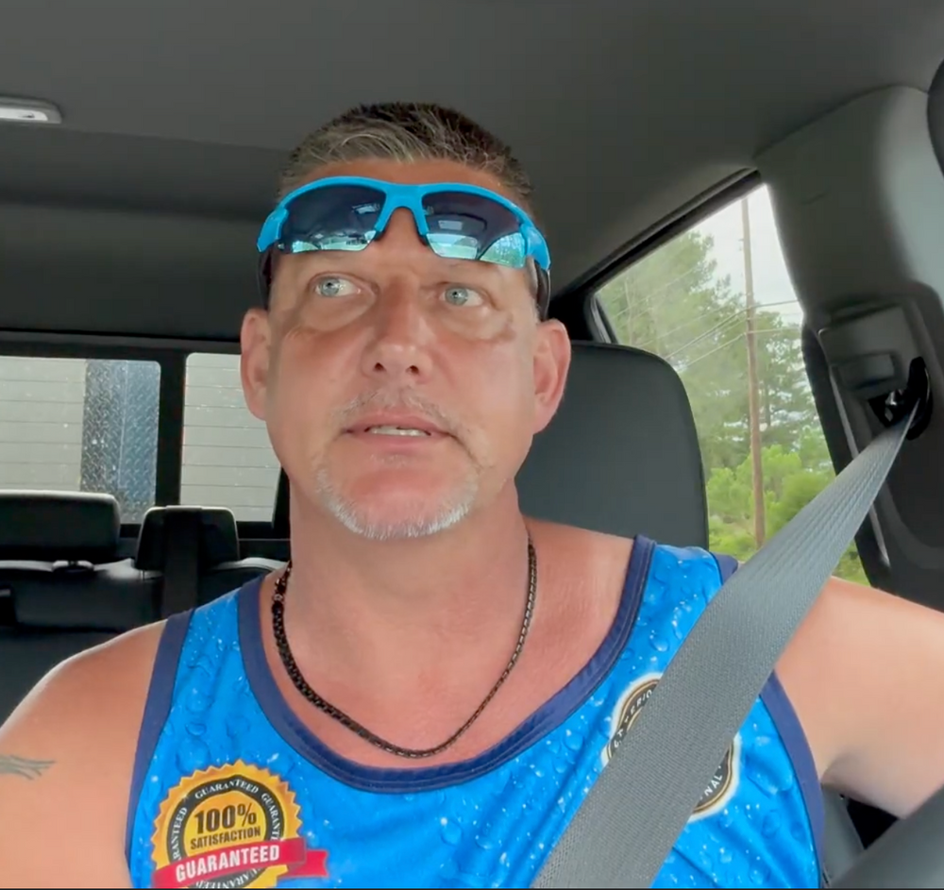
Proven Success Stories
Full video testimonial & customer contact info available
“When I utilized the mapping system, the very first time, within one day of me doing some additional footwork and doing some targeted marketing, [I] secured about $5,000 in contracts in residential homes. One of those contracts was a former home builder who has continued to generate leads for me.”
Utilizes us for SEO, Social Media, FB Ads, website deanonymization, website management
Customer
Keith Pickens, Owner
Pickens Powerwashing | Wake Forest, NC
Retired Raleigh Police Officer, K-9 Unit
Veteran

Slide 16
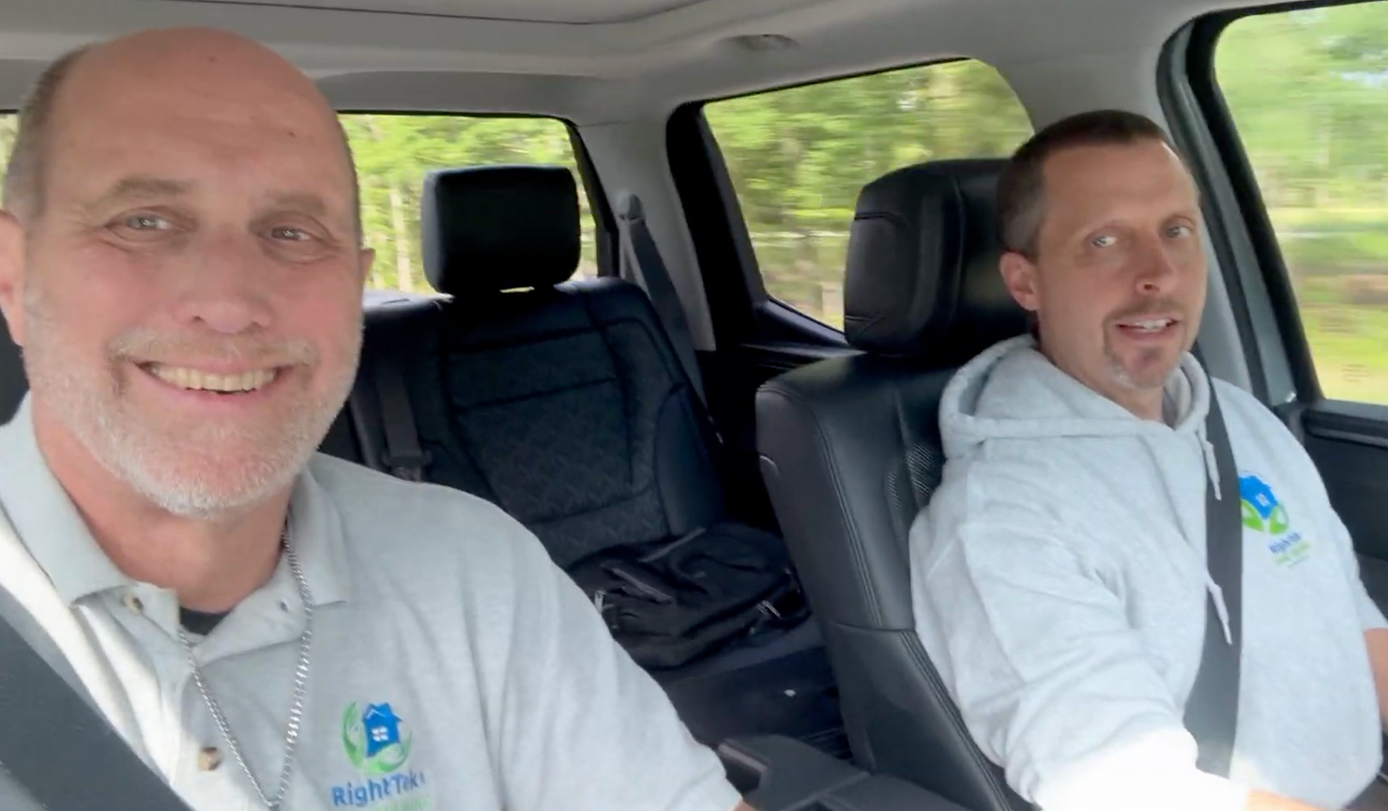
Proven Success Stories
Full video testimonial & customer contact info available
“When I utilized the mapping system, the very first time, within one day of me doing some additional footwork and doing some targeted marketing, [I] secured about $5,000 in contracts in residential homes. One of those contracts was a former home builder who has continued to generate leads for me.”
Utilizes us for SEO, Social Media, FB Ads, website deanonymization, website management
Customer
RightTek HVAC Training, LLC & Trane Trade Warriors | Apex, NC
Bill Timberlake & Anthony Maynor

Slide 17
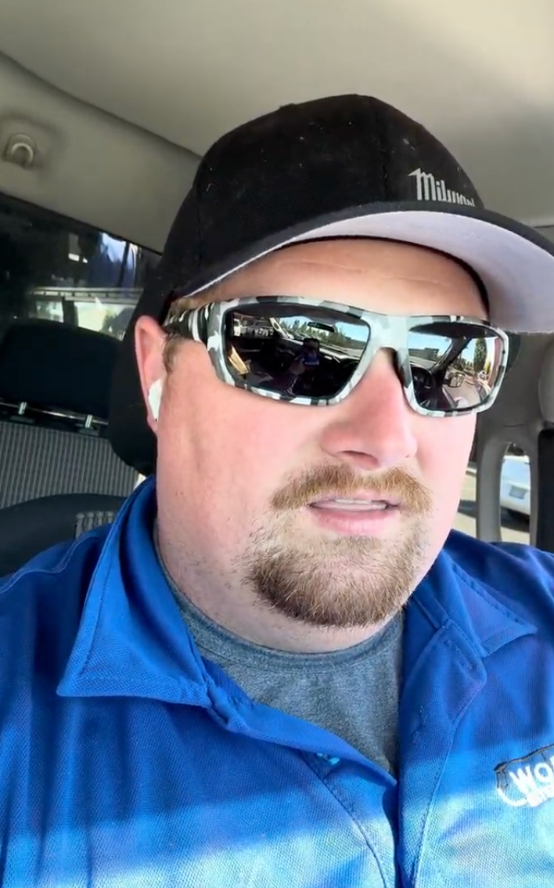
Proven Success Stories
Full video testimonial available
Ben used 5-6 marketing agencies previous to ByteBlink AI
Within the first 2 weeks he received more calls than he ever has
Currently using maps and sending out a team
Utilizes us for SEO, Google Ads, FB Ads, website deanonymization, website management, and maps
Customer
Ben Wirth
Worth It Exterior Cleaning | Portland, Oregon

Slide 18
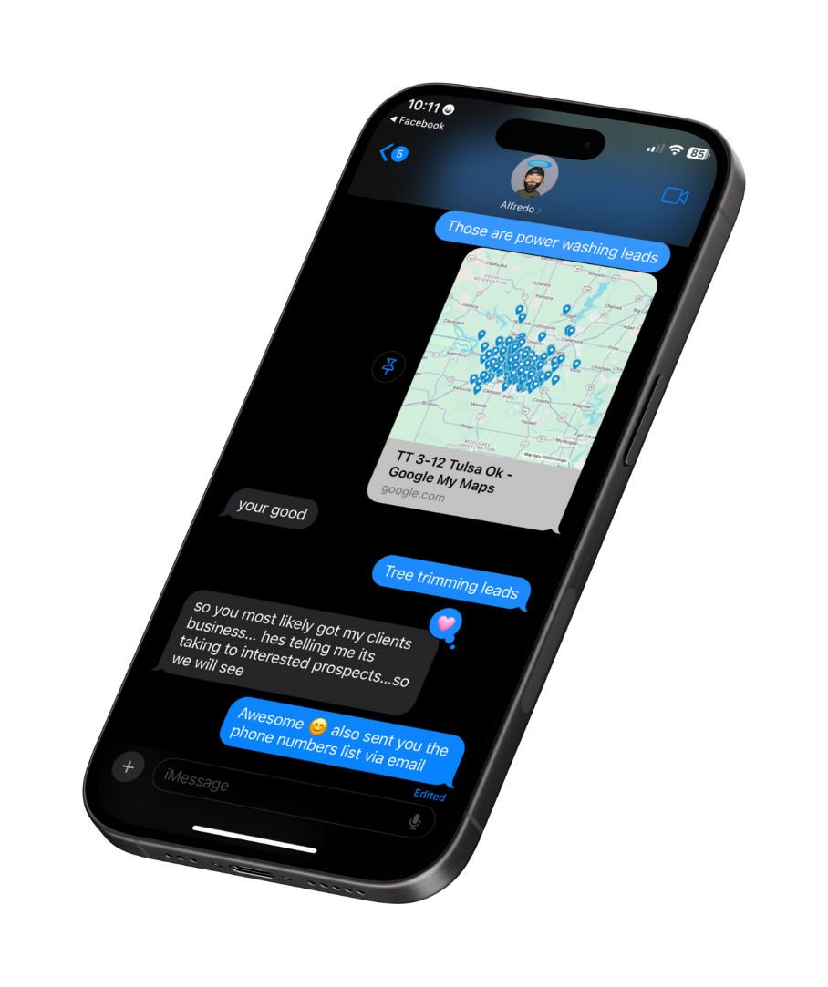
Proven Success Stories
His client purchases 12 zip codes per month and has been using them for several months.
Leads given to a Washington State Exterior Cleaner
Customer
Alfredo M.
Automation Systems - Marketing Referral

Slide 19
Pricing Comparison Overview
A COMPREHENSIVE LOOK AT OUR SERVICE PRICING.
Product
Pricing
Zip Code Targeting
Bulk Intent Data
Website Deanonymization
Fractional CMO
Marketing Audit & DIY Blueprint
$30 | $50 per zip, minimum spend $360 | $350
$2,000/mo
$1,000/mo (25k resolutions)
$200 one-time setup then $0.08 per resolution
$2,000/mo add-on
$500 one time purchase

Slide 20
Why Choose ByteBlink AI?
WE DELIVER PRECISE INSIGHTS, AFFORDABLE STRATEGIES, AND PROVEN RESULTS TO DRIVE REAL GROWTH.
1
2
3
Accurate Insights
Cost-Effective
Proven Results
We provide precise targeting through advanced algorithms.
Achieve high ROI with our affordable pricing structures.
Our case studies demonstrate significant business growth.

Slide 21

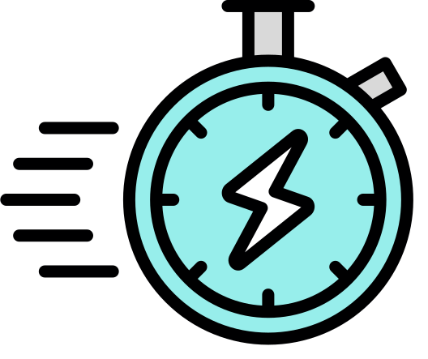

Let’s Get Started
FROM LEAD LISTS TO CMO-LEVEL STRATEGY, OUR SMART TOOLS HELP YOU MARKET SMARTER AND SCALE FASTER.
Personalized Strategy
Expert Consultation
Get tailored solutions for your unique needs.
Speak with industry experts to maximize results.
Immediate Impact
Long-Term Growth
Quick wins: days for maps, weeks for bulk data.
Build sustainable success with data-driven strategies.

Slide 22
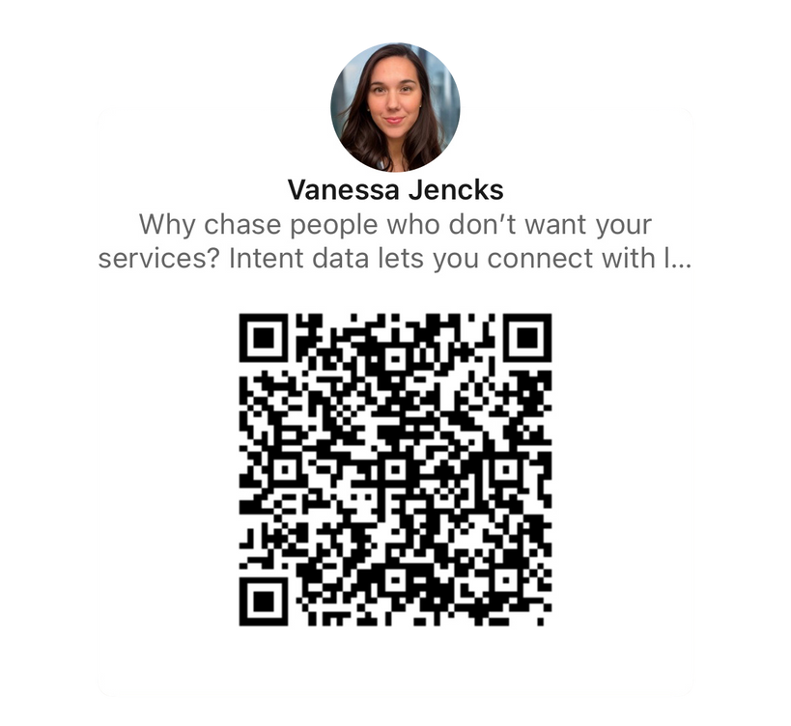
Contact Us
LET’S TALK ABOUT HOW BYTEBLINK AI CAN HELP YOUR BUSINESS GROW.
Email: vanessa@byteblink.ai
Social Media | Facebook, Instagram & LinkedIn
Phone: 864-837-5643

Slide 23
Referrals
REFERRALS PRICING AND RESIDUAL COMPENSATION BREAKDOWN.
Product
Pricing
Pricing
Zip Code Targeting
Bulk Intent Data
Website Deanonymization
Fractional CMO
Marketing Audit & DIY Blueprint
$30 | $50 per zip, minimum spend $360 | $350
$2,000/mo
$1,000/mo (25k resolutions)
$200 one-time setup then $0.08 per resolution
$2,000/mo add-on
$500 one time purchase
$100/mo until $500/mo then 20%
20%/mo
20%/mo
$25 one time
5%/mo
$50 one time
A comprehensive look at our service pricing.

Slide 24
All-in-One Market Coverage
Access 1,464 zip codes in South & Central Florida
Target 2 audiences (mid + high intent) with a mixed funnel dataset
Get unlimited storm-response maps (48 hr. turnaround, M–F)
Includes Zip Code Targeting, Bulk Intent Data, Website Deanonymization, and more
$2,000 setup + $500/month
NEW INTENT DATA AUDIENCE
Filter failed
leads
Match successful leads
Optimized Audience
Omni-Channel
Outreach

Slide 25
Terms
public adjuster Florida, licensed public adjuster Florida, insurance denied my claim Florida, insurance underpaid fire damage claim, not enough insurance payout water damage, insurance won’t cover storm damage Florida, need money fast insurance claim hurricane, insurance delays payment Florida claim, best public adjuster near me, hire public adjuster for insurance claim, do public adjusters get better settlements Florida, public adjuster for denied claim Florida, adjuster for underpaid insurance claim, fire damage insurance underpayment Florida, hurricane damage insurance denied claim Florida, public adjuster insurance won’t pay, insurance adjuster for delayed payment.
property insurance advocate Florida, fire damage public adjuster, water damage claim help Florida, hurricane damage insurance claim, storm damage adjuster, AC leak insurance claim Florida, p-trap leak insurance claim, mold damage claim Florida, how to fight insurance company after property damage, how to appeal denied insurance claim Florida, don’t understand homeowners insurance claim process, how long does it take insurance to pay fire damage.

