Slide 1
Bird Tracking Project
Darlene Ho
12/13/2022
MySQL Workbench/Python/Tableau

Slide 2
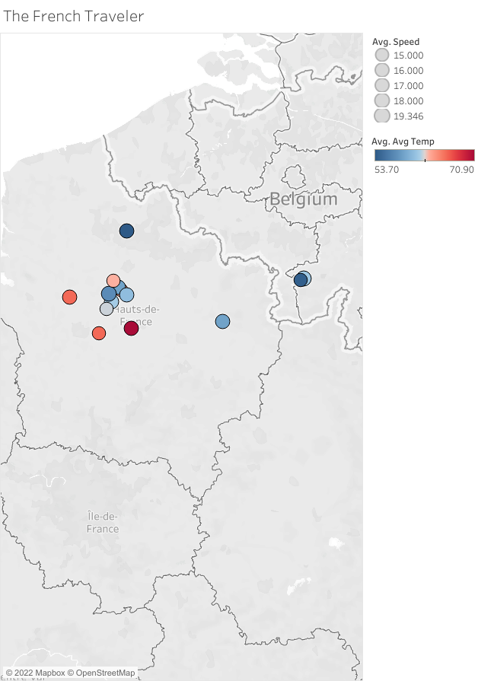

Slide 3
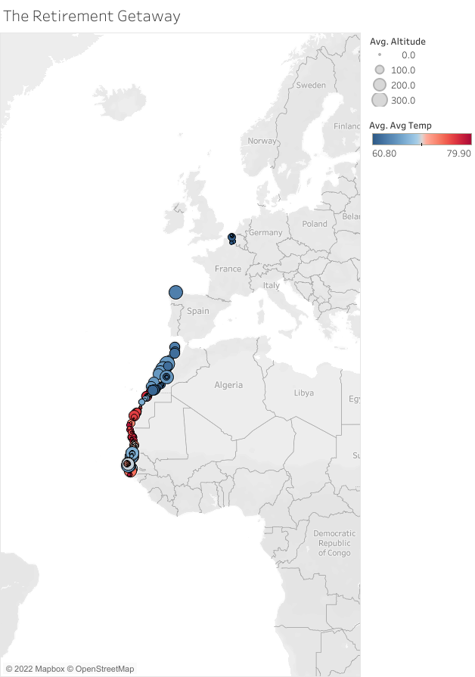

Slide 4
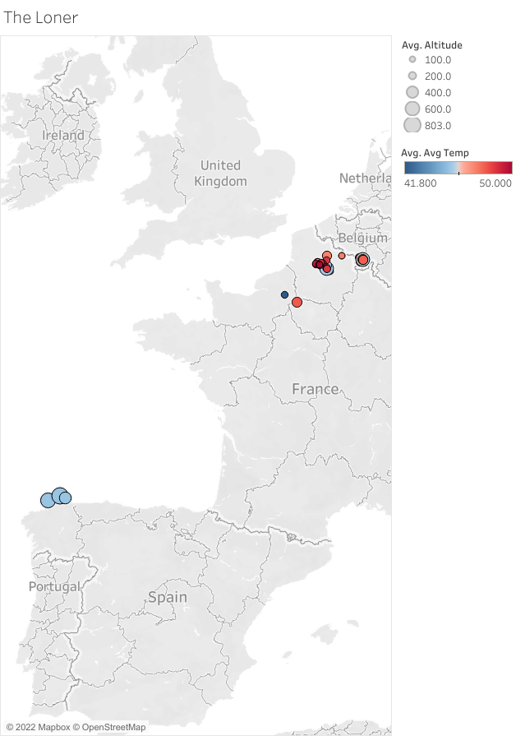

Slide 5
