Slide 1

Presented by: Lingda Tang

Slide 2
What is AngularJS?
A JavaScript framework for creating dynamic web applications
Open Source
  GitHub: https://github.com/angular/angular.js
  MIT License
Uses jQuery
  jQuery 1.7.1 or above
  jQLite

Slide 3
MVC
Model
  The data
Controller
  The behavior
  Modifying / updating the models
View
  The interface
  How the data is presented to the user
JavaScript
HTML

Slide 4
Set it up
WebStorm
  bower install angular
  bower install angular-route
  bower install bootstrap

Slide 5
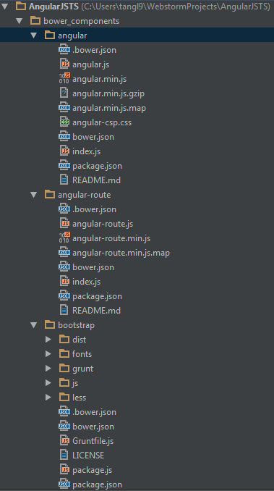

Slide 6
Data Binding
Views are declarative
  The structure of the interface
Controllers do not need to directly manipulate the view
  Changes in the models / data are automatically reflected in the view
  Updates are managed by the frameworks

Slide 7
Sample Application
GitHub:
  https://github.com/christophertfoo/AngularSample

Slide 8
Views
Make use of special ng attributes (directives) on the HTML elements
  ng-app
    Determines which part of the page will use AngularJS
    If given a value it will load that application module
  ng-controller
    Determines which Javascript Controller should be used for that part of the page
  ng-model
    Determines what model the value of an input field will be bound to
    Used for two-way binding

Slide 9
Views
More ng directives
  ng-if=“<model expression>”
    Inserts HTML element if expression is true
    Does not insert element in the DOM if it is false
  ng-repeat=“<variable> in <array>”
    Repeats the HTML element for each value in the array
    Also a key-value pair version for JSON objects
      “(<key>, <value>) in <JSON>”

Slide 10
Views
{{ }}
  Angular expressions
    Like JavaScript expressions except:
      Evaluated in the current scope (see Controllers later on), not the global window
      More forgiving to undefined and null errors
      No control statements: conditionals, loops, or throw
  Insert model values directly into the view

Slide 11
Controller
Function that takes at least one parameter: $scope
  Function is a constructor
  Ex:
    function MyCtrl($scope) { … }
  We will see a different way of creating a controller constructor later
$scope
  JavaScript object
  Contains data (i.e. models) and methods (i.e. functions)
  Can add own properties
    $scope.<my new property> = <value>;

Slide 12
Controller
Dependency Injection
  Pass the modules and services that you need as parameters
  In the previous case $scope is a service that will be injected
  Can be passed as an array of strings to the controller function as well
    Prevents errors when performing minification
  Other useful services
    $http
      Used to handle Ajax calls
      Wrappers around jQuery

Slide 13
Controller
Typically also contains module loading
angular.module(<name>, [<dependencies>]);
  Creates a module with the given name
  This module can then be configured
  Ex.
    var myApp = angular.module(‘myApp’, []);
    myApp.controller(‘MyCtrl’, function($scope) { … });
    myApp.controller(‘OtherCtrl’, [‘$scope’, ‘$http’, function($scope, $http) { … }]);

Slide 14
Models
Properties on the Controller’s $scope object
Standard JavaScript values

Slide 15
Modules
Can be used to separate the application into parts
Application module can include the other modules by listing them as dependencies

Slide 16
Modules
var myControllers = angular.module(‘myControllers’, []);
// Add controllers to the module
myControllers.controller(…);
var myApp = angular.module(‘myApp’, [‘myControllers’]);

Slide 17
More
You can do a lot more with AngularJS
  Custom directives
    http://docs.angularjs.org/guide/directive
  Filters
    http://docs.angularjs.org/guide/dev_guide.templates.filters
To learn more:
  Tutorial: http://docs.angularjs.org/tutorial
  Documentation: http://docs.angularjs.org/guide/overview

Slide 18
Thank you for listening!
Questions / Comments?

Slide 19
Routing
Use different views for different URL fragments
Makes use of template partials
  Templates that are not a whole web page (i.e. part of a page)
  Used in conjunction with the ng-view directive
    ng-view determines where the partial will be placed
    Can only have one ng-view per page

Slide 20
Routing
Enable by injecting the $routeProvider
  myApp = angular.module(‘myApp’, [‘ngRoute’]);
  myApp.config([‘$routeProvider’, function($routeProvider) { … }]);
$routeProvider.when(<path>, {<route>});
  Defines a new route that uses the given path
  The path may have parameters
    Parameters start with a colon (‘:’)
    Ex
      ‘/user/:userId’
  Typical route fields:
    controller = The name of the controller that should be used
    templateUrl = A path to the template partial that should be used
$routeProvider.otherwise({<route>});
  Typical route fields:
    redirectTo: ‘<path>’
API: http://docs.angularjs.org/api/ngRoute.$routeProvider

Slide 21
Routing
URL parameters
  To access the parameters in the URL, use the $routeParams service
  The $routeParams object will have a field with the same name as the parameter
  Ex.
    $routeParams.userId

Slide 22
Routing
Paths default to Hashbang mode
  Example URL.
    http://www.mysite.com/#/users
Can use HTML 5 mode by configuring the $locationProvider
  Ex.
    // Inject $locationProvider into the module using config
    $locationProvider.html5Mode(true);
  Example URL:
    http://www.mysite.com/users

Slide 23
Directive
The restrict option is typically set to:
'A' - only matches attribute name
'E' - only matches element name
'C' - only matches class name
These restrictions can all be combined as needed:
'AEC' - matches either attribute or element or class name

Slide 24
Directive
@ Attribute string binding
= Two-way model binding
& Callback method binding

Slide 25
