Slide 1

Empowering Businesses

Slide 2
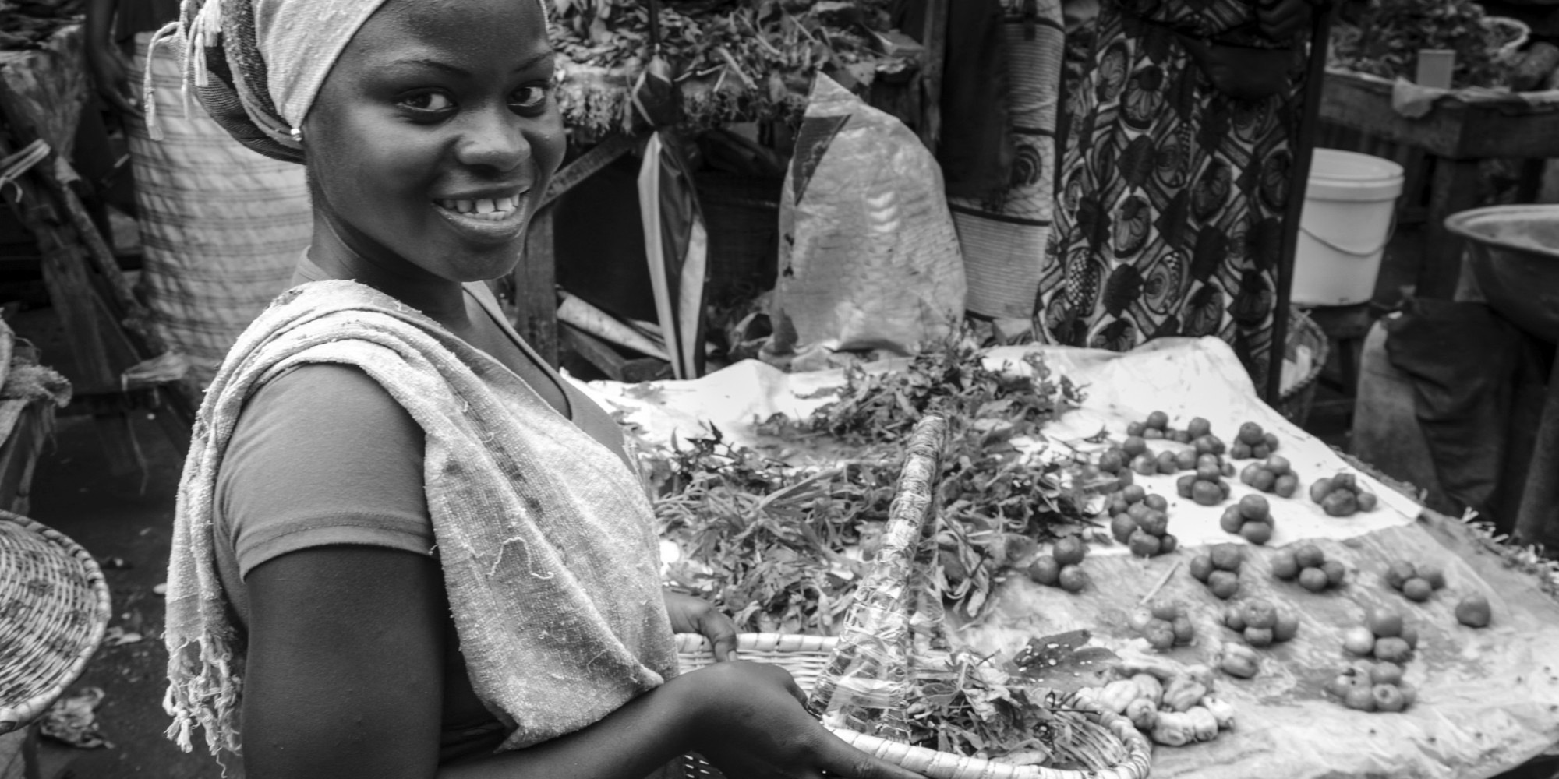
Ghana’s Workers
85%
Informal Sector

Slide 3





Informal Sector
Huge risk

Slide 4

Peer-to-peer lending platform that enables businesses to receive seed capital from a wide pool of individuals

Slide 5
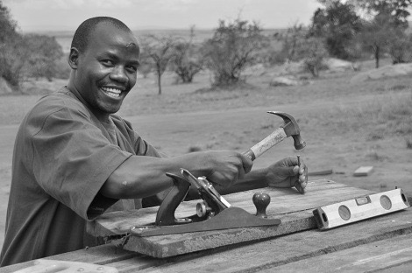
Features

Slide 6
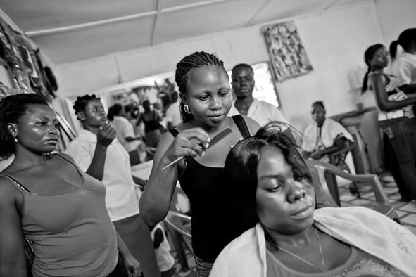
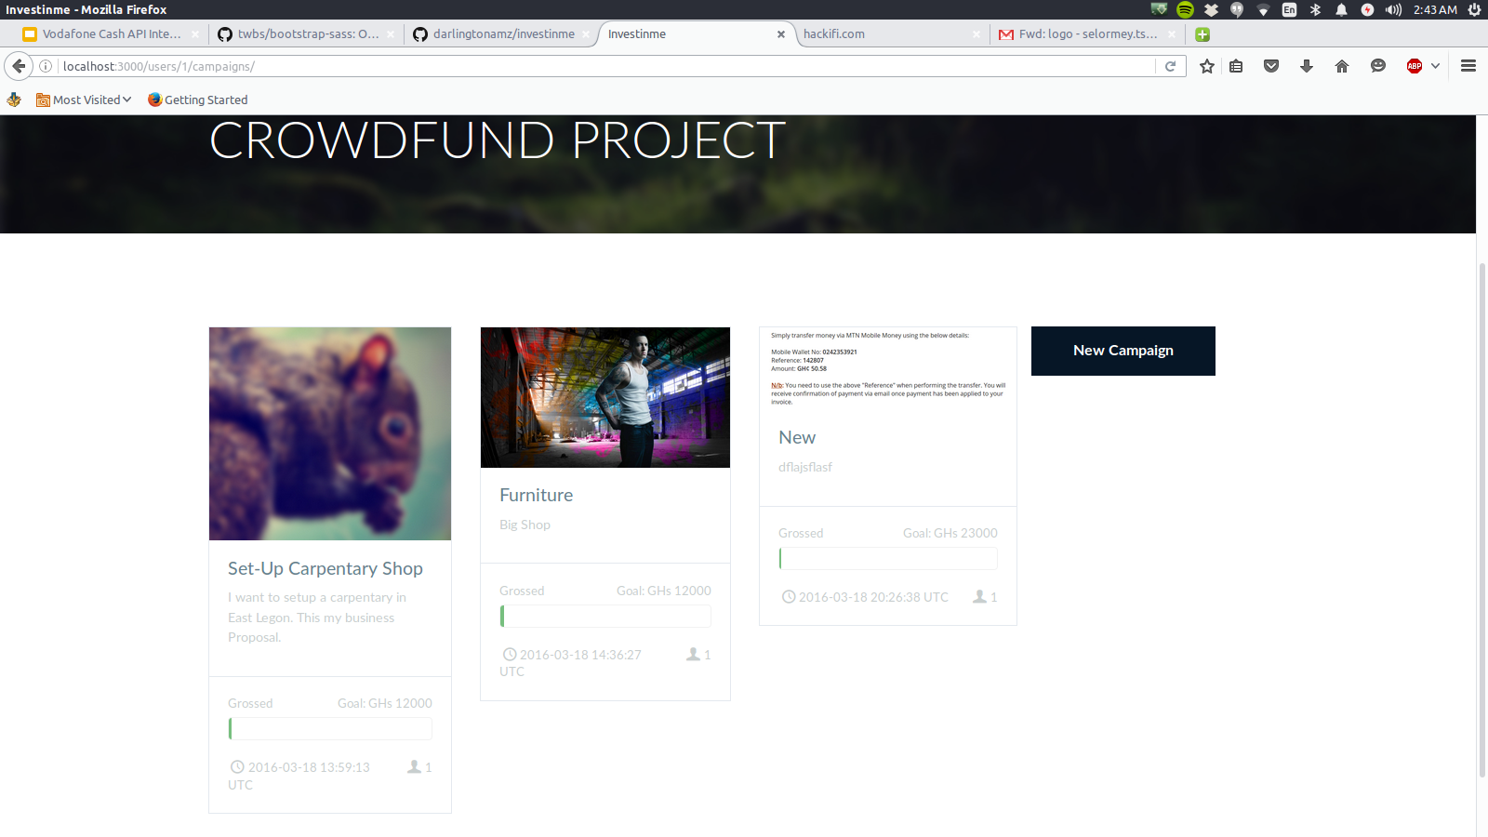

Slide 7
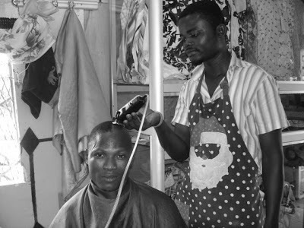
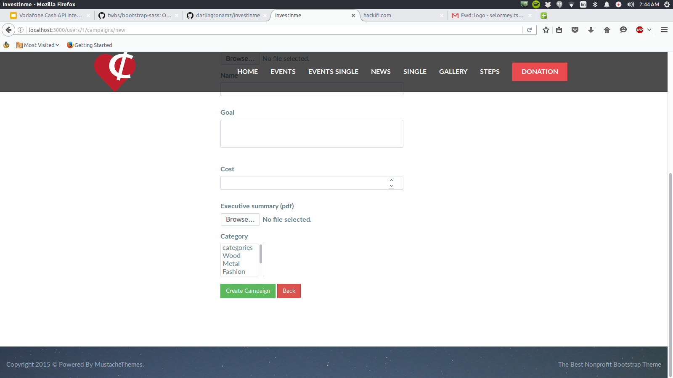

Slide 8
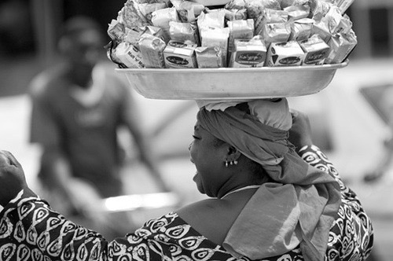
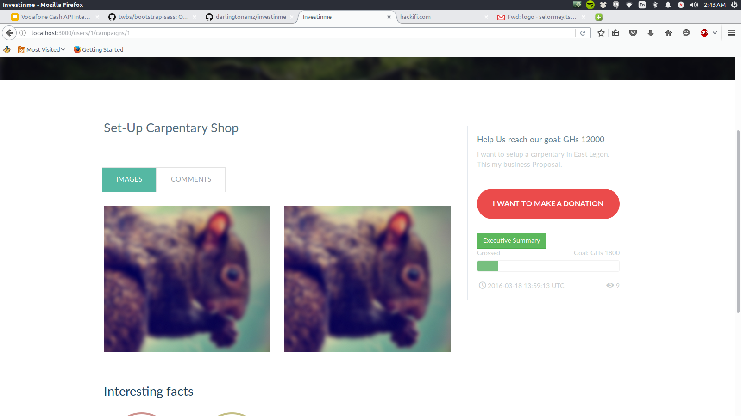

Slide 9
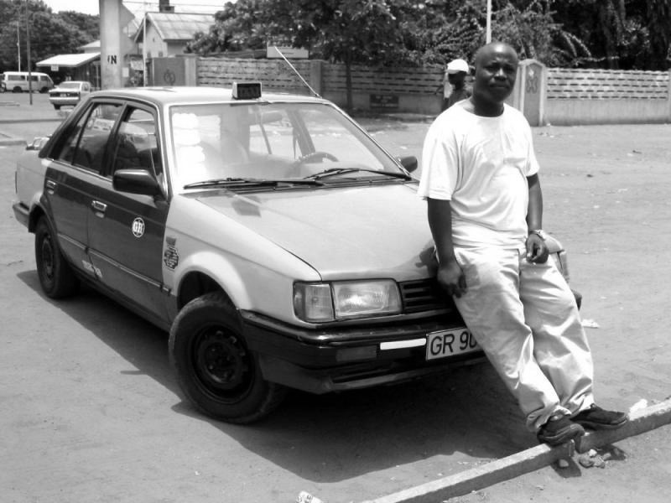
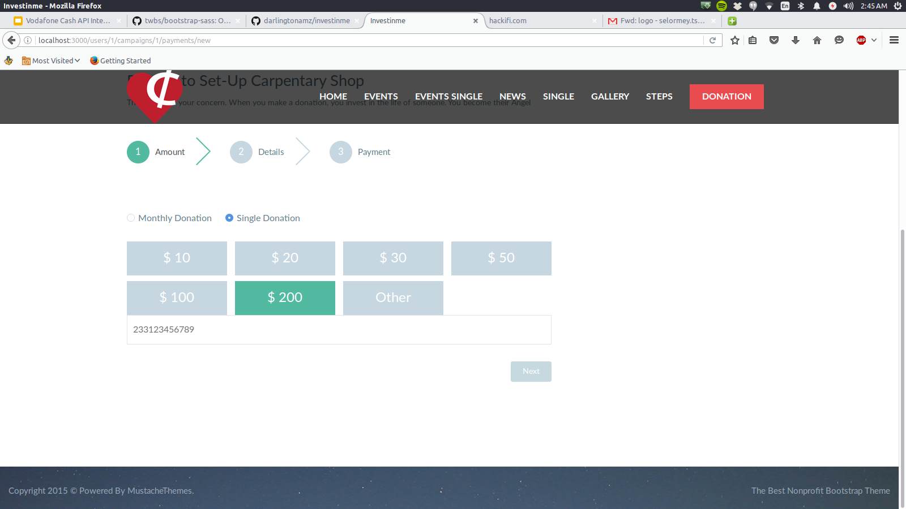

Slide 10


Demo

Slide 11


