Slide 1
Eniac’s
Approach
For Brazilian market

Slide 2
Introduction
Eniac is 100% tech heavily based on apple compatible accessories.
Roots: Have firmed its place in Spain and neighbouring regions.
Thrives on: contact with its customers.
Goal: To go “Global”.

Slide 3
Our Role
Need to study the Brazil market for its behaviour in terms of tech products and the nature of deliveries.
An approach being considered- 3 year contract with Magist operating through external marketplace.
Eventually have own marketplace.

Slide 4
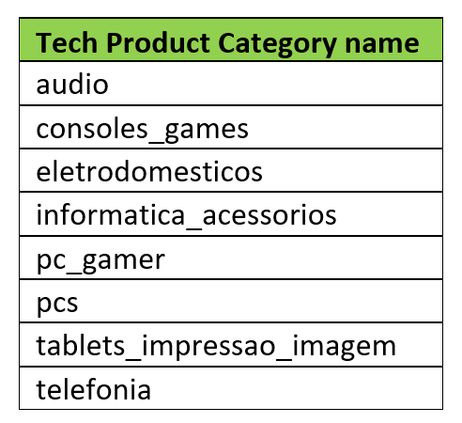
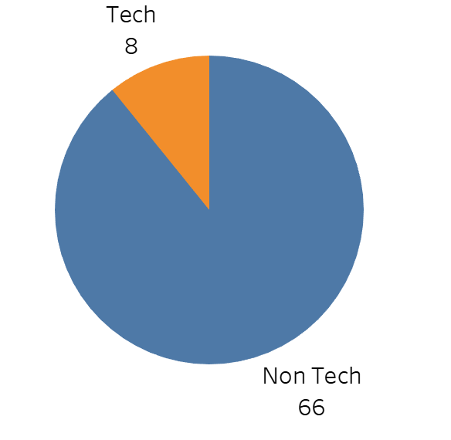
Categories of tech products does Magist data have
Magist have below 8 categories of Tech Products out of all 74 Tech and non-tech product categories.
Product Category Types

Slide 5
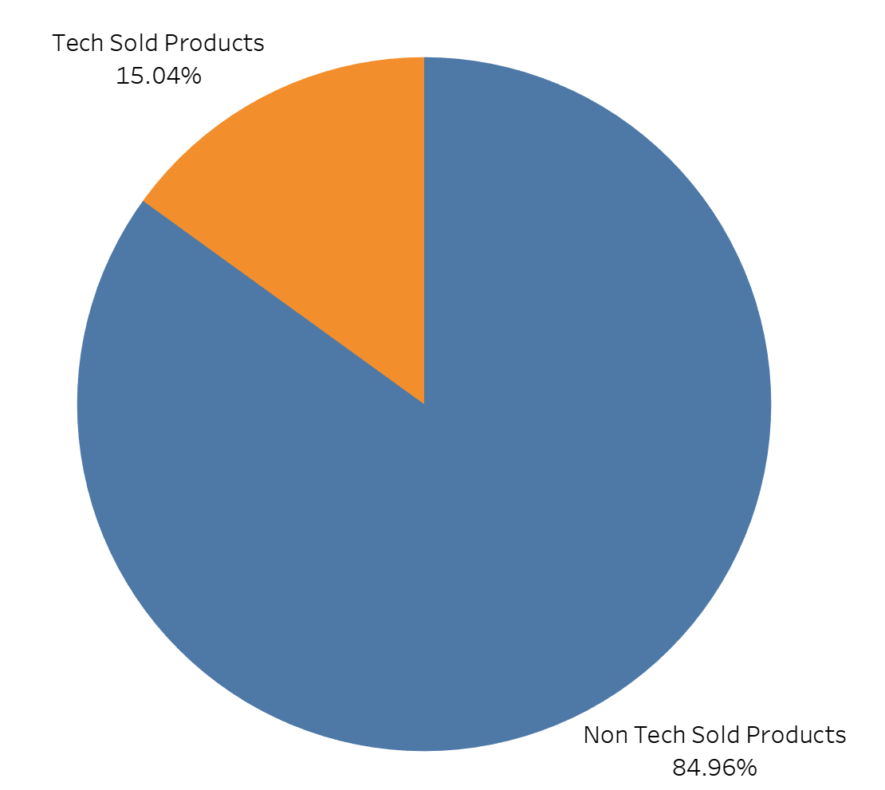
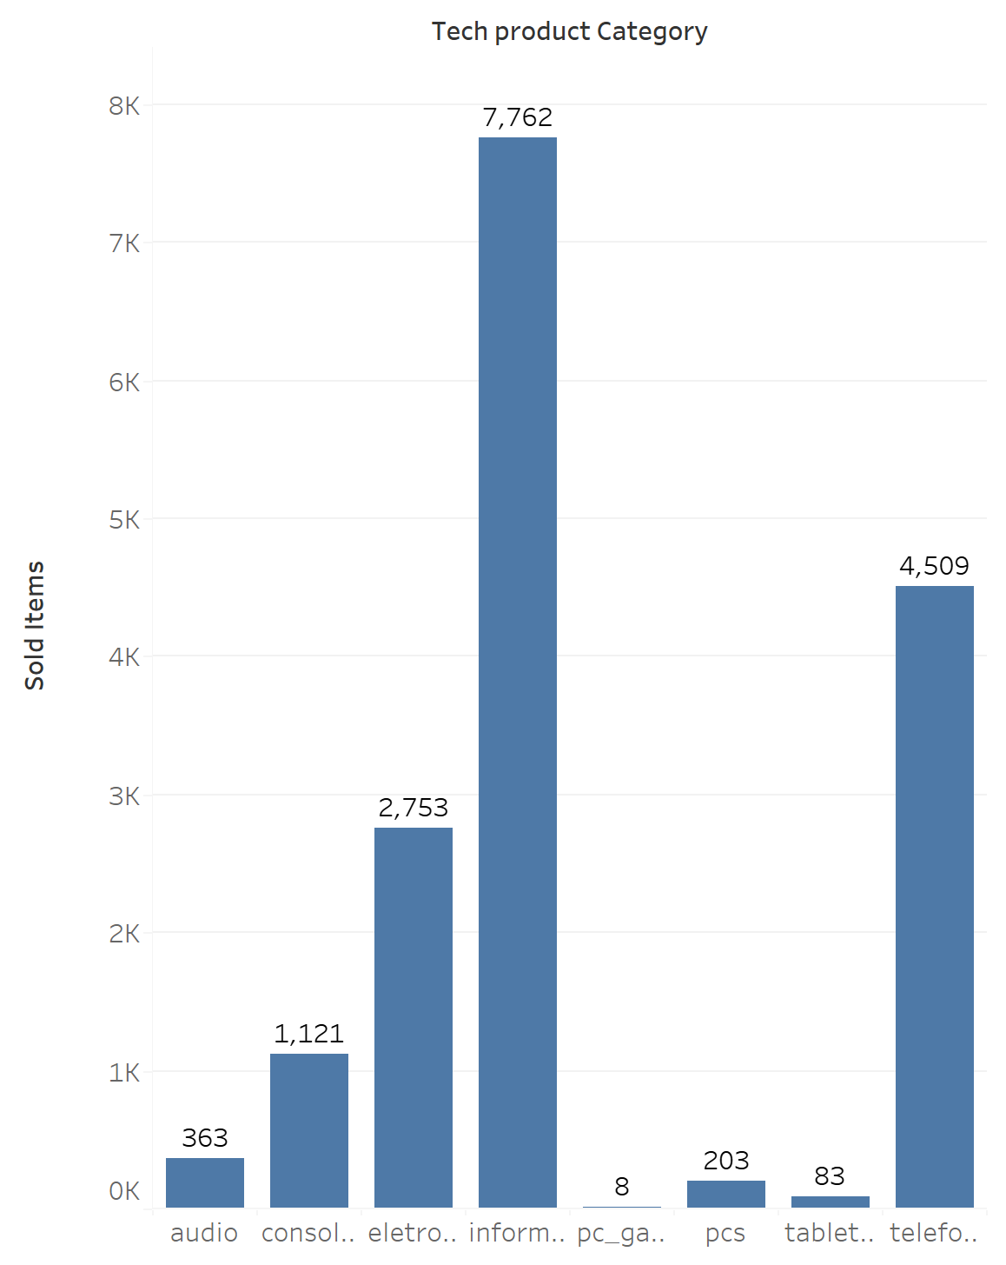
Number of products of tech categories have been sold
Only 15.04% of tech products have been sold as compared to overall products
% of Sold Products
Category wise Tech Products Sold

Slide 6
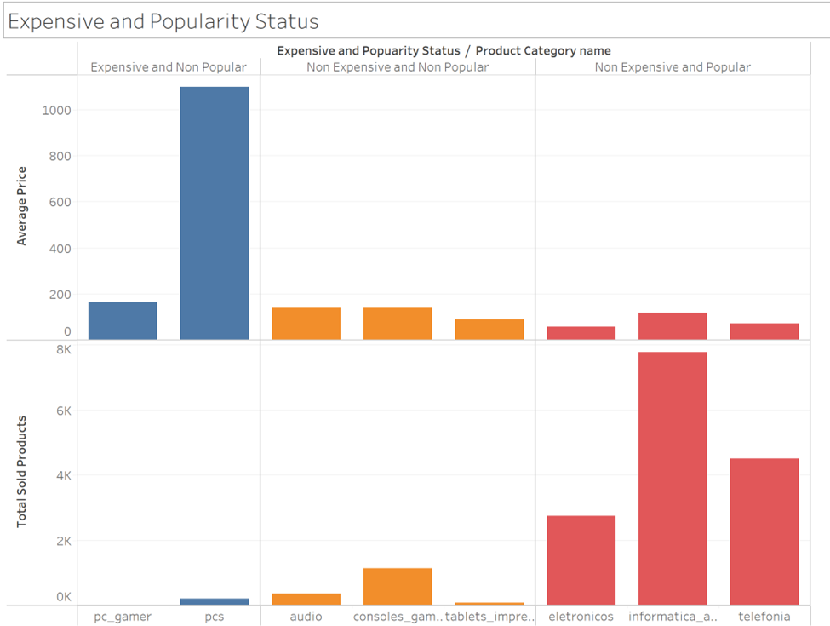
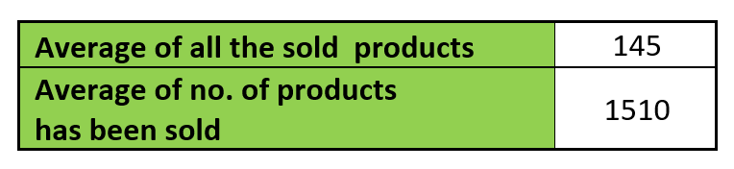
Comparison between expensive and popular tech products
Depends on the average of all the sold products
and the number of products has been sold.
Expensive products are not popular.
Popular products are not expensive.
Expensive and Popularity comparison

Slide 7
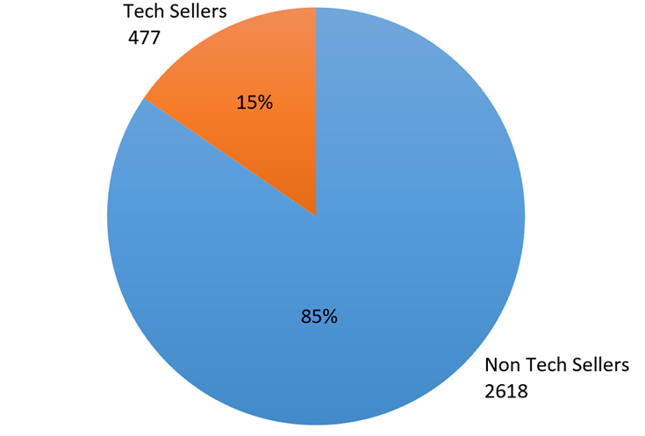
Magist database includes
around 25 months of data

Slide 8
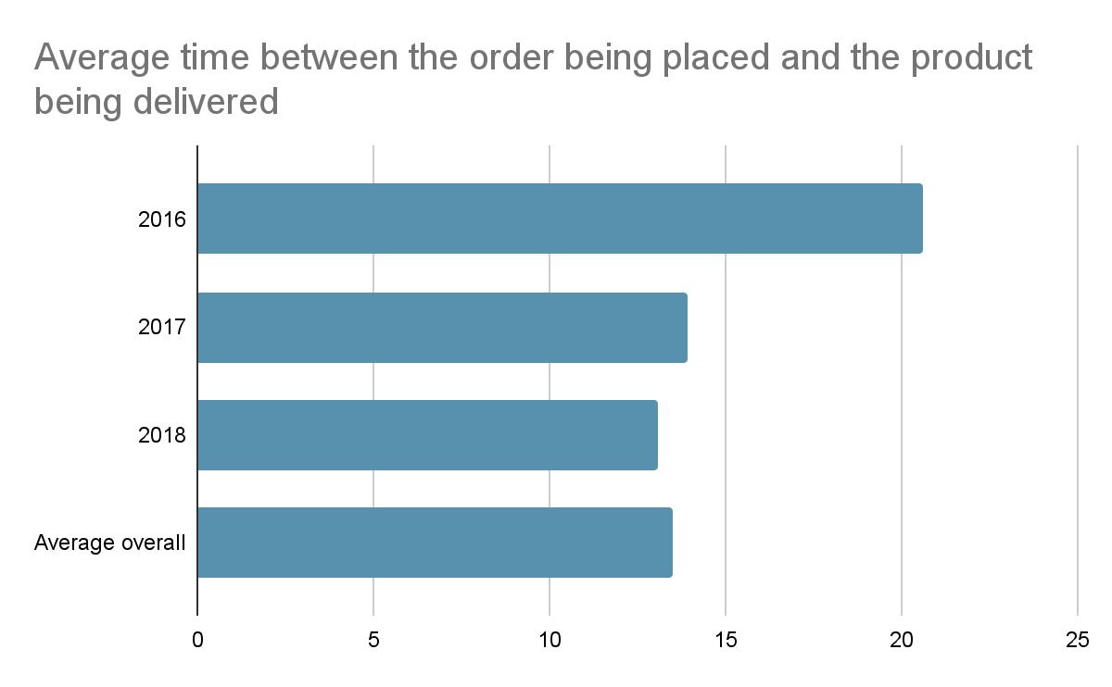
There has been a decrease in days of deliver.
Y
E
A
R
S
DAYS
Notes:
In relation to the delivery time, we have two questions, the first one is:
• What’s the average time between the order being placed and the product being delivered?
In 2016, we have 20 days delayed between
In 2017, we have 14 days
And in the third year
In 2018, we have 13 days delayed between
In conclusion, we have an overall average about 13.5 days delay between

Slide 9
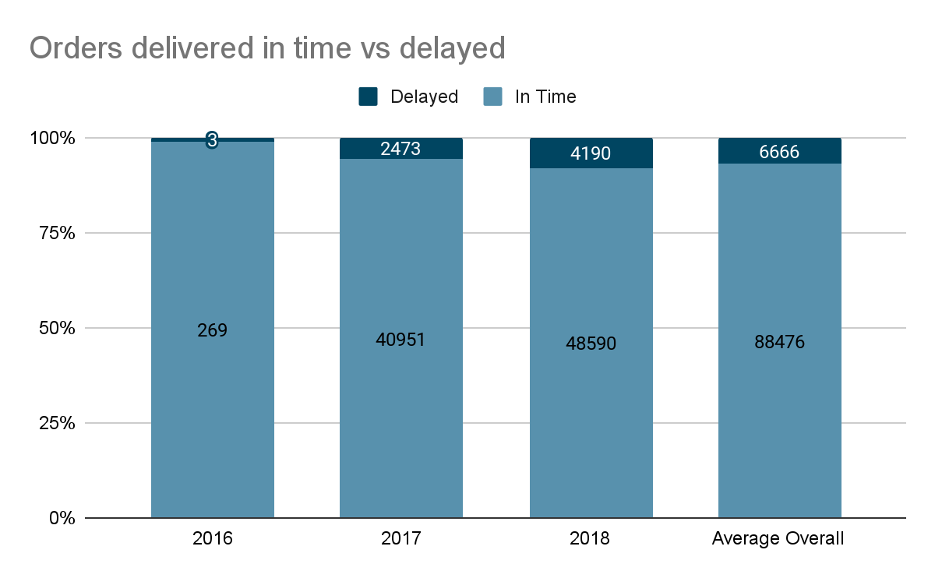
However, there has been an increase in percentage of orders being delayed
P
E
R
C
E
N
T
A
G
E
YEARS
Notes:
However, when we talk about:
• How many orders are delivered on time vs orders delivered with a delay?
In 2016, 1 % of orders were delayed
In 2017, 6 %
And in the third year
2018, we are discussing, about 8.6 % of orders were delayed
Average overall: 7.5 %
The takeaway from here, is that they slightly decrease his delay in days, but they have increase their percentage of orders delayed.

Slide 10
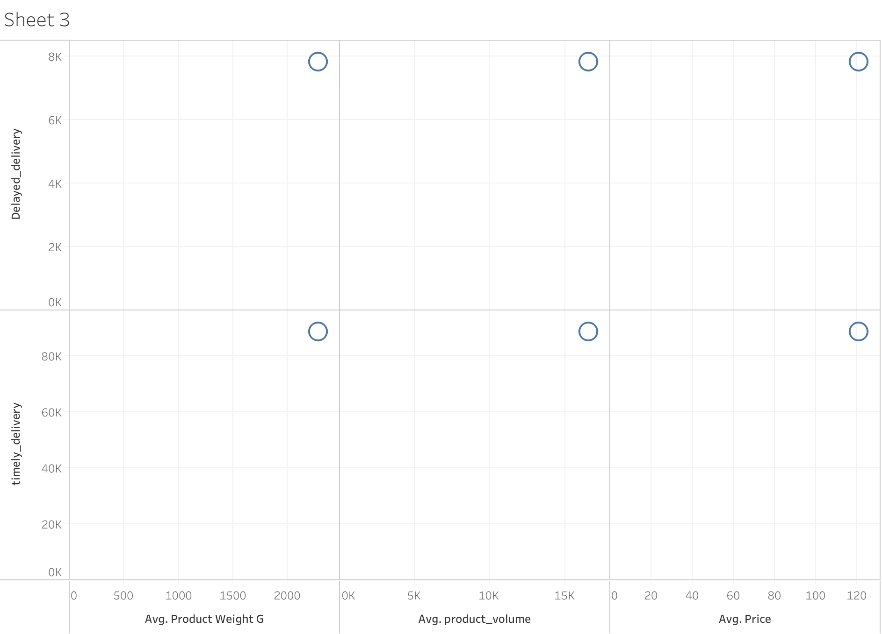
Weight, Volume and Price of product seem not to impact the nature of deliveries.

Slide 11
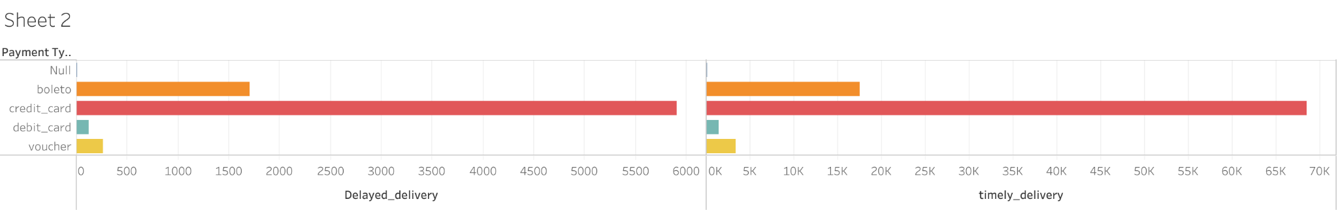
No apparent impact of mode of payment on delivery

Slide 12
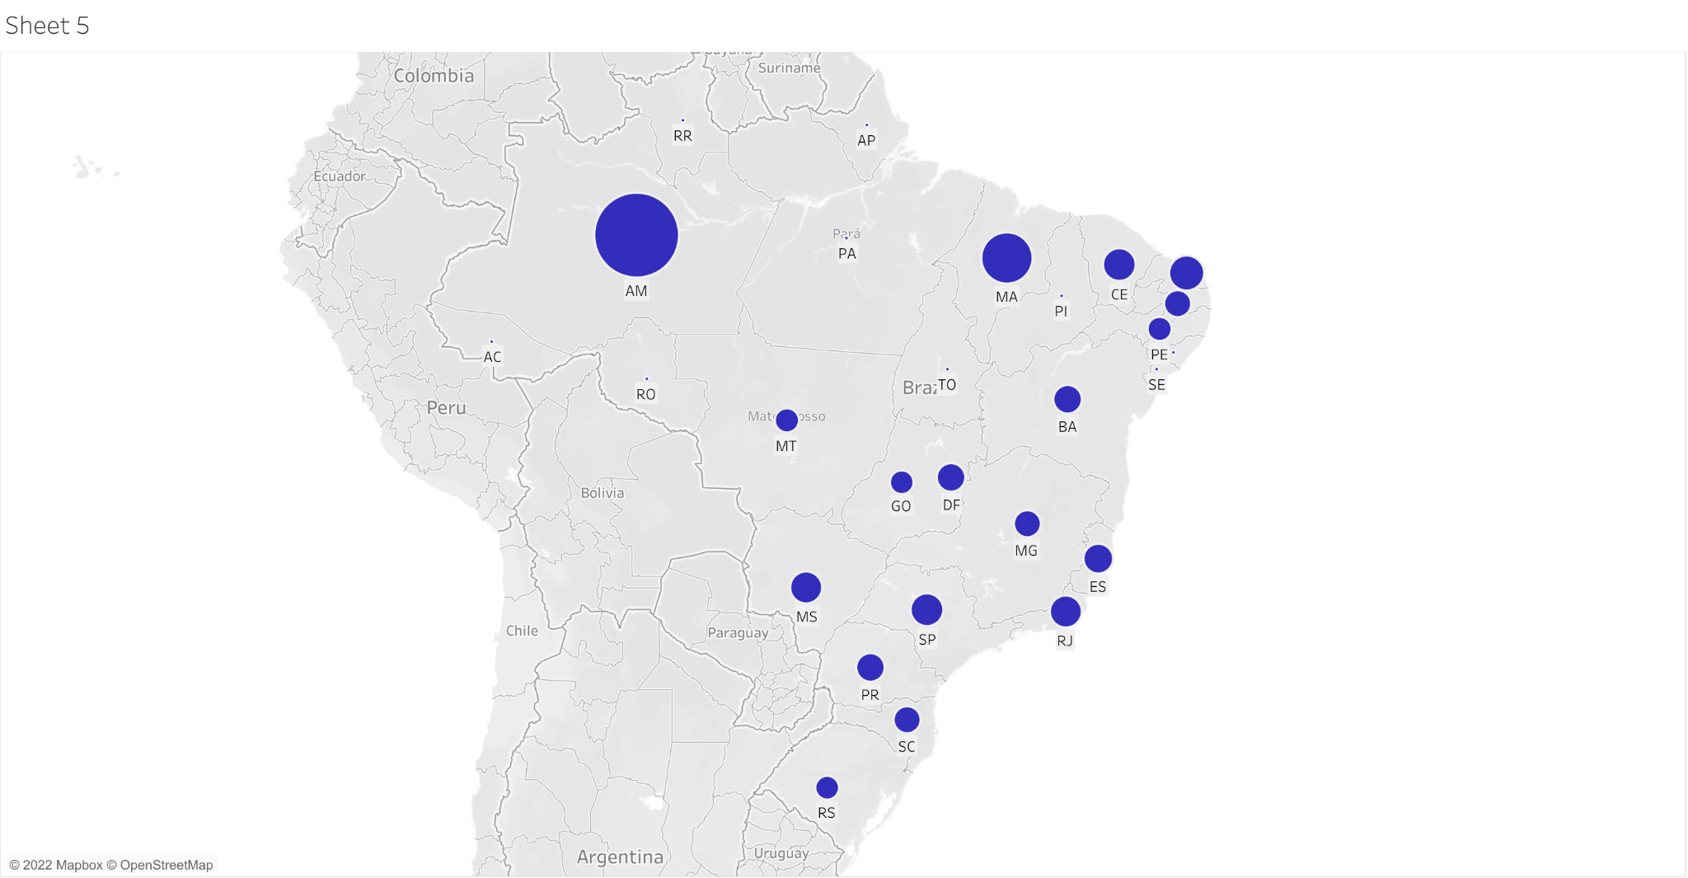
Percentage of deliveries delayed

Slide 13
Conclusion
Magist data shows that Brazilian market is not quite aligned with the products that Eniac has to offer.
With the three years of data, high end tech products show very little popularity.
The deliveries are delayed in areas that are geographically distantly located.

Slide 14
Recommendations
Online Professional Tech Support and Consultation. It could prove to be a source of revenue, would requires less cost and also It would also set up a foundation for the company in Brazil.(Eniac’s Emblem)
Magist deals with relatively smaller companies but Eniac being 100% tech catalogued, it could prove to be less reliable source for Eniac.
Thorough research based analysis on whether it is Brazil or some other country of comparable market size and profits.

Slide 15
Thank you
(Prachee, Ruben, Shiwali, Matthew, Osazee)

