Slide 1
Sensible and differentiated use of discounts
basics for decision-making
22.09.2022
DATA#009 - Andreea - group1:
Shiwali
Osazee
Yusuf
Christoph

Slide 2
Task and Scope
Eniac:
use of temporally discounts e.g. during Black Friday
use of significant discounts on selected products
discounts have an important impact on sales quantity and sales revenue
evaluation of the available data has not yet been carried out
TARGET:
get insights about discounts in the past and provide data-driven recommendations about further discount policy
QUESTION:
What is the right and beneficial level of discounts?
DATA#009 - Andreea - group1
2 / 9
*: April 2017 – March 2018

Slide 3

Assumptions data set for further processing
1
data cleaning constraints
2
product categories
3
category classifier
Some quality issues detected in given data:
table ‘products’ contains many duplicated or missing information
inconsistencies concerning sales prices and payments
first shoot product clustering on raw data derives the following 12 product categories:
charging
storage
covers
hardware
smartwatches
servers
sound accessories
tablets
phones
protection
laptops
others
rudimental classifier:
based on occurance of semantic close keywords in product names and description relied to the 12 defined categories
first category match → assignment
quick check on classified raw data indicates significant heterogeneity and significant amount of false positive assignments yet
80 % of raw data on orders were excluded from analysis due to data quality issues
refinement with marketing and portfolio experts needed
conclusion relied to product categories have to be used currently with caution
DATA#009 - Andreea - group1
3 / 9

Slide 4
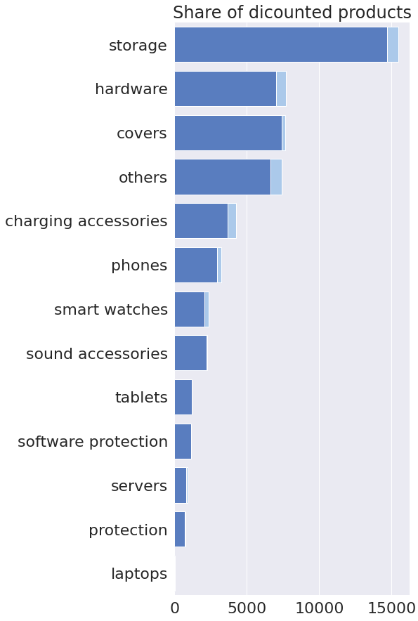
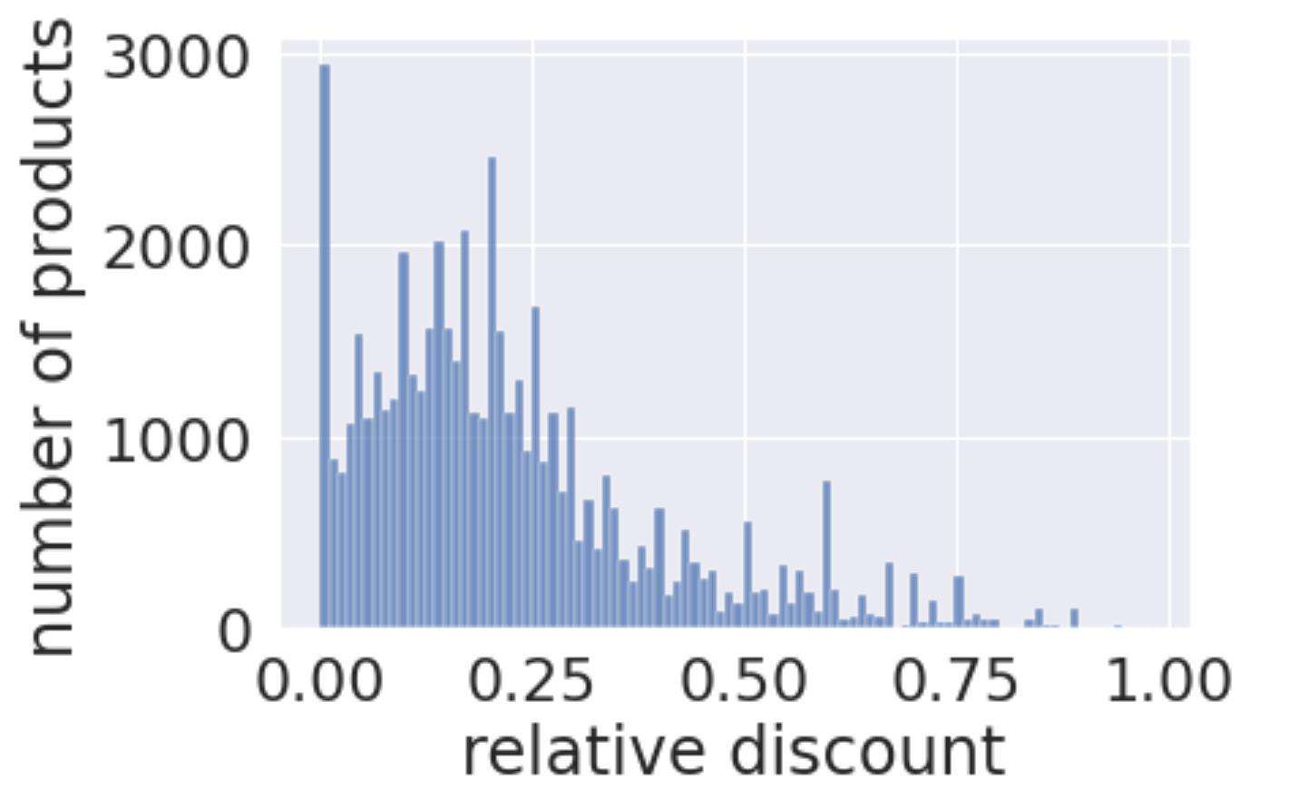
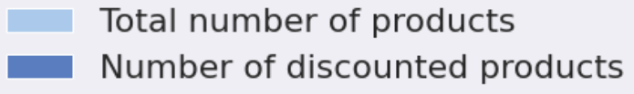
Eniac is already applying discounts extensively
overall share of discounted products: 93 %
DATA#009 - Andreea - group1
4 / 9
*: tech sellers according to definition 1, **: assumption long term currency exchange rate: 5 BRL = 1 €

Slide 5
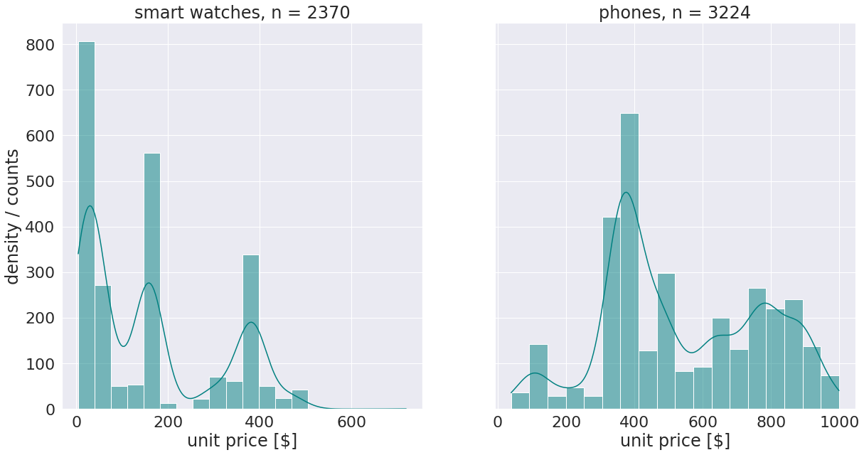
Within product categories high variance of price levels
2 product categories shows striking unit price distributions
hypothesis: within these categories:
different product price segments
products which belong to another category
DATA#009 - Andreea - group1
5 / 9

Slide 6
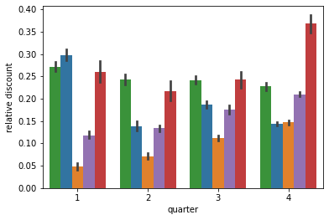
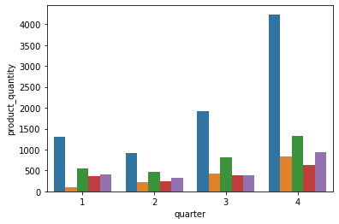
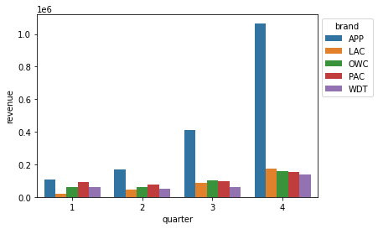
Impact of discounts on revenue depending on price elasticity of demand
top 5 brands concerning total revenue
2 different relations of discounts and revenue visible:
Apple: non-elastic products → sales quantity is not falling strong with rising prices → higher revenues
LaCie: elastic products → lower prices lead to higher sales quantity and revenue → what about margin ??
DATA#009 - Andreea - group1
6 / 9
Note: unit price * quantity = revenue (without shipping costs etc) and unit price = price * (1 - relative discount)

Slide 7
Recommendations for action
Conclusion:
If discounts are beneficial depends on price elasticity of demand of different products and brands
Apart from discounts seasonality effects like christmas and black friday sales have huge impact on sales quantity also
Next steps:
check data pipelines and common understanding database schema
development and implementation of standardized and meaningful product category system
Gather more customer information
→ not only cross-sectional but also longitudinal section analysis of customer behavior possible
→ enables better implementation of cross-selling-features and individual price differentiation
DATA#009 - Andreea - group1
7 / 9

Slide 8
Limitations of analysis
Beneficiality of discounts depends on margin, not on revenue → purchase prices are needed for better insights
marketing campaign e.g. Black Friday affects customer expectations and figure as external influence factors on quantity of sales too
Analysis done on 15 months data which might not be appropriately effective as we are looking for impact of discounts in the long run
Currently relying on brands and time dimension more meaningful than on product categories, cause category classifier leads at the moment to quite heterogeneous cluster
DATA#009 - Andreea - group1
8 / 9

Slide 9
END
Thank You

Slide 10
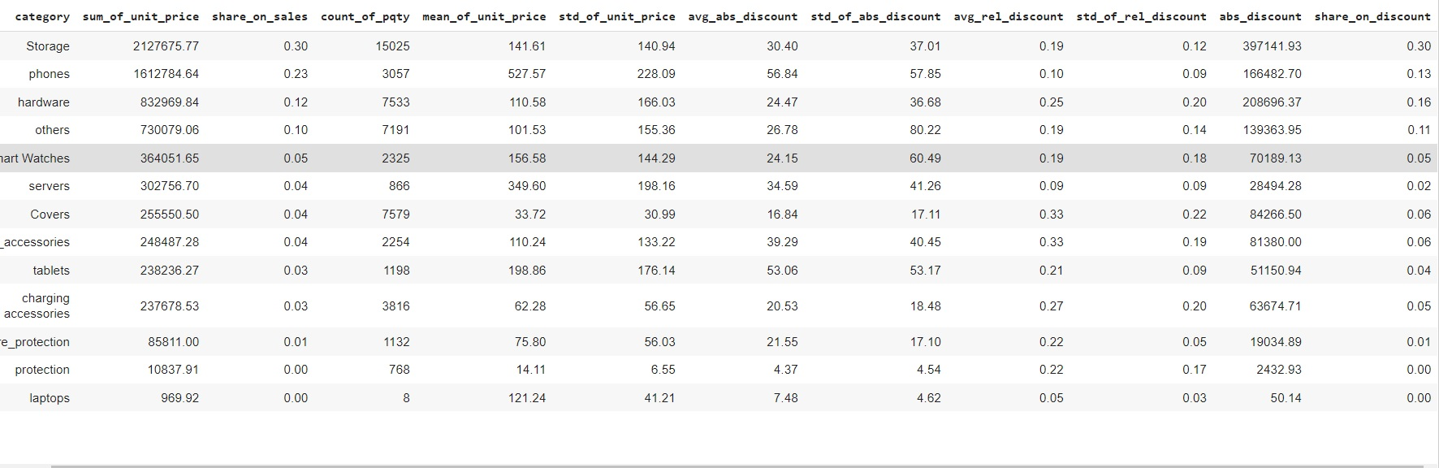
descriptive overview of dataset / categories
DATA#009 - Andreea - group1
3 / 12
*: tech sellers according to definition 1, **: assumption long term currency exchange rate: 5 BRL = 1 €

Slide 11
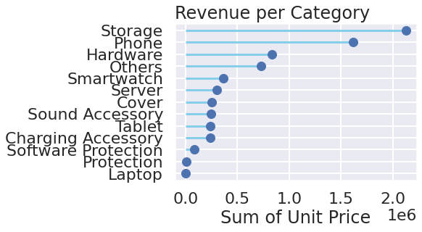

Slide 12
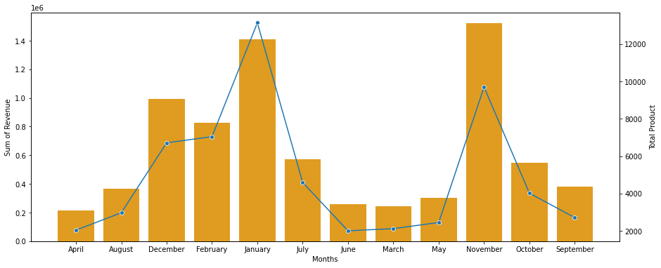

Slide 13
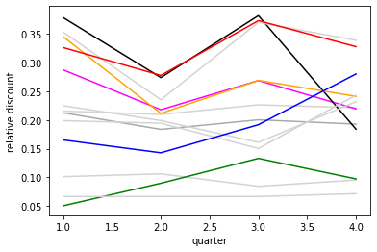
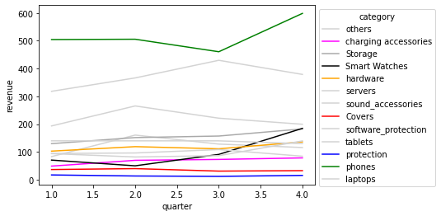
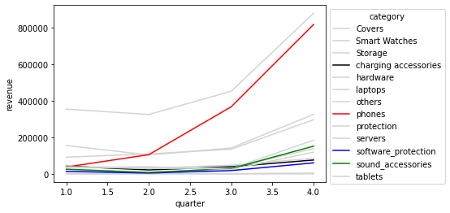
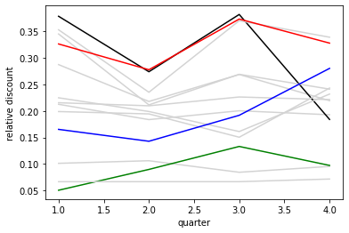
Discounts and Revenue compared based on category
DATA#009 - Andreea - group1
3 / 12
*: tech sellers according to definition 1, **: assumption long term currency exchange rate: 5 BRL = 1 €

Slide 14
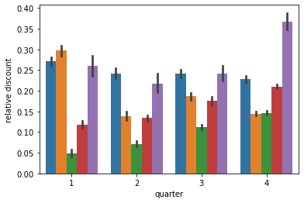
Discount and Revenue compared based on brands

Slide 15
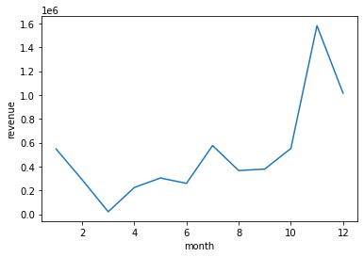
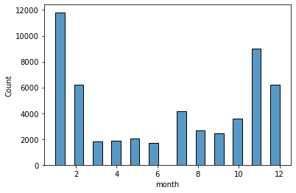
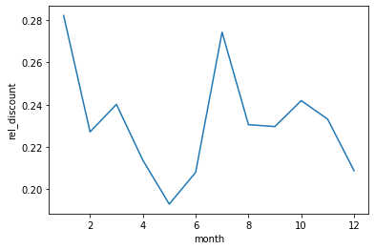
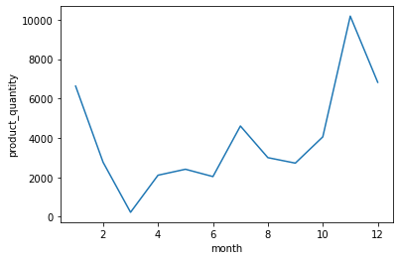
qty ??

